Slide 1
802.11AX Midamble Design for Doppler
Date: 2017-05-03
Authors:

Slide 2
Introduction
In 11ax D1.0, HE-SIG-A in 11ax HE SU, HE SU Ext, HE MU PPDU has reserved one “Doppler” bit.
By setting Doppler bit to 1, we propose a midamble design to combat the outdoor channel variations
  Insert a midambe every M DATA OFDM symbols
  A midamble contains one or more HE-LTFs, and possibly an HE-STF.
Discuss PHY design details: midabmle periodicity, HE-STF, HE-LTF, etc

Slide 3
Midamble vs Travelling Pilots (11ah)
Midamble incurs simpler design than travelling pilots.
  Quicker market adoption
Better performance than Travelling Pilots:
  Able to handle larger Doppler by adjusting periodicity
    On the other hand: 11ax pilots were intentionally made scarcer for better efficiency, therefore channel est update by Travelling Pilots is much slower or not suitable for outdoor channels if using tone decimation.
      20MHz: 30 symbols to brute force, 80MHz: 62 symbols to brute force
  Able to handle power changes better—if midamble contains HE-STF field.
  Able to support much higher data rates: more spatial streams, and wider BW.
    High Doppler Channel ≠ Low Data rate.
    Extendable to more aggressive environments in the future, e.g. automotive.

Slide 4
Midamble Design
Preamble
DATA_1
Midamble
DATA_2
Midamble
DATA_k
M data symbols
M data symbols
M data symbols
HESTF
HELTF1
…
HELTFN
Insert a midamble every M DATA OFDM symbols
Coding/scrambling not disrupted by midambles—i.e. same as no midamble cases.

Slide 5
Midamble Structure (1)
A midamble includes one or more HE-LTF field
A midamble may or may not include a HE-STF field, power variations are typically too small to incur AGC gain changes
    Option 1: the HE-STF in midmable can be a full length 4us HE-STF, the same as in preamble
    Option 2: Shorter HE-STF in midmable than in preamble, e.g. two 0.8us periods
    Option 3: No HE-STF in midamble.
Option 1
Full length HE-STF
HE-LTF(s)
Option 2
Shorter HE-STF
Fig. 2 Midamble Structure
HE-LTF(s)
Option 3
HE-LTF(s)

Slide 6
Midamble Structure (2)
HE-LTF compression rate (1x, 2x, 4x) in midamble may be identical to that in preamble.
    No additional HE-SIG field signaling needed.
    1x HELTF in midamble may be preferred if channel delay is short—reduce overhead significantly, refer to sims later.

Slide 7
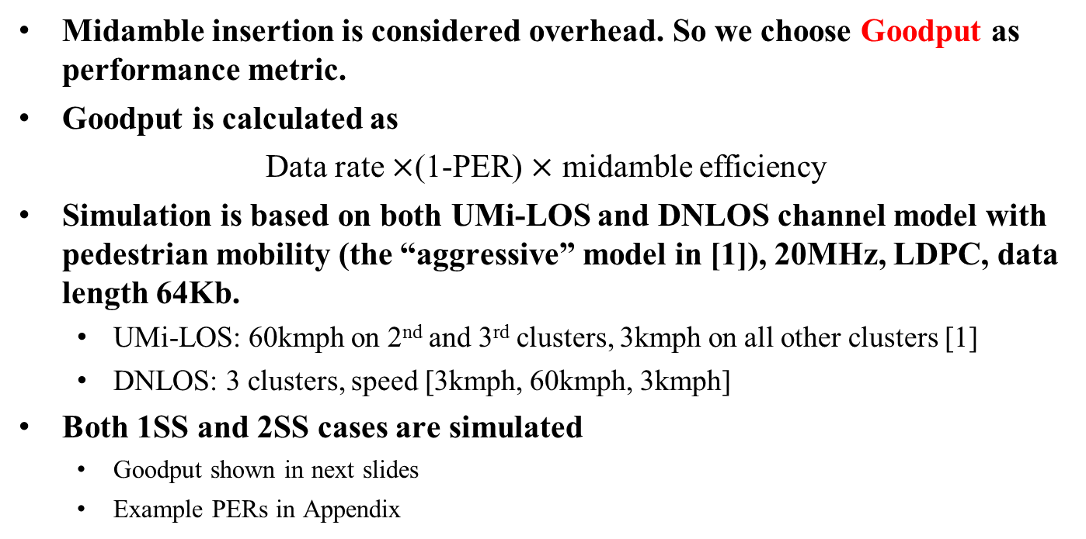
Simulation Setup
Midamble insertion is considered overhead. So we choose Goodput as performance metric.
Goodput is calculated as
Data rate $×$(1-PER) $×$ midamble efficiency
Simulation is based on both UMi-LOS and DNLOS channel model with pedestrian mobility (the “aggressive” model in [1]), 20MHz, LDPC, data length 64Kb.
  UMi-LOS: 60kmph on 2nd and 3rd clusters, 3kmph on all other clusters [1]
  DNLOS: 3 clusters, speed [3kmph, 60kmph, 3kmph]
Both 1SS and 2SS cases are simulated
  Goodput shown in next slides
  Example PERs in Appendix

Slide 8
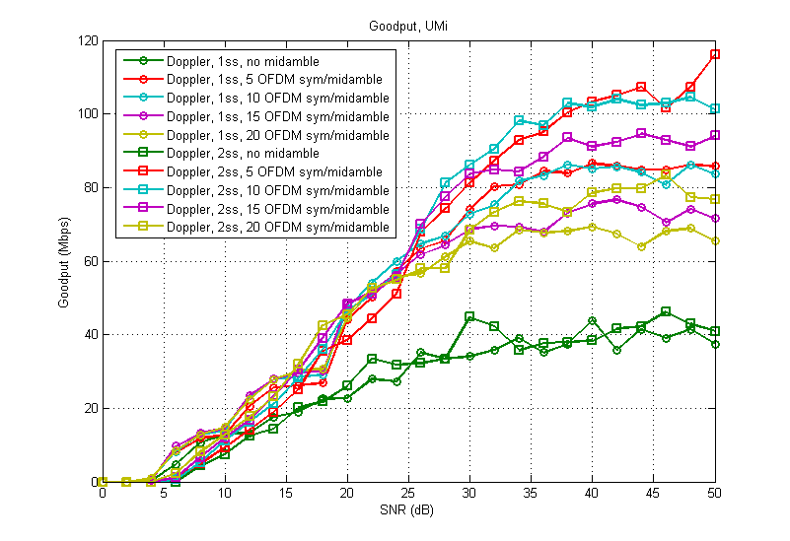
Goodput, UMi-LOS, 4xLTF

Slide 9
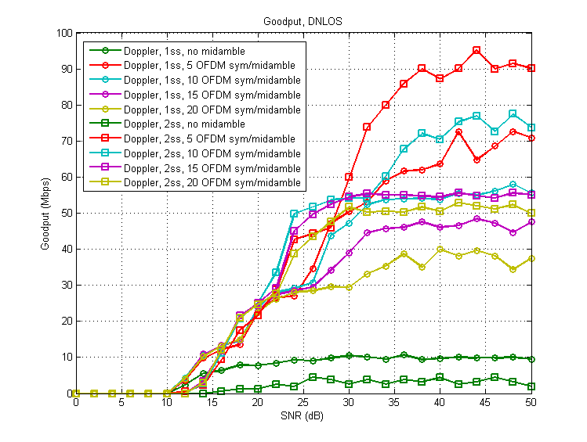
Goodput, DNLOS, 4xLTF

Slide 10
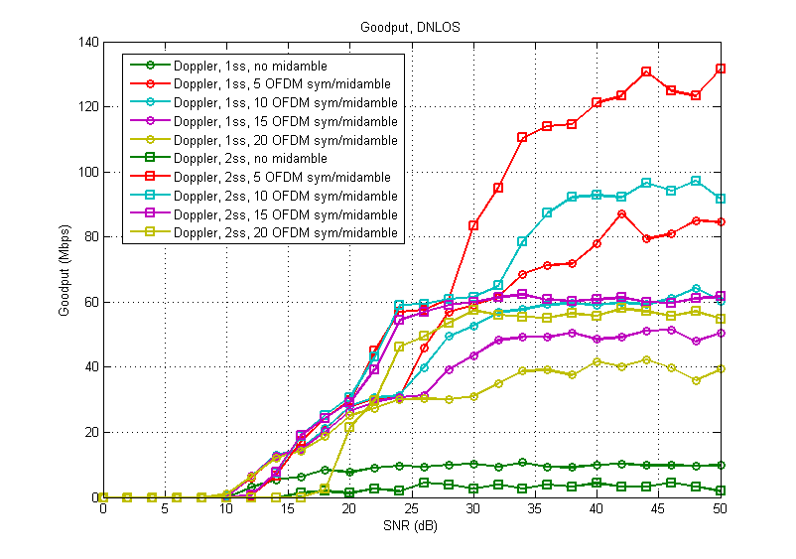
Goodput, DNLOS, 1xLTF

Slide 11
Discussions on Goodput results
2ss transmission outperforms 1ss in terms of goodput at high SNR.
Shorter periodicity M starts to make PER difference at higher data rates (e.g. MCS5), while for low data rates a larger M is tolerable to reduce the overhead.
  Refer to example PER results in Appendix.
We may need to insert midamble every ~10 OFDM symbols in this aggressive pedestrian mobility channel ([1]) that we simulated.
  Tradeoff between PER and overhead
1xLTF reduces the overhead for midamble insertion, getting higher throughput than 4xLTF, especially in short delay channels.

Slide 12
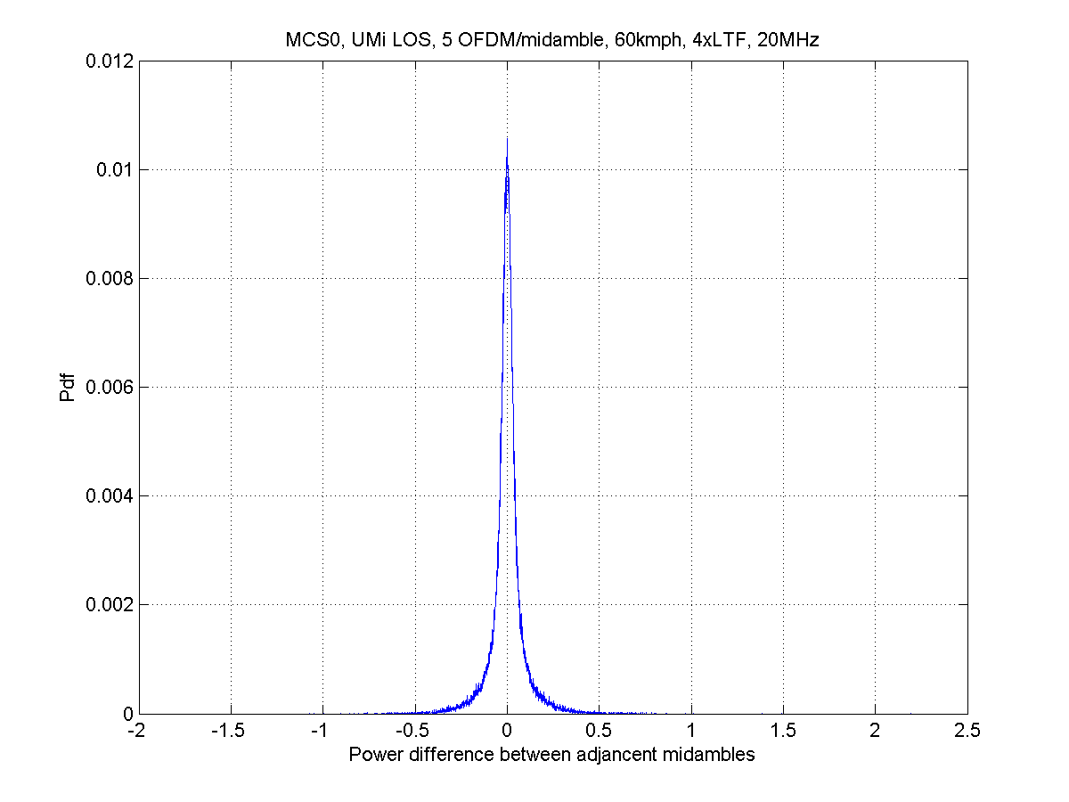
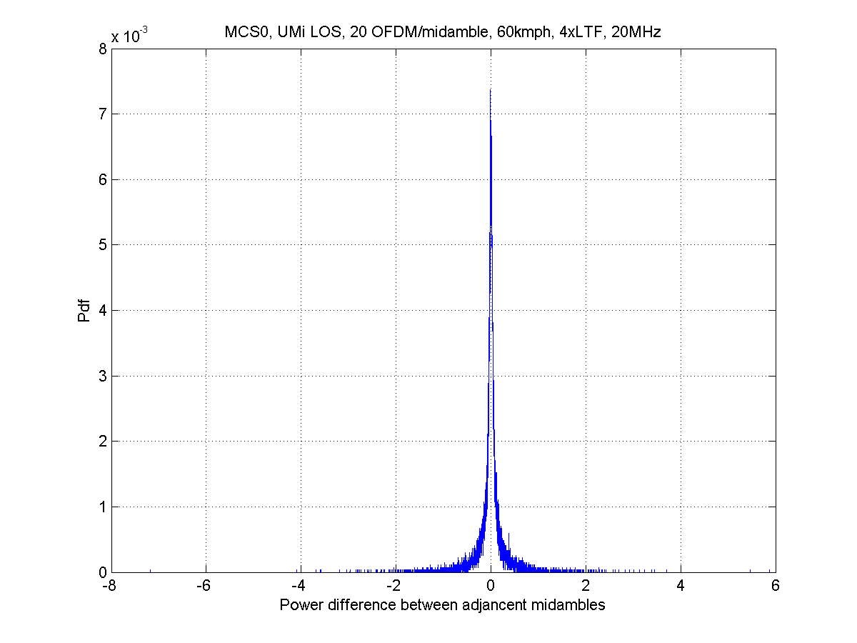
Power fluctuation over midambles
Power fluctuation between adjacent midambles is small in simulated channels.
  No analog gain adjustment is needed.
Midamble without HE-STF is possible, but adding HE-STF may be future-proof (e.g. more aggressive Doppler Channels)
If no HE-STF, gain change can be tracked with data symbols and digitally compensated so no HE-STF is needed.
M=5
M=20

Slide 13
PHY Parameter Updates
Num of Midambles
, where M is midable periodicity
where
TBD

Slide 14
Coex with 11ax Draft1.0 Devices
As shown in 28.3.20 (HE Receive Procedure), Draft 1.0 devices treats Doppler = 1 as unsupported mode when parsing HE-SIG-A, it will then hold CCA-busy based on LSIG-LENGTH field (as in legacy devices).

Slide 15
Conclusions
Midamble is a simple design for high Doppler scenarios.
Need to determine the midamble insertion periodicity,
  E.g. About 10 symbols in the aggressive pedestrian mobility channels.
Flexible design to accommodate any Nss and any BW, not just limited to low data rates.

Slide 16
SP-1
Do you agree to use midamble design when Doppler bit in HE-SIG-A is set to 1?
  Details in the midamble design is TBD.

Slide 17
Appendix: Example PER results

Slide 18
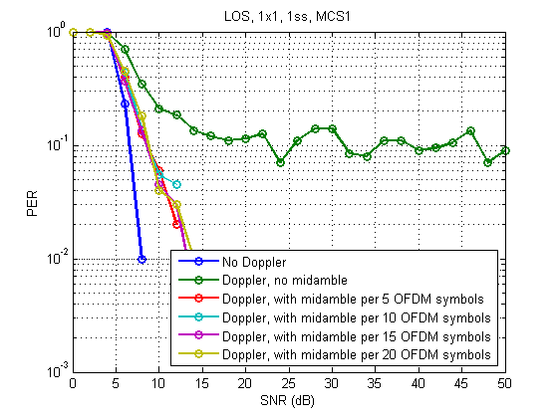
PER, UMi-LOS, 1SS, MCS1

Slide 19
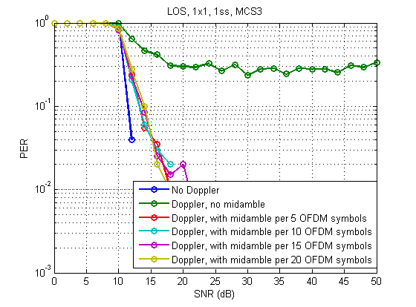
PER, UMi-LOS, 1SS, MCS3

Slide 20
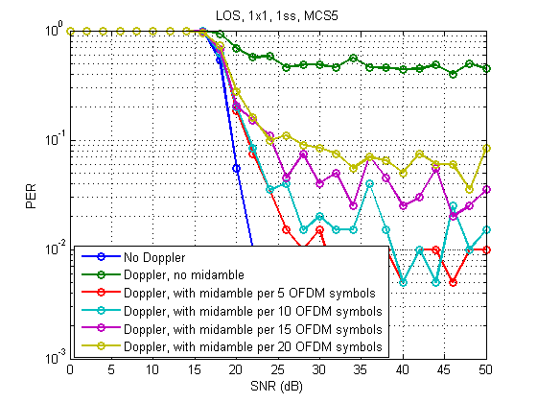
PER, UMi-LOS, 1SS, MCS5

Slide 21
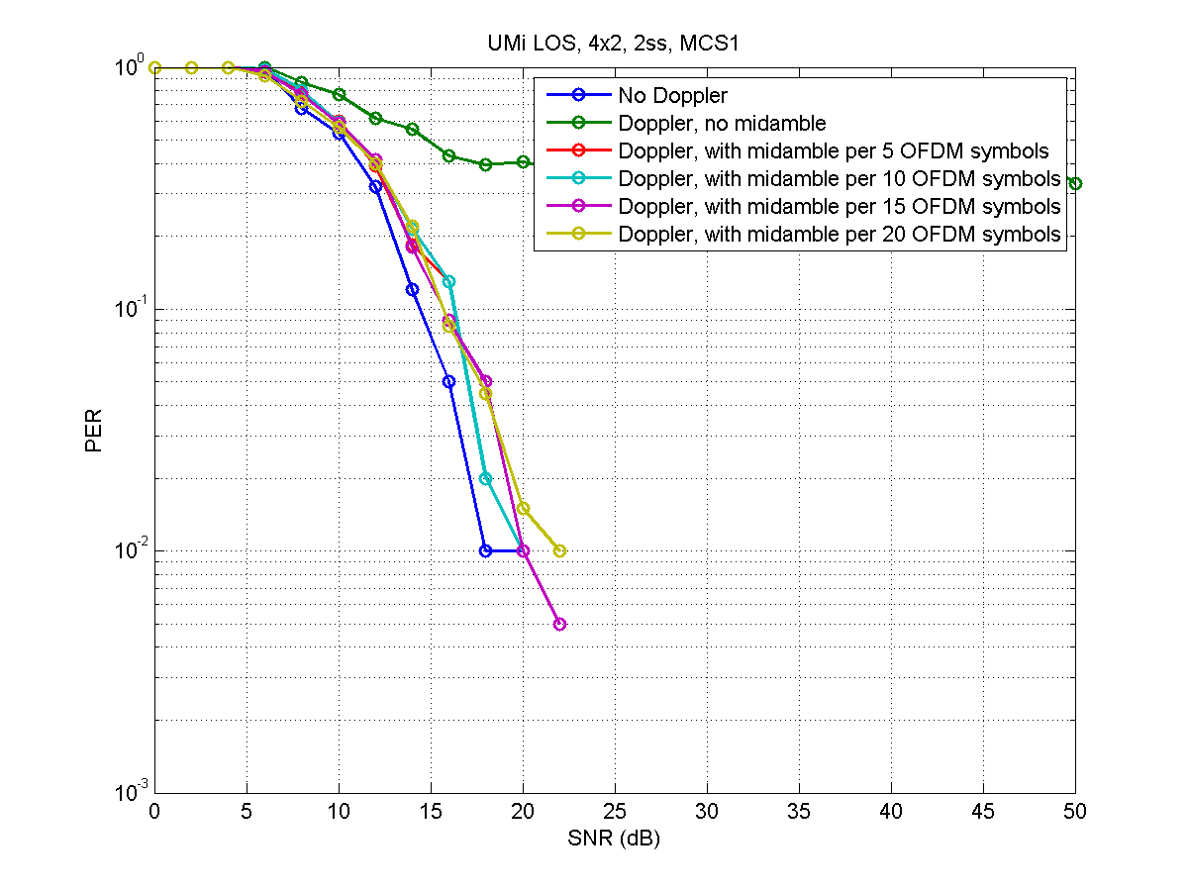
PER, UMi-LOS, 2SS, MCS1

Slide 22
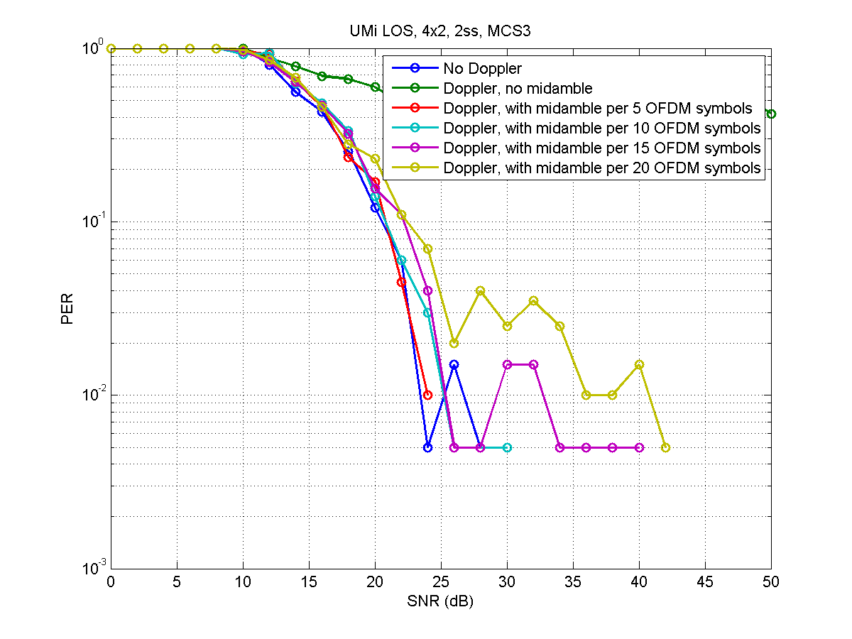
PER, UMi-LOS, 2SS, MCS3

Slide 23
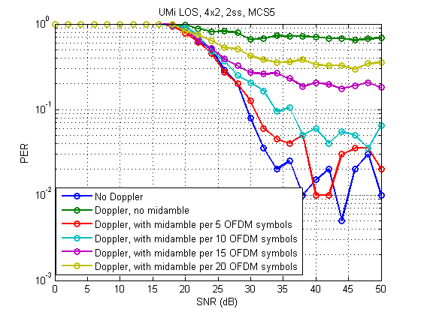
PER, UMi-LOS, 2SS, MCS5

Slide 24
References
[1] 11-14-0882-04-00ax-tgax-channel-model-document

