Slide 1
Suggested modifications to TIG report
Date: 2017-04-26
Author(s):

Slide 2
Abstract
This contribution provides suggested modifications to TIG report (rev4)

Slide 3
Introduction
The latest version (rev4) of TIG report is available at
https://mentor.ieee.org/802.11/dcn/17/11-17-0023-04-00lc-lc-tig-draft-report-outline.docx
In this contribution, several modifications to the document are proposed

Slide 4
Text for “Factories of the future”
Current text for “Factories of the future - Industrial and manufacturing” provides several key informations under the same bullet. It may helps to reorganize the text in several sub-bullets for easier understanding.
Proposal 1: reorganize current text. The proposed text is shown in the next page.

Slide 5
Current text
Proposed text
Factories of the future - Industrial and manufacturing
In industrial and manufacturing scenarios, nowadays only wired solutions are used, because of high requirements with respect to robustness, security and low latency. RF systems do provide large coverage and are easily deployed. But manufacturing belongs to the so-called dense wireless scenarios with multiple links maintained simultaneously all offering the above mentioned high service quality. One big issue is coexistence with other services. Using other RF links in the same spectrum requires protocols like “listen before talk” which implies unpredictable delays and contradicts low latency requirements. Getting dedicated spectrum for industrial wireless is one way. LC operates in unused spectrum and could be another way to solve the current situation. Moreover, it is possible for actors to easily jam the used RF spectrum from great distances outside the plant with simple RF devices. The use of RF-based wireless links instead of cables has obviously a potentially harmful impact on the safe operation of the connected manufacturing facilities in general. LC is inert against RF jamming and propagation is confined inside the plant. Thus LC is inert against outside jamming. In addition, the presence of strong electromagnetic interference may not be suitable for RF communication like in a steel mill, in nuclear power plants or in a power station. In manufacturing scenarios, LC can deliver safe wireless communications with low latency because it does not need to consider coexistence, has well-confined propagation conditions in very small cells, and is robust against jamming and EMI. Moreover, LC can be used complementary to RF systems for data off-loading. If industrial protocols are utilized (i.e. Profinet) there is a need to assign regular network access to the clients and to ensure the transmission of data within a specific period and low latency.
Factories of the future - Industrial and manufacturing
In industrial and manufacturing scenarios, nowadays wired solutions are mainly used, because of high requirements with respect to robustness, security and low latency. Industrial protocols (i.e. Profinet) assign regular network access to the clients and ensure the transmission of data within a specific period and low latency.
Industrial wireless is also attractive due to easy deployment and flexibility. LC based solutions may provide benefits over RF based solutions with respect to,
Suitable for dense deployment: Manufacturing belongs to the so-called dense wireless scenarios with multiple links maintained simultaneously all offering the above mentioned high service quality. LC can deliver safe wireless communications with low latency because it has well-confined propagation conditions in very small cells. Moreover, LC can be used complementary to RF systems for data off-loading.
Coexistence with other RF services: One big issue for industrial wireless networks is coexistence with other services. Using other RF links in the same spectrum requires protocols like “listen before talk” which implies unpredictable delays and contradicts low latency requirements. Getting dedicated spectrum for industrial wireless is one way. LC operates in unused spectrum and could be another way to alleviate the current situation. Note that ambient light impose little interference on LC as discussed below in “LC Technical Feasibility”.
Robustness against jamming: it is possible for actors to easily jam the used RF spectrum from great distances outside the plant with simple RF devices. The use of RF-based wireless links instead of cables has obviously a potentially harmful impact on the safe operation of the connected manufacturing facilities in general. In addition, the presence of strong electromagnetic interference may not be suitable for RF communication like in a steel mill, in nuclear power plants or in a power station. On the other hand, LC is inert against RF jamming and EMI, the propagation is confined inside the plant.

Slide 6
Text for “System architecture”
Current text for “system architecture” is quite high level. A more detailed explanation may helps the readers to get a clear picture.
Proposal 2: extend the current text, with an additional figure for illustration, as shown in the next page.

Slide 7
System Architecture
LC may be able to use the basic service set (BSS), extended service set (ESS) and independent basic service set (IBSS). It is envisioned that infrastructure BSS such as shown in Figure 5 can be the most straightforward deployment. Here a LED-light serves as an AP with several stations associated to it. Since the coverage of one LED-light is usually limited in several square meters, neighboring BSSs may be interconnected by a distribution system (DS) to form an ESS in order to cover a large area. Such architecture is especially suitable for enterprise use cases where multiple LED-lights coexist in the same room. IBSS, where stations communicate with one another directly in an ad-hoc manner, may also be useful.
Figure 5: System Architecture

Slide 8
Text for “What modulation techniques are available in the literature for LC?”
Under the bullet “What modulation techniques are available in the literature for LC?”, modulation schemes for LC are analyzed. Yet, the text under the sub-bullet “Reference receiver design/architecture” has little to do with modulation techniques.

Slide 9
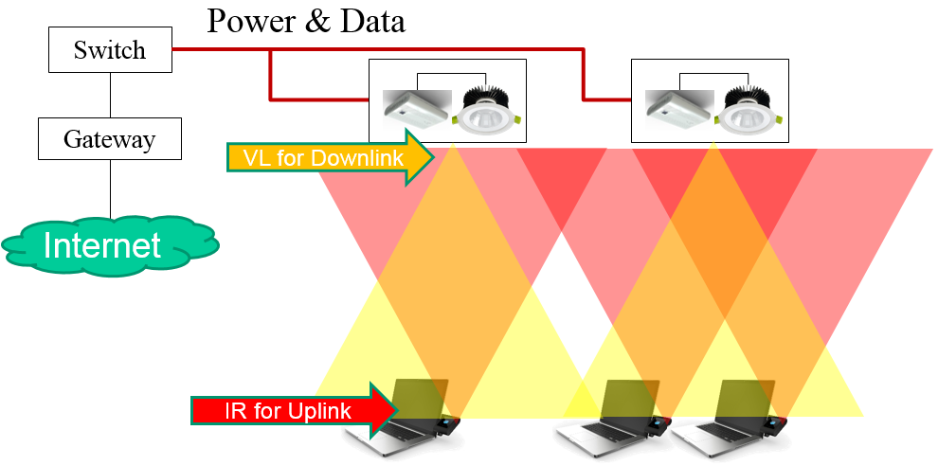
What modulation techniques are available in the literature for LC?
There have been many modulation techniques for light communication studied in the literature. A good overview of most modulation schemes is presented in [14]. This paper also has plenty of references to other papers on the topic of modulation scheme comparison.
About 30 different modulation shemes are presented in [14]. They can basically be categorized into two groups: single carrier modulation (SCM) such as on-off keying (OOK), pulse-position modulation (PPM), discrete Fourier transformation spread OFDM (DFT-S-OFDM), and multi carrier modulation (MCM), such as orthogonal frequency division multi⁃plexing (OFDM). Below, two modulation schemes, each of which represents one group, are introduced for illustration.
Use of OFDM for baseband modulation and the need for mitigation of multipath
Implementation and typical symbol length: Implementation is almost equivalent to the implementation for RF communication with the additional constraint required to generate a real signal. The symbol lengths with FFT between 64 and 512 that are already present in the different 802.11 flavours work quite well for light communication as well. The guard intervals depend on the channel conditions, but for most channels (especially LoS) a very short cyclic prefix is required, as an example. We believe that the 802.11ac as well as 802.11ad OFDM/single carrier specification are the closest to the light communication specification in this aspect.
Reference receiver design/architecture: The link margin calculation touches upon this topic. In addition, Figure 4 shows a general system level architecture for a LC deployment. The visible light spectrum can be used to provide both illumination and communications, while the infrared spectrum can be used from mobile devices to provide the uplink.
Figure 4: Example of the overall architecture

Slide 10
Text for “What modulation techniques are available in the literature for LC?”
Proposal 3: move the current text under the sub-bullet “Reference receiver design/architecture” to “system architecture”

Slide 11
Thank you!
The proposed modifications are illustrated in the attachment

