Slide 1
Data Rate value set for WUR
Date: 2017-05-01
Authors:

Slide 2
Introduction
Most contributions[1-2] focused on the On Off Keying (OOK) with 250kbps data rate
Contributions [3-4] already touched the multiple data rates concept for WUR to achieve either better efficiency or coverage
  Higher data rate can be accommodated for close range
  Lower data ratescan extend outdoor coverage
Furthermore, Manchester coding [5] was proposed to be used in data portion
  Simple implementation. No need to estimate OOK detector threshold
  Avoid long periods of zero waveform.
In this contribution, we consider the data rate candidates

Slide 3
Discussion on data rate
The link margin discussion by using 250 Kbps OOK @2.4G in [4] shows
  the achieved range is shorter than 30m in UMi-NLOS channels
  about 30dB link margin available at close distance (10 m) for indoor channels
Repetition and BCC coding are candidate ways to reduce data rate such that to increase the range and robustness
  BCC can obtain more coding gain compared with repetition, but requires more hardware implementation
Reducing normal OOK symbol time by n times is one way to increase data rate
  Wave form is recommended to have several periods within 4 us, such as L-STF.
The question is how high data rate and how low data rate we can have?

Slide 4

High data rate
We discuss the high data rate from the perspective of link budget margin available
Link Budget Settings for WUR
  fc = 2.4GHz and 5GHz
  Tx_Power: 20 dBm
  4MHz: The allowed TX_Power is 30 dB in 2.4GHz and 17 dB in 5 GHz in US, and 16 dB in both 2.4 GHz and 5GHz in China [7]
  Propagation Loss (PL): 802.11ax channel models [6]
  Tx/Rx Antenna Gain: 0 dB
  Rx Noise Figure: NF=10 + 8 dB
  Noise Floor for 4 MHz channel: N_0=-108 dBm
  N_0 = -174+10log10(BW)
  Rx SNR = Tx_Power – PL –Shadowing- N_0 – NF [8]

Slide 5
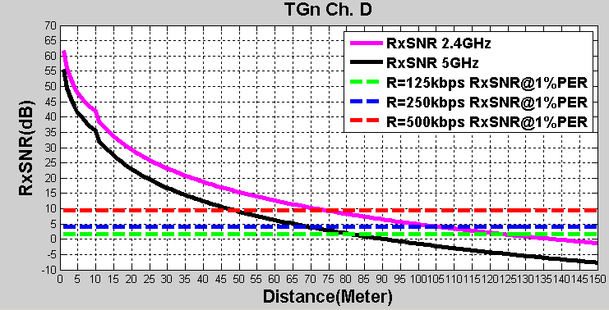
High data rate
Please refer to Appendix for
the RxSNR@1%PER
2.4 GHz/5 GHz | @ 10 m | @30 M | Cross Point
Link margin available for 500 Kbps | 33dB/27 dB | 14 dB /8 dB | 73 m/48 m
Link margin available for 250 Kbps | 38 dB/32 dB | 19 dB/13 dB | 105 m/70 m
We recommend 250 Kbps as high data rate due to available link margin and cross point

Slide 6
Low data rate
15 dB loss (31.6 x) in 2.4 GHz and 18 dB loss (63 x) in 5 GHz for WUR
  Based on the PSD and EIRP [7], we observe that
  4 dB transmission power lower over the 4 MHz than that over the 20 MHz in 2.4 GHz
  7 dB transmission power lower over the 4 MHz than that over the 20 MHz in 5 GHz
  Lower transmission power may result in PHY CCA idle status issued by the exiting 20 MHz receiver (energy detection) with higher probability compared with 20 MHz .11 packet, hence it requires more protection
  8 dB loss due to RX noise figure[7]
  3 dB loss due to OOK detection
  The low data rate for WUR is 189.8 /31.6 Kbps in 2.4 GHz and 95.2 Kbps in 5GHz in general
  The lowest data rate for OFDM WiFi is 6 Mbps over the 20 MHz bandwidth
  The lowest data rate for DSSS WiFi is 1 Mbps over 22 MHz bandwidth (only in 2.4 GHz, is not recommended as base line)
  Therefore, we consider 62.5 Kbps as low date rate for WUR
  12 bytes payload requires 1.5 ms transmission time

Slide 7
Summary
In this contribution, we discussed the possible high data rate and low data rate.

Slide 8
Reference
[1] 11-16-0865-01 WUR performance investigation on wake up receiver
[2] 11-16-0341-00 LP-WUR (Low-Power Wake-Up Receiver) Follow-Up
[3] 11-17-0350-00 Various Symbol Types for WUR
[4] 11-17-0399-01 WUR Link Budget Analysis
[5] 11-17-0366-01 WUR Modulation and Coding
[6] 11-14-0882-04 IEEE 802.11ax channel model document
[7]11-17-0365-00 regulations and noise figure impact on snr
[8] Cambridge.Next Generation Wireless LANs.802.11n and 802.11ac.2Ed.2013

Slide 9
Appendix
Simulation Assessment:
  The conventional OOK pulse generator:
    13-tone OFDM transmitter: [-6,6] of L-LTF
    Manchester coding (1 us on/off @500Kbps, 2 us on/off @250Kbps, 4 us on/off @125Kbps)
  Sim para.:
    100 bits payload size, TGn Ch. D
    No CFO/STO/RF impairment
    No channel coding and equalization
    Energy detection
  4MHz LPF (IIR) – generated using MATLAB
    Butterworth, order=3, cutoff freq. = 2MHz, sampling rate =20MHz

Slide 10
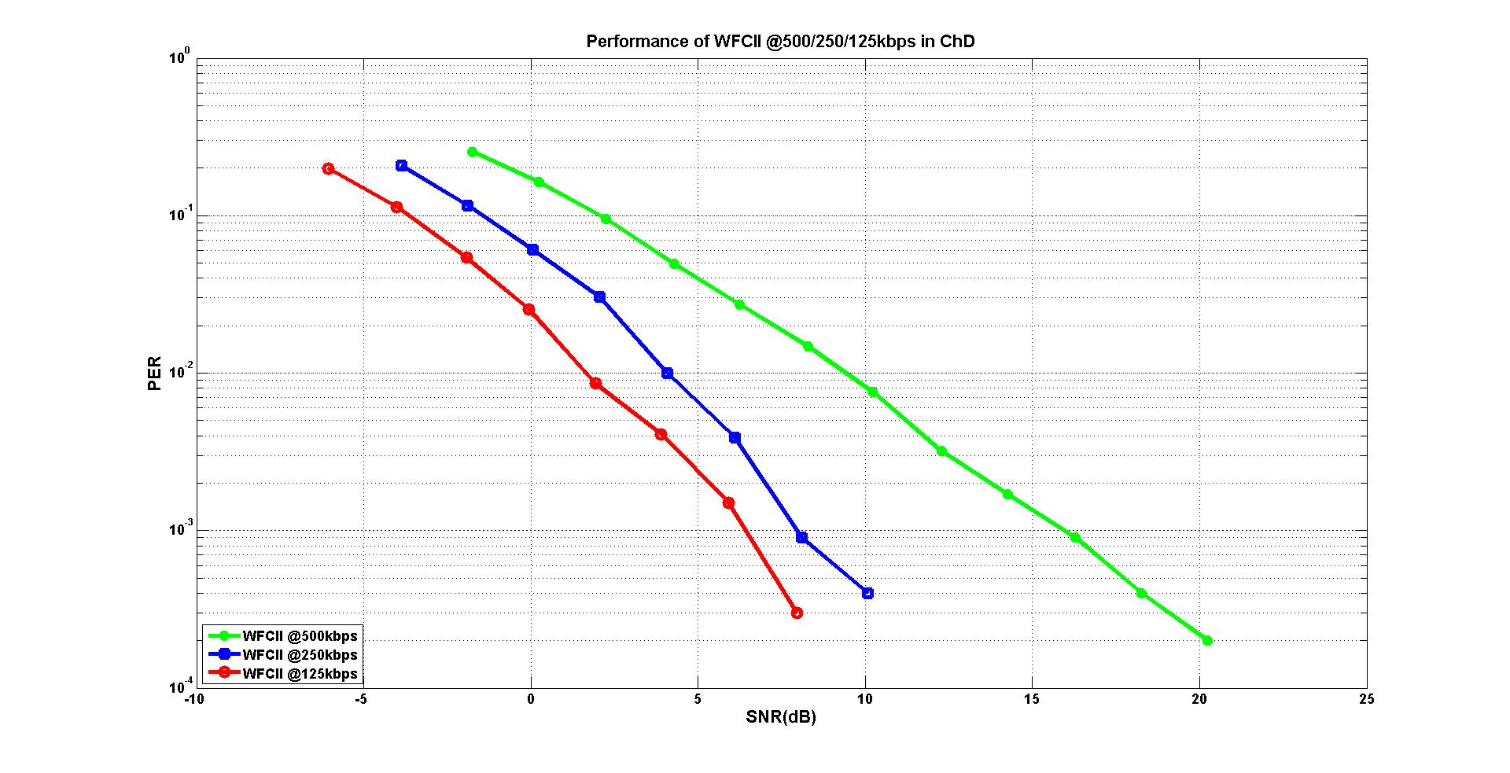
WUR simulation

