Slide 1
Multi Sub-band Scheduling
Date: 2017-05-08
Authors:
Name | Affiliation | Address | Phone | Email
Junghoon Suh | Huawei |  |  | junghoon.suh@huawei.com
Osama Aboul-Magd
Edward Au

Slide 2
Background
Waveform coding is necessary [1]
Multi band scheduling is proposed [2]
How do we apply the waveform coding in the multi band scheduling case ?
Optimum receiver filter taps
  Trade-off between ISI, Power consumption and Adjacent band interference rejection

Slide 3
Multi band scheduling for 4 MHz WUR frame
4 tones
WUR Frame 0
4 MHz
14 tones
STA 0
Preamble for
regular Wi-Fi STAs
7 tones
20 MHz
WUR Frame 1
4 MHz
14 tones
STA 1
7 tones
WUR Frame 2
4 MHz
14 tones
STA 2
4 tones
BW of each WUR frame is 4 MHz
  14 tones excluding the center tone (DC or Null)
There are 3 maximum WUR frames in parallel per PPDU in Freq Domain
There are 7 Guard tones between WUR frames
There are 4 Edge tones on both outer WUR frames
WUR Frame 0 is targeted to STA 0, WUR Frame 1 to STA 1, and WUR Frame 2 to STA 2, respectively

Slide 4
How to generate WUR frames for Multi band scheduling: WUR Frame 0
-32 -31 -30 … 12 13 14 15 16 17 18 19 20 21 22 23 24 25 26 27 28 29 30 31
64 IFFT
t
0
63
Waveform coding
& Blank GI
ON
ON
Blank
GI
OFF
Blank
GI
OFF
t
t
0
16
48
79
0
16
48
79
Data 1
Data 0

Slide 5
How to generate WUR frames for Multi band scheduling: WUR Frame 1
-32 -31 -30 … -8 -7 -6 -5 -4 -3 -2 -1 0 1 2 3 4 5 6 7 8 … 30 31
64 IFFT
t
0
63
Waveform coding
& Blank GI
ON
ON
Blank
GI
OFF
Blank
GI
OFF
t
t
0
16
48
79
0
16
48
79
Data 1
Data 0

Slide 6
How to generate WUR frames for Multi band scheduling: WUR Frame 2
-32 -31 -30 -29 -28 -27 -26 -25 -24 -23 -22 -21 -20 -19 -18 -17 -16 -15 ………. 29 30 31
64 IFFT
t
0
63
Waveform coding
& Blank GI
ON
ON
Blank
GI
OFF
Blank
GI
OFF
t
t
0
16
48
79
0
16
48
79
Data 1
Data 0

Slide 7
BW
GI, ON/OFF Duration
Waveform
Generation
Waveform Coding
& Data Mapping
Forward Error
Correction Coding
OOK Source
for STA 0
WUR Frame 0
GI, ON/OFF Duration
BW
Waveform
Generation
Waveform Coding
& Data Mapping
Forward Error
Correction Coding
OOK Source
for STA 1
WUR Frame 1
GI, ON/OFF Duration
BW
Waveform
Generation
Waveform Coding
& Data Mapping
Forward Error
Correction Coding
OOK Source
for STA 2
WUR Frame 2
BPF
@ 6.56 MHz
ED*
HD*
FEC
Decoding
STA 0 Source
Recovered
Blank GI
Removal
Waveform Generation may
not be processed every
transmission time.
One time generated and
stored in advance
LPF
FEC
Decoding
STA 1 Source
Recovered
Channel
ED*
HD*
Blank GI
Removal
* ED and HD stand for Energy Detection and Hard Decision
BPF
@ -6.56 MHz
FEC
Decoding
STA 2 Source
Recovered
ED*
HD*
Blank GI
Removal

Slide 8
System Diagram for 4 MHz Multi Band Scheduling
WUR Frame 0 to 2 are generated by occupying each corresponding tones with Long Training
Sequences (LTS) and by taking 64 point IFFT
  Tone index 14 to 27 except for 21 are occupied with the corresponding LTS for WUR
  Frame 0, the center tone 21 is left blank with no energy
  Tone index -7 to 6 except for 0 are occupied with the corresponding LTS for WUR Frame 1, the DC tone 0 is left blank with no energy
  Tone index -28 to 15 except for -21 are occupied with the corresponding LTS for WUR
  Frame 2, the center tone -21 is left blank with no energy
We propose to prepend a 0.8 usec Blank GI during the Waveform Coding (WFC).
  0.8 usec Blank GI followed by 1.6 usec ON (OFF) and 1.6 usec OFF (ON) WFC according to source data
Waveform coded symbols from WUR Frame 0 to 2 are added in time domain sample by sample before transmission, assuming the same TX sampling rate for the WUR Frame 0 to 2
Receiving STA from STA 0 to STA 2 may be informed of its corresponding band in a PPDU
through the main radio, so each STA may configure its receiver filter according to
the corresponding band
  e.g.) STA 0 needs to configure its RX filter to Band Pass Filter @ 6.56 MHz center freq. with 4 MHz bandwidth

Slide 9
Digital Filter Design
F
t
f
-W
0
W
-T_{max}
T_{max}
T_{s} = 1/f_{s} , sampling time in second, f_{s} is the sampling rate
T_{max} = (in second)
W is one sided BW in Hz , where {(the number of actually occupied subcarriers + 2) / 2 }times the sub-carrier spacing which is 312.5 KHz.
  E.g.) in case of 14 occupied tones, W becomes (16 /2) * 312.5 KHz, that is, 2,500,000 Hz
  We give one extra tone to each side of 14 occupied tones to make 16 tones
Intermediate filter tap (h)
t = - T_{max} : T_{s} : T_{max}

Slide 10
Digital Filter Design continues
Windowing Mask has smooth transition to zero on its both ends so that it avoids abrupt jumps at the beginning and end of the truncated filter, and hence avoids the freq spillover in the truncated filter. Moreover, the windowing provides a reasonable time-localization in the truncated filter’s impulse response, and thus, keeps the induced ISI within an acceptable limit [4]
Hanning window (h_{w}) of duration T_{w} is given by
where
The final filter coefficient ( ) for LPF is
  sample by sample multiplication between and
If we denote the central freq to be
  Then the final filter coefficient ( ) for the center freq is

Slide 11
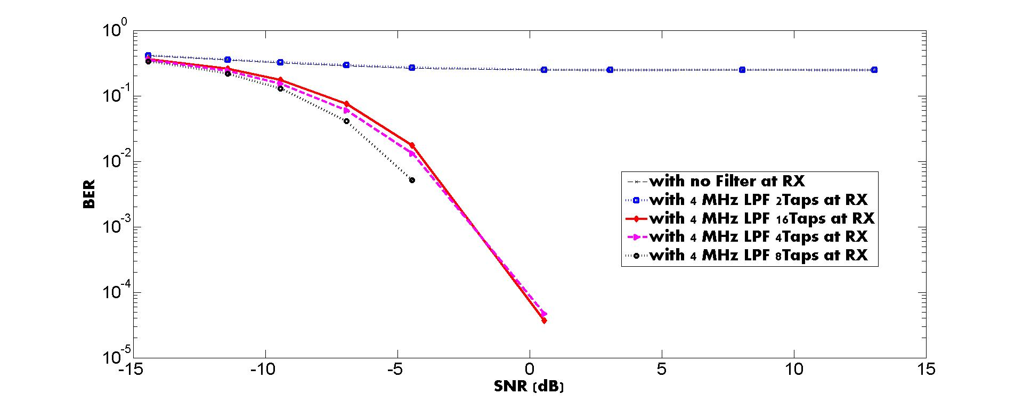
Performance of STA 1 while STA 0 and STA 2 WUR frames exist as interferences
* AWGN and RF impairments
based on [3]
Due to the adjacent band
interferences, 2 Tap filter
does not work
Due to the Intra SI, 16 tap
filter is not the best
8 Tap is the most optimum
choice between interference
rejection and ISI
Considering the power
consumption, 4 tap filter is
another good choice

Slide 12
RF impairments Baseband model
RF impairments
Carrier
Freq
Offset
Phase
Noise
AWGN
Baseband
Signal
X
X
+
Phase
Noise
AWGN
CFO is 200 ppm of 2.4 GHz, i.e., -240 KHz ~ 240 KHz
  Linearly shifts every 4 usec (based on 802.11 residual CFO model)
    “n” varies linearly every 4 usec in
    4 usec is the data rate, 250 KHz
Phase noise based on 802.11 phase noise model

Slide 13
Conclusions
There is no performance loss by the adjacent WUR frame interference
Tone plans for the multi band scheduling of 4 MHz WUR frame
(14 tones excluding the center tone)
  7 Guard tones between WUR frames and 4 Edge tones
Each waveform of 4 MHz WUR frame in a PPDU is generated by occupying its corresponding tones with its corresponding L-LTS
Blank GI pre-pended and Waveform coded WUR frames are added sample
by sample in the time domain before transmission
Receiving STA knows its corresponding band through the main radio
Receiving STA tune its RX filter according to the corresponding band
  Filter taps are recommended to be 4 or 8 taps under the trade off between ISI, Power consumption and Interference rejection capability

Slide 14
References
[1] Qualcomm “17/0366r1 WUR Modulation and Coding”, IEEE 802.11 TGba, Mar 2017, Vancouver BC Canada
[2] Mediatek “17/0028r0 On Waking-Up Multiple WUR Stations”, IEEE 802.11 TGba, Jan 2017, Atlanta GA USA
[3] Huawei, “17/0376r0 Waveform Generation for Waveform Coding”, IEEE 802.11 TGba, Mar 2017, Vancouver BC Canada
[4] J. Abdoli, et. al., “Filtered OFDM: A New Waveform for Future Wireless Systems”, 2015 IEEE 16th International Workshop on Signal Processing Advances in Wireless Communications (SPAWC)

