Slide 1
Blank GI for the Waveform Coding
Date: 2017-05-08
Authors:
Name | Affiliation | Address | Phone | Email
Junghoon Suh | Huawei |  |  | junghoon.suh@huawei.com
Jia Jia
Osama Aboul-Magd
Edward Au
David Yang
Ming Gan

Slide 2
Background
Performance loss was observed during the RX filtering and over IEEE Chan D [1][2]
  Performance loss varies by the filter tap order
  Inter Symbol Interference (ISI) is the main cause of the filtering loss
  GI is necessary in WFC design
  Performance loss with Inter Symbol Interference caused by multipath fading channel
Trade-off between ISI compensation and Energy loss
  Without GI, performance is lost due to the ISI
  With GI, performance is degraded due to the lost energy of the symbol [3]

Slide 3
Performance of Blank GI over Chan D
L-LTS occupied for middle 13 tones to generate the waveform
100 bit payload size, 4 Tap LPF
Equal symbol energy of WFC I, II, and III
  WFC I : Unexpected energy loss after CP removal → Degradation of non-coherent detection
  WFC II : Significant ISI (No CP removal) → Degradation
CP
CP
0us 0.8us 2.4us 4us
0us 0.8us 2.4us 4us
Information “0”
Energy Loss
Information “1”
0us 2us 4us
0us 2us 4us
Information “0”
Time dispersion
ISI area
Information “1”

Slide 4
Proposed solution WFC III: A blank energy GI with 0.8us duration is placed before transmitting each of the 3.2us OFDM symbol. The GI is removed at RX before performing symbol detection.
  The energy supposed to be consumed for CP, is now added to the energy of the ON portion with the proposed blank GI
  ISI suppression , and No energy loss
  No extra cost: same symbol duration with symbol energy unchanged, no additional RX complexity, no additional RX power consumption
Blank
Blank
0us 0.8us 2.4us 4us
0us 0.8us 2.4us 4us
Information “1”
Information “0”

Slide 5
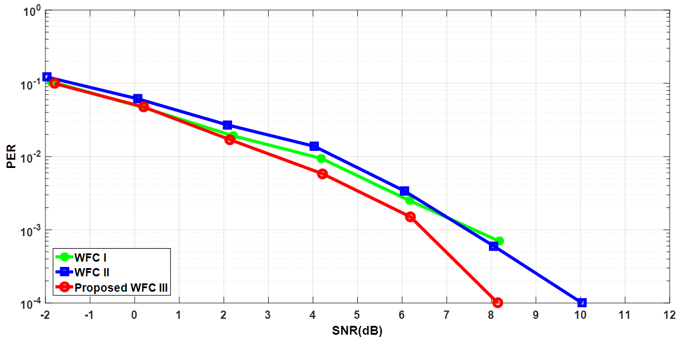
Performance of Blank GI over Chan D:
4 order Filter, 4 usec symbol

Slide 6
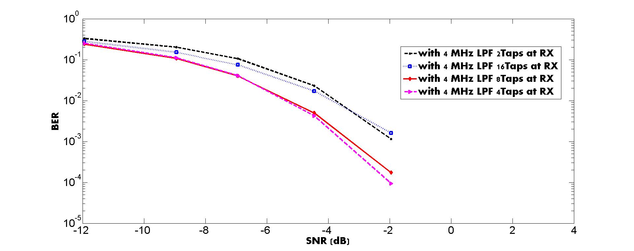
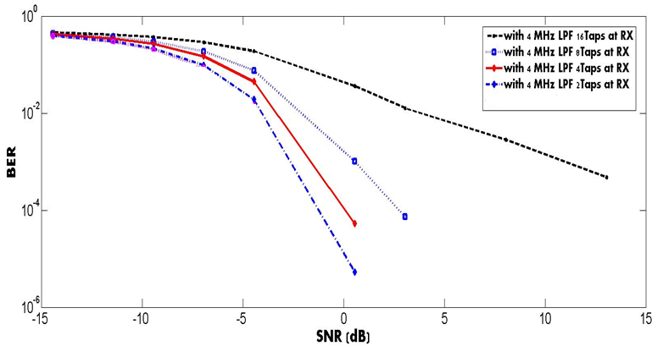
Performance of different RX Filter Taps w/ or w/o Blank GI
Middle 13 tones occupied with L-LTS out of 64 subcarriers
Without any GI
Middle 13 tones occupied with L-LTS out of 64 subcarriers
With Blank GI
AWGN and RF impairments (CFO and Phase noise) considered [1]

Slide 7
Conclusion
Performance loss with ISI is compensated by Blank GI
  There is no cost, No Additional Power consumption and No Additional Complexity related with Blank GI
  1.5 dB gain over Chan D at 1% PER
  1.5 dB gain for Filter tap order 4 at 1% BER
CP in main radio is necessary to enable a cyclic convolution after taking an FFT at the receiver and thus to enable the easier equalization (EQ) on Freq domain as well as ISI compensation
  WUR does not need EQ but only needs ISI compensation ← Blank GI is proposed
  There is no received symbol energy loss with GI removal ← Blank GI is proposed

Slide 8
Reference
[1] Huawei “17/376r0 Waveform Generation for Waveform Coding”, IEEE 802.11 TGba, Mar 2017, Vancouver, BC Canada
[2] Huawei “17/373r2 Performance Investigations on Single-Carrier and Multi Carrier based WUR”, IEEE 802.11 TGba, Mar 2017, Vancouver, BC Canada
[3] Intel “17/367r0 Studies of PER Performance”, IEEE 802.11 TGba, Mar 2017, Vancouver, BC Canada

