Slide 1
Considerations on WUR Synchronization
Date: 2017-05-10
Authors:
Authors:

Slide 2
Background
Prior presentations [1] [2] have discussed how to provide synchronization for WUR via WUR beacons
  [1] suggests carrying partial TSF information (e.g. 3 octets)
  Pros: able to handle contention delay
  Cons: overhead to carry the partial TSF
  [2] suggested to use the arrival time of WUR beacon
  Pros: 0 octet timing info
  Cons: susceptible to contention delay
Objective: get the best of both approaches
[1] Po-Kai Huang, “WUR Beacon,” 802.11-17/0343r2, March 2017
[2] Tianyu Wu, “WUR duty cycle mode and timing synchronization,” 802.11-17/0371r4, March 2017

Slide 3
Feasibility Study: Use 1 Octet for SYNC
STA operations with SYNC message transmitted at TSF1
Replace TSF1'[7,14] with received PTSF and get a new value BASE
Handle the carry-over bit: choose a value from set [BASE +/- n * 16384 us] that is closest to TSF1' and set local clock to the value
  Range of time covered by the 1 octet should be greater than 2 * maximum_clock_drift
  Assume a 200ppm clock drift and 10 seconds beacon interval, difference between TSF1 and TSF1' is less than 2000 us.

Slide 4
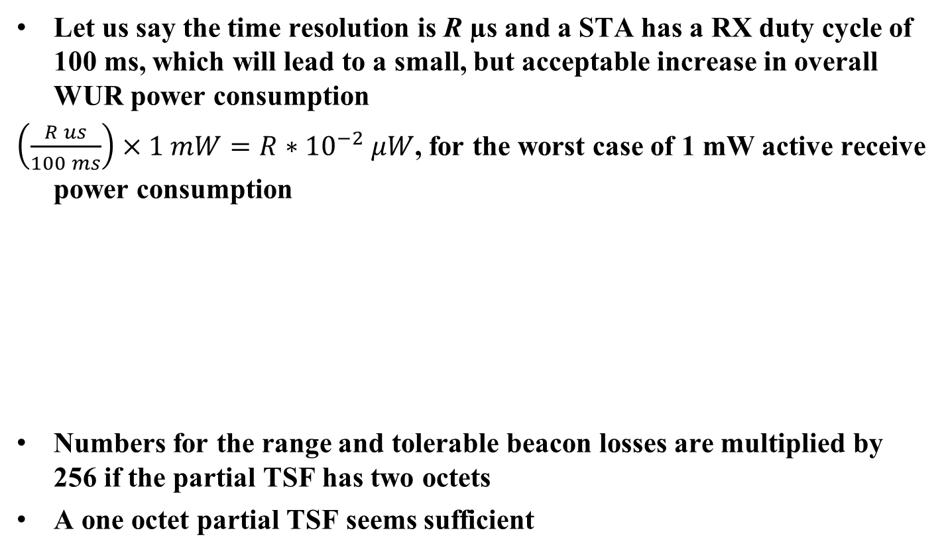
Tradeoff for Different Time Resolutions
Let us say the time resolution is R µs and a STA has a RX duty cycle of 100 ms, which will lead to a small, but acceptable increase in overall WUR power consumption
$\left(\frac{R us}{100 ms}\right)×1 mW=R∗{10}^{−2} μW$, for the worst case of 1 mW active receive power consumption
Numbers for the range and tolerable beacon losses are multiplied by 256 if the partial TSF has two octets
A one octet partial TSF seems sufficient
Time resolution (µs) | Delay range covered by 1 octet (ms) | Extra power consumption (µW) | Tolerable beacon losses (assuming 10s interval, 200ppm drift)
32 | 8.192 | 0.32 | 2
64 | 16.384 | 0.64 | 4
128 | 32.768 | 1.28 | 8
256 | 65.536 | 2.56 | 16
512 | 131.072 | 5.12 | 32

Slide 5
Straw Poll
Do you support the following?
  WUR beacon frame can carry partial TSF for synchronization
Yes: 23
No: 0
Abstain: 17

Slide 6
Motion
Move to add the following sentence to 802.11ba SFD
“The WUR beacon frame may carry partial TSF for synchronization. The number of bits of the partial TSF is TBD.”
Move: Steve Shellhammer
Second:
Yes:
No:
Abstain:

