Slide 1
TBTT Information Field Type (TIFT)
Clarification for P802.11REVmd
Date: 2017-08-14
Authors:
Name | Affiliations | Address | Phone | email
Roger Marks | Huawei | Denver, CO, USA | 1-802-capable | roger@ethair.net
Lyu Yunping (Lily) | Huawei | Nanjing, PRC |  | lvyunping@huawei.com

Slide 2
Abstract
This contribution, intended for presentation to IEEE 802.11 TGm, identifies ambiguity in the TBTT Information Field Type (TIFT) subfield in the Reduced Neighbor Report. It proposes clarification, using the TIFT to specify an additional property of the reported neighbor. It also proposes to improve the value of the RNR by including an option to specify HESSID along with additional improvements.

Slide 3
TBTT Information Field Type (TIFT)
Status
Reference to TBTT Information Field Type in IEEE Draft P802.11-REVmd/D0.1:
§9.4.2.171.2 Neighbor AP Information field
The TBTT Information Field Type subfield is 2 bits in length and defines the structure of the TBTT Information field. (11ai) Values 2 and 3 are reserved.
Figure 9-582—TBTT Information Header subfield

Slide 4
TIFT Issues
The standard incorrectly states that the TBTT Information Field Type “defines the structure of the TBTT Information field”
      it does not, though it did in pre-standard drafts
              the name could therefore be improved, but that’s not proposed here
How to resolve the ambiguity of the TBTT Information Field Type (TIFT)?
  How to differentiate the use of TIFT = 0 and 1?

Slide 5
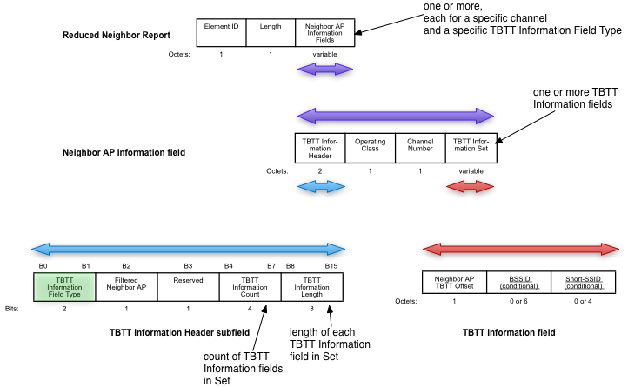
What is TBTT Information Field Type (TIFT)?

Slide 6
802.11ai Draft History
D6-D11: TIFT specification is same as published standard
D6: Revised, based on editorial comment resolution, to final form, with TIFT values 0 and 1 unspecified
D2-D4: TIFT (0/1) differentiates format of TBTT Information field
earlier drafts:
  “A STA that receives a Reduced Neighbor Report element in which the TBTT Information Field Type field is 1 and in which the BSSID field is not present may switch to another channel or to another band as specified in the received Operating Class field and Channel Number field. However, if the TBTT Information Field Type is 1 and BSSID field is included in the TBTT Information, the STA may switch to a neighbor AP as specified in the received Operating Class field, Channel Number field, and BSSID field.”
  “Value 0 indicates the presence of the informative Neighbor AP Information that is used to help the STA in AP discovery. Value 1 indicates the presence of the Neighbor AP Information that is used to recommend the STA to switch to the channel, the band, or the neighbor AP as specified in the Neighbor AP Information field. Values 2, and 3 are reserved.”
  “If the AP considers its operating channel too congested to accommodate STAs, the AP should include one (or more) Neighbor AP Information element with TBTT Information Field Type indicating value 1 to the TBTT Information Header of the Neighbor AP Information field of the Reduced Neighbor AP Report element in the Beacon or FILS Discovery frame or Probe Response frame to redirect the STA conducting initial link setup from current band to other band or to redirect the STA conducting initial link setup to other AP of the current channel.”

Slide 7
TGai Proposals for dedicated RNR channel
•IEEE 802.11-11/1510r0 (Marc Emmelmann)
Non-AP STA conducts active scanning in 2.4GHz band –
receives valid 5GHz channel list
  Option a) verify this information via passive scanning on specific 5GHz channel
  Option b) directly start link set-up on 5GHz channel
  [pointed out numerous challenges]
•IEEE 802.11-12/0546r1 (Dapeng Liu)
802.11ai can use a pre-configured/dedicated channel for passive scan… STA monitoring that particular channel instead of scanning all the channels… Scanning time is reduced since not necessary to change channels and wait…11ai can specify a default channel for passive scan
  [pointed out problems to be solved]

Slide 8
Issue 1: HESSID
RNR currently provides an optional Short-SSID. But many purposes call for an identifier of the ESS. The HESSID identifies the ESS:
  (3.1) homogenous extended service set (ESS): A collection of basic service sets (BSSs), within the same extended service set (ESS), in which every subscription service provider network (SSPN) or other external network reachable at one BSS is reachable at all of them.
  (3.4) HESSID: homogenous extended service set identifier
Industry recognizes this parameter:
  because SSIDs are not globally administered, it is possible that two APs with the same SSID are, in fact, in different wireless networks. The homogeneous extended service set identifier (HESSID) element allows mobile devices to detect this condition. When two APs have the same SSID but from different wireless networks, the two networks have different HESSIDs.
  -Wi-Fi CERTIFIED PasspointTM (Release 2) Deployment Guidelines, Rev 1.1 (Dec 2016)
  -Wi-Fi CERTIFIED PasspointTM (Release 1) Deployment Guidelines, 1.0 (Oct 2012)
A more robust RNR solution would allow RNR to provide a HESSID, which is more authoritative than SSID for purposes of BSS transition and reassociation.

Slide 9
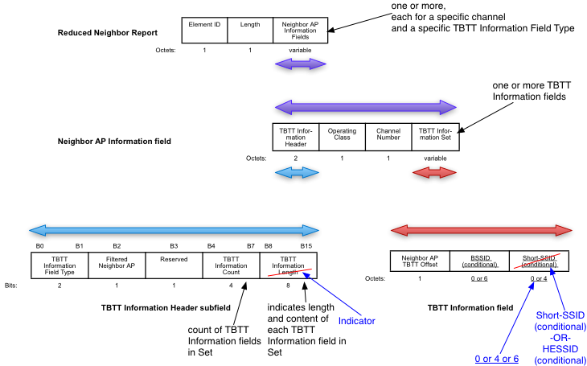
Proposal (figure) - Issue 1

Slide 10
Proposal (table) - Issue 1
9.4.2.171.2 Neighbor AP Information field
The TBTT Information Length Indicator subfield is 1 octet in length and contains indicates information about the Neighbor AP Information field, including the length in octets of each TBTT Information field that is included in the Neighbor AP Information field. The TBTT Information Length subfield is 1, 5, 7, or 11 indicating the TBTT Information field contents. Other values are reserved.(11ai)
(11ai)The TBTT Information Length Indicator subfield is interpreted as shown in Table 9-259 (TBTT Information field(11ai)).
Table 9-259—TBTT Information Field
TBTT Information Length Indicator subfield value | TBTT Information field length (octets) | TBTT Information field contents
1 | 1 | The Neighbor AP TBTT Offset subfield
5 | 5 | The Neighbor AP TBTT Offset subfield and the Short-SSID subfield
7 | 7 | The Neighbor AP TBTT Offset subfield and the BSSID subfield
11 | 11 | The Neighbor AP TBTT Offset subfield, the BSSID subfield and the Short-SSID subfield
13 | 13 | The Neighbor AP TBTT Offset subfield, the BSSID subfield, and the HESSID subfield
0, 2–4, 6, 8–10, 12, 14–255 | Reserved | Reserved
Add column to support future enhancements, allowing use of the reserved values of the Indicator to indicate other combinations of length and contents.

Slide 11
Issue 2: Use of TIFT = 1
Indicates the recommendation of designated channel in which the STA can find a neighbor providing a secondary RNR identifying an AP suitable for BSS transition and reassociation (such as in the same ESS).
      STA can quickly scan the designated channel and learn the right AP with which to associate, instead of having to scan all channels identified in the RNR (which might be a large number).
      If the secondary RNR specifies HESSID, then STA can identify handover candidates that match its preferred HESSID.

Slide 12
Proposal - Issue 2
The TBTT Information Field Type subfield is 2 bits in length and defines the structure of the TBTT Information field. The subfield is set to 1 when RNRs provided by neighbors in the designated channel are recommended for BSS transition and reassociation. The subfield is set to 0 otherwise. Values 2 and 3 are reserved.

Slide 13
Summary of Proposed Changes
The proposed changes to to §9.4.2.171 are incorporated in a separate contribution:
  Document IEEE 802.11-17/0667r2

Slide 14
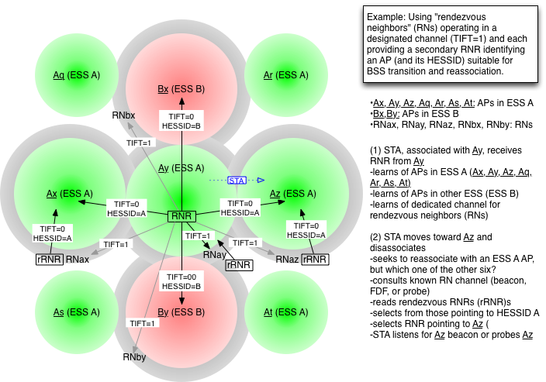
Appendix: Potential Usage of TIFT=1

Slide 15
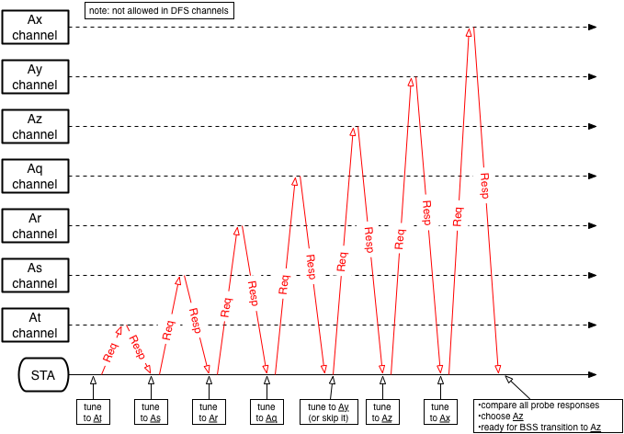
Example without RNs: Active Probing

Slide 16
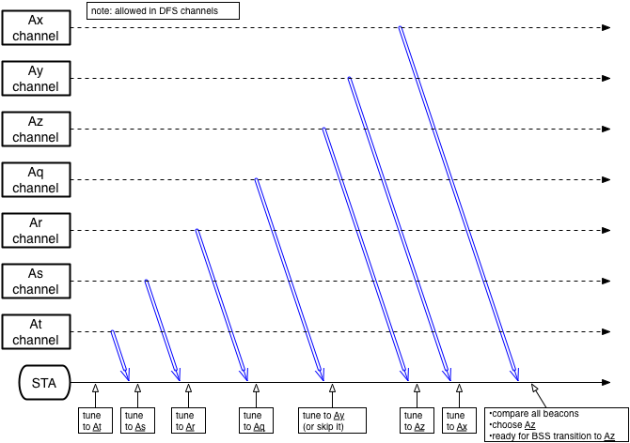
Example without RNs: Passive Probing

Slide 17
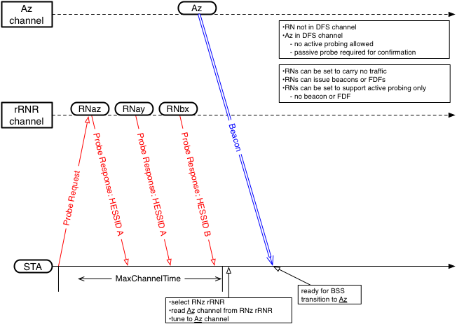
Example using RNs

