Slide 1
TBTT Information Field Type (TIFT) Clarification for P802.11REVmd
Date: 2017-06-13
Authors:
Name | Affiliations | Address | Phone | email
Roger Marks | Huawei | Denver, CO, USA | 1-802-capable | roger@ethair.net
Lyu Yunping (Lily) | Huawei | Nanjing, PRC |  | lvyunping@huawei.com

Slide 2
Abstract
This contribution, intended for presentation to IEEE 802.11 TGm, identifies ambiguity in the TBTT Information Field Type (TIFT) subfield in the Reduced Neighbor Report. It proposes clarification, using the TIFT to specify additional properties of the reported neighbor.

Slide 3
TBTT Information Field Type (TIFT)
Status
Reference to TBTT Information Field Type in IEEE Draft P802.11-REVmd/D0.1:
§9.4.2.171.2 Neighbor AP Information field
The TBTT Information Field Type subfield is 2 bits in length and defines the structure of the TBTT Information field. (11ai) Values 2 and 3 are reserved.
Figure 9-582—TBTT Information Header subfield

Slide 4
TIFT Issues
The standard incorrectly states that the TBTT Information Field Type “defines the structure of the TBTT Information field”
it does not, though it did in pre-standard drafts
the name could therefore be improved, but that’s not proposed here
How to resolve the ambiguity of the TBTT Information Field Type (TIFT)?
How to differentiate the use of TIFT = 0 and 1?
How to make use of TIFT = 2 & 3?

Slide 5
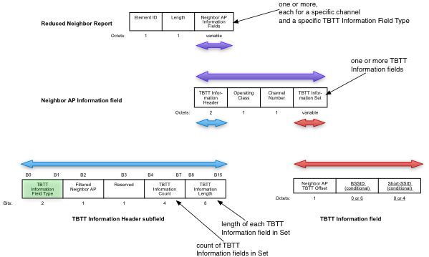
What is TBTT Information Field Type (TIFT)?

Slide 6
802.11ai Draft History
D5-D11: TIFT specification is same as published standard
D5: Revised, based on editorial comment resolution, to final form, with TIFT values 0 and 1 unspecified
D2-D4: TIFT (0/1) differentiates format of TBTT Information field
earlier drafts:
“A STA that receives a Reduced Neighbor Report element in which the TBTT Information Field Type field is 1 and in which the BSSID field is not present may switch to another channel or to another band as specified in the received Operating Class field and Channel Number field. However, if the TBTT Information Field Type is 1 and BSSID field is included in the TBTT Information, the STA may switch to a neighbor AP as specified in the received Operating Class field, Channel Number field, and BSSID field.”
“Value 0 indicates the presence of the informative Neighbor AP Information that is used to help the STA in AP discovery. Value 1 indicates the presence of the Neighbor AP Information that is used to recommend the STA to switch to the channel, the band, or the neighbor AP as specified in the Neighbor AP Information field. Values 2, and 3 are reserved.”
“If the AP considers its operating channel too congested to accommodate STAs, the AP should include one (or more) Neighbor AP Information element with TBTT Information Field Type indicating value 1 to the TBTT Information Header of the Neighbor AP Information field of the Reduced Neighbor AP Report element in the Beacon or FILS Discovery frame or Probe Response frame to redirect the STA conducting initial link setup from current band to other band or to redirect the STA conducting initial link setup to other AP of the current channel.”

Slide 7
TGai Proposals for dedicated RNR channel
•IEEE 802.11-11/1510r0 (Marc Emmelmann)
Non-AP STA conducts active scanning in 2.4GHz band –
receives valid 5GHz channel list
Option a) verify this information via passive scanning on specific 5GHz channel
Option b) directly start link set-up on 5GHz channel
[pointed out numerous challenges]
•IEEE 802.11-12/0546r1 (Dapeng Liu)
802.11ai can use a pre-configured/dedicated channel for passive scan… STA monitoring that particular channel instead of scanning all the channels… Scanning time is reduced since not necessary to change channels and wait…11ai can specify a default channel for passive scan
[pointed out problems to be solved]

Slide 8
Two proposed uses of TIFT
TIFT can provide additional properties of the reported neighbor, indicating whether it:
is an AP that belongs to the same ESS as that of the AP sending this RNR and is suitable for BSS transition and reassociation.
This informs the STA of which neighbors are handover targets (independent of the SSID, which is unreliable).
is a “rendezvous neighbor”, meaning that it identifies, in its own rendezvous RNR, only APs that belong to the same ESS as that of the AP sending this RNR and are suitable for BSS transition and reassociation.
STA can quickly read the rendezvous RNR and learn the right AP with which to associate, instead of having to scan all neighbor APs (which might be large number).
–“Rendezvous neighbor” does not need to be an AP; it could be just a provider of RNR information.
–If the “rendezvous neighbor” is lightly loaded, it can respond quickly to active probing.

Slide 9
Proposal
The TBTT Information Field Type subfield is 2 bits in length and defines the structure of the TBTT Information field. Values 2 and 3 are reserved and set in accordance with Table 9-582a.
Table 9-582a—TBTT Information Field Type
TBTT Information Field Type bit | Meaning
Bit 0 | Each neighbor designated in the Neighbor AP Information field is an AP that belongs to the same ESS as that of the AP sending this Reduced Neighbor Report and is suitable for BSS transition and reassociation.
Bit 1 | Each neighbor designated in the Neighbor AP Information field is a rendezvous neighbor, which identifies, in its own rendezvous Reduced Neighbor Report, only APs that belong to the same ESS as that of the AP sending this Reduced Neighbor Report and are suitable for BSS transition and reassociation.

Slide 10
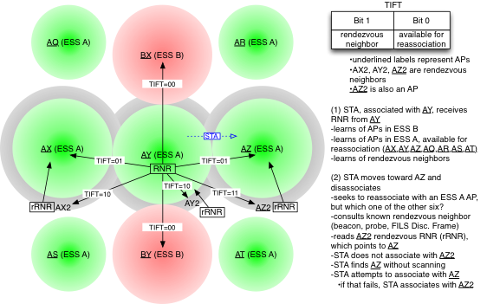
How TIFT might be used

Slide 11
Many possible implementations
In managed high-density enterprise network, STA learns reassociation AP directly without scanning all the neighbor APs.
Many possible rendezvous neighbor designs
could use 2.4 GHz band
rendezvous neighbor could be APs, or not
rendezvous neighbor support active probing only
Rendezvous neighbor ranges could be distinct
rRNR might specify the TBTT, for efficient scanning
Rendezvous neighbor ranges could overlap
might coordinate to avoid simultaneous TBTT, avoiding collision
rRNR might specify the TBTT, for efficient scanning
rRNR might not specify the TBTT, and the STA (knowing the correct channel) would scan for beacon or FILS Discovery Frame, or actively probe
STA detecting multiple rRNRs could choose the strongest

Slide 12
Summary of Proposed Changes
The proposed changes to to §9.4.2.171.2 are incorporated in a separate contribution:
Document IEEE 802.11-17/0667r1

