Slide 1
Simulated WUR Performance in Frequency Selective Channels
Date: 2017-05-07
Authors:

Slide 2
Abstract
The performance in frequency selective channels is simulated to obtain a feeling for robustness to ISI in general and how different parameters impact this robustness
A relatively simple but flexible channel model is used
The results show that ISI is not a problem for the wake-up signal (WUS) when the symbol rate is 250 kb/s, which agrees well with what can be expected from rule-of-thumbs
The loss in frequency diversity for a 4 MHz WUS compared to a 20 MHz signal is also studies and found to be around 2-3 dB for a 4 MHz WUS at 10% “outage”, but significantly more if higher demands are required

Slide 3
Outline
Motivation
Channel modeling
Methodology
Simulation Results
Conclusions

Slide 4
Motivation
According to the PAR, the performance for the WUR should be as good as the primary receiver
In [1], the relative performance was discussed in terms of link budget, i.e., assuming AWGN
Here two additional aspects are considered:
  How much ISI can be handled (without an equalizer).
  How the fading margin varies with BW and delay spread
The simulations also complement [2], where ISI caused by the channel selective filter was discussed

Slide 5
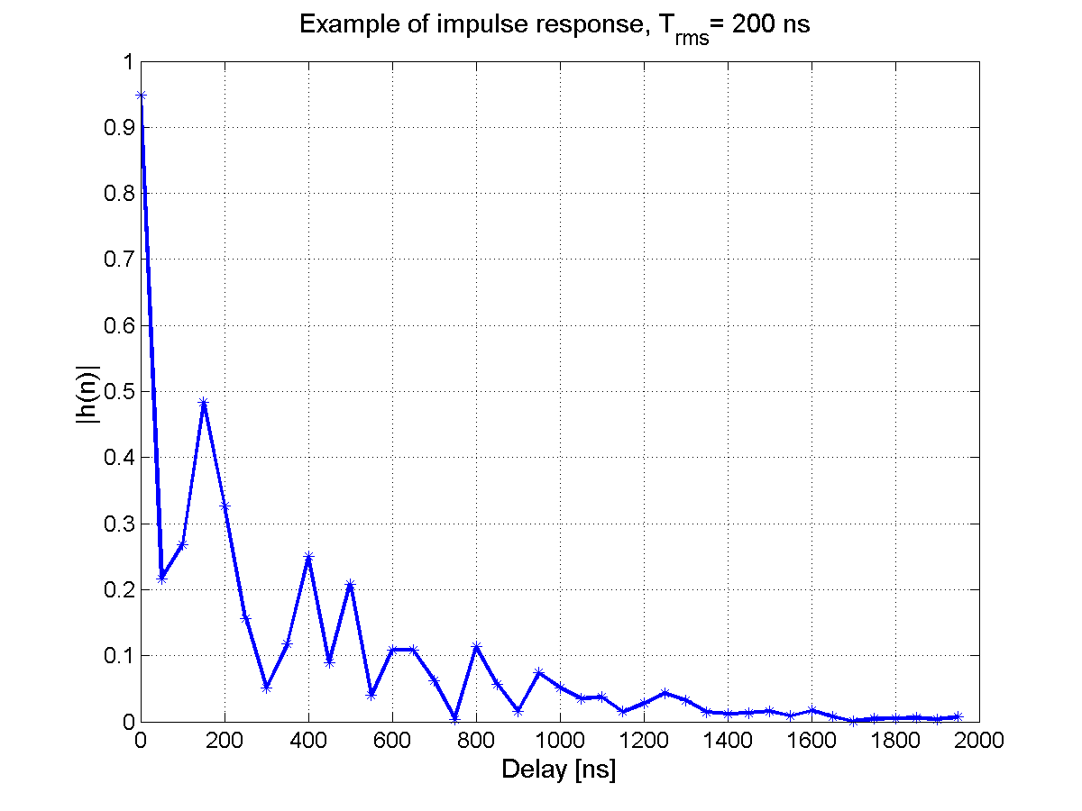
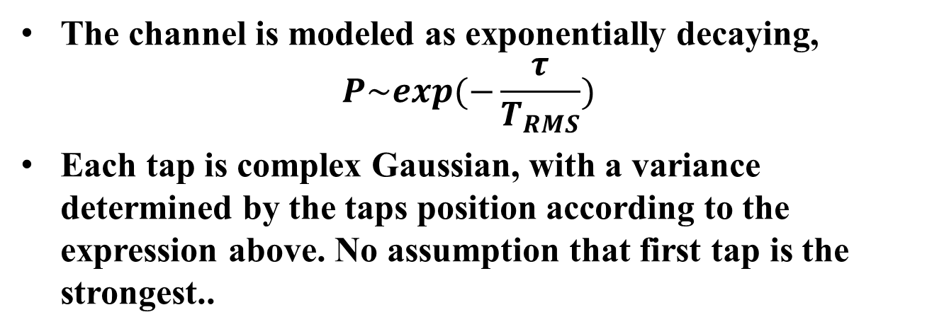
Channel modeling
The channel is modeled as exponentially decaying,
$$P\sim exp(−\frac{τ}{T_{RMS}})$$
Each tap is complex Gaussian, with a variance determined by the taps position according to the expression above. No assumption that first tap is the strongest..

Slide 6
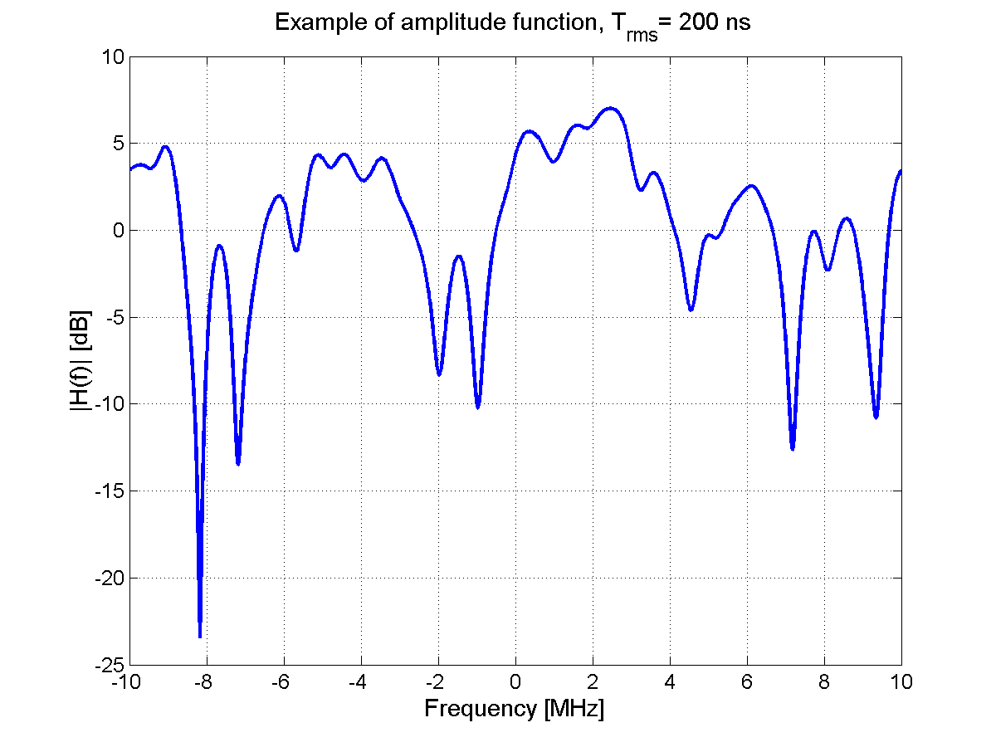
Channel modeling, cont’d
A commonly used rule-of-thumb is that ISI is not a problem if the delay spread < 10% of symbol duration
Most likely the wake-up signal will have a bandwidth much larger than the symbol rate, so it is not clear that the commonly used rule-of-thumb apply

Slide 7
Methodology
When the receiver performance depends more on the channel variation than on the exact BER for one specific channel realization, it is more important to have statistics over channel variations than over noise
10 000 channel realizations are here simulated for each delay spread value
For each realization, however, the WURx is defined to be in outage if a single transmitted packet with 200 bits is not received error free

Slide 8
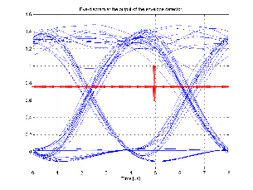
Methodology cont’d
-
Env. Det.
ADC
4
correlator
|
.
|
LPF
ADC run at 4x oversampling relative WUS symbol rate
Correlator (coeff. +-1) operating on signal with DC bias
DC (decision threshold for OOK) estimated at correlator peak
DC subtracted and final down-sampling performed

Slide 9
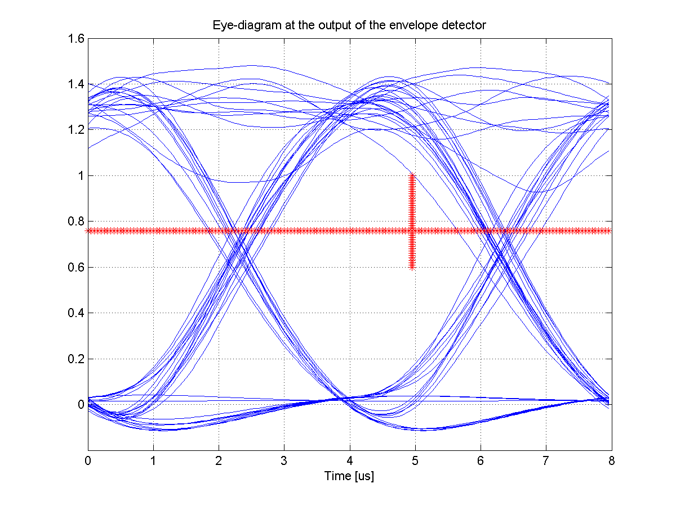
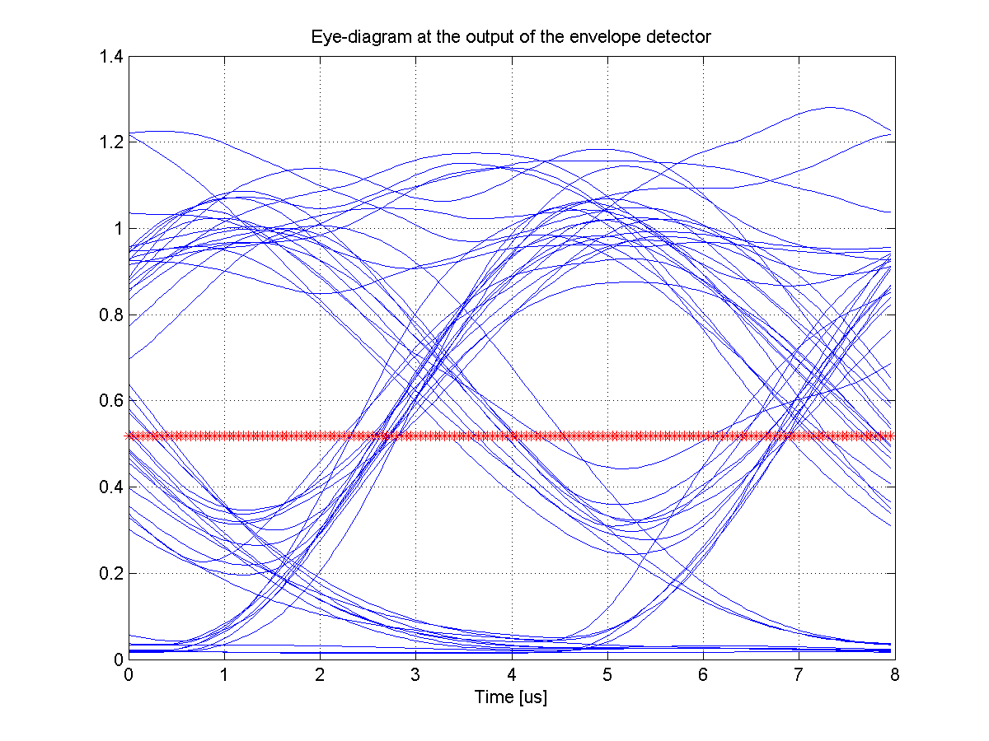
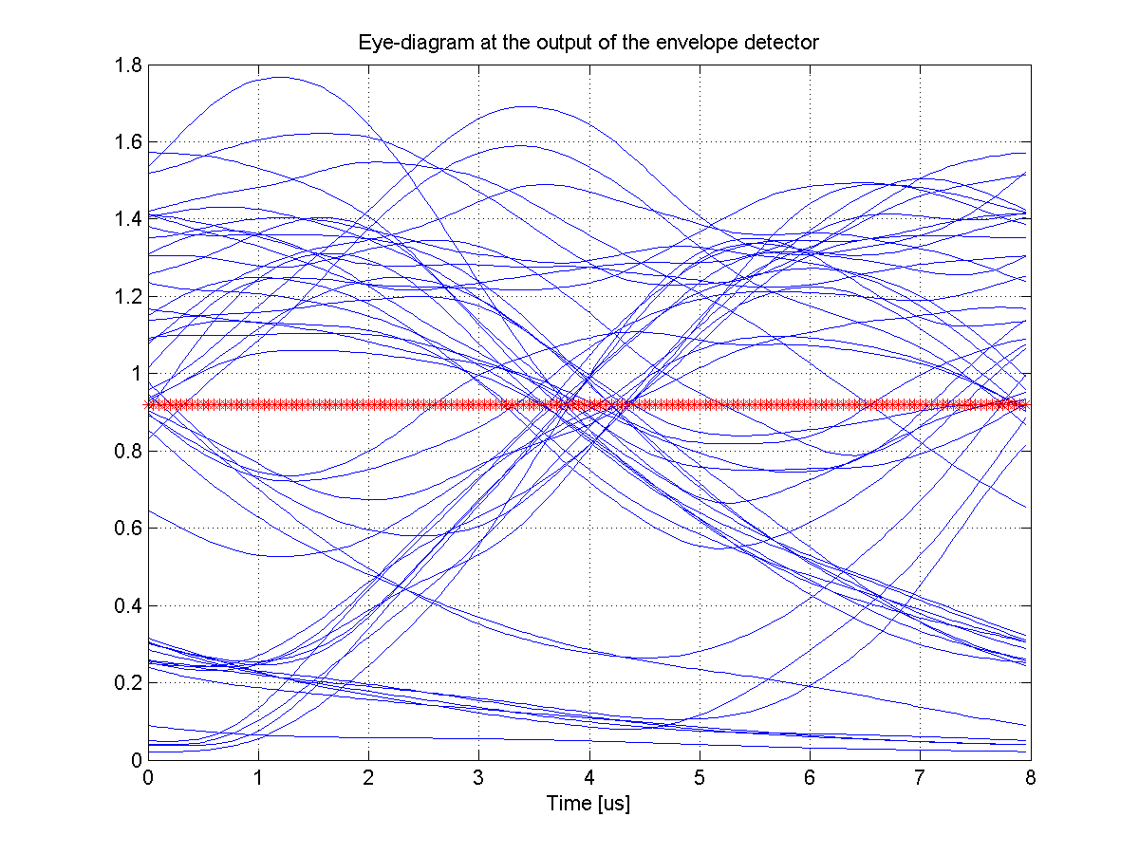
Methodology, cont’d
Simulation done with time synchronization and decision threshold estimation ON
Eye-diagram above are for a noise less case with RMS delay spread: 0,1, and 2 us
Red line is the estimated threshold used for decision

Slide 10
Simulation results
There are in particular two things that have been studied
  How much ISI can be handled
  How is the bandwidth impacting the fading margin
The ISI is studied
  without noise, in which case an error is due to that ISI closes the eye
  with noise to study the degradation in SNR due to ISI
The fading margin is studied by considering how the required SNR depends on BW

Slide 11
Simulation results, cont’d
The WUS is generated using a 64 point IFFT running at 20 MHz, so 250 kb/s
SNR defined over 20 MHz, as agreed in [3]
A 64 bits syncword is used for time synchronization and decision threshold estimation. As discussed in [4]

Slide 12
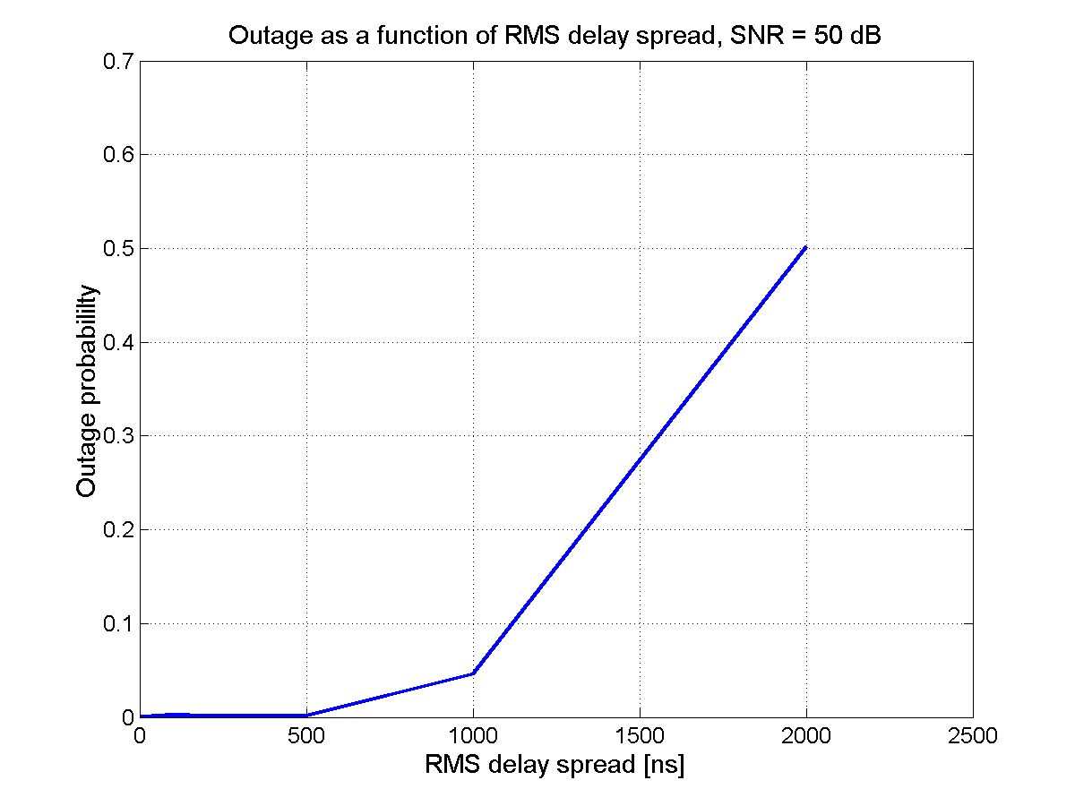
Noiseless case
Without noise, the eye starts to close between 1 and 2 us rms delay spread
Due to threshold estimation error, errors start to occur (slightly) before the eye is closed

Slide 13
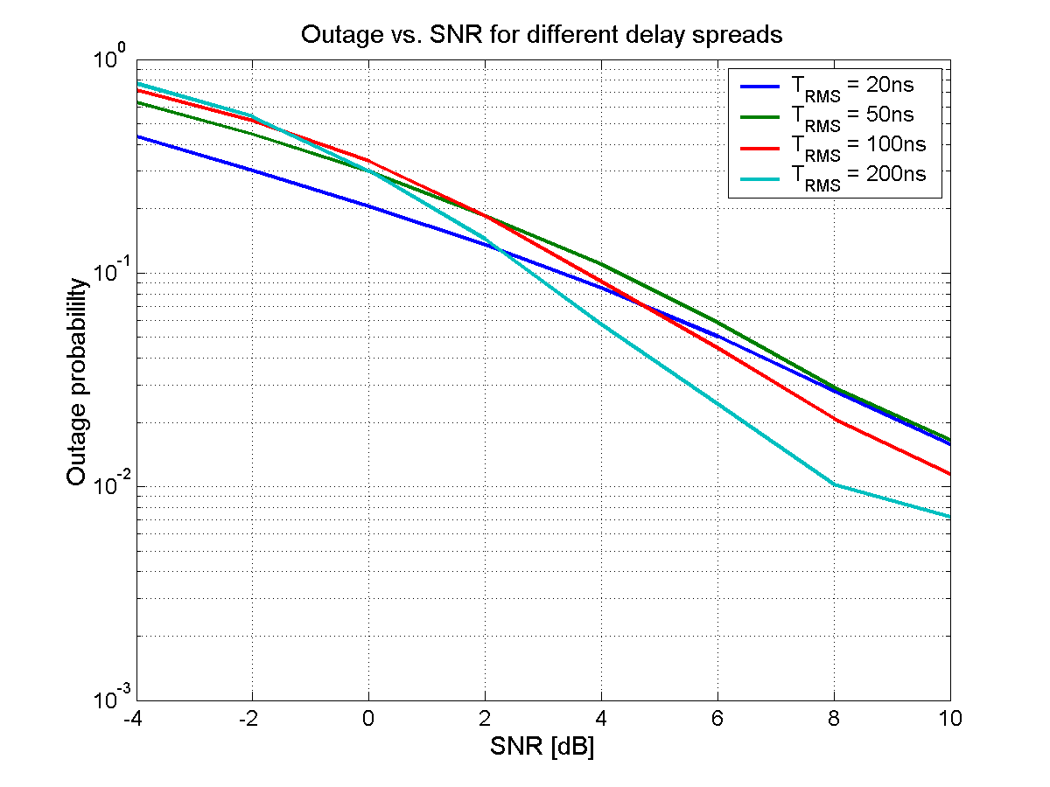
Impact of delay spread, 4 MHz WUS
For (very) low SNR, even a small reduction of the eye-opening due to ISI has a detrimental impact. For larger SNR, it is beneficial to have frequency diversity
ISI not a problem. Lack of frequency diversity may be…

Slide 14
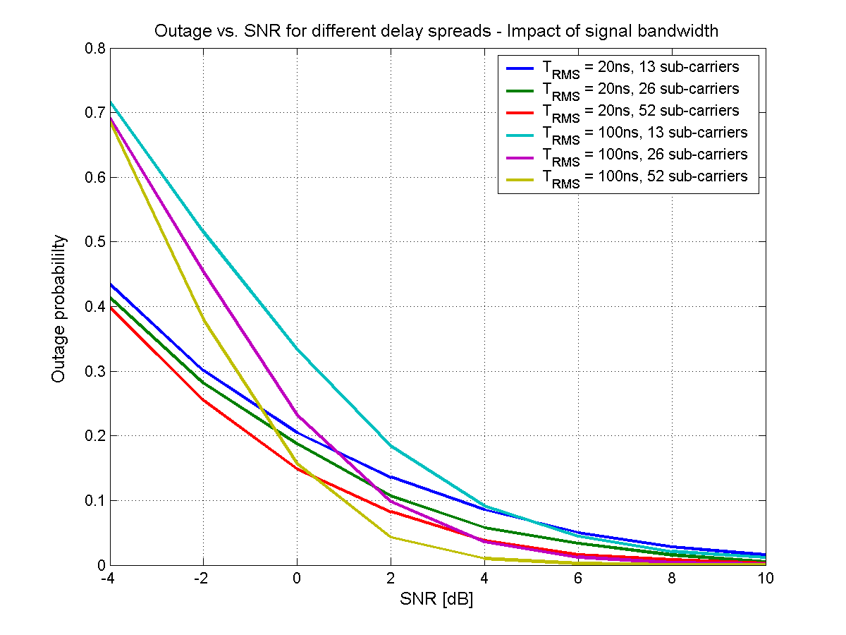
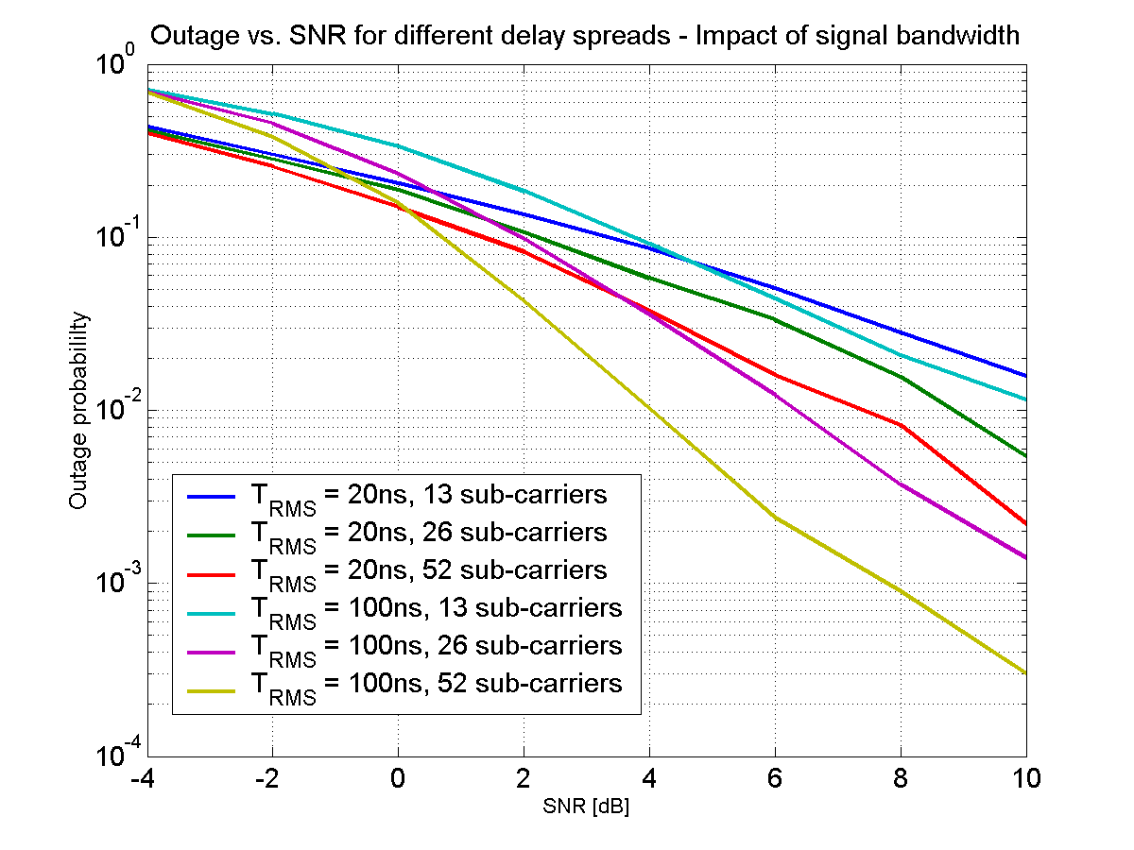
Impact of signal bandwidth
For 10% outage, the loss by only having a 4 MHz BW is limited to about 2 dB.
However, for use cases with fixed installation, it seems 0.1% outage would be a more reasonable figure, and then the loss > 5 dB

Slide 15
Impact of channel selective filter
-
BPF
Env. Det.
ADC
4
correlator
|
.
|
LPF
To improve the SNR at the input to the envelope detector, a 4 MHz wide BPF is used to filter out the noise outside the signal bandwidth
In [2], the impact of a channel selective filter was discussed in terms of introduced ISI

Slide 16
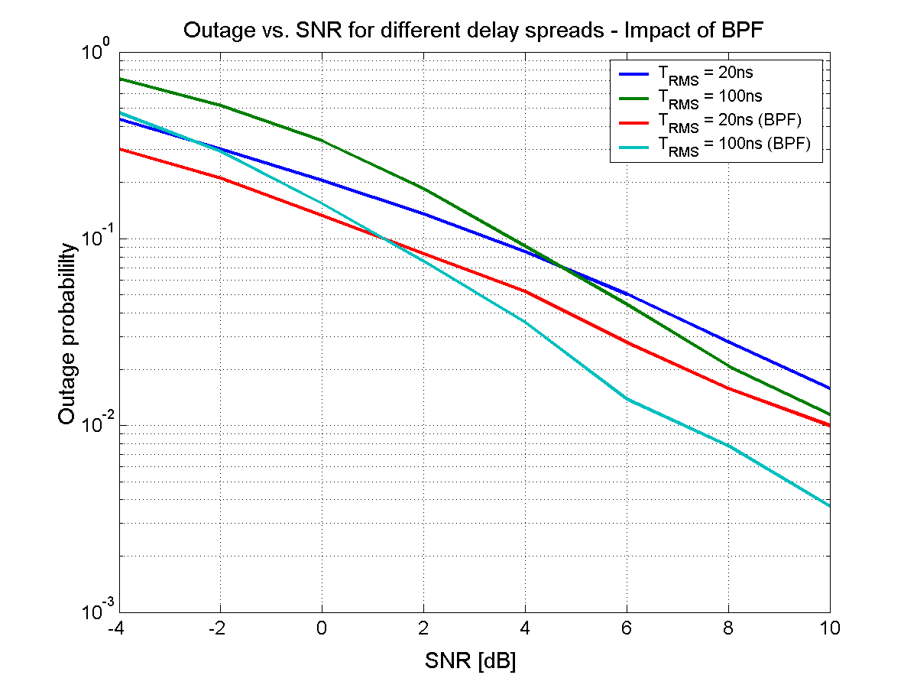
Impact of channel selective filter
The gain by removing noise is about 2-3 dB. Rather independent of the delay spread
For (unreasonably) large delay spread, one can expect it could potentially degrade, but not for practical values

Slide 17
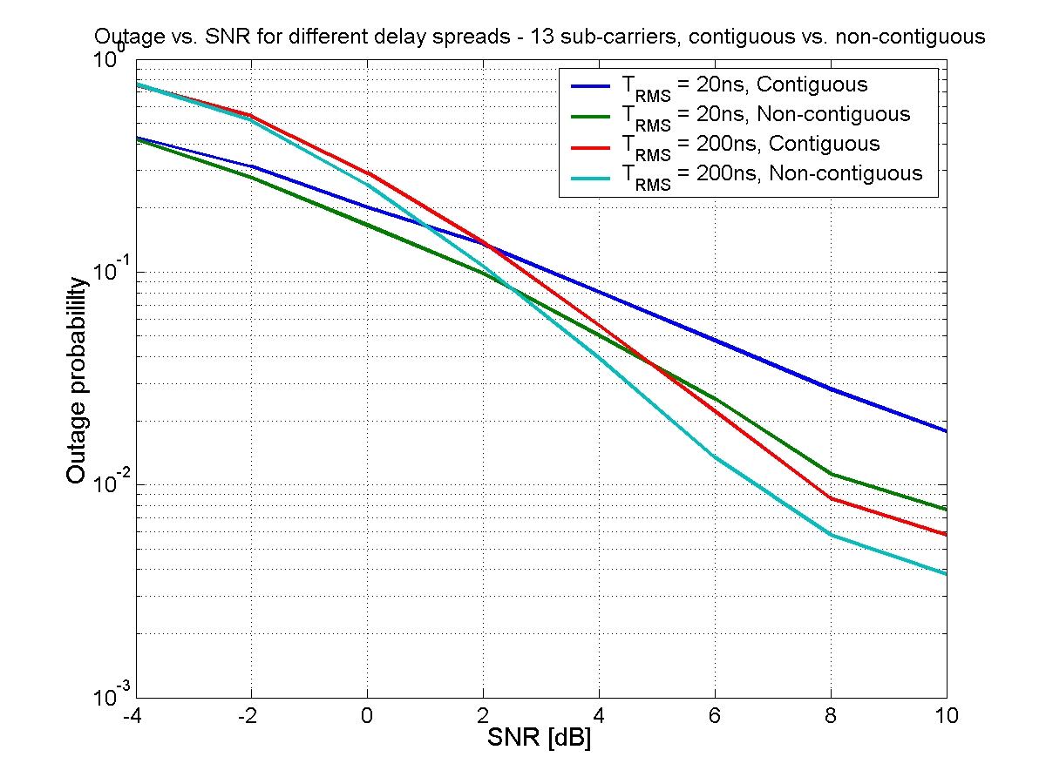
Non-contiguous sub-carrier allocation
6
13
7
5
10 MHz
As a simple test, 6 + 7 sub-carriers were allocated to the WUS, about 10 MHz apart
The gain from the diversity is seen when the delay spread is small
Using the idea in [4], and multiplexing the WUS with data using OFDMA, this is easily achieved…

Slide 18
Conclusions
ISI not a problem for expected delay spreads, say below 500ns RMS for data rate of 250kb/s. This is very much in-line with the 10% rule-of-thumb
What instead potentially is more of a problem is that the channel may be non-selective and by that require a larger fading margin than the 20 MHz data signal
Waveform optimization does not seem justified due to ISI, as we are far from where it seems to be a problem
Estimation of the threshold seems to be the major imperfection, which speaks in favor for Manchester Coding

Slide 19
References
11-17/0365r0 “Regulations and Noise Figure – Impact on SNR”, Steve Shellhammer and bin Tian
11-17/0376r0, “Waveform Generation for Waveform Coding,” Junghoon Suh
11-17/0188r4 “Simulation Scenario and Evaluation Methodology”, Shahrnaz Azizi et al.
11-17/0365r0 “Concurrent transmission of data and a wake-up signal in 802.11ax – Follow-up”, Leif Wilhelmsson and Miguel Lopez

