Slide 1
WUR PHY Performance Study with
Phase Noise and ACI
Date: 2017-5-8
Authors:

Slide 2
Abstract
In this presentation, wake-up receiver PHY performance is evaluated with the phase noise model proposed in [11-17/326r0] and ACI (adjacent channel interference)

Slide 3
Tx Setup
Packet length: 32 bits (assumption: 16-bit ID, 8-bit payload, 8-bit CRC)
WUR signal OOK pulse:
  BW = 4.06 MHz (13 tones including DC)
  13 L-STF coefficients {1+1i -1-1i 1+1i -1-1i -1-1i 1+1i 0 -1-1i -1-1i 1+1i 1+1i 1+1i 1+1i}
  Symbol period = 4 µsec (including 0.8 µsec CP)
Manchester coding (MC)
  Code rate ½ (MC ½): 125 kbps
    Bit 1 → [1 0], i.e. 4 µsec on, 4 µsec off
    Bit 0 → [0 1], i.e. 4 µsec off, 4 µsec on
  Code rate 1/4 (MC ¼): 62.5 kbps
    Bit 1 → [1 0 1 0], i.e. 4 µsec on, 4 µsec off, 4 µsec on, 4 µsec off
    Bit 0 → [0 1 0 1], i.e. 4 µsec off, 4 µsec on, 4 µsec off, 4 µsec on
  MC ½ with BCC ½ : 62.5 kbps

Slide 4
Rx Setup
4 MHz LPF (IIR) – generated using MATLAB
  Numerator order=1, denominator order=1
  Passband freq. = 2MHz, Stopband freq.=6MHz, Sampling freq. =160MHz
WUR with in-phase only (single rx chain) unless indicated as both I/Q
Channels: AWGN, Channel D and B
Phase noise model [11-17/326r0]
  Power consumption of LO: 20 uW, 75 uW, 1mW, no phase noise
  Worse phase noise as power consumption decreases (see backup slides)
2.4 GHz band operation
ACI: +16 dB higher than the received signal
  (1) 25 MHz and (2) 20 MHz (3) 16 MHz (4) 12 MHz separated
SNR is measured after the 4 MHz LPF and 4 MHz sampling
Measured PER

Slide 5
Manchester Coding ½ with Phase Noise
AWGN, Channel D and B
Performance degradation is ~ 0.5dB compared to the no phase noise case

Slide 6
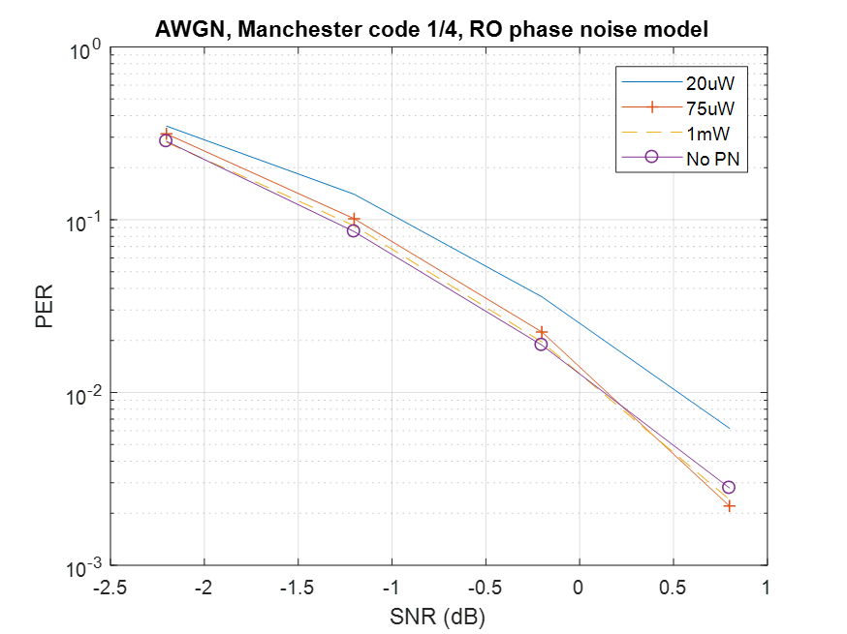
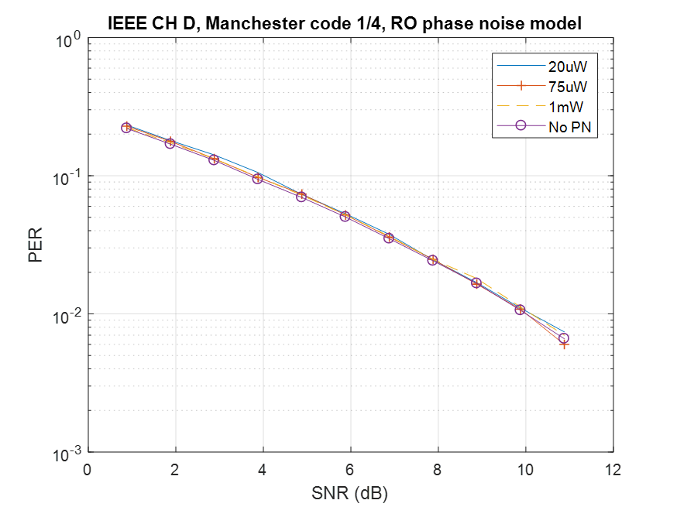
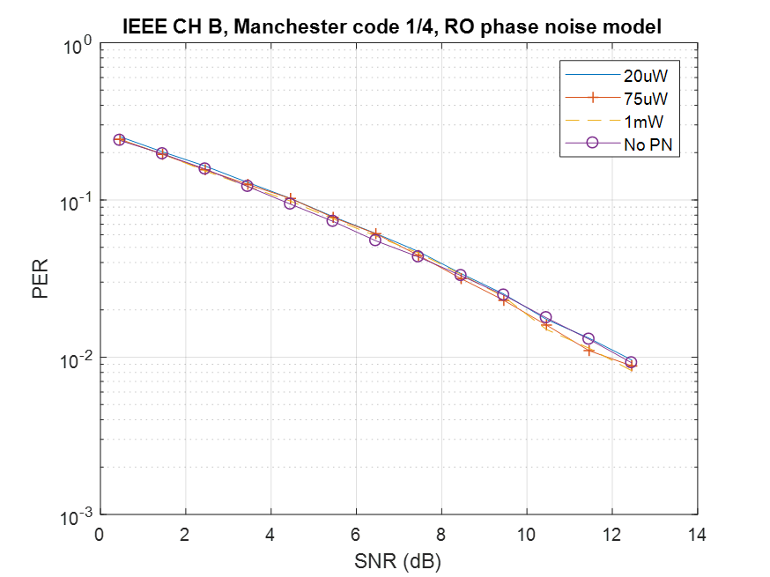
Manchester Coding ¼ with Phase Noise
AWGN, Channel D and B
Performance degradation is ~ 0.5dB compared to the no phase noise case

Slide 7
Manchester Coding 1/2, Phase Noise,
ACI +16dB
AWGN, Channel D and B
ACI +16dB higher than the received signal, 25 MHz separation
Performance degradation ~ 1dB compared to the no ACI cases

Slide 8
Manchester Coding 1/4, Phase Noise,
ACI +16dB
AWGN, Channel D and B
ACI +16dB higher than the received signal, 25 MHz separation
Performance degradation ~ 0.5 dB compared to the no ACI cases

Slide 9
Manchester Code ¼ with Phase Noise and ACI +16dB
AWGN, Channel D and B
Ch B
Ch B
Ch D
Ch D
AWGN
AWGN

Slide 10
Manchester Code ½ and Manchester Code ¼
MC ¼ is ~2dB better than MC ½
~2dB
Ch B
Ch B
Ch D
Ch D
AWGN
AWGN

Slide 11
ACI Separation (25 MHz versus 20 MHz)
AWGN, MC ¼, ACI +16dB
Simple LPF causing performance degradation

Slide 12
ACI Separation (less than 20 MHz)
AWGN, MC ¼, ACI +16dB
Phase noise (20 uW)
ACI separation: 12 MHz and 16 MHz
Performance degradation worsens

Slide 13
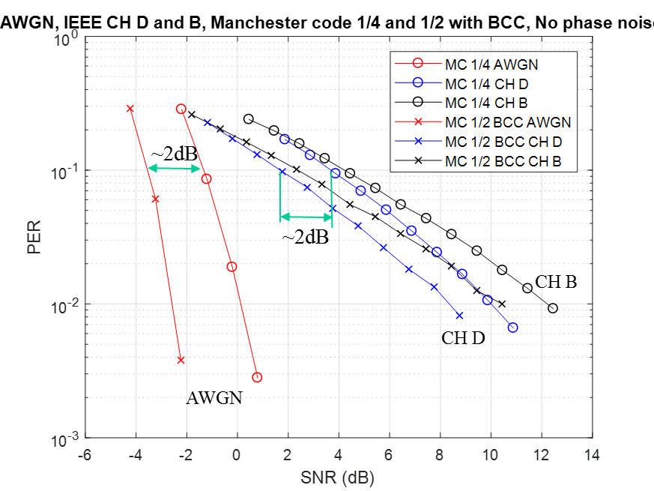
Comparison between Manchester Code ¼ and Manchester Code ½ + BCC (soft decision)
Packet length: 32 bits
BCC encoder:
  1/2 rate
  Constraint length k=7
  Code gen.:[171,133]
  Appended 6 zeros (tail bits) to the wake-up packet
Viterbi decoder:
  Soft (unquantized) decoding
  Trace-back depth: 34 (default value in MATLAB)
At PER =10%, MC ½+BCC is ~2dB better than MC ¼

Slide 14
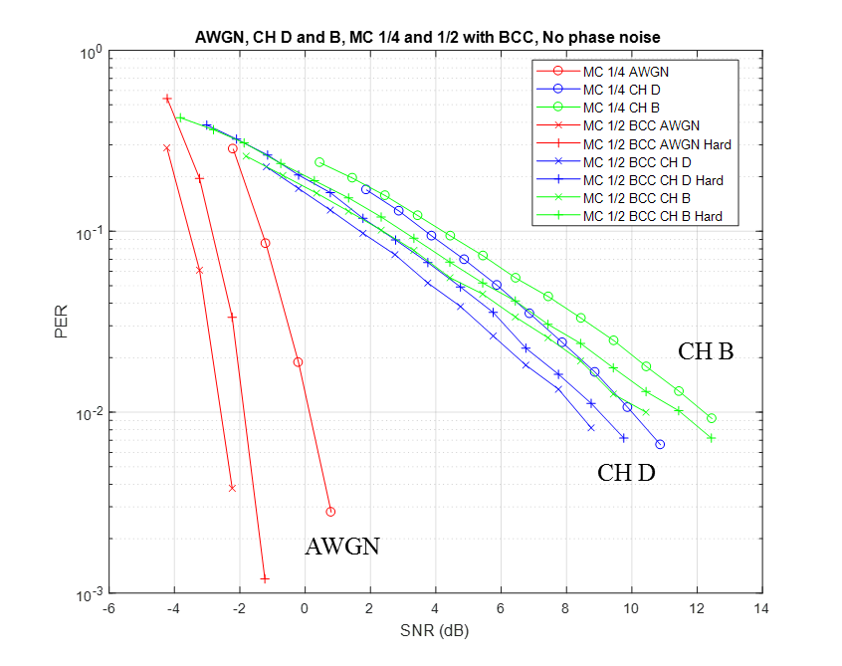
Comparison between Manchester Code ¼ and Manchester Code ½ + BCC (hard decision)
The simulation setup is same as the soft decision case
The hard decision case shows ~ 0.6 dB performance degradation compared to the soft decision case
  MC ½+BCC’s gain over MC ¼ decreases to ~1.4dB

Slide 15
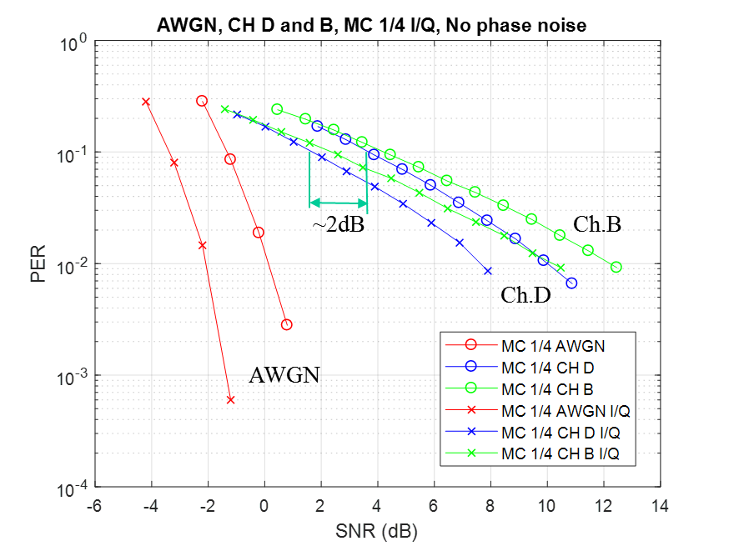
Comparison between In-phase only and both I/Q WURx
MC ¼, no phase noise
Wake-up receiver using I/Q performs ~2dB better than the in-phase only case
  Same envelop detector

Slide 16
Performance Comparison between
MR (main radio) and WUR
SNR measured after the 4 MHz LPF and 4 MHz sampling
  SNR = P_{rx} – P_{noise} – NF
  where P_{rx} is received power, P_{noise} = -174+10log10(BW) is noise power, BW is the received signal bandwidth, NF is noise figure
 | MR (MCS0) (1) | WUR (MC ¼ I-only) (2) | Gain/Loss (1)-(2)
BW | 20MHz | 4MHz
NF | 10 dB | 10 + 8 dB | -8 dB
P_{noise} | -101 dBm | -108 dBm | +7 dB
SNR @ 10% PER (Ch. D) | 9 dB (100 bytes) [11-15/1308r0] | 3.7 dB (32 bits) (1.7 dB using I/Q) | +5.3 dB (+7.3 dB)
P_{rx} | -82 dBm | -86.3 dBm (-88.3 dBm using I/Q) | + 4.3 dB (+ 6.3 dB using I/Q)
[11-15/1308r0] Minyoung Park, et.al., “Link Budget Analysis”

Slide 17
Summary and Conclusions
The 4 MHz WUR signal design with a simple 4 MHz LPF effectively mitigates effect of phase noise and ACI
  Phase noise (the 20 uW case) contributes 0.5 dB PER performance degradation
  ACI (+16dB, 25MHz) contributes 1dB PER performance degradation
In-phase only WUR using MC ¼ shows 4.3 dB better receive sensitivity than MR
  This compensates the 4 dB lower maximum transmit power limit in EU and China in the 2.4 GHz band
    Actually AP’s transmit power (e.g. 20 dBm) is much higher than STA’s transmit power (e.g. 15 dBm) and the transmission range is limited by the transmission power of the STA
  Using both I/Q or BCC can increase the gain by 2 dB (but with increased power consumption)
  → WUR using I/Q or BCC shows 6.3 dB better receive sensitivity than MR
WUR operation in the 5 GHz band has the following challenges
  Need to consider the DFS band
  LO consumes more power (~ 2x)
  Max transmit power is 7 dB less than the 20 MHz signal due to the regulations

Slide 18
Backup

Slide 19
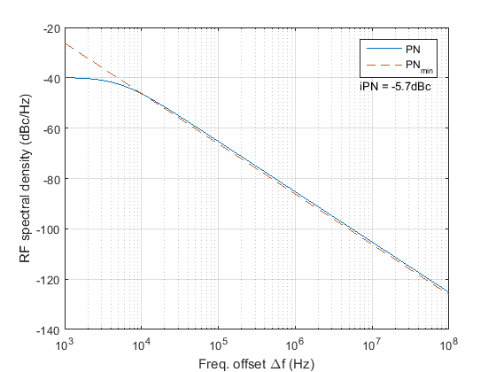
Finding the Constant c for a Given LO Power Consumption
Step 1: Choose power consumption P_{min}
Step 2: Find constant c that makes PN overlap with PN_{min}
Example 1:
  f₀ = 2.437GHz
  PNmin(Δf ) at Pmin=75µW
  PN(Δf ) with c = 0.5e-15
  Integrated PN (iPN) =-5.7dBc
    10 KHz ~ 2 MHz

Slide 20
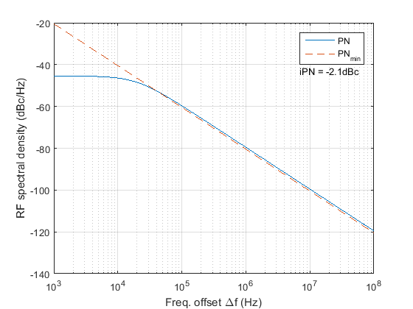
Example 2: P_{min}=20 µW
Parameters
  f₀ = 2.437 GHz
  PN_{min}(Δf ) at P_{min}=20 µW
  PN(Δf ) with c = 1.875e-15
  Integrated PN (iPN) =-2.1dBc
    10 KHz ~ 2 MHz

Slide 21
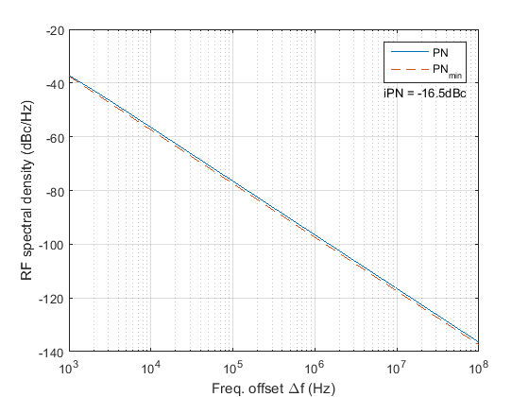
Example 3: P_{min}=1mW
Parameters
  f₀ = 2.437GHz
  PN_{min}(Δf) at P_{min}=1 mW
  PN(Δf) with c = 3.75e-17
  Integrated PN (iPN) =-16.5dBc
    10 KHz ~ 2 MHz

Slide 22
Discrete Time Phase Noise Model of White Frequency Noise [2]
Ref. [2] describes how to generate phase noise due to the white frequency noise for a discrete time based simulation based on [3,6]:
Definitions
  is the phase noise at index k
  f₀ is the nominal oscillator frequency (i.e. center frequency)
  c is the constant that determines the rate at which the variance of an oscillator increases with time due to the white frequency noise [4]
  is the simulation time-step
  is the independent standard Gaussian random variable
Eq. (3) only considers white frequency noise (i.e. white Gaussian noise)
For the evaluation of 802.11ba receiver performance, add the phase noise generated by eq. (3) to a received WUR signal
Ref. [5] provides a MATLAB code that generates phase noise using eq. (3)
(3)

Slide 23
Proposed 802.11ba Phase Noise Model
Consider the white frequency noise as the source of the phase noise
Choose a power consumption (P_{min}) of LO (i.e. Ring oscillator) of a wake-up receiver (e.g. P_{min}= 20 µW)
Use the minimum phase noise model [eq. (1) in Slide 4] shown in [3] to estimate the phase noise performance (PN_{min}) of a Ring oscillator at P_{min}
Use the phase noise model [eq. (2) in Slide 5] shown in [2,4] and find a constant c that overlaps the phase noise performance (PN) estimated from eq. (2) and PN_{min}
Use eq. (3) in Slide 8 to generate the phase noise and add the phase noise to a received wake-up signal for the evaluation of 802.11ba

Slide 24
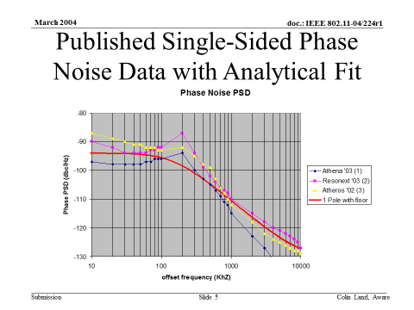
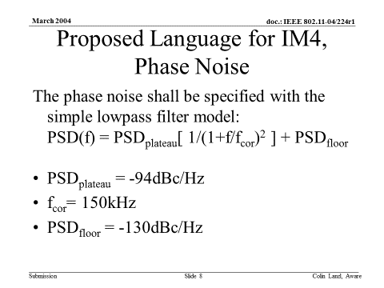
TGn Phase Noise Model [11-04/224r1]

Slide 25
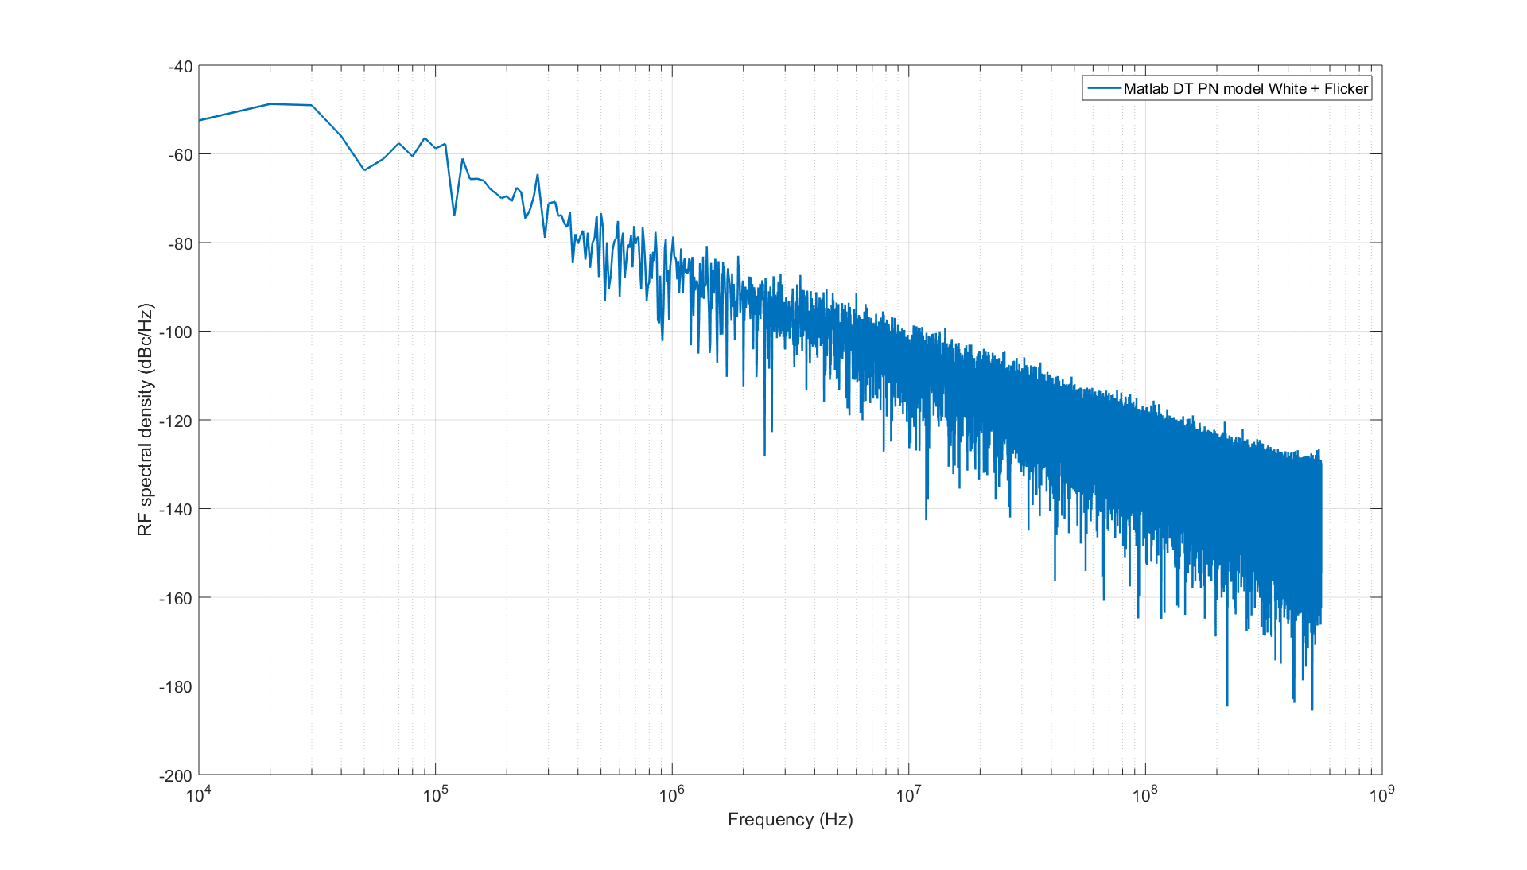
Phase Noise Profile of a Ring Oscillator [2]
Example: 65 nm, 75 µW power consumption
[2] O. Khan; B. Wheeler; F. Maksimovic; D. Burnett; A. M. Niknejad; K. Pister, "Modeling the Impact of Phase Noise on the Performance of Crystal-Free Radios," in IEEE Transactions on Circuits and Systems II: Express Briefs , vol.PP, no.99, pp.1-1

Slide 26
References
[1] Minyoung Park, et.al., “WUR phase noise model study,” IEEE 802.11-17/0026r0
[2] O. Khan; B. Wheeler; F. Maksimovic; D. Burnett; A. M. Niknejad; K. Pister, "Modeling the Impact of Phase Noise on the Performance of Crystal-Free Radios," in IEEE Transactions on Circuits and Systems II: Express Briefs , vol.PP, no.99, pp.1-1
[3] Navid, T. H. Lee, R. W. Dutton, “Minimum Achievable Phase Noise of RC Oscillators”, JSSC 2005
[4] A. Demir, A. Mehrotra, and J. Roychowdhury., "Phase noise in oscillators: a unifying theory and numerical methods for characterization," Transactions on Circuits and Systems I: Fundamental Theory and Applications, vol. 47, no. 5, pp. 655-674, May 2000.
[5] Osama Khan. Free Running Oscillator. [Online]. https://github.com/openwsn-berkeley/free-running-oscillator/blob/master/free-running-oscillator.m
[6] David C. Lee, "Modeling Timing Jitter in Oscillators," , 2001.

