Slide 1
Overview on Use Cases for Light Communication
Date: 2017-05-02
Authors:

Slide 2
Abstract
This presentation contains use cases for Optical Wireless Communication (OWC) / Light Communication (LC) classified into different application areas:
Visible Light Communication (VLC),
Free-Space Optics (FSO),
and miscellaneous applications.

Slide 3
Introduction
Light Communication (LC) offers new solutions to support existing or enable new use cases in different fields of communication by using the optical spectrum.
Important use cases are addressing connectivity or lower distance applications (Screen-2-Camera, Visible Light Communication).
Free-space optics can also provide outdoor solutions for distances of hundreds of meters.
LC is also of interest for specific outdoor solutions for long-range communications (airborne, submarine).

Slide 4


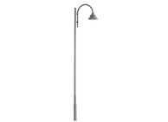
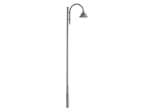
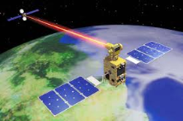



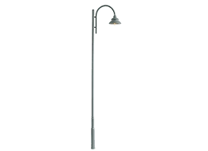
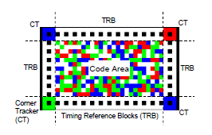


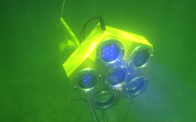

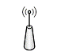
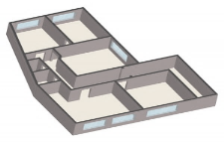

Visible Light /Optical Wireless Communications
Screen-2-Camera
Illumination
Free Space Optics
Other
In- & Outdoor (< 1 m)
Indoor (< 10 m)
Outdoor (< 20 m)
Outdoor (< 500 m)
Outdoor (> 500 m)
Device-2-Device
Office Lighting
Streetlight-2-Customer
WTTB/H
Airborne Communication
EMI sensitive areas (e.g. plane cabins)
Color Barcodes
Vehicle-2-Vehicle
Mobile Backhaul
Submarine Communication
Indoor Localisation

Slide 5
Visible Light Communication (Illumination)
Illumination
Indoor
Distance: < 10 m
Office lighting
Plane cabins
Localisation
Outdoor
Distance: < 20 m
Streetlight-to-device
Vehicle-to-vehicle
Indoor (< 10 m)
Outdoor (< 20 m)
Office Lighting
Streetlight-2-Customer
EMI sensitive areas (e.g. plane cabins)
Vehicle-2-Vehicle
Indoor Localisation

Slide 6
Free-Space Optics
Free Space Optics
Outdoor
Distance: < 500 m
Wireless-to-the-Building/Home (WTTB/H) access solutions
Mobile Backhaul in different scenarios (e.g. macro cell, small cell, WTTB/H)
Outdoor (< 500 m)
WTTB/H
Mobile Backhaul

Slide 7
Screen-to-Camera
Screen-2-Camera
Indoor & Outdoor
Distance: < 1 m
Device-to-Device communication
Color Barcodes
In- & Outdoor (< 1 m)
Device-2-Device
Color Barcodes

Slide 8


Other application areas
Other
Outdoor
Distance: > 500 m
Airborne communication (e.g. inter-satellite)
Submarine communication
Outdoor (> 500 m)
Airborne Communication
Submarine Communication

Slide 9
Summary
Use cases of Optical Wireless Communication / Light Communication presented from different application areas.
Promising new use cases identified in broadband access and backhaul.
Focus in the TIG “Light Communication” is on Visible Light Communication.
Standardized solutions required for incorporation in complex and heterogeneous network infrastructures.

Slide 10
References
Penguin Automated Systems Inc. (Penguin ASI), Naughton, ON, Canada, 2012. [Online]. Available: http://www.penguinasi.com
Hao et al., “COBRA: Color Barcode Streaming for Smartphone Systems,” MobiSys ’12. New York, NY, USA: ACM, 2012, pp. 85–98.
OICETS (Optical Interorbit Communications Engineering Test Satellite) / Kirari https://directory.eoportal.org/web/eoportal/satellite-missions/o/oicets
O. Bouchet, et al “Visible-light communication system enabling 73 Mb/s data streaming,” IEEE Globecom 2010, Miami, Florida, December, 2010.

