Slide 1
Polling for MU Measurements
Date: 2017-19-04
Authors:
Chittabrata Ghosh

Slide 2
Abstract
In this presentation, we propose a mechanism that enables the AP in allocating resources to only those STAs that intend to perform 11az-based measurement in measurement phase
Chittabrata Ghosh

Slide 3
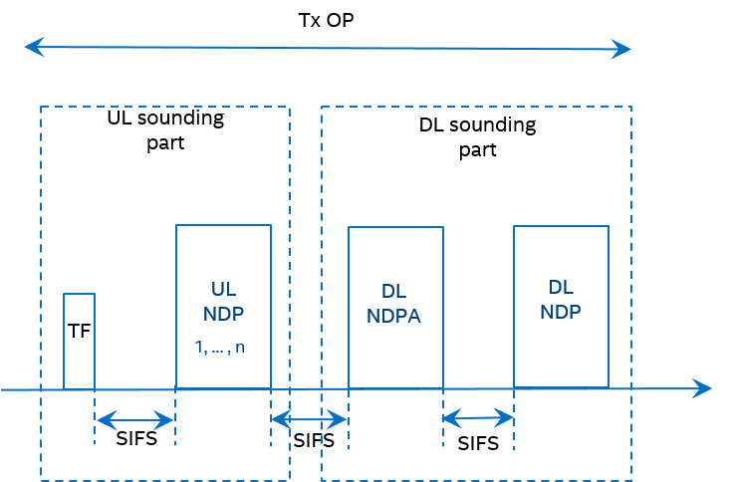
Introduction
April 2017
doc.: IEEE 802.11-17/0598r1
TGaz has agreed on using NDP-based sounding mechanism for measurement in the measurement phase
Within a single TXOP, the UL sounding is followed by the DL sounding
In UL sounding, UL NDPs are solicited from STAs assigned resources identified in the Trigger frame
However, for efficient resource allocation, the AP needs to identify the STAs that intend to perform measurements
Chittabrata Ghosh

Slide 4
Issues with On Channel Availability for Measurement Phase
April 2017
doc.: IEEE 802.11-17/0598r1
An initiating STA might establish multiple FTM sessions on same or different channels with different responding STAs with the considerations:
Larger window size results in frequent scheduling conflicts (due to concurrent FTM sessions), leading to high power consumption and may impact QoS on associated data connection
Spectral inefficiency since single STA in SU mode takes entire BW to signal on channel availability
Scheduled burts instance
Conflicting duration
Chittabrata Ghosh

Slide 5
Numerical Computation of one NDP-based Measurement Sequence
April 2017
doc.: IEEE 802.11-17/0598r1
We assume 5ms might be typical duration of a SP
NDP-based Measurement duration = 100us*4+4*SIFS = 450us ~ 0.5ms
Short NDP feedback: [100us + SIFS + 75us] = 200us
Short NDP + Measurement phase = 450+200 = 600us
LMR feedback duration = 120us (for DL/UL)
2 LMRs (UL and DL) = 240us;
Each measurement with feedback duration = 840us
Chittabrata Ghosh

Slide 6
Motivation for Short NDP Feedback
April 2017
doc.: IEEE 802.11-17/0598r1
Increasing the success probability of resource allocation for measurement phase
Polling a large subset (i.e., 144 in 40MHz) of STAs to receive ranging / measurement requests from a small subset (i.e., 14 STAs assuming 10% success) of STAs
Varying channel conditions – different number of measurements per fix (x, y, z coordinates) requires a reliable range / distance
Dynamic requirement of measurements with mobility
Mobility between 2 STAs require dynamic measurements with no channel condition change– refresh rate of fix, i.e., constant number of measurements per fix (x, y, z coordinates)
Minimize the on channel time, be power efficient, and QoS friendly
Chittabrata Ghosh

Slide 7
Illustration of a single NDP Short Feedback with Multiple NDP-based Measurement Phases
April 2017
doc.: IEEE 802.11-17/0598r1
Short NDP Feedback
UL Sounding and DL Sounding for first set of STAs
UL Sounding and DL Sounding for second set of STAs
MU LMR Feedback Sequence
SIFS
SIFS
SIFS
(Assume 10% polling success)
[14 STAs respond for
measurement request]
(8 STAs have resource allocation for measurement )
(6 STAs have resource allocation for measurement )
(14 STAs respond with LMR feedback)
(First wake-time for 14 STAs)
(Doze time for 8 STAs)
(Doze time for 6 STAs)
(Wake-time for 6 STAs)
(On-channel availability for 14 STAs)
Chittabrata Ghosh

Slide 8
Proposed Solution to Address Issues for On Channel Availability in 11az for Efficient Resource Allocation
April 2017
doc.: IEEE 802.11-17/0598r1
AP needs to know STA is available on channel prior to Ranging Resource allocation (UL and DL) in a spectrum and power efficient manner:
Preferably reuses 802.11ax feature(s)
Allow spectral efficient indication for “On Channel Availability”
Prevents waste of medium and minimizes measurements window
Scheduled burts instance
Conflicting duration
Chittabrata Ghosh

Slide 9
Proposed Mechanism: Short NDP Feedback in 802.11ax for On Channel Availability Indication
April 2017
doc.: IEEE 802.11-17/0598r1
NDP Short Feedback for Ranging:
Short feedback can serve requests for a simple YES/NO questions from 72 clients in a 20MHz and 144 in a 40MHz and up to 288 in 80MHz sufficiently large to support large number of STAs as needed by MU TF based operation of Ranging
An ID is assigned a-priori to each STA that is used for resource allocation in the Trigger frame that initiates the NDP Short Feedback frame exchange
New question in the NDP Short feedback “Would you like to Range?”
If STA wants to be allocated Ranging Measurement resources it indicates YES
If no resource are required or STA not available On Channel it does not respond
Immediately following the NDP Short feedback for ranging is the NDP sounding-based measurement phase
Chittabrata Ghosh

Slide 10
Proposed Short NDP Sequence with 11az-based MU Measurement Sequence
April 2017
doc.: IEEE 802.11-17/0598r1
TxOP
NDP Short Feedback
Frequency
TF
Spatial
Based on short NDP feedback requests for ranging from STAs, the AP allocates ranging resource to all or a subset of the STAs in the Trigger frame that initiates UL sounding
The feedback mechanism is within the TxOP of the sounding-based measurement frame exchange
Chittabrata Ghosh

Slide 11
Summary
April 2017
doc.: IEEE 802.11-17/0598r1
We have identified the inefficiency of scheduling FTM burst instances leading to temporal conflicts of concurrent FTM bursts
To alleviate this problem, we have proposed to use the NDP short feedback mechanism defined in 802.11ax for the AP to identify ranging requests from STAs
Chittabrata Ghosh

Slide 12
Straw poll
April 2017
doc.: IEEE 802.11-17/0598r1
Do you support to define a polling phase for ranging request feedback prior to NDP sounding-based measurement?
Chittabrata Ghosh

