Slide 1
Channel Estimation Field for EDMG OFDM PHY in 11ay
Date: 2017-04-14
Authors:

Slide 2
Introduction
This presentation proposes a design of the Channel Estimation Field (CEF) for EDMG OFDM PHY for PPDU transmission over a 2.16 GHz channel in 11ay.

Slide 3
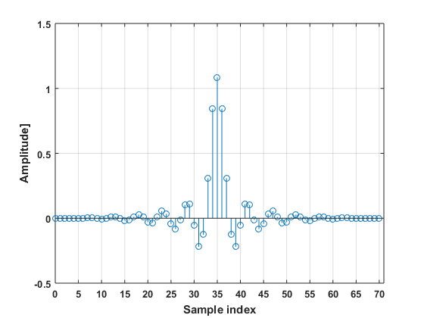
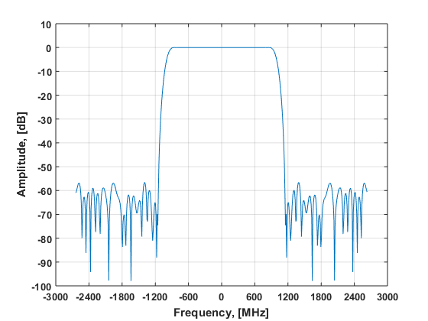
Legacy DMG-CEF for OFDM PHY
Legacy 11ad DMG-CEF, [1]:
  The legacy DMG-CEF field for OFDM PHY is defined in time domain and is based on the Golay sequences similar to the SC PHY;
  The pulse shaping filter impulse response is defined in the standard, it has almost flat frequency response for in-band subcarriers corresponding to the data and pilots;
  The maximum frequency response amplitude deviation for the data subcarriers is equal to ~0.8 dB;
  Figures below show pulse shaping filter time and frequency responses;

Slide 4
EDMG-CEF Definition, N_{CB} = 1
In accordance with [2], the EDMG-CEF for 2.16 GHz (N_{CB} = 1) PPDU transmission is defined in frequency domain as follows:
  EDMG-CEF^{iSTS}_{-177, 177} = [Seq^{iSTS}_{left, 176}, 0, 0, 0, Seq^{iSTS}_{right, 176}],
  i_{STS} =1, 2, 3, 4, 5, 6, 7, 8
Pilot sequences:
  Seq^{iSTS}_{left,176} and Seq^{iSTS}_{right,176} are well designed pilot sequences providing low PAPR in time domain after application of IDFT;
  Each space-time stream i_{STS} has its own sequence {Seq^{iSTS}_{left,176}, Seq^{iSTS}_{right,176}}, composing a sequence set;

Slide 5
EDMG-CEF Definition, N_{CB} > 1
There are two main approaches to design EDMG-CEF for N_{CB} > 1:
  Independent sequence design for each N_{CB} factor:
    4.32 GHz, N_{CB} = 2: EDMG-CEF^{iSTS}_{-386, 386} = [Seq^{iSTS}_{left, 385}, 0, 0, 0, Seq^{iSTS}_{right, 385}]
    6.48 GHz, N_{CB} = 3: EDMG-CEF^{iSTS}_{-596, 596} = [Seq^{iSTS}_{left, 595}, 0, 0, 0, Seq^{iSTS}_{right, 595}]
    8.64 GHz, N_{CB} = 4: EDMG-CEF^{iSTS}_{-805, 805} = [Seq^{iSTS}_{left, 804}, 0, 0, 0, Seq^{iSTS}_{right, 804}]
    i_{STS} =1, 2, 3, 4, 5, 6, 7, 8
  Modular design based on the EDMG-CEF for N_{CB} = 1, [1]:
    EDMG-CEF^{iSTS}_{-386, 386} = [Seq^{iSTS}_{left}, 3P, Seq^{iSTS}_{right}, 30P, 0, 0, 0, 30P, Seq^{iSTS}_{left}, 3P, Seq^{iSTS}_{right}];
    EDMG-CEF^{iSTS}_{-596, 596} = [Seq^{iSTS}_{left}, 3P, Seq^{iSTS}_{right}, 64P, Seq^{iSTS}_{left}, 0, 0, 0, Seq^{iSTS}_{right}, 64P, Seq^{iSTS}_{left}, 3P, Seq^{iSTS}_{right}];
    EDMG-CEF^{iSTS}_{-805, 805} = [Seq^{iSTS}_{left}, 3P, Seq^{iSTS}_{right}, 64P, Seq^{iSTS}_{left}, 3P, Seq^{iSTS}_{right}, 30P, 0, 0, 0, Seq^{iSTS}_{left}, 3P, Seq^{iSTS}_{right}, 64P, Seq^{iSTS}_{left}, 3P, Seq^{iSTS}_{right}, ];
    3P, 30P, and 64P – notation defines 3, 30, and 64 pilots accordingly;

Slide 6
Sequence Set Design for N_{CB} =1
Design rules:
  A frequency domain pilot sequence {Seq^{iSTS}_{left,176}, Seq^{iSTS}_{right,176}}, for the i_{STS}-th space-time stream, i_{STS} = 1:N_{STS}, is defined using {±1, ±j} alphabet;
    Comment: this allows simple channel estimation avoiding implementation of division operation;
  The Peak to Average Power Ratio (PAPR) for each sequence {Seq^{iSTS}_{left,176}, Seq^{iSTS}_{right,176}} in the set should be less or equal to 3.0 dB;
    Comment: low PAPR value allows channel estimation in the “linear” power amplifier regime, this minimizes the non-linear distortion of the resulting channel estimation;
  All frequency domain pilot sequences {Seq^{iSTS}_{left,176}, Seq^{iSTS}_{right,176}}, i_{STS} = 1:N_{STS}, should be different;
    Comment: this allows to avoid unintentional beamforming;

Slide 7
Sequence Set Construction
The sequence set {Seq^{iSTS}_{left,176}, Seq^{iSTS}_{right,176}}, i_{STS} = 1:N_{STS} for MIMO is constructed applying iterative procedure described below.
  The iteration process starts from the basic sequences A^{iSTS}₀ and B^{iSTS}₀ defined using {±1, ±j} alphabet:
    A^{iSTS}₀ = {+1, +j, +j, -1, -j, +j, -1, +1, -1, +j, +1}, i_{STS} = 1, 2, …, 8;
    B^{iSTS}₀ = {-1, +1, -1, +j, +1, +1, -j, -j, -j, +1, +1} , i_{STS} = 1, 2, …, 8;
  The iterative procedure for the i-th sequence is defined as follows:
    A^{iSTS}_{k} = {W^{iSTS}_{k} *A^{iSTS}_{k-1}, B^{iSTS}_{k-1}};
    B^{iSTS}_{k} = {W^{iSTS}_{k} *A^{iSTS}_{k-1}, -B^{iSTS}_{k-1}};
    where “k” defines iteration index;
  To achieve the sequence length for A and B of 176 symbols, one needs to make 4 iterations, i.e. k = 1, 2, …, 4, this gives 176 = 16 * 11;
  The sequences Seq^{iSTS}_{left,176}, Seq^{iSTS}_{right,176} are defined as follows:
    Seq^{iSTS}_{left,176} = B^{iSTS}₄, Seq^{iSTS}_{right,176} = A^{iSTS}₄;

Slide 8
Weight Vector Definition
Table 1: Weight vector definition.
Space-time stream # | W^{iSTS}_{k} vector
1 | [+1,-1,+j,-j]
2 | [-j,+1,-j,-j]
3 | [+1,-j,+1,-j]
4 | [-1,+1,-1,-j]
5 | [+1,+j,-1,-j]
6 | [-1,+j,+1,-j]
7 | [+j,-j,-j,-j]
8 | [+1,+1,+j,-j]

Slide 9
Sequence Set PAPR Properties
Table 2 below provides a summary of PTPR properties of the designed sequence set.
Table 2: Peak to average power ratio in [dB] for EDMG-CEF signal in time domain.
Space-time stream # | W vector | PAPR, [dB], N_{CB} = 1
1 | [+1,-1,+j,-j] | 2.9775
2 | [-j,+1,-j,-j] | 2.9788
3 | [+1,-j,+1,-j] | 2.9800
4 | [-1,+1,-1,-j] | 2.9800
5 | [+1,+j,-1,-j] | 2.9838
6 | [-1,+j,+1,-j] | 2.9845
7 | [+j,-j,-j,-j] | 2.9886
8 | [+1,+1,+j,-j] | 2.9923

Slide 10
PAPR Properties of DMG-CEF for OFDM
DMG-CEF PAPR properties:
  The DMG-CEF field is defined using Gv₅₁₂ and Gu₅₁₂ sequences in time domain:
    Gv₅₁₂ = {-Gb₁₂₈, +Ga₁₂₈, -Gb₁₂₈, -Ga₁₂₈};
    Gu₅₁₂ = {-Gb₁₂₈, -Ga₁₂₈, +Gb₁₂₈, -Ga₁₂₈};
    Cef = {-Ga₁₂₈, +Gv₅₁₂, +Gu₅₁₂, -Gb₁₂₈};
  The original CEF filed is defined at the SC chip rate 1.76 GHz, then it is resampled to the OFDM sample rate 1.5 x 1.76 = 2.64 GHz applying x3 times up sampling, filtering, and x2 times down sampling procedure;
  Filter characteristics are defined in the 11ad std. and shown at the previous slide;
Estimated PAPR:
  The estimated PAPR for DMG-CEF: 3.1292 dB;
Conclusion:
  The proposed EDMG-CEF sequence set has acceptable PAPR properties;

Slide 11
PAPR Properties of VHT-CEF for OFDM
The IEEE 802.11ac standard defines sequence for VHT-LTF field used for channel estimation with PAPR properties summarized in Table 3, [1].
Table 3: Peak to average power ratio in [dB] for VHT-CEF signal in time domain.
Space-time stream # | N_{CB} = 1 | N_{CB} = 2 | N_{CB} = 3 | N_{CB} = 4
1 - 8 | 3.5766 | 3.4066 | N/A | 4.7514
Conclusion:
  Proposed sequences have slightly better PAPR properties than defined in 11ac standard.

Slide 12
Transmit Waveform Definition
The EDMG-CEF field transmit waveform in time domain is defined as follows:
  P_{EDMG-CEF} is the EDMG-CEF mapping matrix;
  Q_{k} is spatial mapping matrix per k-th subcarrier;
  is the total number of active subcarrier;
  is the number of OFDM symbols in EDMG CEF for given total number of space-time streams N_{STS};

Slide 13
EDMG-CEF Mapping Matrix
EDMG-CEF mapping matrix:

Slide 14
Simulation Results
Channel estimation in frequency domain:
  Estimation time interval – 2 OFDM symbols;
  Solid line – perfect channel knowledge, dashed line – channel estimation;
LOS channel, flat
NLOS channel, Rayleigh, RMS = 3 ns
  LOS channel: min SNR degradation ~0.2 dB, max SNR degradation ~0.4 dB
  NLOS channel: min SNR degradation ~0.5 dB, max SNR degradation ~0.9 dB

Slide 15
Notes on EDMG-CEF Design, N_{CB} > 1
Intel completed analysis and design of EDMG-CEF for N_{CB} > 1 applying independent sequence design for each N_{CB}.
The summary of achieved PAPR sequence characteristics are defined in the Table 4 below.
Table 4: Peak to average power ratio in [dB] for EDMG-CEF signal in time domain.
Space-time stream # | N_{CB} = 1 | N_{CB} = 2 | N_{CB} = 3 | N_{CB} = 4
1 | 2.9775 | 3.2192 | 3.5595 | 3.2681
2 | 2.9788 | 3.2259 | 3.5654 | 3.2696
3 | 2.9800 | 3.2261 | 3.5895 | 3.2928
4 | 2.9800 | 3.2270 | 3.6065 | 3.3038
5 | 2.9838 | 3.2292 | 3.6201 | 3.3066
6 | 2.9845 | 3.2299 | 3.6208 | 3.3114
7 | 2.9886 | 3.2477 | 3.6314 | 3.3188
8 | 2.9923 | 3.2499 | 3.6395 | 3.3190

Slide 16
Conclusions
This presentation proposes design of EDMG-CEF field for PPDU transmission over a 2.16 GHz channel.
The sequence design is based on the regular iterative procedure.
The proposed sequence set has low PAPR (less than 3.0 dB) with almost constant PAPR value over the set.

Slide 17
SP/M
Do you agree:
  to include the text from (11-17-0596-00-00ay 30 6 3 OFDM EDMG-CEF Definition) defining EDMG-CEF field for PPDU transmission over the 2.16 GHz channel to the spec draft?

Slide 18
References
IEEE802.11-2016
11-17-0594-00-00ay OFDM Signal Parameters Definition in 11ay
Draft P802.11ay_D0.3

