Slide 1
TG ax – Spatial Reuse
OBSS_PD/TPC Examined
Date: 2017-04
Authors:

Slide 2
Background
Comments on OBSS_PD Spatial Reuse addressed by this presentation
  5494, 5495, 5503, 6762, 6768, 7129, 7230, 9947, 10031, 10033
Proposal to link OBSS_PD adjustment with TPC was approved
BUT
No described scheme for selecting the OBSS_PD level
Dynamic adjustment of CCA, “DSC” was described and analyzed over many scenarios but was never approved for the SFD or Draft

Slide 3
Objectives
To examine OBSS_PD/TPC as presently described and to see what affect TPC has
To examine what happens if DSC is used
  As decision maker for OBSS_PD/TPC
  Independently

Slide 4
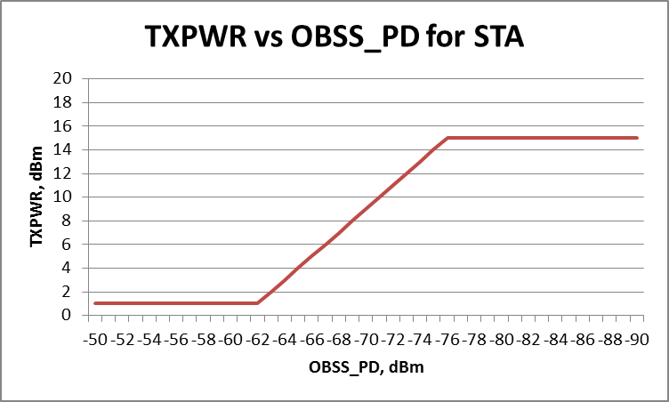
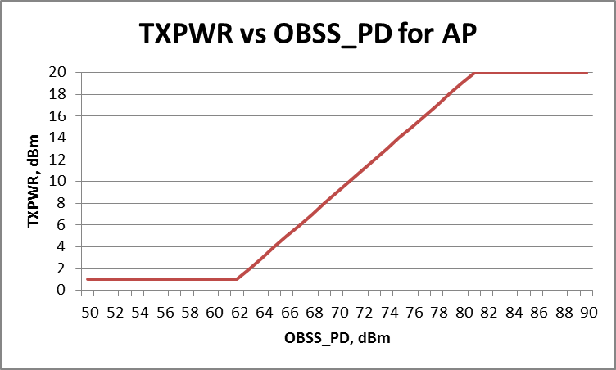
TXPWR and OBSS_PD
The spatial reuse scheme presently in 11ax Draft allows a STA to reduce its OBSS_PD if it also decreases its Transmit Power.
The relationship is defined by the equation:
TXPWRmax= TXPWRref – (OBSS_PDlevel- OBSS_PD min)
      OBSS_PDmax >OBSS_PDlevel>OBSS_Pdmin
TXPWRref = 21 dBm, OBSS_PD max= -62 dBm, OBSS_PDmin = -82 dBm
For a STA with TXPWR = 15 dBm, AP = 20dBm (as per the Simulation Document)
Note full power for -76dBm
Note: These are the default values

Slide 5
Assumed OBSS_PD/TPC scheme
STA has a packet to transmit
An OBSS signal is being received, STA notes OBSS Pr
STA calculates allowed TXPWR and adjusts TXPWR
  E.g. OBSS Pr = -72 dBm
  Max TXPWR = 21 – (-72 + 82) = 11 dBm
  i.e. a reduction of 4 dB for a STA with 15 dBm max TXPWR
  a reduction of 9 dB for an AP with 20 dBm max TXPWR
STA then transmits its packet
NOTES:
This behavior is not actually described in the Draft, but it is certainly allowed and is a reasonable interpretation (given that no description is given on how it is to be used).
In order to transmit, the OBSS_PD must be set to the level of the received OBSS Pr.
SRG OBSS_PD allows AP to set max and min OBSS_PD (no descriptions)
Non-SRG OBSS_PD fixes max and min OBSS_PD (as per evaluated here)

Slide 6
Simplified Indoor small BSSs scenario
3 CH frequency reuse
Just two cells (to keep it simple)

Slide 7
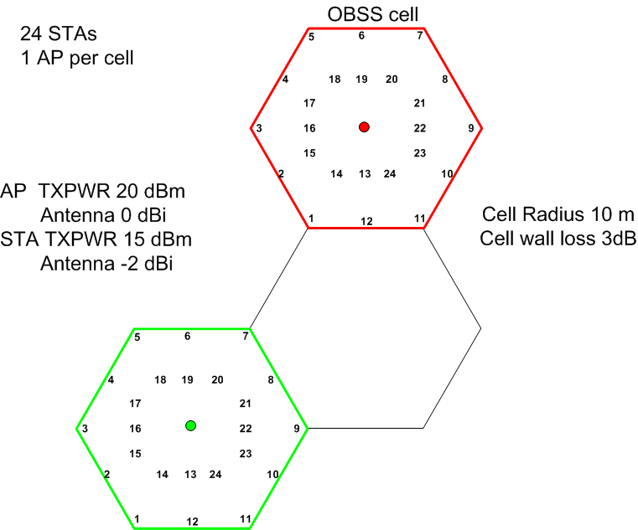
Cell 1

Slide 8
Interactions
To analyze the situation we need to look at all the combinations:
Cell 1, UL OBSS cell, UL
Cell 1, UL OBSS cell, DL
Cell 1, DL OBSS cell, UL
Cell 1, DL OBSS cell, DL
We need to determine:
  Wanted SNIR in Cell 1
    (if STA/AP transmits over the OBSS)
  Resulting SNIR in OBSS cell
    (if Cell 1 STA/AP transmits).

Slide 9
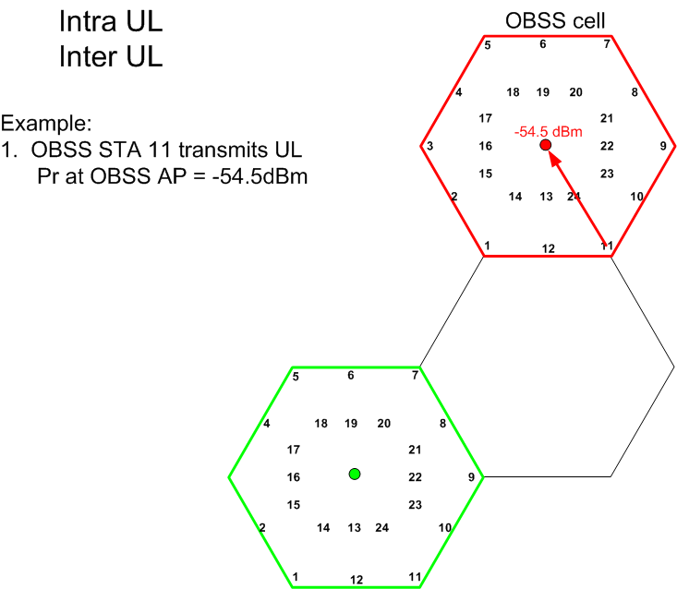

Slide 13
TPC

Slide 14
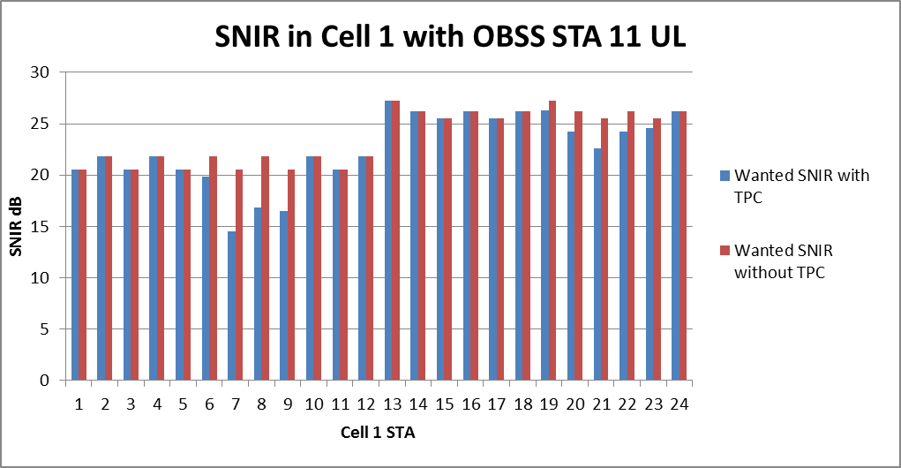
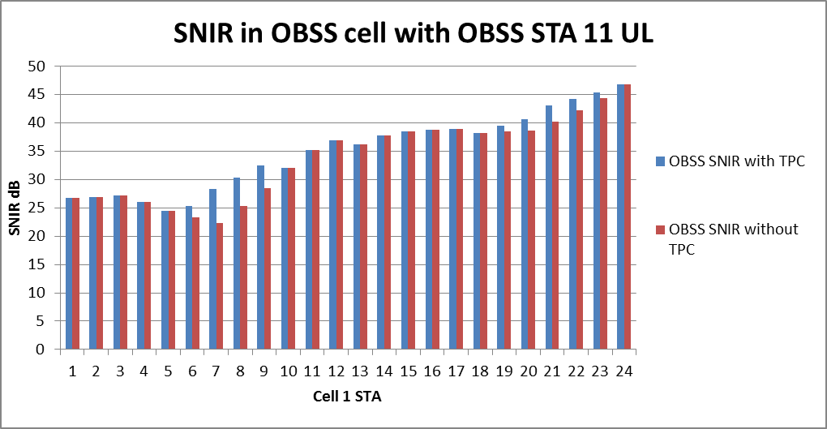
Wanted SNIR with interference
From OBSS STA 11
TPC reduces the wanted SNIR below
desired 20dB
TPC improves the SNIR in
the OBSS cell but still above 20dB
Without TPC

Slide 15
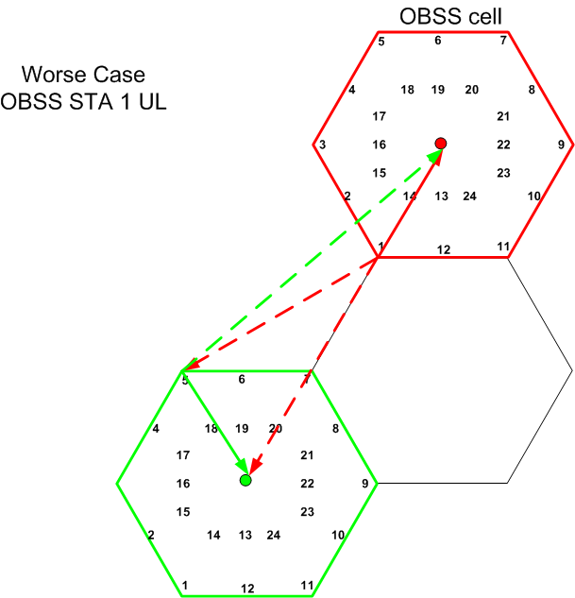
UL UL worse case

Slide 16
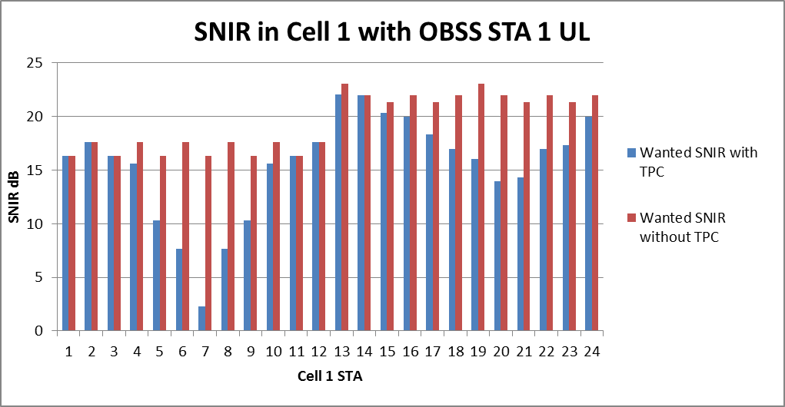
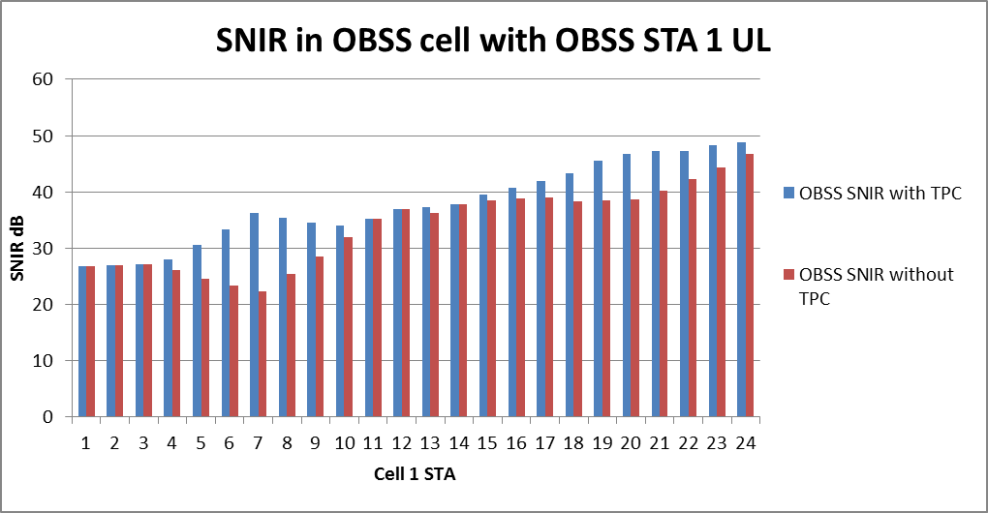
Wanted SNIR with interference
From OBSS STA 1
TPC has drastic effect for the
close STAs
SNIR of 16, 17 dB reduced to 2dB
Worse case UL, UL
OBSS_PD/TPC not good
The OBSS SNIR is above 20 dB
with and without TPC.

Slide 17
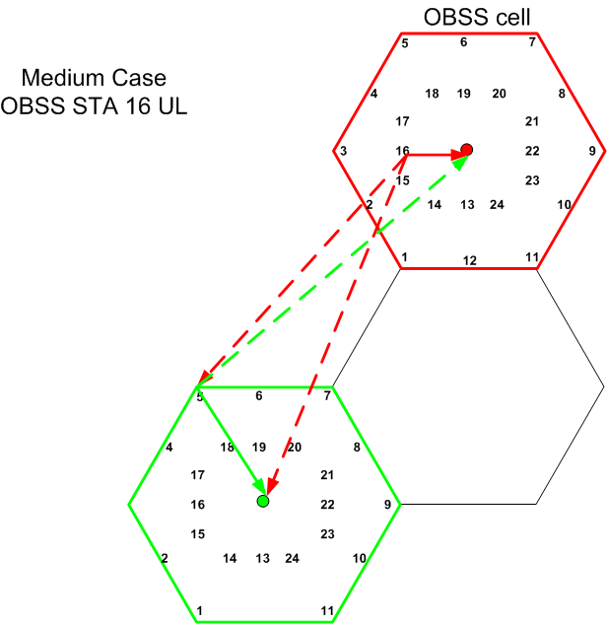

Slide 18
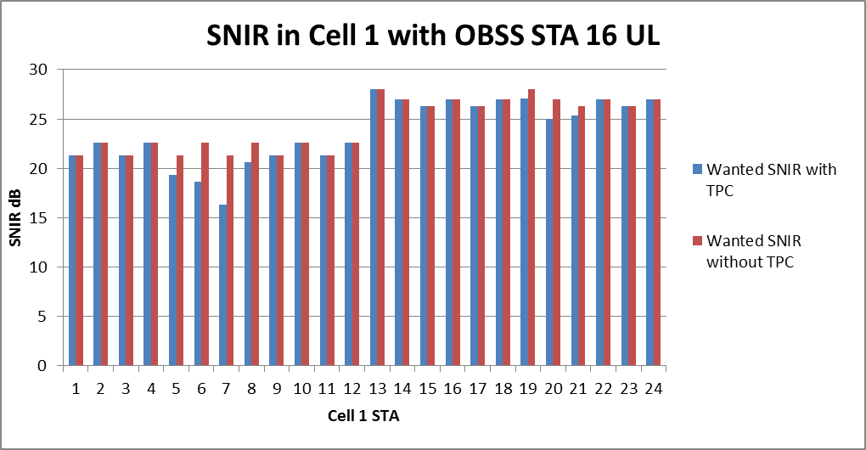
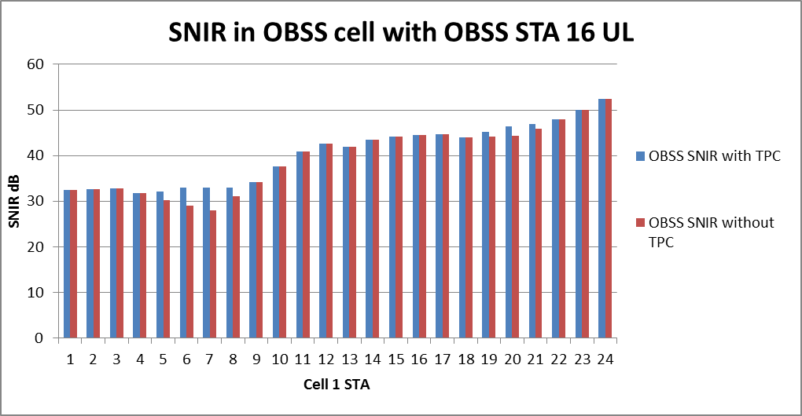
Wanted SNIR with interference
From OBSS STA 16
Again TPC causes
Wanted SNIR to drop
below 20dB at closest STAs
For most STAs,
none or little TPC effect
Well above 20 dB with
or without TPC

Slide 19
Summary for UL UL
The assumed TPC scheme protects the OBSS, but causes poor wanted SNIR in too many cases
  No real incentive to apply TPC as better off for the STA if it is not applied.
Need to make a better decision on when to transmit based upon more than just apply TPC and go?
In the UL, UL situation the better result is if TPC was not used
NOTE: The graphs shown are for one OBSS, but in cell structure there could be 3, hence different STAs affected.

Slide 20
Now we look at UL, DL

Slide 21
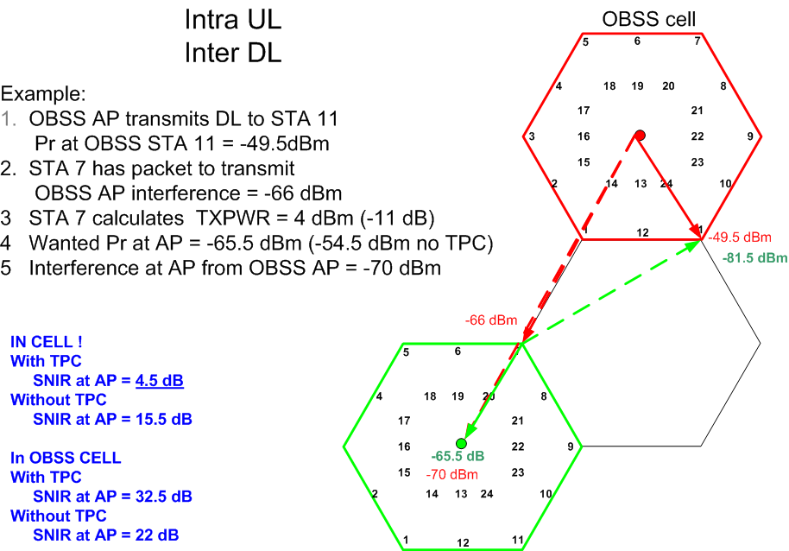

Slide 22
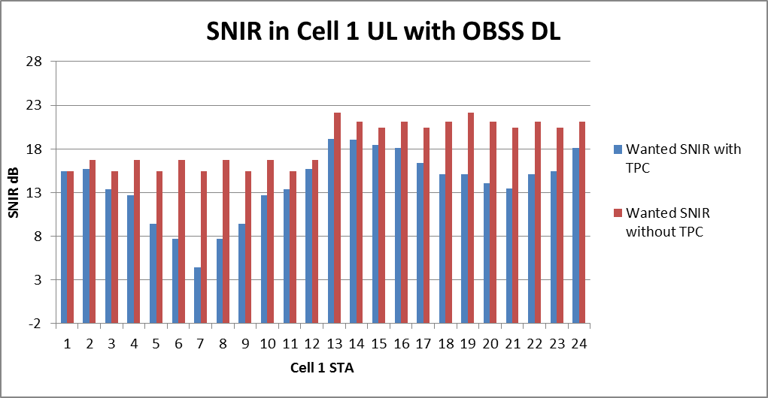
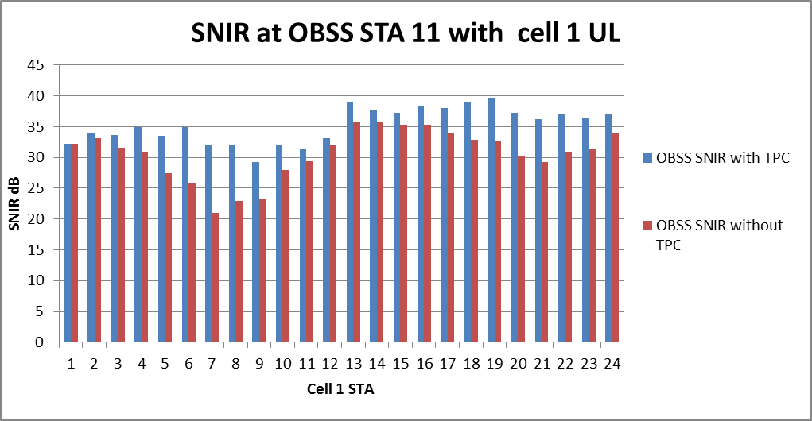
Lower SNIR overall due to OBSS AP
Closer OBSS STAs increase TPC
worsens wanted SNIR significantly
(AP to AP interference)
OBSS STA 11 DL SNIR above 20dB
TPC does reduce interference but not really needed

Slide 23
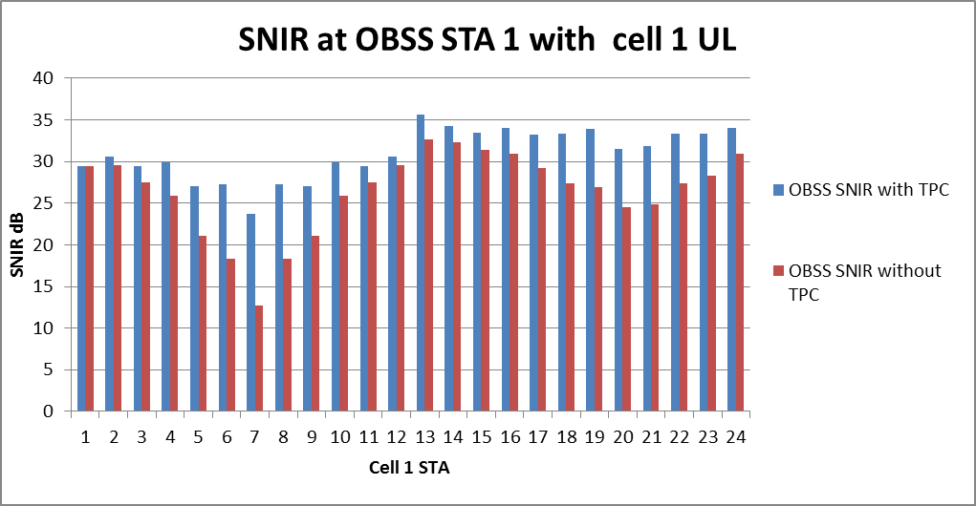
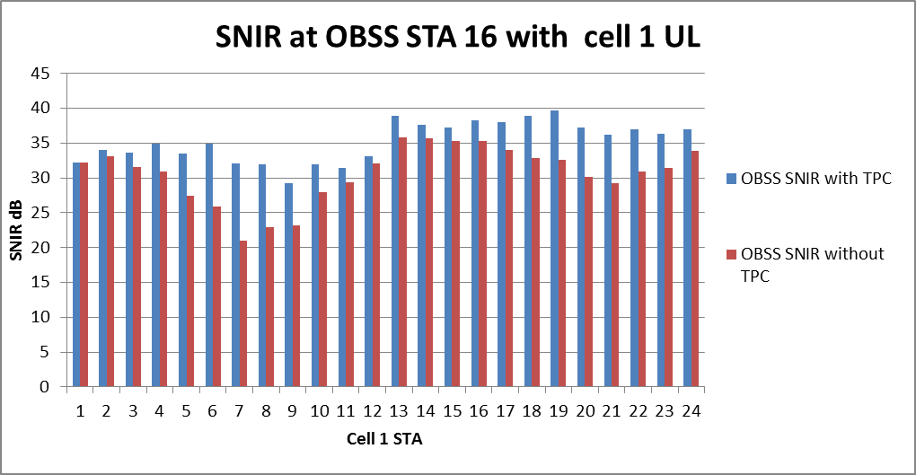
Worse case in the OBSS
(STA 1 is closest to cell 1)
TPC does reduce interference
BUT
Wanted SNIR is low
Typical case in the OBSS
Above 20dB SNIR
with or without TPC

Slide 24
Summary for UL DL
The OBSS AP higher TX power results in the UL wanted SNIR is lower for the outer STAs (15 dB)
If TPC used the UL SNIR goes very low for many STAs
In the OBSS TPC does improve the OBSS SNIR DL
Simply using TPC with the assumed scheme is not acceptable
Need a better method for decision to transmit

Slide 25
Now we look at DL, UL

Slide 26
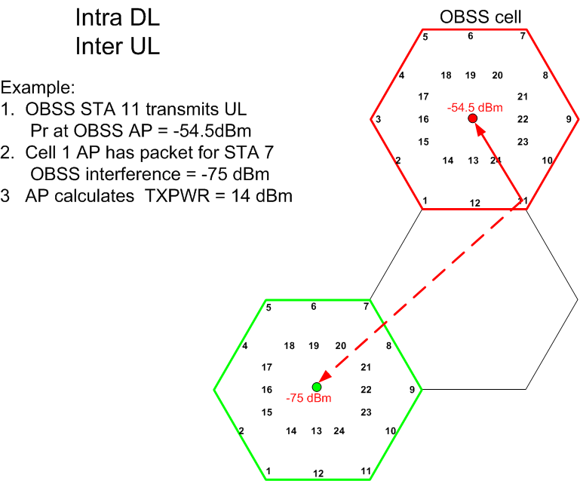

Slide 27
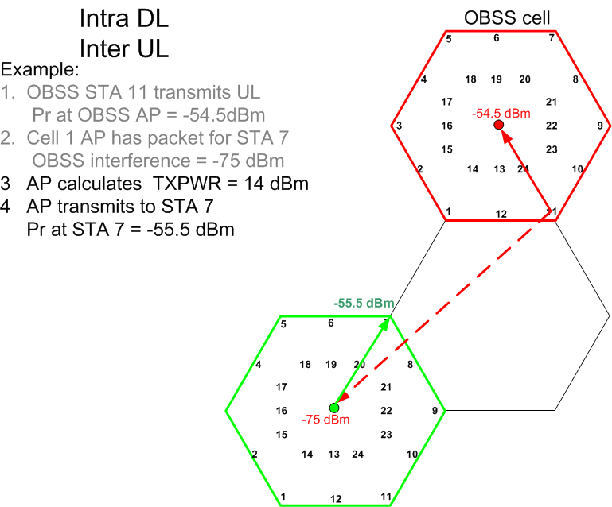

Slide 28
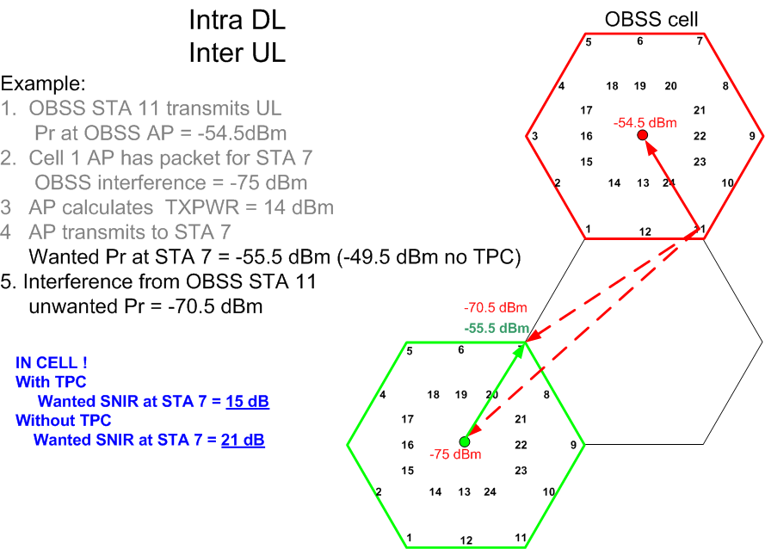

Slide 29
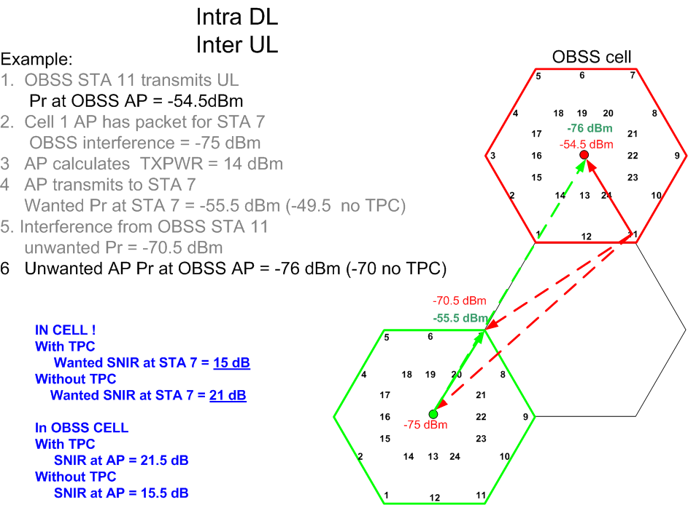

Slide 30
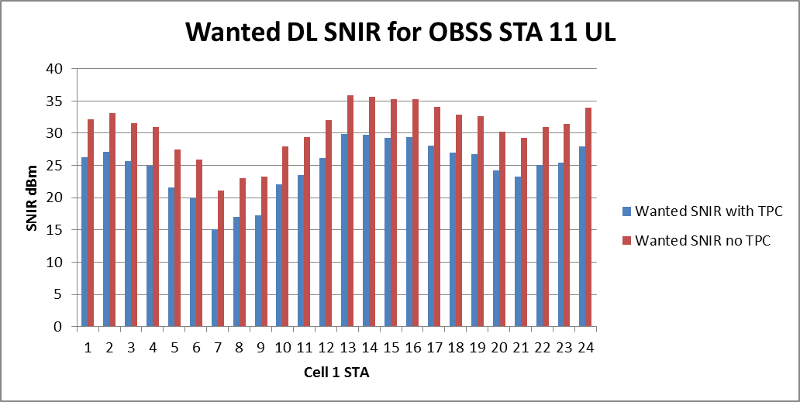
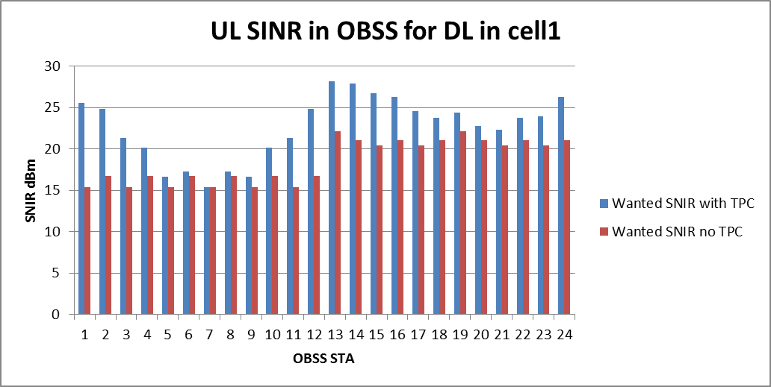
DL UL
Wanted DL for OBSS STA 11 UL
SNIR>20dB if no TPC
(STA 7 is closest )
UL SNIR in OBSS for Cell 1 DL transmissions
(Lower values as AP is
interferer)
(OBSS STA 7 is furthest
So no TPC)

Slide 31
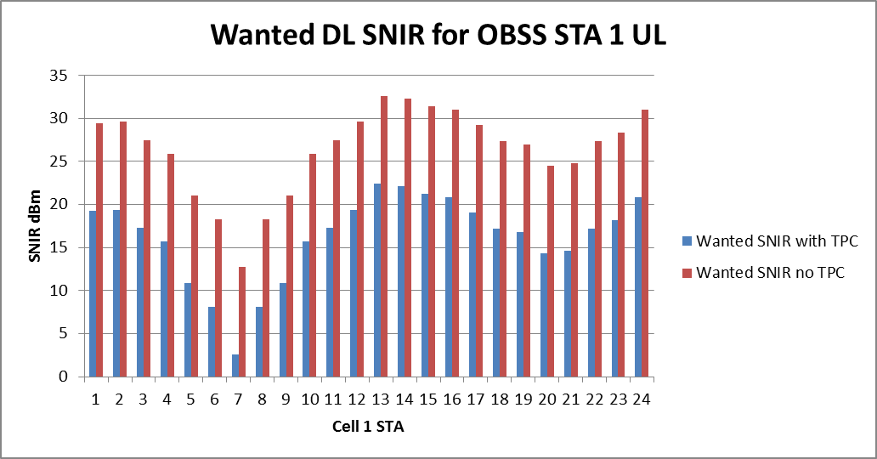
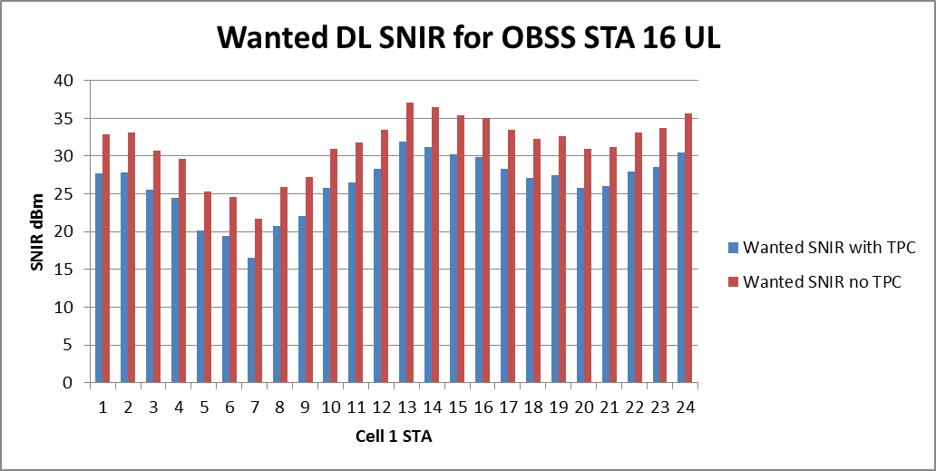
Worse case
OBSS STA 1 is closest
Typical case

Slide 32
DL UL Summary
Again the assumed OBSS_PD/TPC scheme does not perform well
Better results for the wanted SNIR if no TPC
Need better decision on when to transmit

Slide 33
Now we look at DL, DL

Slide 34
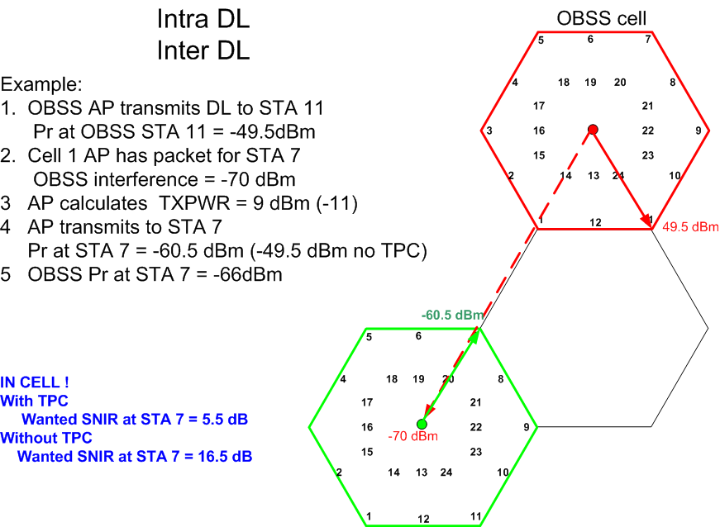

Slide 35
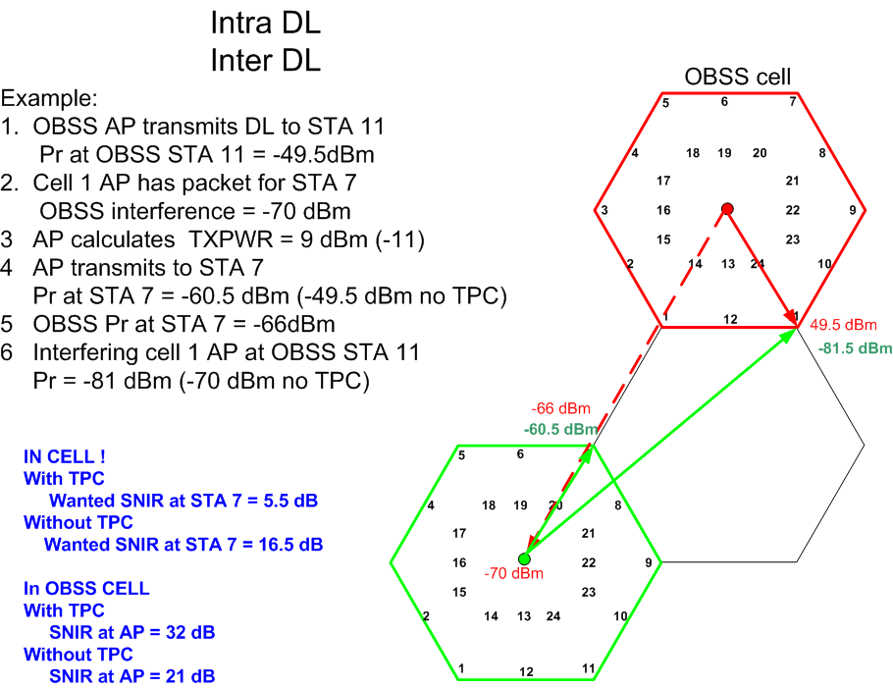

Slide 36
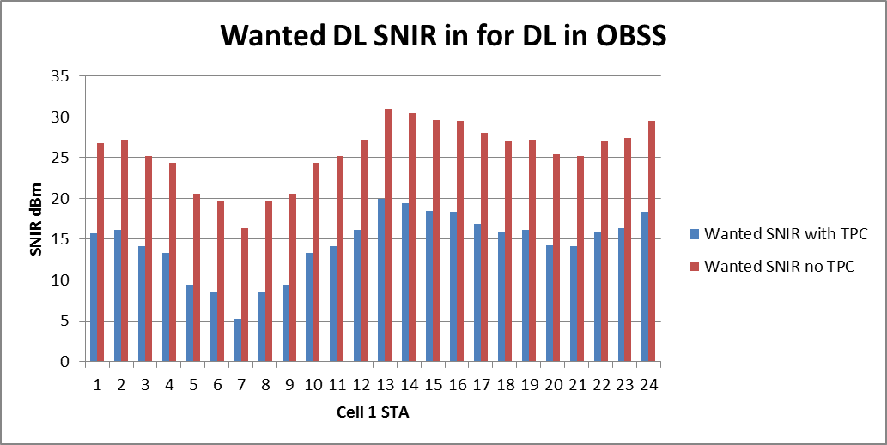
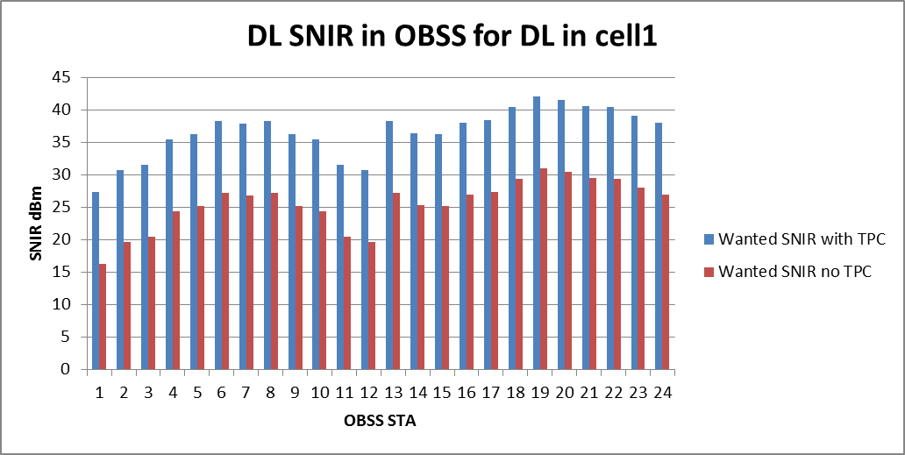
DL DL
STA 7 is closest to
OBSS AP
SNIR 16 dB reduced to 5 by TPC
OBSS STA 1 is closest to
Cell 1 AP (then STA 12)
SNIR 16 dB increased to 27 by TPC
Only 3 OBSS STAs below 20dB
With no TPC

Slide 37
DL DL Summary
Assumed TPC scheme causes the wanted SNIR to remain below 20dB for all STAs
Without TPC, SNIR >20dB for all STAs except one (7) (16 dB cf 5 dB with TPC)
TPC improves the SNIR in the OBSS but even without it the SNIR > 20 dB for all STAs except 1.

Slide 38
Conclusion
It is clear that the assumed scheme for OBBS_PD and TPC has problems.
No scheme is described in the Draft
In order to work, a better decision process is required.

Slide 39
Use DSC to make TX decision
A STA using DSC will set its effective CCA level to the received signal strength of the wanted beacon, minus a margin
CCAeff = MIN (DSC Upper Limit, RSSI _{beacon} ) – DSC Margin
DSC Margin is related to wanted SNIR, say 20 dB
DL beacon from AP is 7 dB stronger than UL packet, hence DSC Margin for STA set to 27dB
AP Threshold setting
Weakest UL is -55dBm, with 20dB margin
AP sets threshold to -75 dBm

Slide 40
DSC Explained
DSC STA Measures the RSSI of the beacon,
  example -50dBm
A STA transmit power is 7 dB less than the AP
DSC STA sets Margin at (7dB + target SNIR )
  Say target SNIR is 20dB, then Margin = 27dB
  Effective CS/CCA threshold = -77dBm
Hence, if OBSS_PD below the effective CS/CCA threshold, DSC STA transmits, (if above, does not transmit)
Probability is that at the AP, the SNIR is >20dB
I.E. The DSC STA knows the received signal strength at the AP and makes decision to transmit based upon the level of the interferer with reasonable confidence that the resulting SNIRs are acceptable.

Slide 41

UL, UL situation
Take worse case example OBSS STA 1 UL.
DSC prevents transmission of STAs 4 - 10, and 19 -21
  (These are the closest cell 1 STAs to OBSS STA 1)
In this case, using DSC to make the decision to transmit overcomes worse of the TPC problem.
Still no real incentive or need to use TPC as it worsens the wanted SNIR

Slide 42
DSC would stop STA 6-9 from transmission
DSC would stop STA 5-9 from transmission
For UL, UL using DSC to make decision is perfect

Slide 43
UL, DL
OBSS AP is the interferer.
DSC allows Transmit only on
STAs 13 – 17 and 24
TPC does cause wanted SNIR to be
Lower than 20dB
DSC is perfect for UL DL
Use of TPC does reduce wanted SNIR below 20 dB and makes no real difference in the OBSS

Slide 44
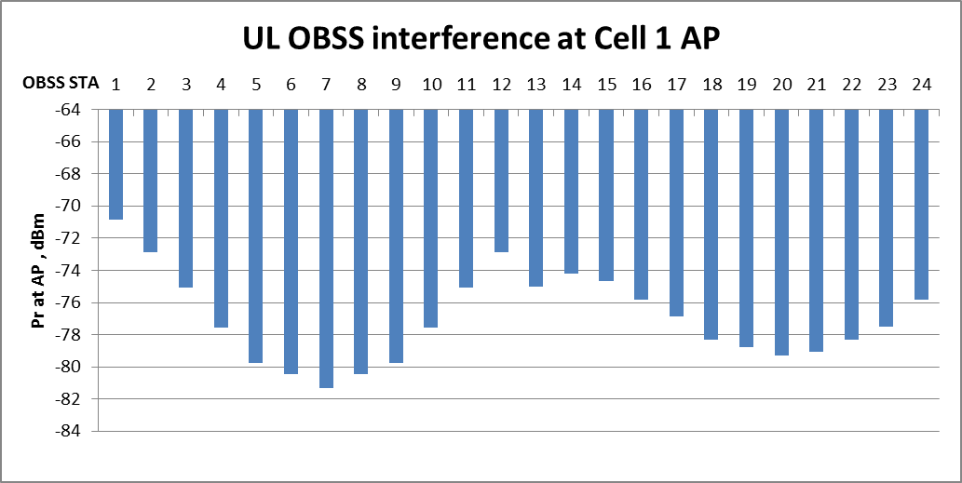
For DL UL
Worse case
OBSS STA 1 is closest to Cell 1 AP
Unwanted Pr = -71 dBm
AP (DSC) CCA is set to -75dBm
DSC Stops AP from transmitting
If OBSS STA 1 is transmitting
AP Threshold – AP transmits if below
So let’s look at OBSS STA 16 situation

Slide 45
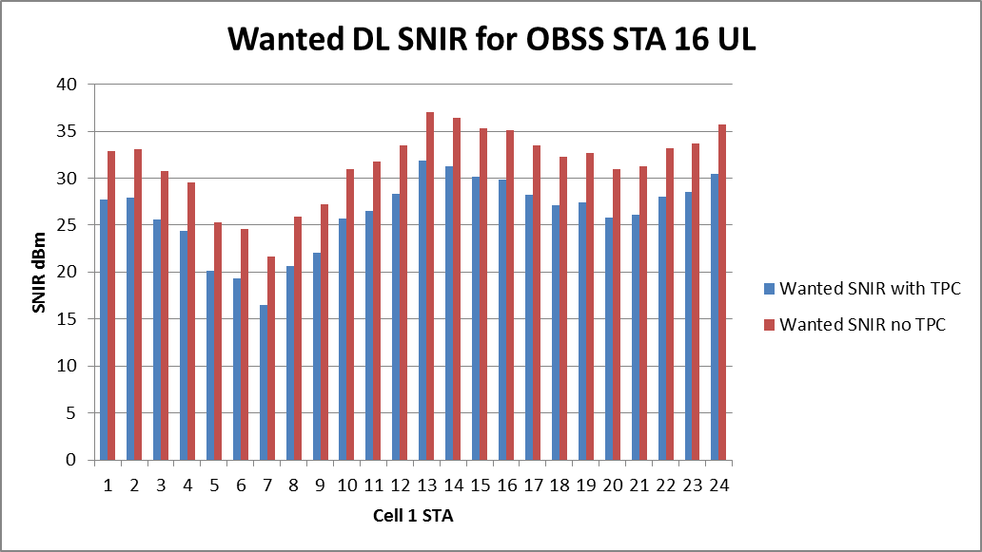

DL, UL
DSC allows this
Without TPC, 0 STAs <20 dB
With TPC 3 STAs <20dB
DSC makes a good decision but
better wanted SNIR if no TPC
AP to AP interference
Resulting interference in OBSS
DSC stops 1-3, 11-15
TPC does not help much
But case can be made to use TPC
As long as DSC used

Slide 46
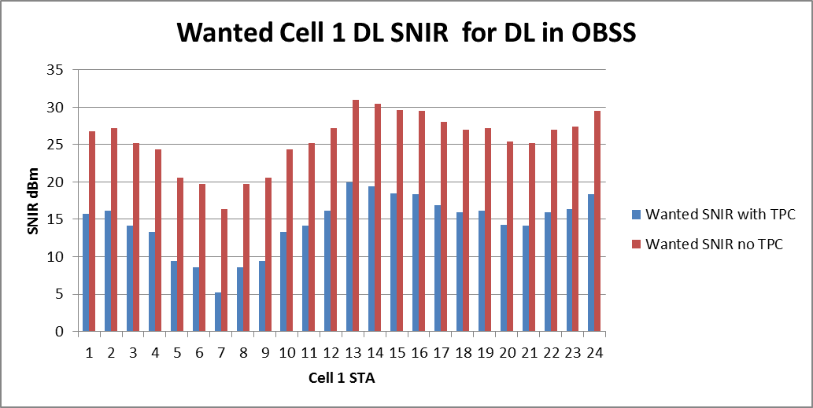
DL, DL
OBSS AP to AP is -70 dBm
All or nothing
DSC prevents DL if OBSS AP is transmitting
Reasonable decision as in a number of cases either wanted or the OBSS SNIR is bad with or without TPC
.

Slide 47
Effects of using DSC 3CH cell
OBSS_PD/TPC using the assumed scheme results in many cases of poor SNIR and is not viable
Using DFC to make the transmit decision and OBSS_PD/TPC improves the results
  Using DFC to make the transmit decision works well
  Often results in poorer SNIR in wanted Cell (incentive?)
  Improves performance in the OBSS
Using DFC on its own provides the better results overall
Note: These results are for the enterprise cell scenario

Slide 48
Let’s look (quickly) at another scenario
Indoor Enterprise

Slide 49
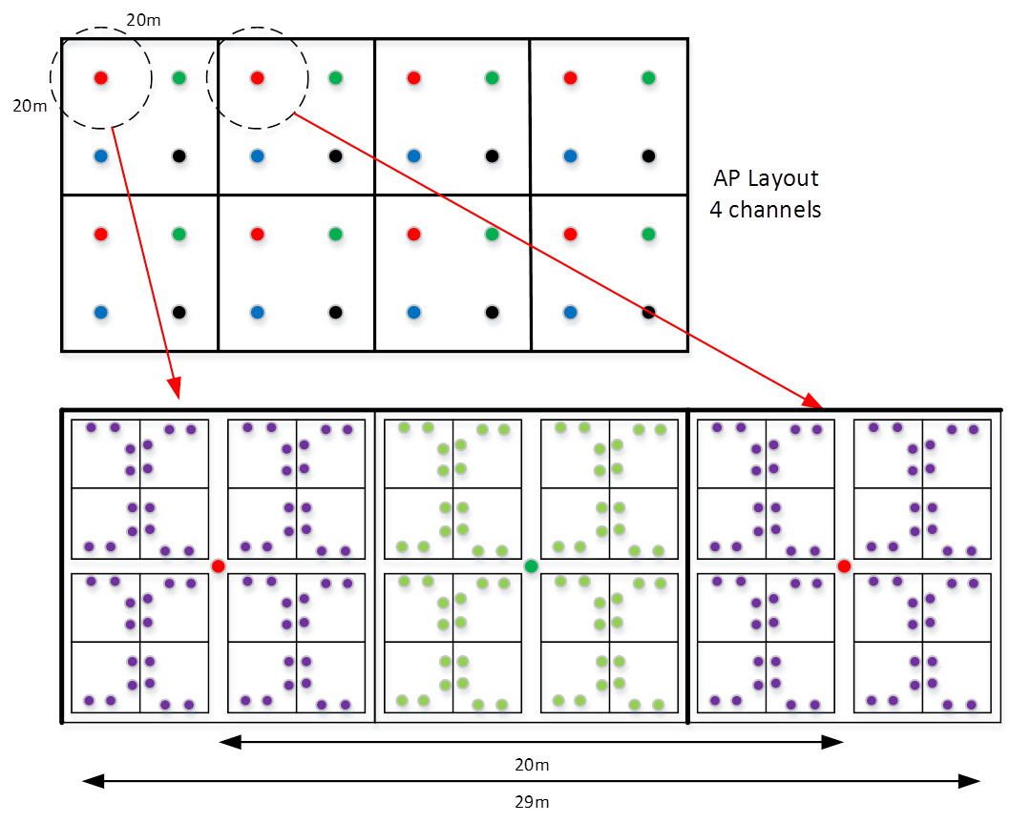
Indoor Enterprise Scenario

Slide 50
Complete OBSS, 100%
-45 dBm
OBSS
49
53
57
61
64
STA 9
Worse case
9
33
37
41
45
AP to AP -64 dBm
9
13
25
29
12
16
32
4
8
1
5
17
21
-80 dBm

Slide 51
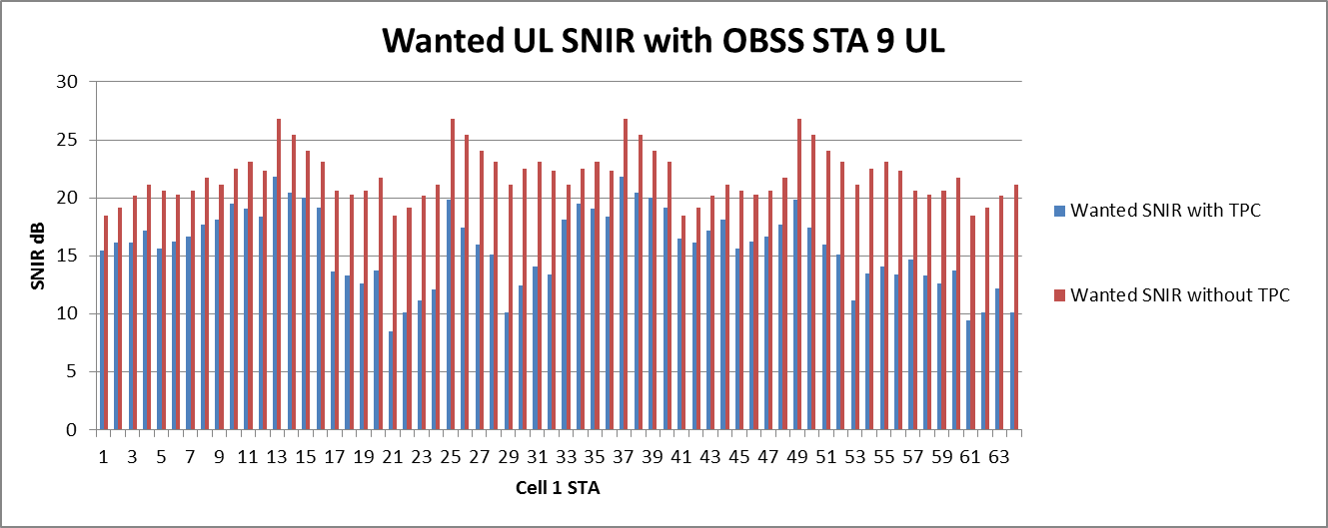
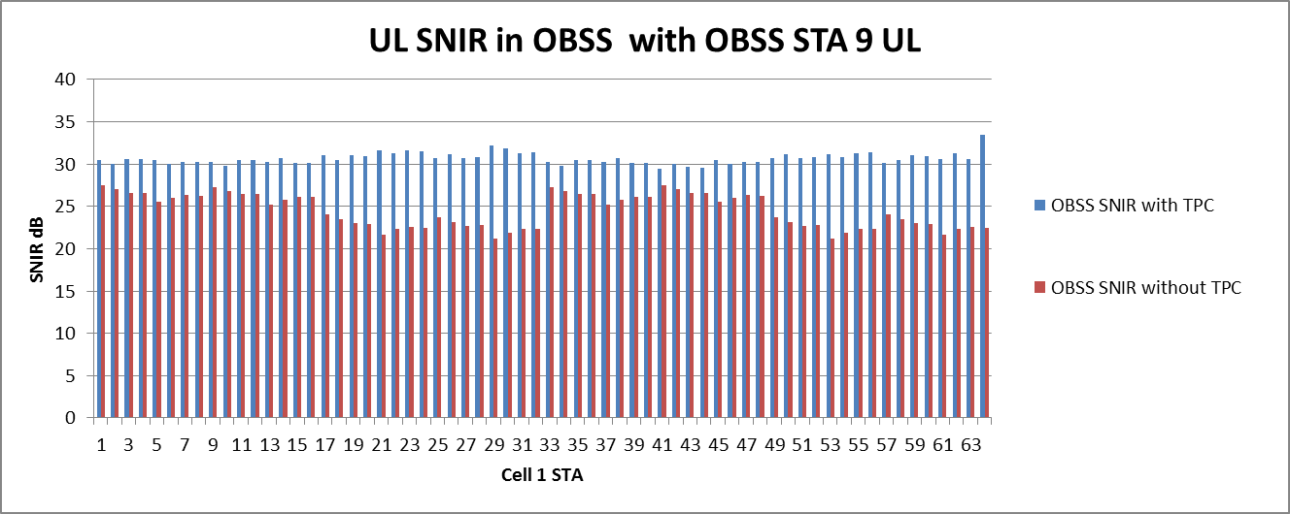
Worse case UL, UL
Without TPC
Generally OK
With TPC <15dB SNIR
In too many cases
OK
with or without TPC
>20dB
Clear case where TPC
Should not be used

Slide 52
Worse case UL, UL
With DSC
Without TPC
Generally OK
With TPC <20dB SNIR
DSC stops 1, 17-24,28-32, 52-64
DSC stops worse TPC SNIR
but TPC SNIR is still low
OK with or without TPC
>20dB
TPC results in low wanted SNIR

Slide 53
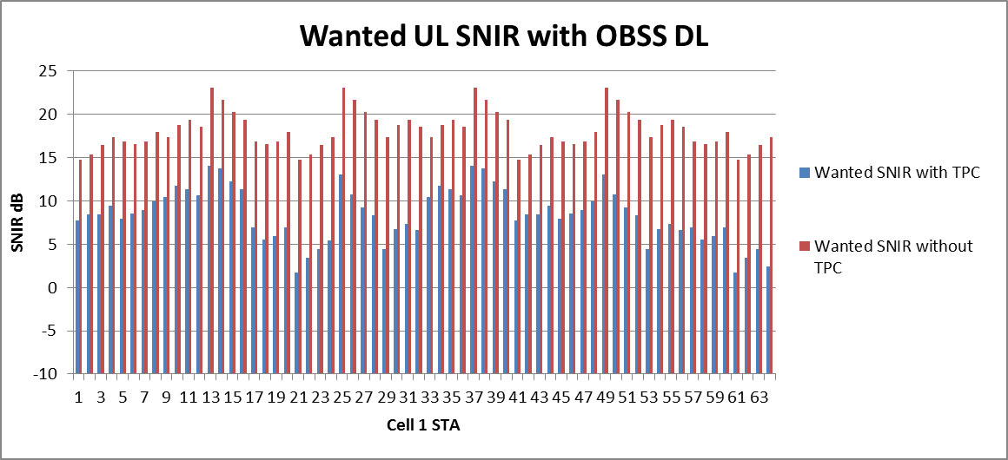
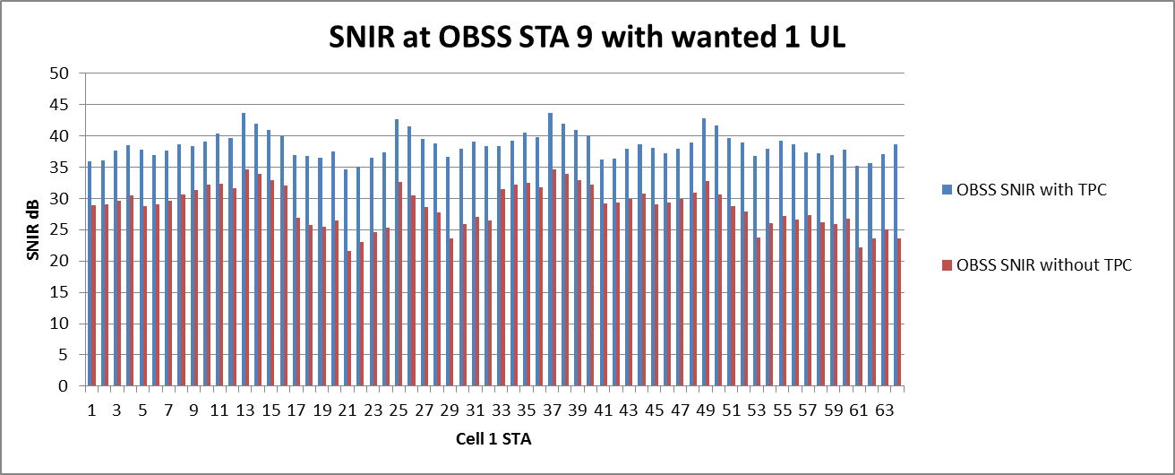
UL, DL
SNIR 15- 20dB
With TPC 2-10dB
OBSS AP is the interferer
Worse Case
(OBSS STA9 is closest)
OK with or without TPC
>20dB

Slide 54
UL, DL
With DSC
DSC allows only
13-15, 25, 37-39, 49
No TPC SNIR>20dB
with TPC SNIR<13dB
Pretty Good if no TPC!
Worse case
OK with or without TPC
>20dB
Better result if TPC not used

Slide 55
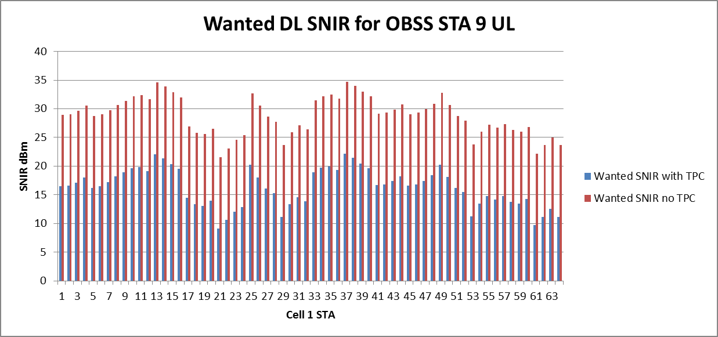
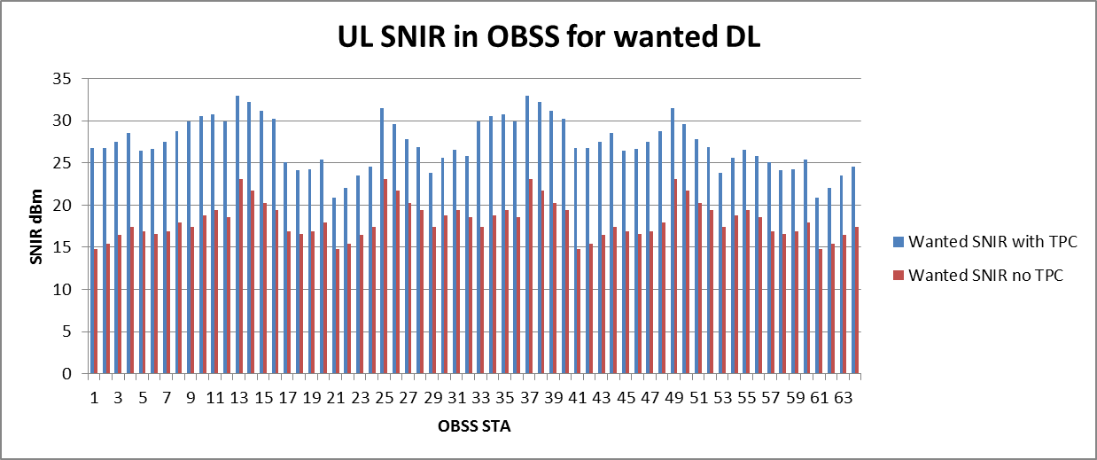
Worse case DL, UL
Without TPC great
Generally >25 dB
With TPC 10-20dB SNIR
TPC drops wanted
To <15 dB in many cases
BUT inverse effect to
wanted
Drops the OBSS SNIR
AP to AP interference

Slide 56
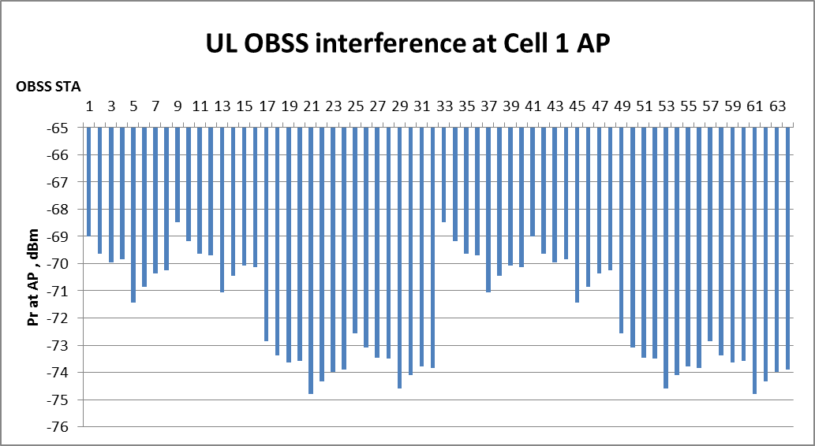
Worse case DL, UL
With DSC
DSC prevents any
Transmission
Does the right thing
For OBSS STA 9
AP DSC Threshold
= -70dBm
Let’s look at OBSS
STA 16 (DSC allows TX)

Slide 57
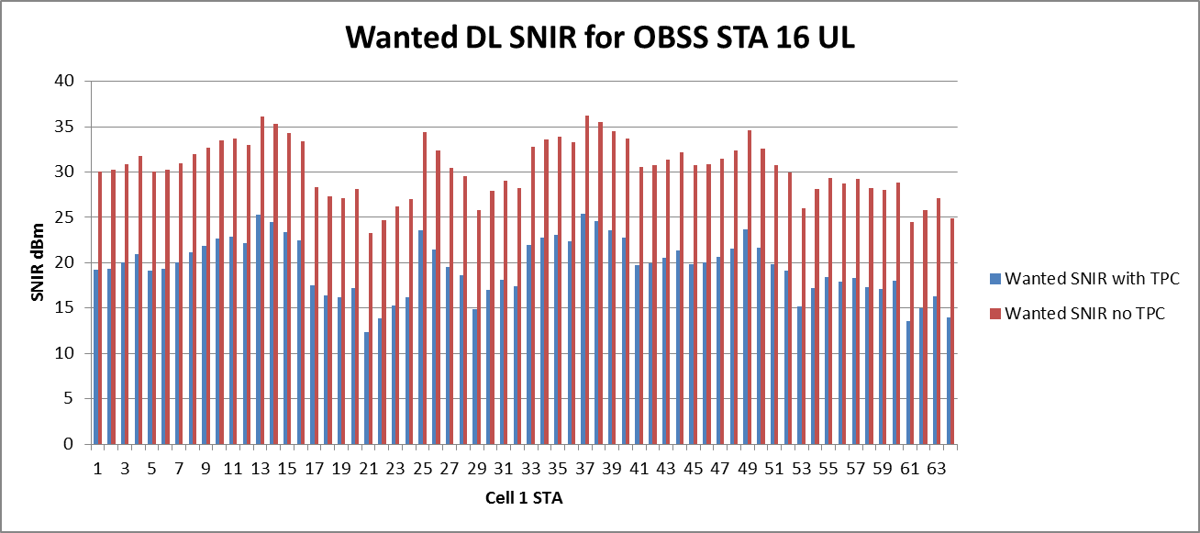
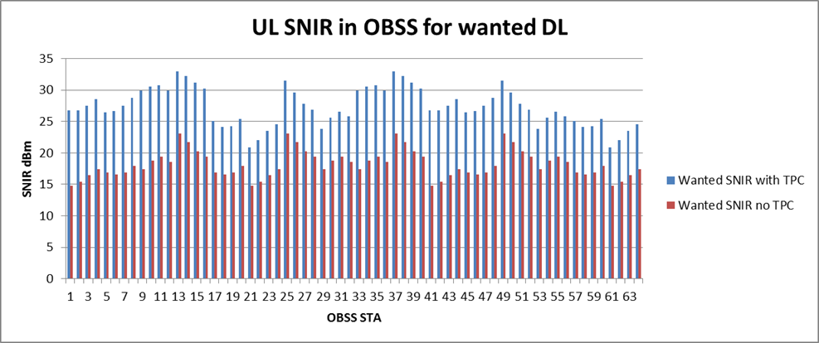
DL, UL
Wanted Looks good no TPC
With TPC most wanted SNIR<20dB
Inverse of the wanted cell
DSC keeps OBSS SNIR > 15dB
Better OBSS SNIR with TPC
Case can be made for TPC
with DSC but not that obvious
OBSS STA 16

Slide 58
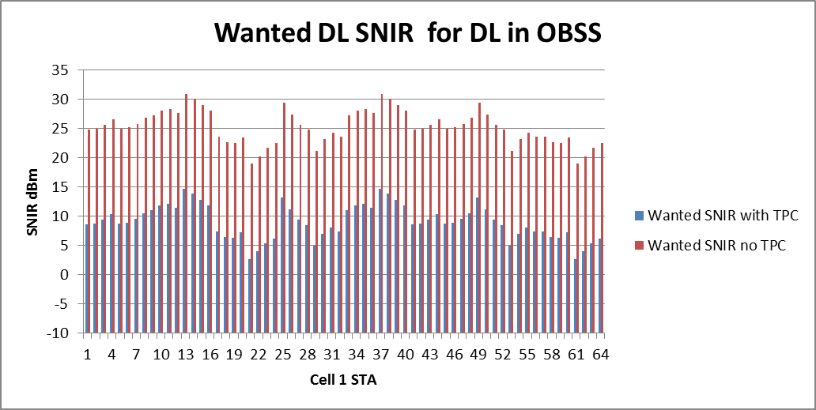
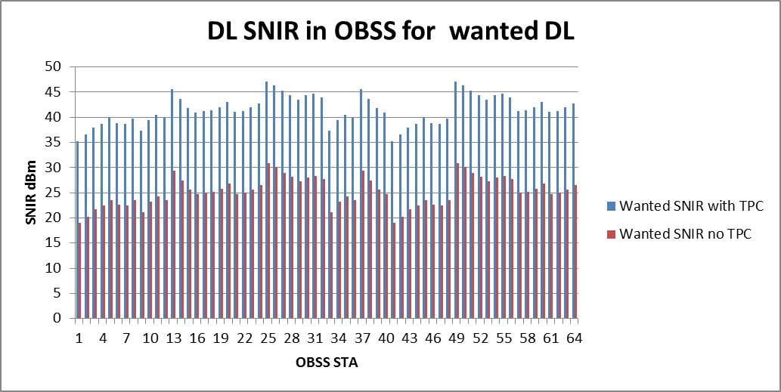
DL, DL
Wanted Looks good no TPC
With TPC <10dB SNIR
No TPC > 20dB
(bar 2 out of 64)
Not acceptable

Slide 59
DL, DL
OBSS AP to wanted AP = -65dBm
AP threshold is -70dBm
So DSC stops all
DL, DL transmissions
Note, in this case DSC is being conservative, as no-TPC ( DSC only) is OK, but as we saw in the cell scenario it did the right decision.
OBSS_PD/TPC assumed scheme does not work.

Slide 60
Conclusions Indoor Enterprise
OBSS_PD/TPC assumed scheme is not acceptable
OBSS_PD/TPC with DSC making transmit decision is much better, but for UL/UL and UL/DL conditions TPC produces poor wanted SNIR.
DSC on its produces the better results

Slide 61
Way Ahead?
Leave as is
  OBSS_PD with TPC undefined as to how to use it or how to set the OBSS_PD level
  Results in low SNIR for the wanted signal in many cases
  Impossible to test or evaluate
Use DSC to make transmit decision for OBSS_PD/TPC
  DSC used for decision to transmit or not, but TPC still used coupled to the OBSS_PD level corresponding to the Pr of the OBSS signal
  Provides a defined procedure that stops many transmissions that result in poor SNIR
  Tends to produce worse (bad) wanted SNIR in exchange for better OBSS SNIR,
  Can be tested and evaluated
Use DSC independently (only for inter-BSS packets)
  No real advantage in using TPC, in fact quite the opposite, so why do it?
  MORE

Slide 62
Way Ahead Combinations?
Keep 1) and add 2)
  Keep existing text for OBSS_PD
  Allow use of DSC to make the TX decision (would be optional use)
  Keeps TPC requirement which is shown to result in poorer wanted SNIR in many cases
2) and 3)
  DSC used for decision to transmit or not, but TPC still used coupled to the OBSS_PD level corresponding to the Pr of the OBSS signal
  DSC may be used independently
  Not using TPC results in the better overall performance
Keep 1), add 2) and 3) Let the Market decide
  Keep existing text for OBSS_PD (allow addition of other methods later?)
  Add text to allow use of DSC to make the TX decision,
  Allow DSC to be used

Slide 63
Straw Poll #1
In response to 17/0582, which option(s) would you allow as the way ahead for spatial reuse in 11ax?
May vote for more than one to allow for combinations (see Straw Poll #2)
Leave as is?
Use DSC to make transmit decision but hard coupled to OBSS_PD/TPC NON SRG PD, and SRG PD ?
Use DSC independently (inter-BSS only)
Results

Slide 64
Straw Poll #2
To be run based upon the results of Straw Poll #1
In response to 17/0582, which do you prefer as the way ahead for spatial reuse in 11ax?
Leave as is?
Use DSC to make transmit decision but hard coupled to OBSS_PD/TPC NON SRG PD, and SRG PD ?
Use DSC independently (inter-BSS only) ?
1) and 2) ?
2) and 3)?
1), 2) and 3)?

