Slide 1
TG ax – Spatial Reuse
OBSS_PD/TPC Examined
Date: 2017-04
Authors:

Slide 2
Background
Comments on OBSS_PD Spatial Reuse addressed by this presentation
  5494, 5495, 5503, 6762, 6768, 7129, 7230, 9947, 10031, 10033
Proposal to link OBSS_PD adjustment with TPC was approved
BUT
No described scheme for selecting the OBSS_PD level
Dynamic adjustment of CCA, “DSC” was described and analyzed over many scenarios but was never approved for the SFD or Draft

Slide 3
Objectives
To examine OBSS_PD/TPC as presently described and to see what affect TPC has
To examine what happens if DSC is used
  As decision maker for OBSS_PD/TPC
  Independently

Slide 4
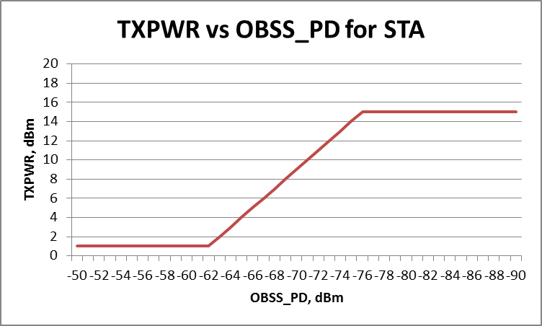
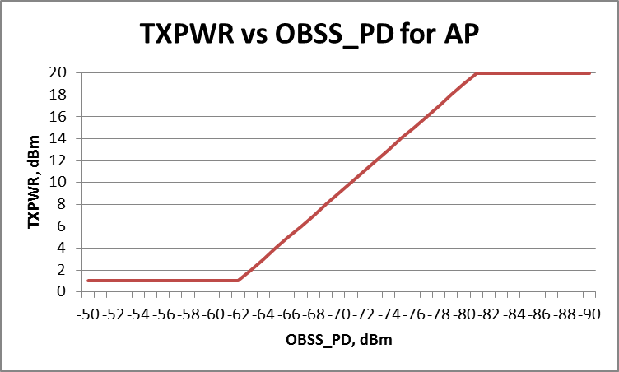
TXPWR and OBSS_PD
The spatial reuse scheme presently in 11ax Draft allows a STA to reduce its OBSS_PD if it also decreases its Transmit Power.
The relationship is defined by the equation:
TXPWRmax= TXPWRref – (OBSS_PDlevel- OBSS_PD min)
      OBSS_PDmax >OBSS_PDlevel>OBSS_Pdmin
TXPWRref = 21 dBm, OBSS_PD max= -62 dBm, OBSS_PDmin = -82 dBm
For a STA with TXPWR = 15 dBm, AP = 20dBm (as per the Simulation Document)

Slide 5
OBSS_PD/TPC scheme
STA has a packet to transmit
An OBSS signal is being received, STA notes OBSS Pr
STA calculates allowed TXPWR and adjusts TXPWR
  E.g. OBSS Pr = -72 dBm
  Max TXPWR = 21 – (-72 + 82) = 11 dBm
  i.e. a reduction of 4 dB for a STA with 15 dBm max TXPWR
  a reduction of 9 dB for an AP with 20 dBm max TXPWR
STA then transmits its packet

Slide 6
Simplified Indoor small BSSs scenario
Starting with 3 CH frequency reuse
Just two cells (to keep it simple)

Slide 7
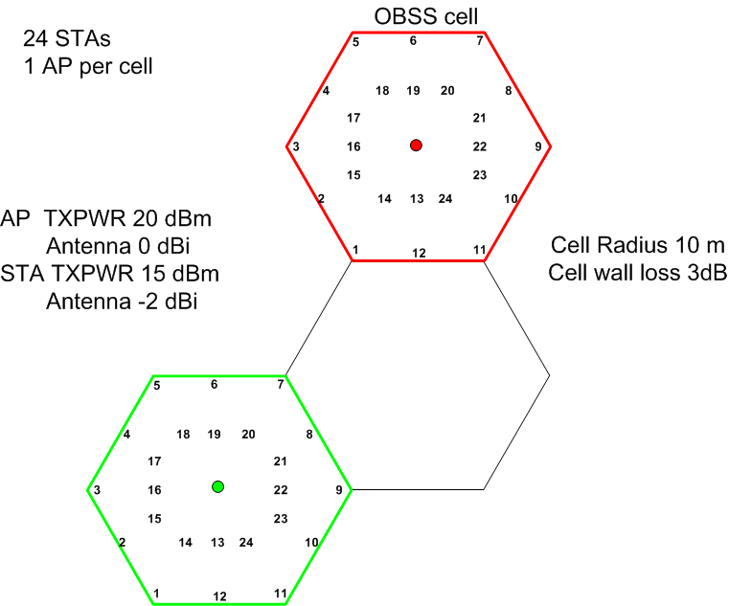
Cell 1

Slide 8
Interactions
To analyze the situation we need to look at all the combinations:
Cell 1, UL OBSS cell, UL
Cell 1, UL OBSS cell, DL
Cell 1, DL OBSS cell, UL
Cell 1, DL OBSS cell, DL
We need to determine:
  Wanted SNIR in Cell 1(if it transmits over the OBSS)
  Resulting SNIR in OBSS cell (if Cell 1 STA/AP transmits).

Slide 9
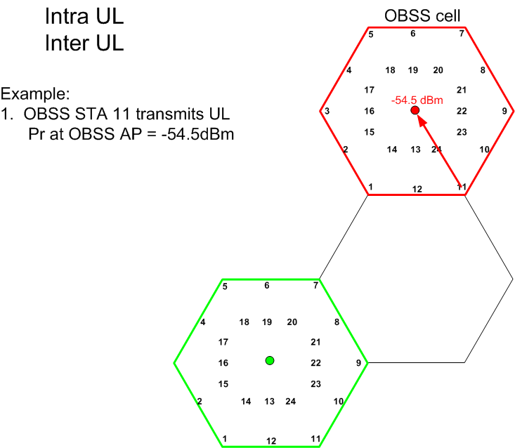

Slide 10
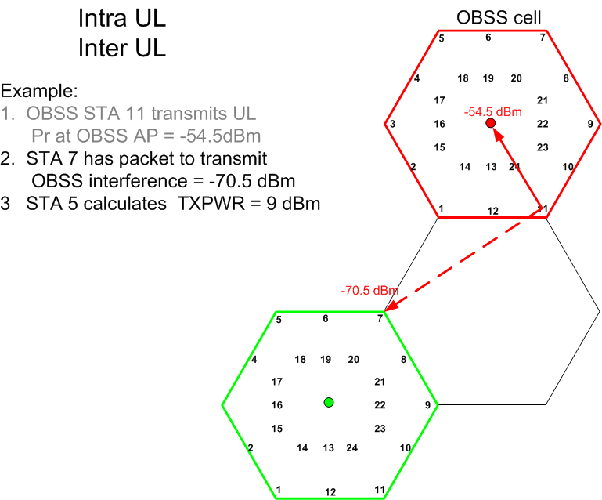

Slide 11
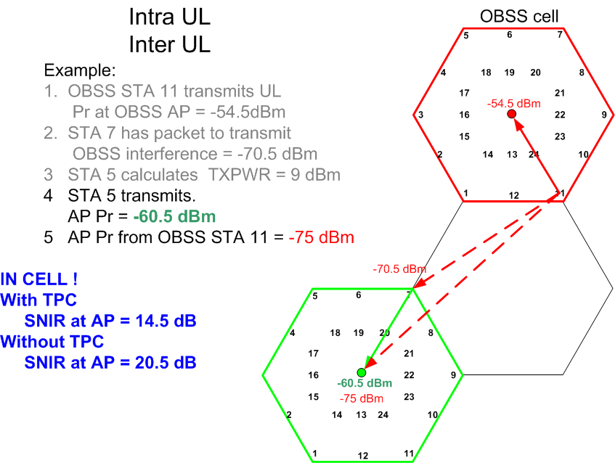

Slide 12
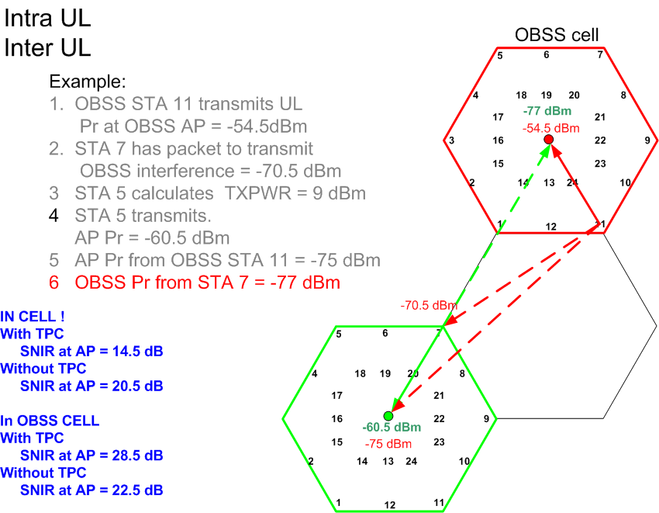
TPC

Slide 13
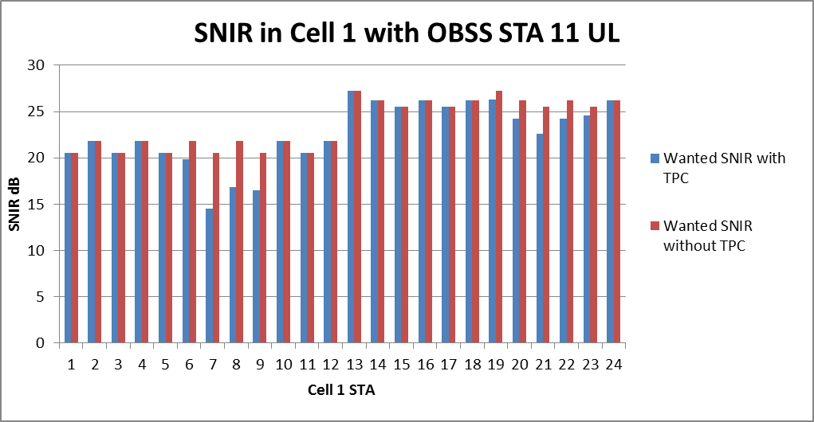
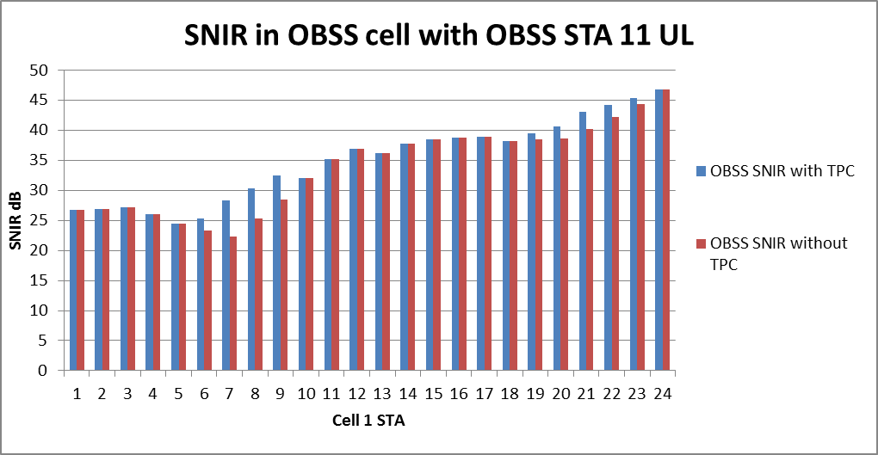
Wanted SNIR with interference
From OBSS STA 11
TPC reduces the wanted SNIR below
desired 20dB
TPC improves the SNIR in
the OBSS cell but still above 20dB
Without TPC

Slide 14
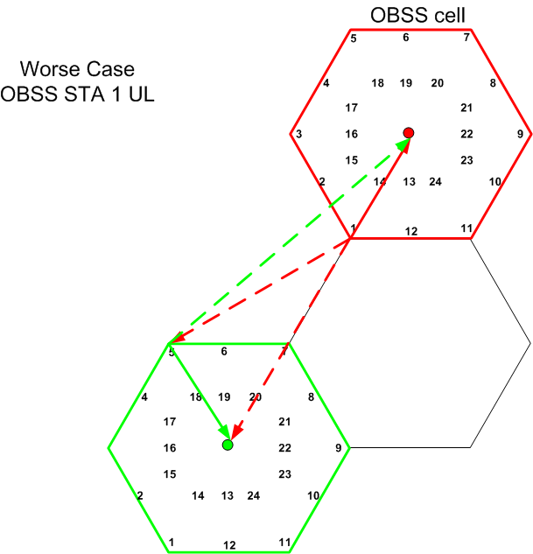
UL UL worse case

Slide 15
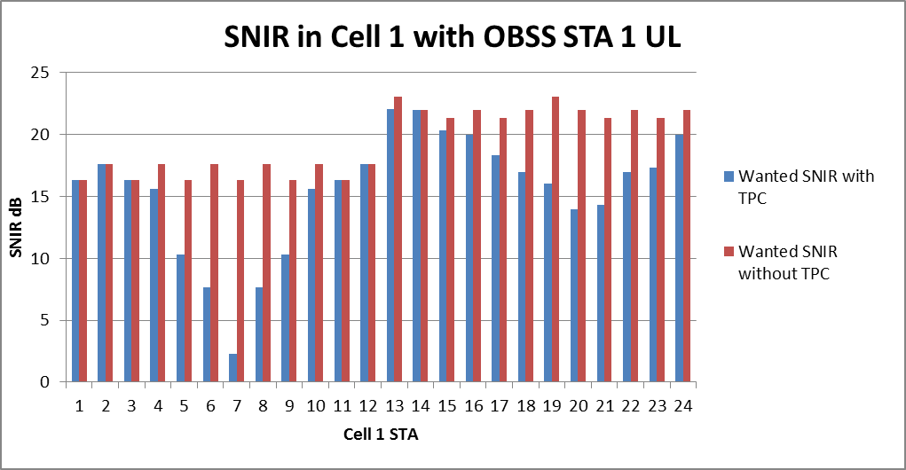
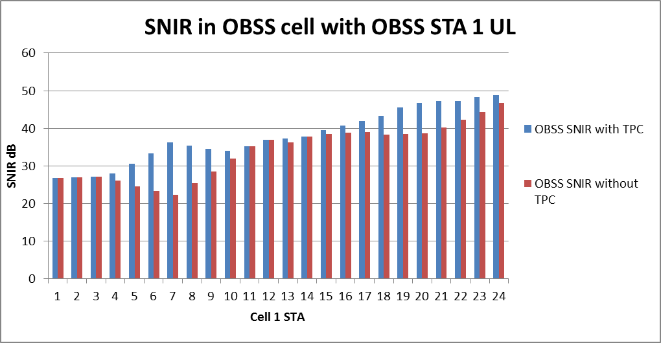
Wanted SNIR with interference
From OBSS STA 1
TPC has drastic effect for the
close STAs
SNIR of 16, 17 dB reduced to 2dB
Worse case UL, UL
OBSS_PD/TPC not good
The OBSS SNIR is above 20 dB
with and without TPC.

Slide 16
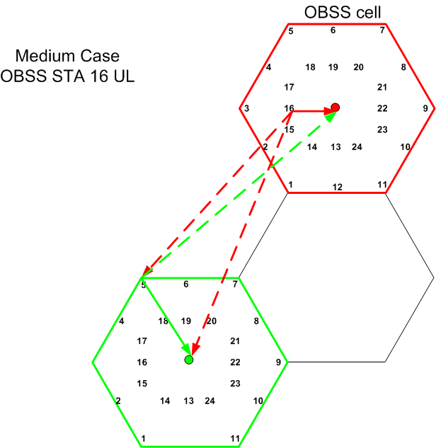

Slide 17
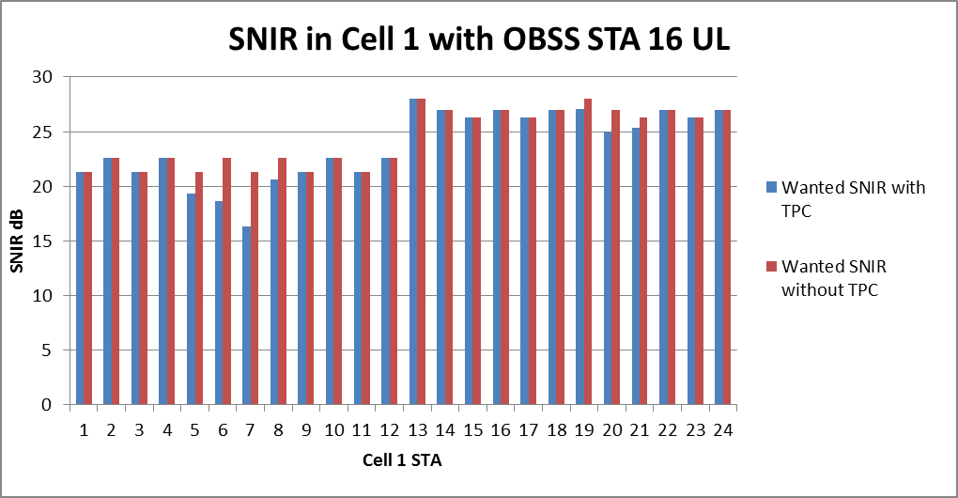
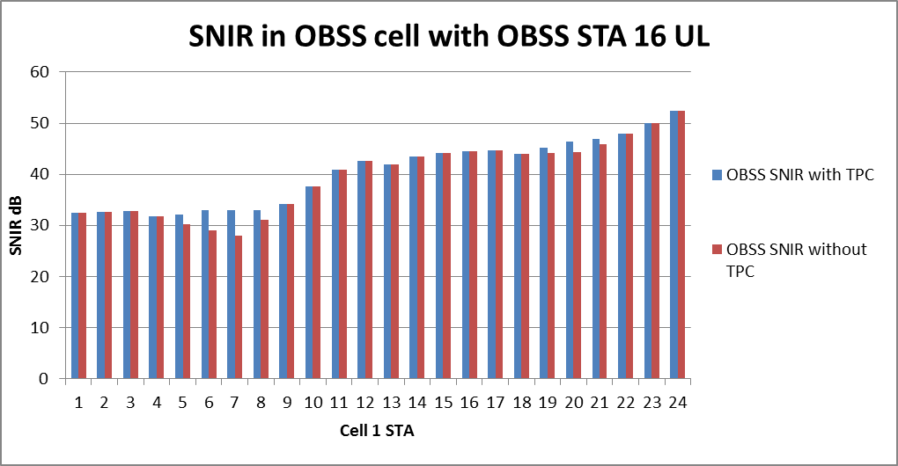
Wanted SNIR with interference
From OBSS STA 16
Again TPC causes
Wanted SNIR to drop
below 20dB
For most STAs,
none or little TPC
Well above 20 dB with
or without TPC

Slide 18
Summary for UL UL
The assumed TPC scheme is not good
  True it protects the OBSS, but causes poor wanted SNIR in too many cases
  No real incentive to apply TPC as better off for the STA if it is not applied.
Need to make a better decision on when to transmit based upon more than just apply TPC and go
In the UL, UL situation the better result is if TPC was not used

Slide 19
Now we look at UL, DL

Slide 20
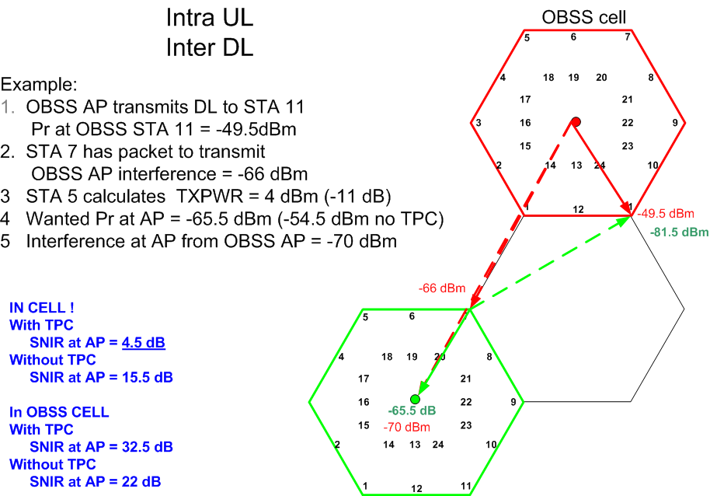

Slide 21
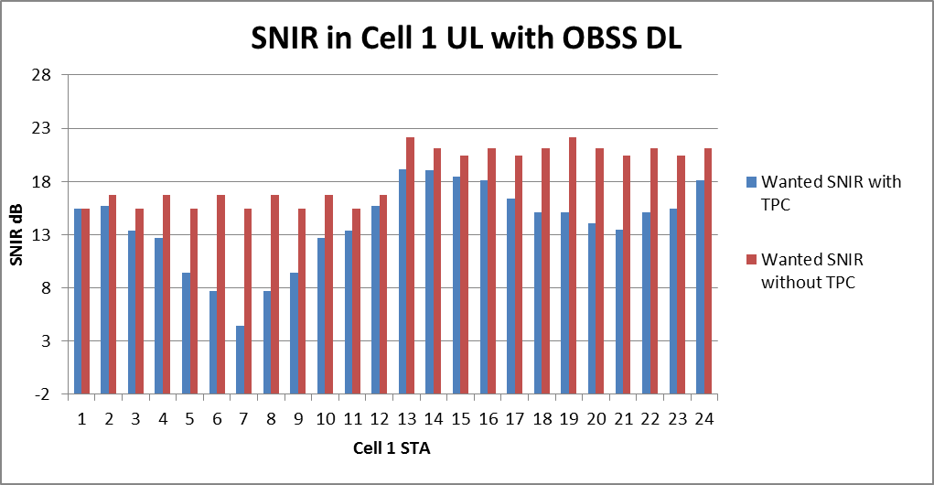
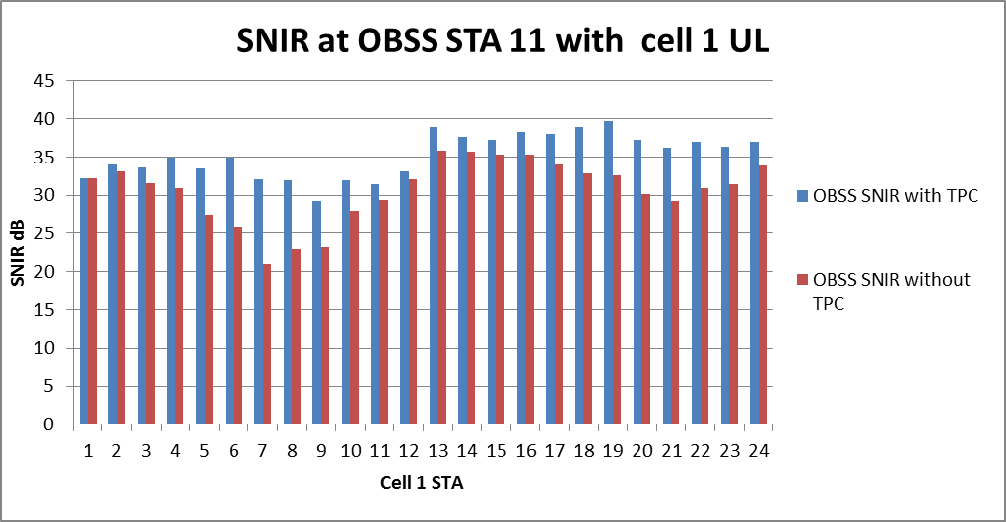
Lower SNIR overall due to OBSS AP
Closer OBSS STAs increase TPC
worsens wanted SNIR significantly
(AP to AP interference)
OBSS STA 11 DL SNIR above 20dB
TPC does reduce interference but not really needed

Slide 22
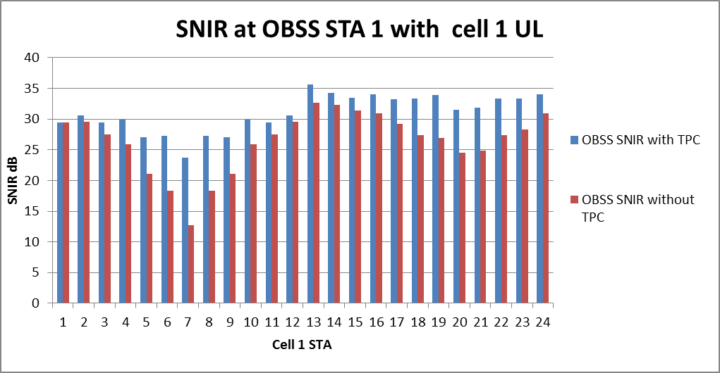
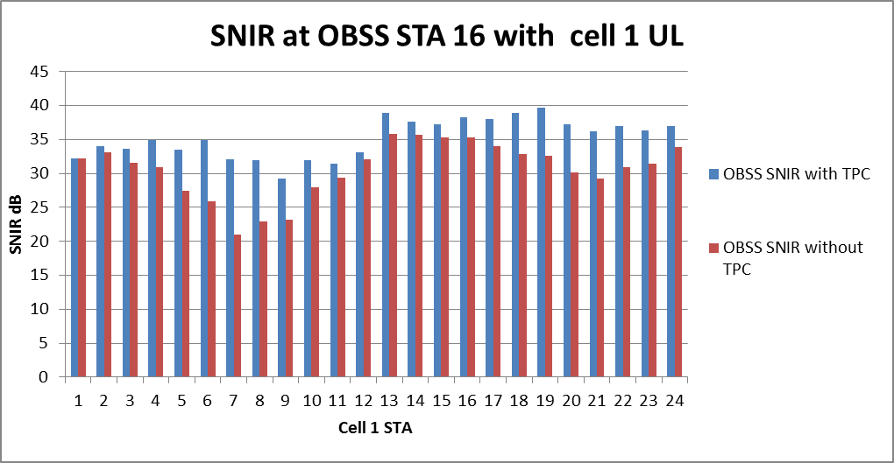
Worse case in the OBSS
(STA 1 is closest to cell 1)
TPC does reduce interference
BUT
Wanted SNIR is low
Typical case in the OBSS
Above 20dB SNIR
with or without TPC

Slide 23
Summary for UL DL
The OBSS AP means that the UL wanted SNIR is lower for the outer STAs (15 dB)
If TPC used the UL SNIR goes very low for many STAs
In the OBSS TPC does improve the OBSS SNIR DL
TPC using the assumed scheme is not acceptable
Need a better method for decision to transmit

Slide 24
Now we look at DL, UL

Slide 25
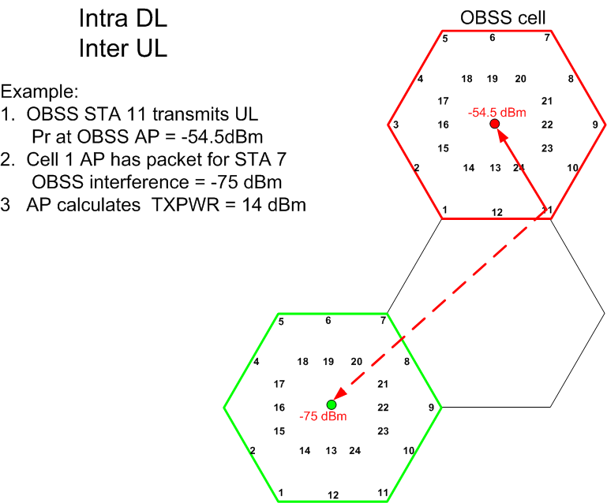

Slide 26
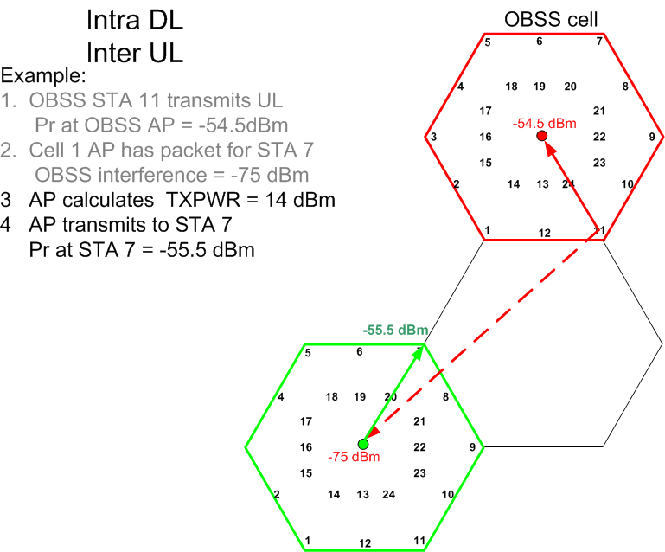

Slide 27
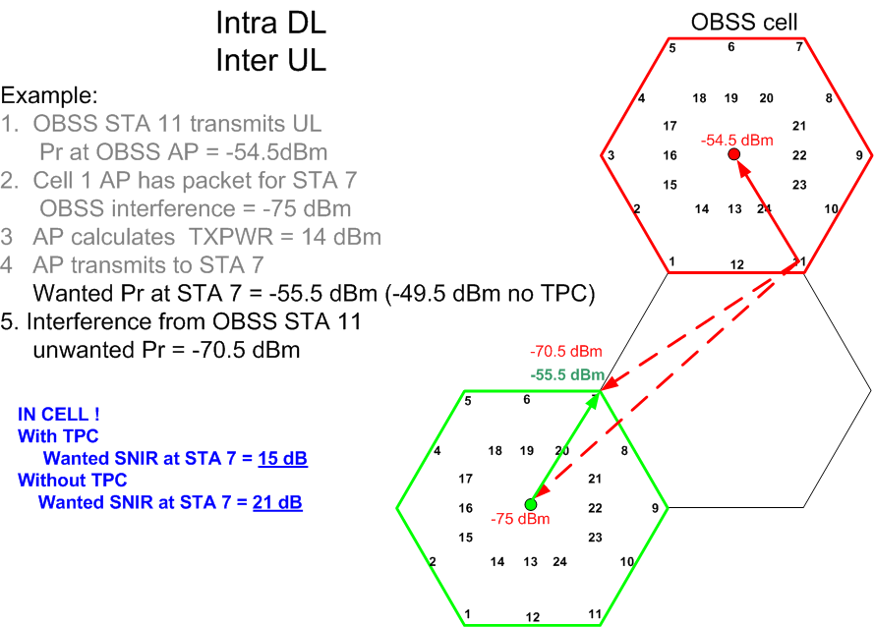

Slide 28
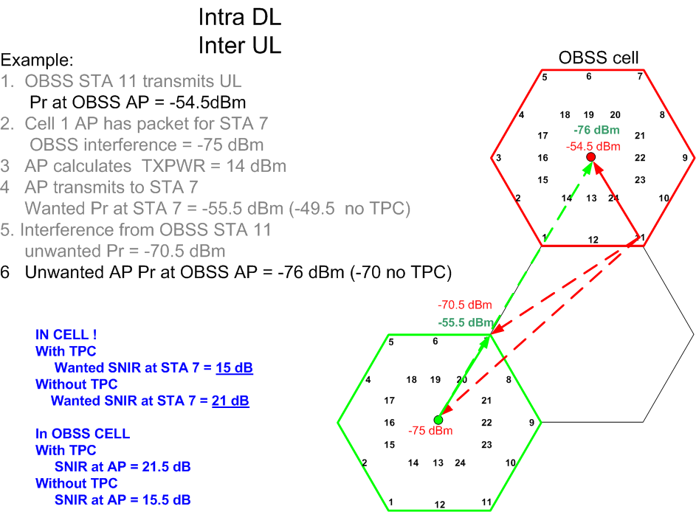

Slide 29
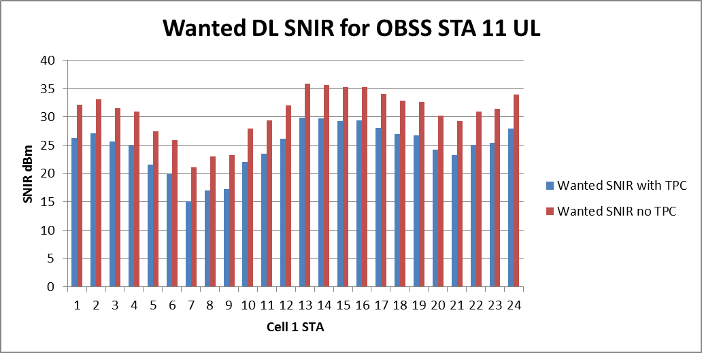
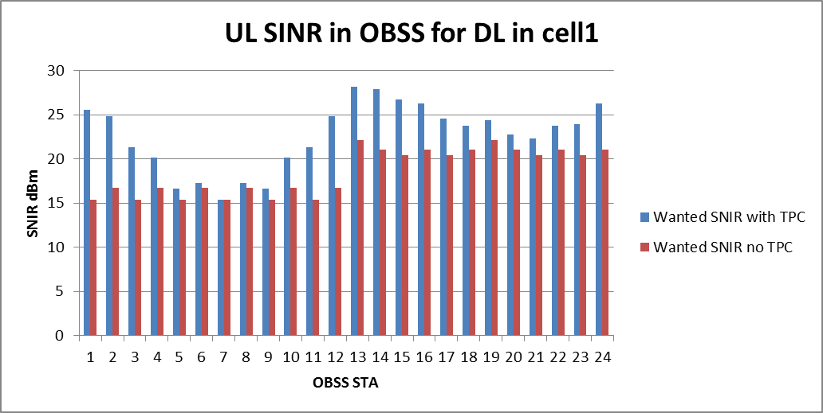
Wanted DL for OBSS STA 11 UL
SNIR>20dB if no TPC
(STA 7 is closest )
UL SNIR in OBSS for Cell 1 DL transmissions
(Lower values as AP is
interferer)
(OBSS STA 7 is furthest
So no TPC)

Slide 30
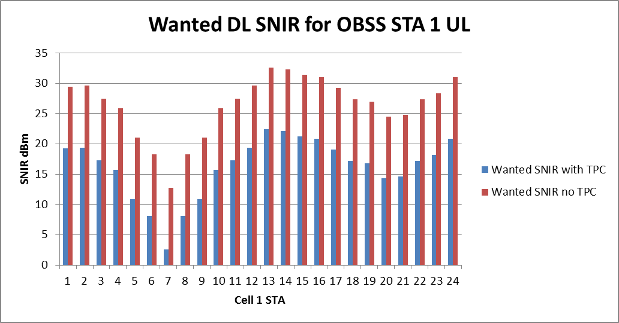
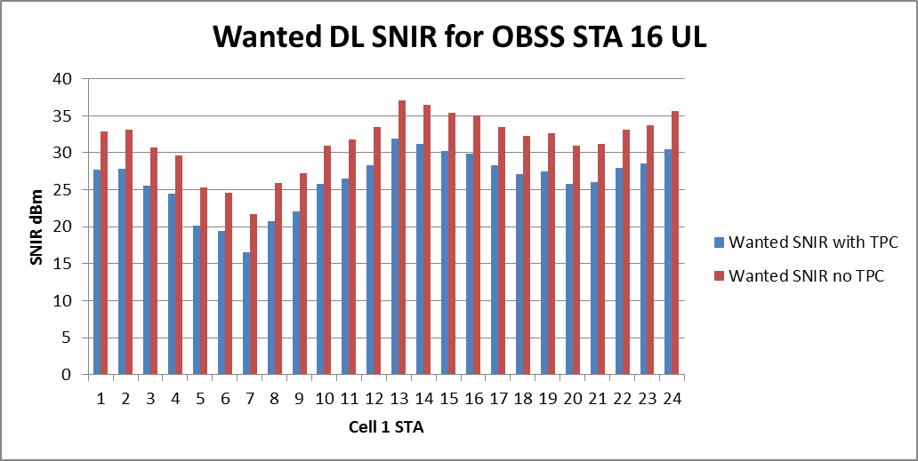
Worse case
OBSS STA 1 is closest
Typical case

Slide 31
DL UL Summary
Again OBSS_PD/TPC does not perform well
Better results if no TPC
Need better decision on when to transmit

Slide 32
Now we look at DL, DL

Slide 33
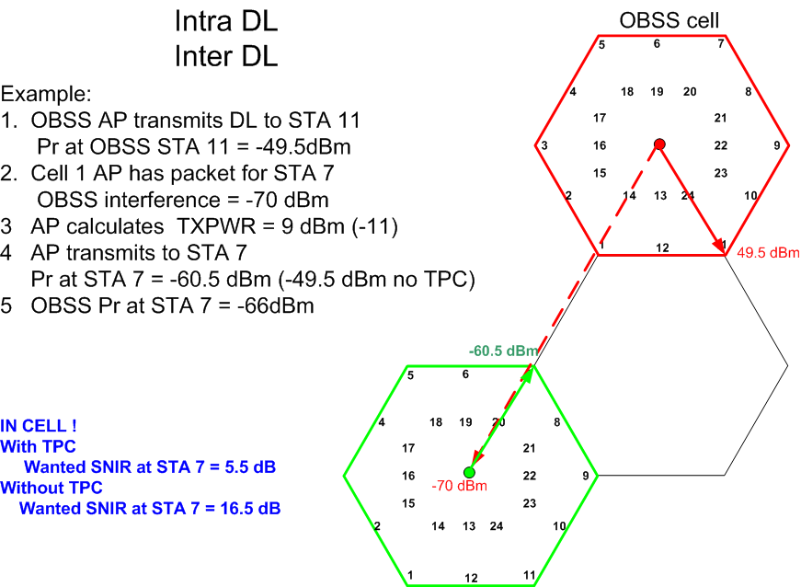

Slide 34
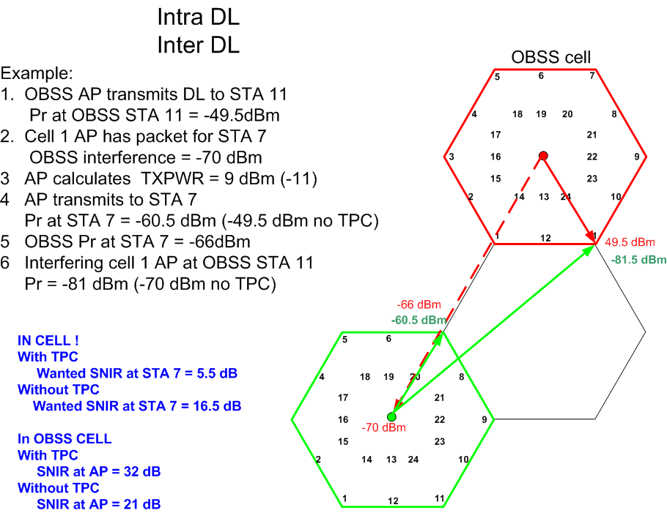

Slide 35
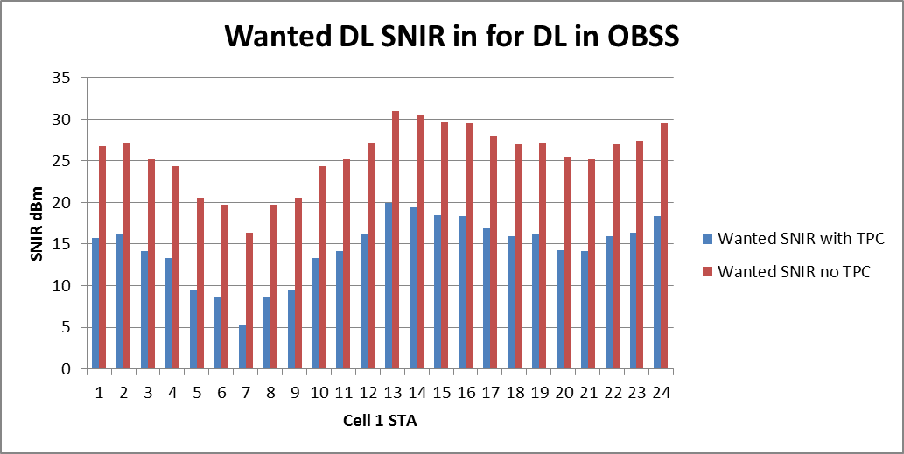
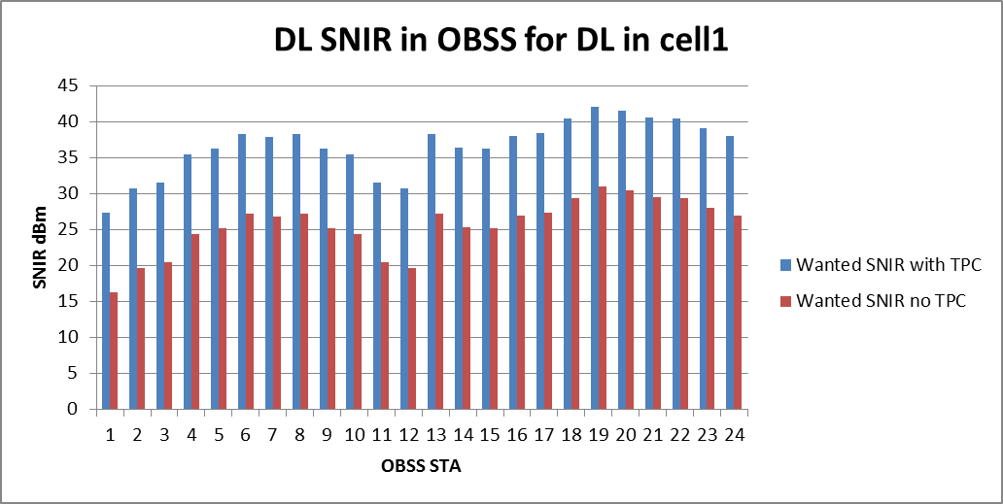
STA 7 is closest to
OBSS AP
SNIR 16 dB reduced to 5 by TPC
OBSS STA 1 is closest to
Cell 1 AP (then STA 12)
SNIR 16 dB increased to 27 by TPC
Only 3 OBSS STAs below 20dB
With no TPC

Slide 36
DL DL Summary
TPC causes the wanted SNIR to remain below 20dB for all STAs
whereas without TPC SNIR >20dB for all STAs except one (7) (16 dB cf 5 dB withTPC)
TPC improves the SNIR in the OBSS but even without it the SNIR > 20 dB for all STAs except 1.

Slide 37
Conclusion
It is clear that a simple use of OBBS_PD and TPC does not work.
A better decision process is required.

Slide 38
Can DSC help?
A STA using DSC will set its effective CCA level to the received signal strength of the wanted beacon, minus a margin
CCAeff = MIN (DSC Upper Limit, RSSI _{beacon} ) – DSC Margin
DSC Margin is related to wanted SNIR, say 20 dB
DL beacon is 7 dB stronger than UL packet, hence DSC Margin for STA set to 27dB
AP Threshold setting
Weakest UL is -55dBm, with 20dB margin
AP sets threshold to -75 dBm

Slide 39

UL, UL situation
Take worse case example OBSS STA 1 UL.
DSC prevents transmission of STAs 4 - 10, and 19 -21
  (These are the closest cell 1 STAs to OBSS STA 1)
In this case, using DSC to make the decision to transmit overcomes worse of the TPC problem.
Still no real incentive or need to use TPC as it worsens the wanted SNIR

Slide 40
DSC would stop STA 6-9 from transmission
DSC would stop STA 5-9 from transmission
For UL, UL using DSC to make decision is perfect

Slide 41
UL, DL
OBSS AP is the interferer.
DSC allows Transmit only on
STAs 13 – 17 and 24
TPC does cause wanted SNIR to be
Lower than 20dB
DSC is perfect for UL DL
No advantage to use TPC

Slide 42
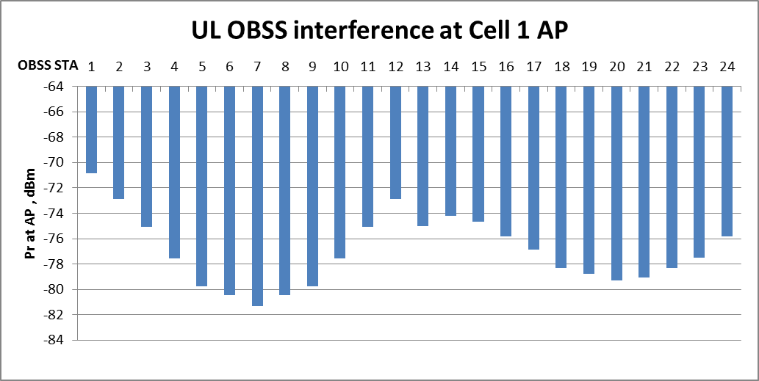
For DL UL
Worse case
OBSS STA 1 is closest to Cell 1 AP
Unwanted Pr = -71 dBm
AP (DSC) CCA is set to -75dBm
DSC Stops AP from transmitting
If OBSS STA 1 is transmitting
AP Threshold – AP transmits if below
So let’s look at OBSS STA 16 situation

Slide 43
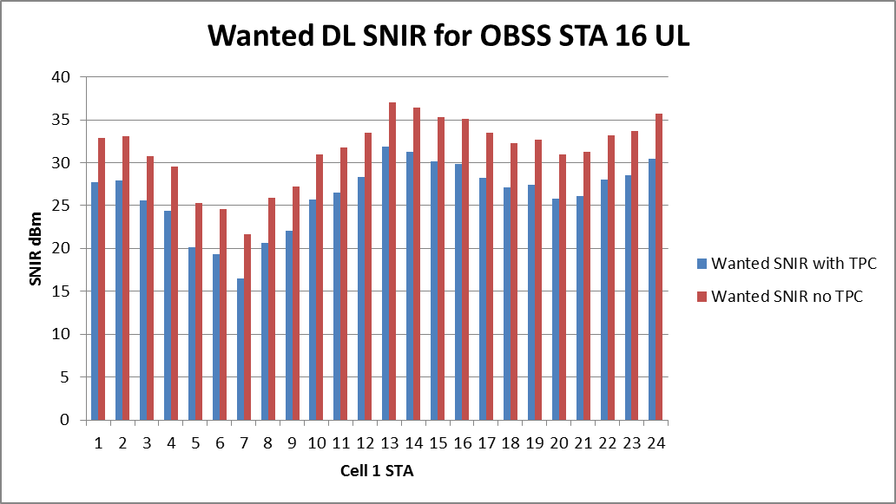

DL, UL
DSC allows this
Without TPC, 0 STAs <20 dB
With TPC 3 STAs <20dB
DSC makes a good decision but
TPC does not help
AP to AP interference
Resulting interference in OBSS
DSC stops 1-3, 11-15
TPC does not help much
But case can be made to use TPC
As long as DSC used

Slide 44
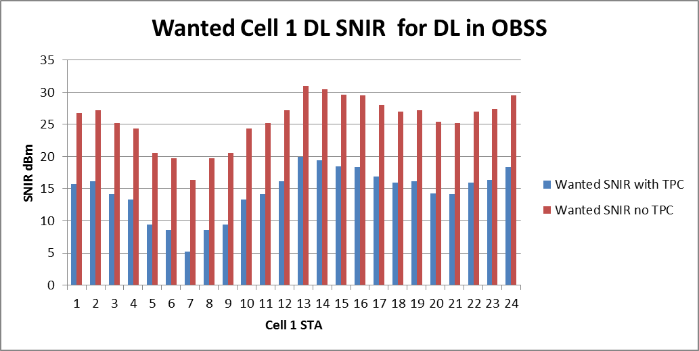
DL, DL
OBSS AP to AP is -70 dBm
All or nothing
DSC prevents DL if OBSS AP is transmitting
Note: One could contrive a method where the AP estimates the signal to the STA, but as STAs are mobile this is dangerous.

Slide 45
Effects of using DSC 3CH cell
OBSS_PD/TPC on its own results in many cases of poor SNIR and is not viable
Using DFC and OBSS_PD/TPC is an option
  Using DFC to make the transmit decision works well
  results in poorer performance in wanted Cell (incentive?)
  Improves performance in the OBSS
Using DFC on its own provides the better results
Note: These results are for the enterprise cell scenario

Slide 46
Let’s look at another scenario
Indoor Enterprise

Slide 47
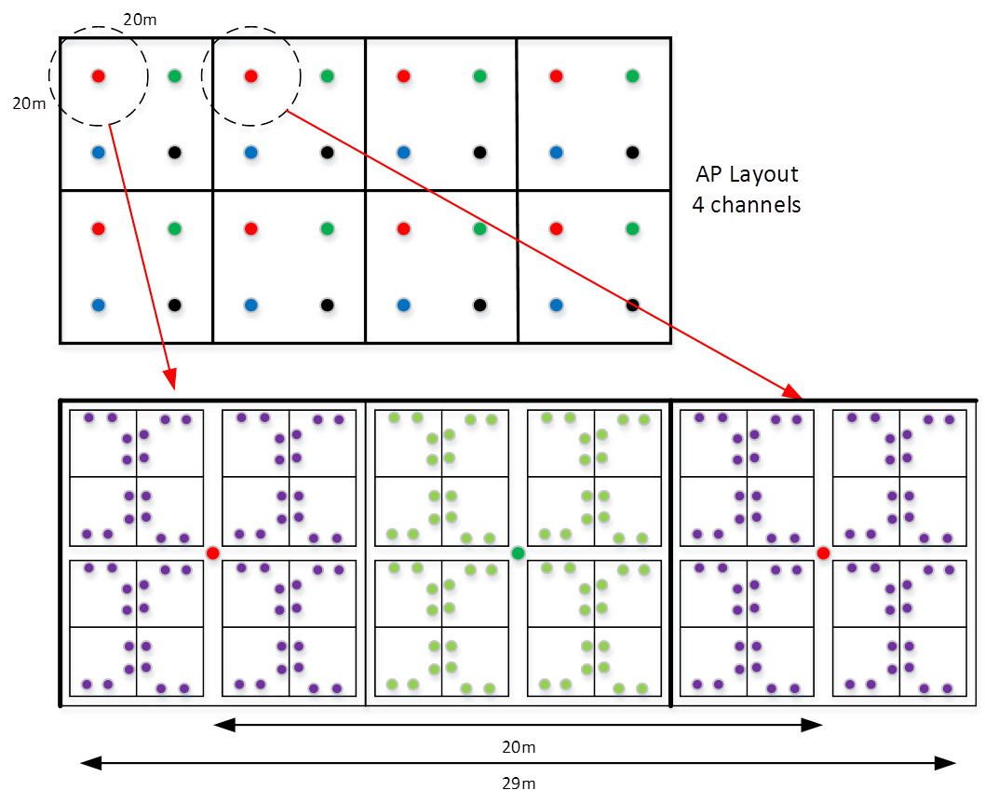
Indoor Enterprise Scenario

Slide 48
Complete OBSS, 100%
-45 dBm
OBSS
49
53
57
61
64
STA 9
Worse case
9
33
37
41
45
AP to AP -64 dBm
9
13
25
29
12
16
32
4
8
1
5
17
21
-80 dBm

Slide 49
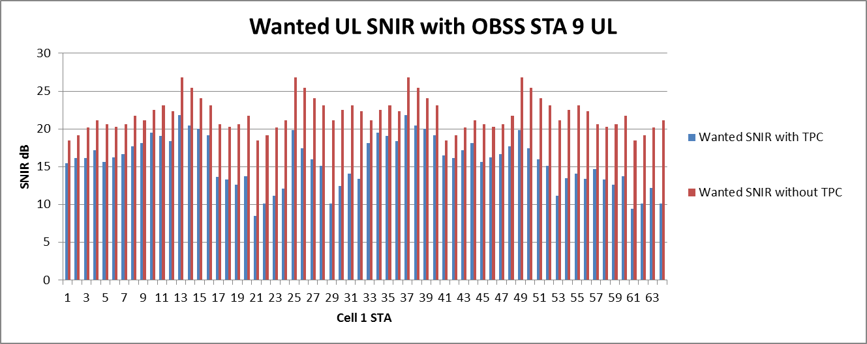
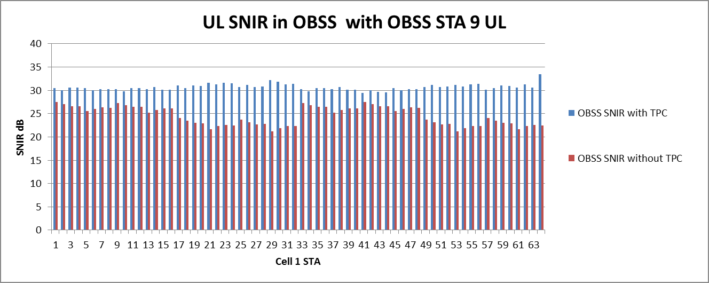
Worse case UL, UL
Without TPC
Generally OK
With TPC <10dB SNIR
In too many cases
OK with or without TPC
>20dB
Clear case where TPC
Should not be used

Slide 50
Worse case UL, UL
With DSC
Without TPC
Generally OK
With TPC <20dB SNIR
DSC stops 1, 17-24,28-32, 52-64
Stops worse TPC SNIR
but TPC SNIR is still low
OK with or without TPC
>20dB
Clear case where TPC
Should not be used

Slide 51
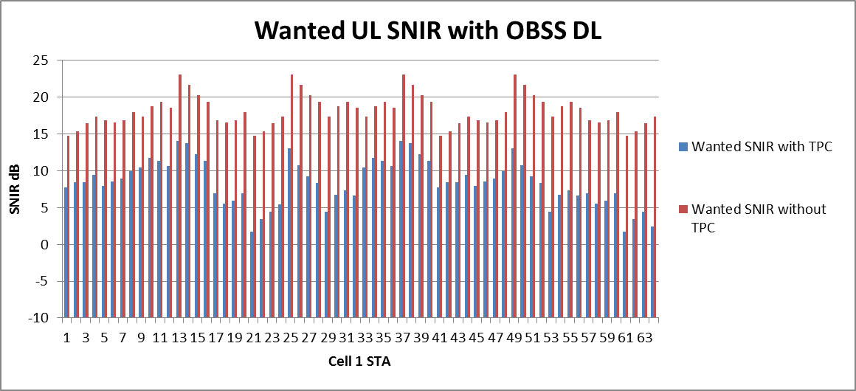
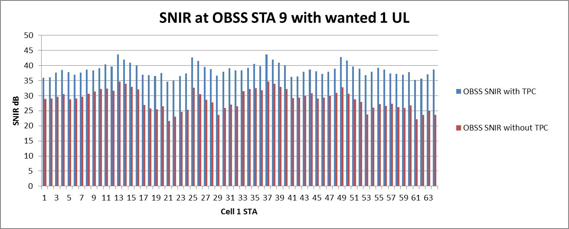
UL, DL
SNIR 15- 20dB
With TPC 2-10dB
OBSS AP is the interferer
Worse Case
(OBSS STA9 is closest)
OK with or without TPC
>20dB

Slide 52
UL, DL
With DSC
DSC allows only
13-15, 25, 37-39, 49
No TPC SNIR>20dB
with TPC SNIR<13dB
Pretty Good if no TPC!
Worse case
OK with or without TPC
>20dB
Clear case where TPC
Should not be used

Slide 53
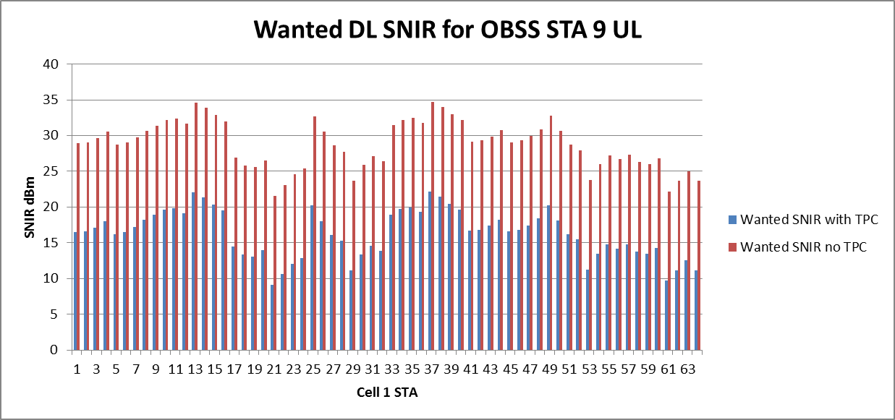
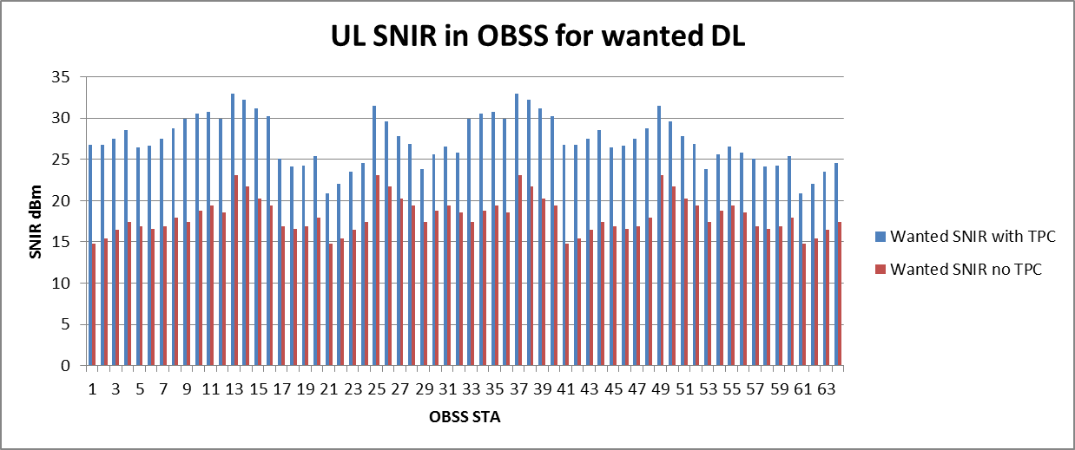
Worse case DL, UL
Without TPC great
Generally >25 dB
With TPC 10-20dB SNIR
TPC drops wanted
To <15 dB in many cases
BUT inverse effect to
wanted
Drops the OBSS SNIR
AP to AP interference

Slide 54
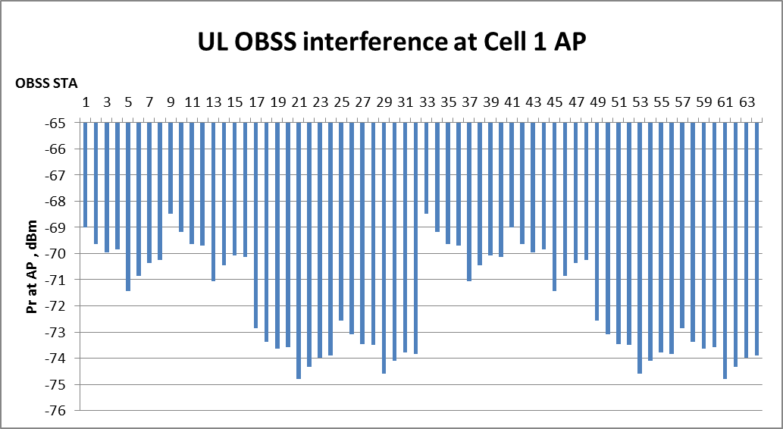
Worse case DL, UL
With DSC
DSC prevents any
Transmission
Does the right thing
For OBSS STA 9
AP DSC Threshold
= -70dBm
Let’s look at OBSS
STA 16 (DSC allows TX)

Slide 55
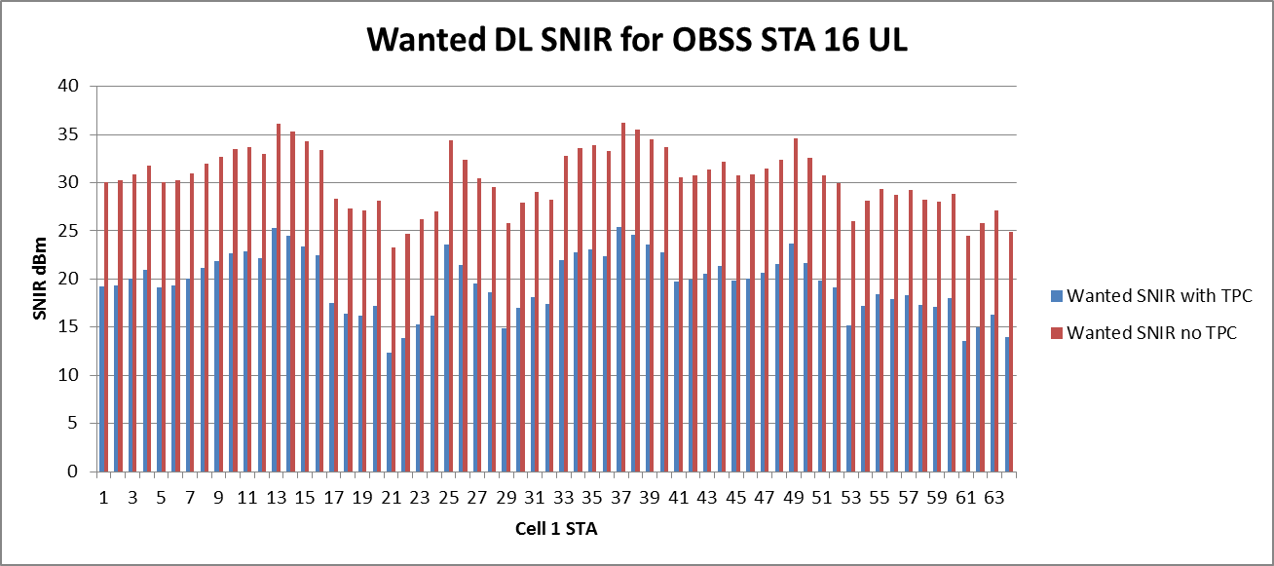
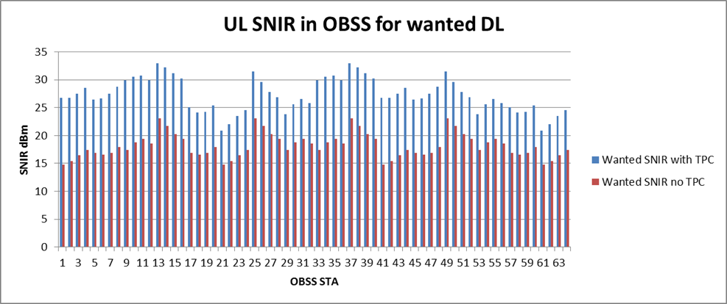
DL, UL
Wanted Looks good no TPC
Inverse of the wanted cell
DSC keeps OBSS SNIR > 15dB
Case can be made for TPC
with DSC but not that obvious

Slide 56
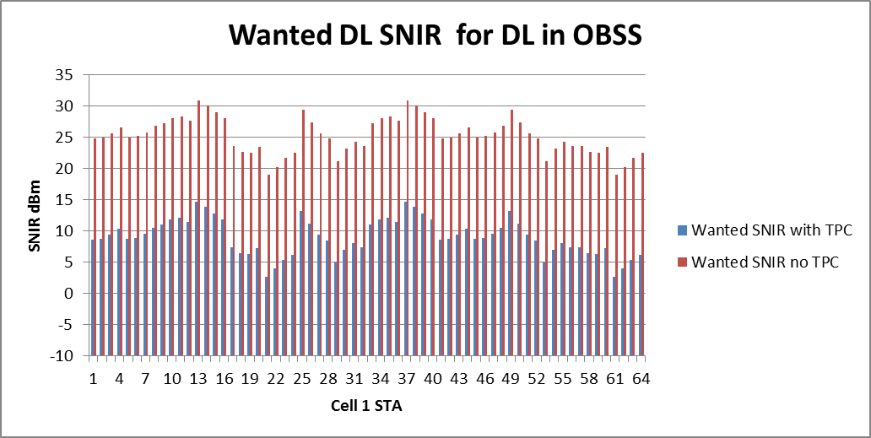
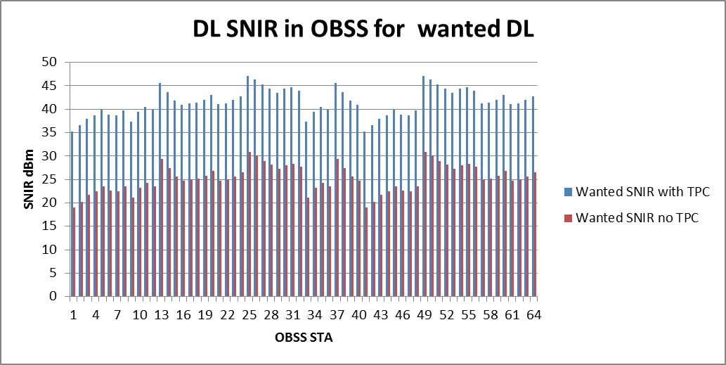
DL, DL
Wanted Looks good no TPC
With TPC <10dB SNIR
No TPC > 20dB
(bar 2 out of 64)
Not acceptable

Slide 57
DL, DL
OBSS AP to wanted AP = -65dBm
AP threshold is -70dBm
So DSC stops all
DL, DL transmissions
Note, in this case DSC is being conservative, as no-TPC ( DSC only) is OK, but we saw in the cell scenario it did the right decision.
OBSS_PD/TPC does not work.

Slide 58
Conclusions Indoor Enterprise
OBSS_PD/TPC as defined is not acceptable
OBSS_PD/TPC with DSC making transmit decision is much better, but for UL/UL and UL/DL conditions TPC produces poor wanted SNIR.
DSC on its own is better option

Slide 59
Way Ahead?
Leave as is
  OBSS_PD with TPC undefined as to how to use it or how to set the OBSS_PD level
  Results in low SNIR for the wanted signal in many cases
  Impossible to test or evaluate
Use DSC to make transmit decision but hard couple to OBSS_PD
  DSC used for decision to transmit or not, but TPC still used coupled to the OBSS_PD level corresponding to the Pr of the OBSS signal
  Provides a defined procedure that stops many transmissions that result in poor SNIR
  Tends to produce worse (bad) wanted SNIR in exchange for better OBSS SNIR,
  Can be tested and evaluated
Use DSC independently (only for inter-BSS packets)
  No real advantage in using TPC, in fact quite the opposite, so why do it?
Allow both 2) and 3)
  Let the market decide

Slide 60
Straw Poll
In response to 17/0582, which option(s) do you prefer as the way ahead for spatial reuse in 11ax?
May vote for more than one
Leave as is ?
Use DSC to make transmit decision but hard couple to OBSS_PD/TPC NON SRG PD, and SRG PD ?
Use DSC independently (inter-BSS only) ?
Allow both 2) and 3) ?
Results
1 -
2 -
3 -
4 -
Note: If 2), 3) or 4) then will bring text

