Slide 1
1st Vice Chair Report –
May 2017 – Deajeon, S. Korea
Date: 2017-05-08
Authors:

Slide 2
Abstract
Agenda Items for 1st Vice Chair -
M3.3 II Other WG meeting plans
M3.4 II Meeting room locations
M3.5 II Next meeting reminder
M3.6 II Meeting registration
M3.7 II Recording attendance
M3.8 II File server
M3.9 II Breakfast, breaks, Social logistics
Friday:
  F3.1.1 II Straw Poll of membership regarding this meeting location
  F3.1.2 DT Future venues status and discussion

Slide 3
Monday–
802.11 Opening Plenary
802.11 First Vice Chair Report

Slide 4
M3.3 Other WG meeting plans
802.11 802.15 802.16 802.18 802.19 802.21 802.24
Treasurer Report: 11-17/0565r1
Patent policy (in IEEE-SA bylaws), patent policy (slide set), and antitrust guidelines

Slide 5
M3.4 Meeting room locations
Download the Combined Meeting Schedule
MEETING MAP (FLOOR PLAN) next slide

Slide 6
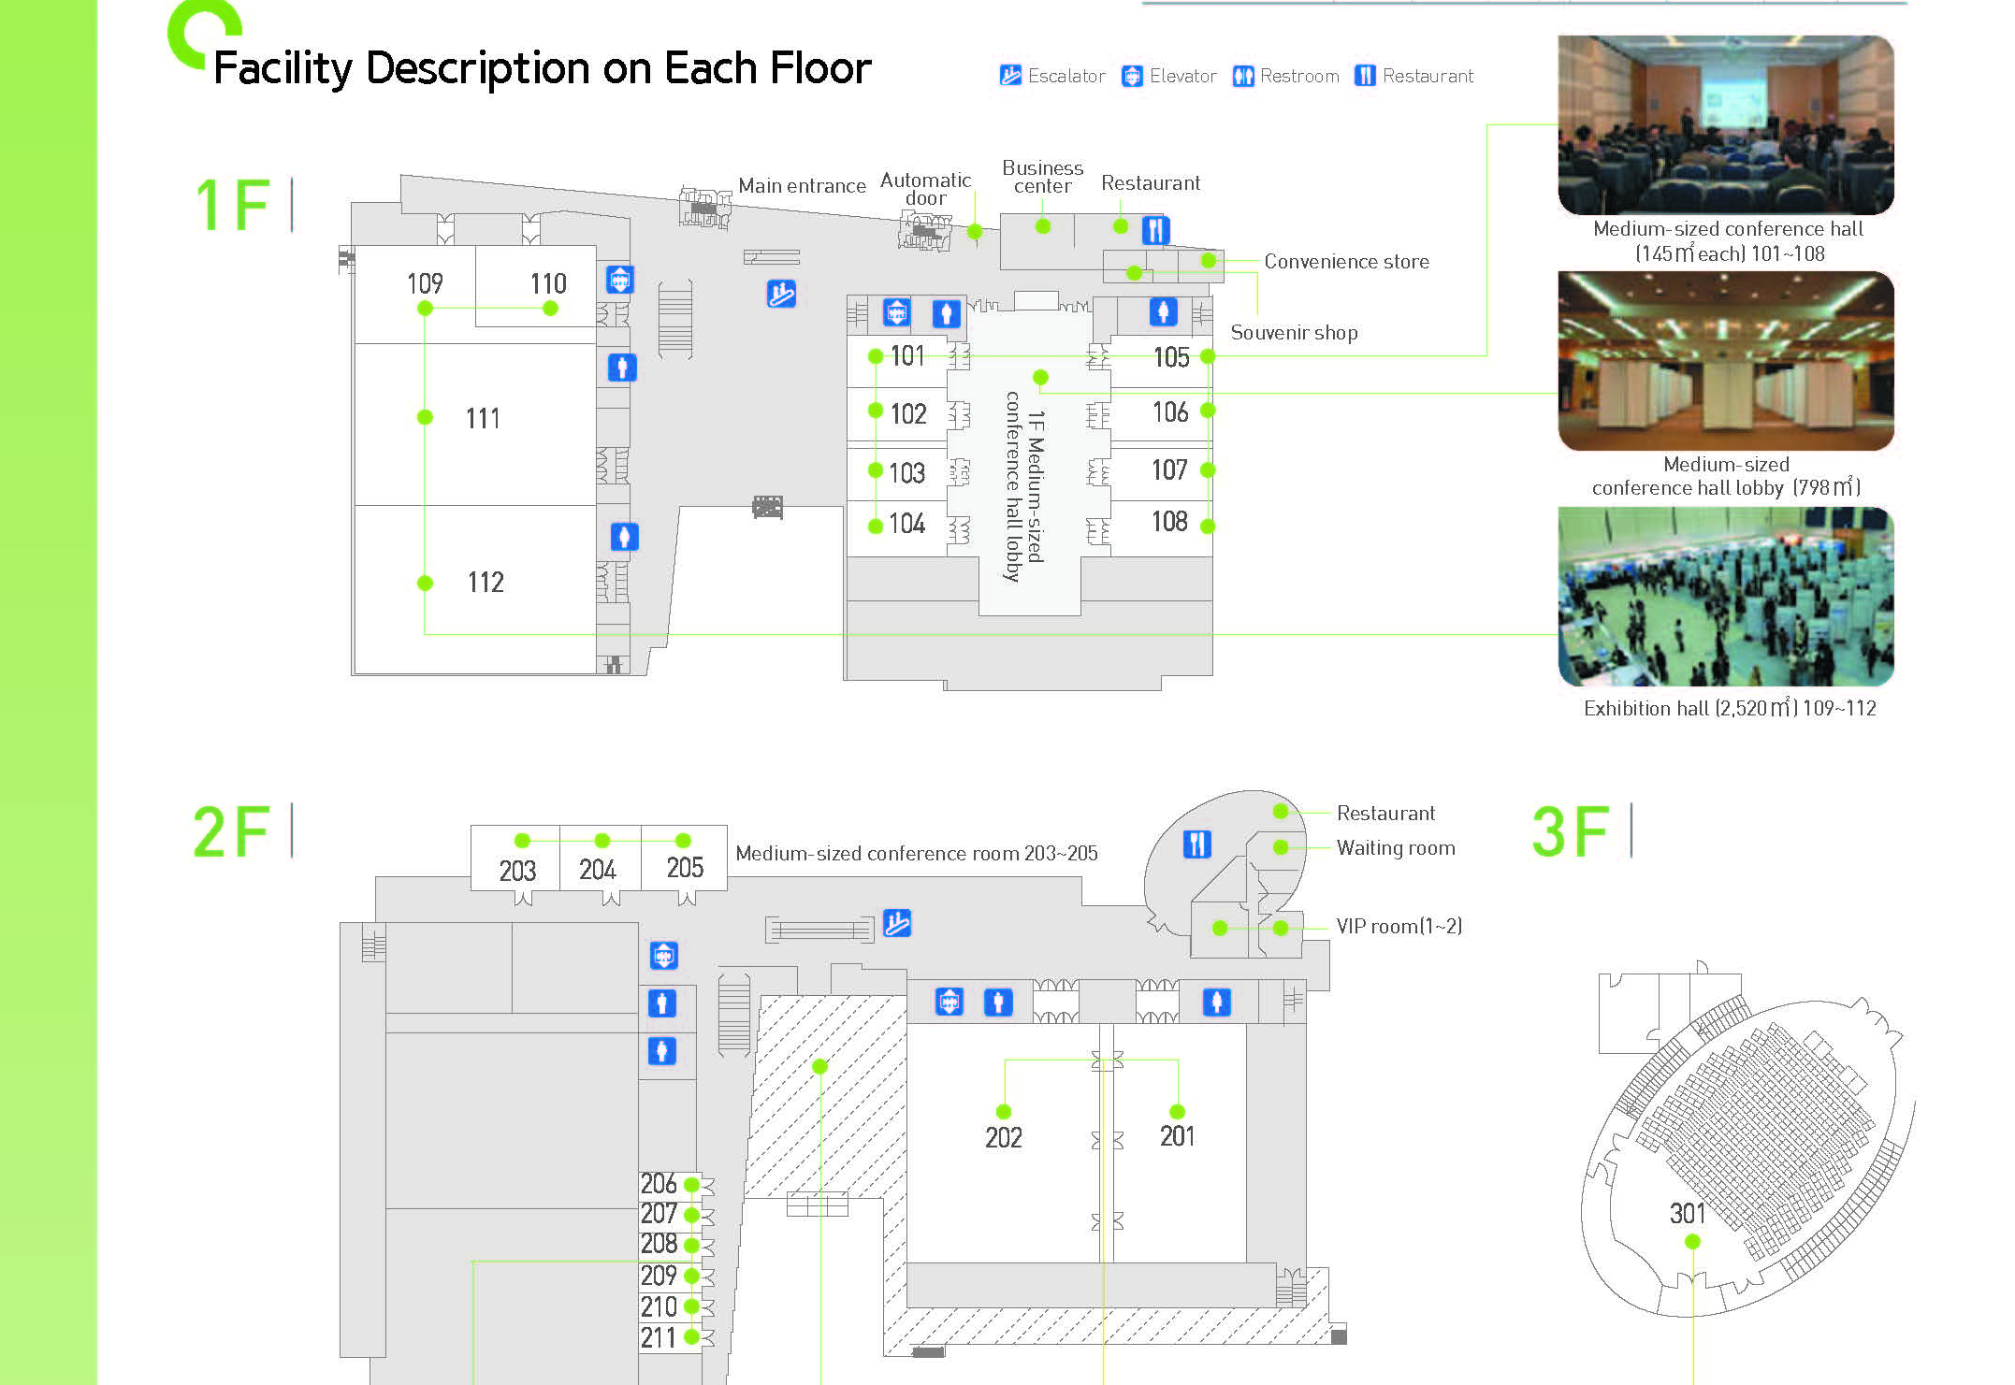

Slide 7
Online Calendar
This session’s meetings are also shown on the 802.11 calendar on the 802.11 home page (http://www.ieee802.org/11).
This is a Google calendar “802_11_calendar@ieee.org”
There are multiple ways of accessing this information, for example from a cell-phone, or as a remote calendar.
Note: the schedule on this calendar will be updated as will IMAT.

Slide 8
M3.5 Next meeting reminder
802 Plenary: 9-14 July 2017 –
  Estrel Hotel and Convention Center, Berlin, Germany
  Event Information and Registration
  Hotel Reservation
  REGISTRATION FEES & DEADLINES
  Early Registration
  * $US 450.00 for all attendees
  * Deadline: 6:00 PM Pacific Time, Friday, May 19, 2017
802W Interim: 10-15 Sept 2017 –
  Hilton Waikoloa Village, Kona, HI, USA
  Registration targeted to Open 10 July 2017
  Early-Bird Meeting Registration Deadline: 11 Aug 2017
Notes:
Report version R0 and R1 had an error on the date of Early-Bird Registration Deadline – 19 May is correct.

Slide 9
M3.7 Recording attendance
It is a requirement that attendees record their participation at an 802.11 session and declare their affiliation. This record is usually made using the IMAT attendance system.
  If you wish to participate without recording attendance, send an email per session to the WG 2nd vice chair declaring your participation and affiliation. You cannot gain or maintain 802.11 voting membership using this method.
You must record 75% attendance of required 802.11 slots in a session for that session to count towards gaining or maintaining 802.11 voting membership
  You need a single IEEE-SA web account
    The IEEE SA web account requires a working email address
    do not remove your email address from the account
  Use the email address associated with that web account when registering attendance
    If you change email addresses, update the web account, don’t create a new web account, or your membership status may not be calculated properly
  Record attendance using this URL: IMAT.IEEE.ORG/

Slide 10
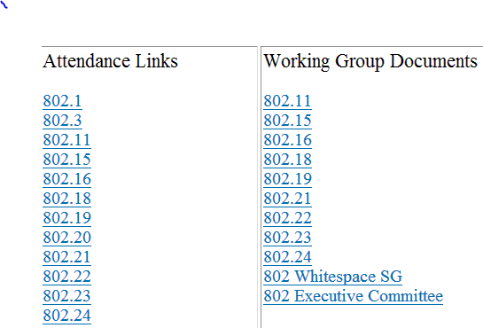
M3.8 Local File Document Server information
Local FTP server: ftp://griffin.events.ieee.org (anonymous)
External Document Server https://mentor.ieee.org/802.11/documents

Slide 11

Meals
- Breakfast is included in your room rate
- Morning and Afternoon tea will be served in the foyer areas on level 1 and 2
- Lunch will be available from 1200 – 1330 and will be served on Level 2, in Room 202
M3.09 FOOD & BEVERAGE

Slide 12
Network Assistance
WIRED CAFÉ
    Level 1:
    Please report any disruption of service in the café to Linespeed Events staff.
NETWORK HELP DESK
    For attendees experiencing difficulties accessing the meeting network a Help Desk NETWORK HELP DESK
    Network Help is available in near the Registration Desk.

Slide 13
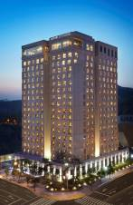
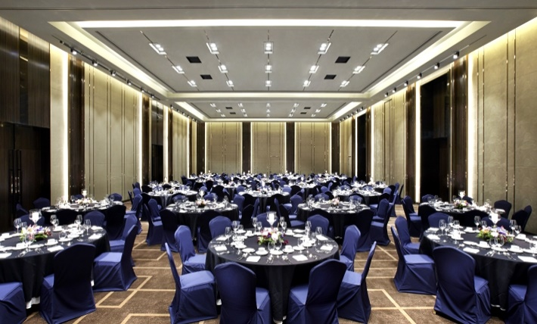
Wednesday Evening Social
The Wednesday Social is included in your meeting fee for all attendees, below are the details. We look forward to you joining us.
Venue: Crystal Ballroom, Level 1, The Lotte City Hotel Daejeon
Timings: 630pm – 930pm
Cultural performance: 715pm
Dinner: Buffet sit down,
Soft drink, wine, beer and local Korean beverage included

Slide 14
802.11 Mid-Week Plenary
Agenda Items:
2.5 – Announcements
5.1 – Room Change Reports

Slide 15
W5.1 Room Change Requests
Cancel:
Add:

Slide 16
802.11 WG Closing Plenary
Agenda Items:
3.1.1 – Straw Poll
3.1.2 -- Future venues status and discussion

Slide 17
F3.1.1 -Straw Poll regarding this meeting location
Straw Poll:
How many people would like to come back to this venue?
Yes -
No –
Like the Social –
Disliked the Social – 0
Did not go to Social –

Slide 18
F3.1.2: Future Venue Insight
Future 802 Wireless Interims:
Sept 2017 Hilton Waikoloa
Jan 2018 Hotel Irvine
May 2018 Marriott Warsaw, Poland
Sept 2018 Hilton Waikoloa

Slide 19
F3.1.2: Future Venue Insight
Future 802 Plenary Sessions:
  July 2017 Estrel Hotel – Berlin
  Nov 2017 Caribe Hotel and Convention Center – Orlando, FL
  March 2018 Hyatt Regency O’Hare – Rosemont, IL
  July 2018 Manchester Grand Hyatt – San Diego, CA
  Nov 2018 Suzhou, China - TBC
    (New facility, pricing model being negotiated, Sponsor capability investigation)

Slide 20
References
Plenary Meeting Status File: EC-16/66r0
https://mentor.ieee.org/802-ec/dcn/16/ec-16-0066-00-00EC-802-plenary-future-venue-contract-status.xlsx
802 Executive Secretary Report: EC-17/36r0
https://mentor.ieee.org/802-ec/dcn/17/ec-17-0036-00-00EC-executive-secretary-agenda-items-march-2017-plenary.pptx

