Slide 1
802.11 Working Group Opening Report
May 2017
Date: 2017-05-07
Authors:

Slide 2
Introduction
This presentation, together with the reports cited on the next slide, forms the opening report of the IEEE 802.11 Working Group for May 2017.
Subgroup status is reported in the “Snapshots” submission (see documents slide for link). This is incorporated by reference into this opening report.
“Mx.y.z” terminology indicates that the item was on the tentative agenda for the Monday 802.11 plenary, and was agenda item x.y.z.

Slide 3
Introductions – Sponsor
We gratefully acknowledge ETRI who have sponsored this meeting.
We also recognize and thank the following individuals for their help setting the meeting up:
  Byung-Jae Kwak
  Jae Seung Lee

Slide 4
M1.3 Meeting Decorum
%
Photography or recording by permission only (December 2014 IEEE-SA Standards Board Ops Manual 5.3.3.2)
Press (i.e., anyone reporting publicly on this meeting) are to announce their presence (December 2015 IEEE-SA Standards Board Ops Manual 5.3.3.3)
Laptop speakers, cell phone / tablet ringers off
Wear your badges at all times in meeting areas
  Help the hotel security staff improve the general security of the meeting rooms
  Laptops HAVE BEEN STOLEN at previous meetings
  DO NOT assume that meeting areas are secure
Please observe proper decorum in meetings

Slide 5
M2.3.1 Summary of Liaisons
Outgoing from last session:
  LC Stakeholder Liaison Statement: 11-17/0272r3
  802 Liaison (from PDED): 11-17/292r4 became ec-17/65r0

Slide 6
M 2.4 Other project of interest – P1932.1
Title: Standard for Licensed/Unlicensed Spectrum Interoperability in Wireless Mobile Networks
Scope: This standard defines a mechanism for communications among entities operating in licensed and unlicensed spectrum. The mechanism includes interoperation among MAC/PHY protocols designed for unlicensed and licensed spectrum operations and a controller for coordination among communicating entities.
Need for Project: This standard is needed to enable interoperability among devices designed for licensed and unlicensed frequency spectrum, including WiFi and LTE devices, which currently there is no such mechanisms

Slide 7
M 2.4 Other project of interest – P1932.1 (cont)
Additional Explanatory Notes: The introduction of CCA slot structure and alignment in LAA channel access in the 3GPP TSG RAN WG1 Meeting #82 document R1-154065 introduce an ECCA slot to align the CCA slots to a baseline CCA slot structure and to avoid being unsynchronized with OFDM symbol boundaries. However, this solution is provided for in-channel transmissions over unlicensed and does not cover the multi-channel alignment problem.
802.11 Chair has invited P1932.1 Chair to brief the WG on what they are doing

Slide 8
M3.1 802.11 Working Group Session Documents
WG Session Reports
WG Agenda | https://mentor.ieee.org/802.11/dcn/11-17-0536
Opening report | https://mentor.ieee.org/802.11/dcn/11-17-0537
Snapshots | https://mentor.ieee.org/802.11/dcn/11-17-0560
1st vice chair | https://mentor.ieee.org/802.11/dcn/11-17-0566
2nd vice chair | https://mentor.ieee.org/802.11/dcn/11-17-0561
Treasurer | https://mentor.ieee.org/802.11/dcn/11-17-0256
Supplementary Material | https://mentor.ieee.org/802.11/dcn/11-17-0538
Motions | https://mentor.ieee.org/802.11/dcn/11-17-0562
Closing report | https://mentor.ieee.org/802.11/dcn/11-17-0563
Previous Session Minutes | https://mentor.ieee.org/802.11/dcn/11-17-0339

Slide 9
M3.2 Joint meetings and Reciprocal Credit
Reciprocal credit is provided to 802.11 voters for attendance at: 802.18, 802.19, 802.24, 802.1**
  Reciprocal credit for 802.1 is for 801.1Qbz, 802.1CF, 802E, 802c
** When meeting

Slide 10
M3.10 802 EC and IEEE-SA Standards Board decisions
The EC Approved
  P802.11ak Conditional sponsor ballot
  P802.11aj Unconditional sponsor ballot
  P802.11 revision PAR
  802 liaison to RAN/RAN1/RAN4 from PDED (11-17/292r4)
The SASB approved
  P802.11 revision PAR

Slide 11
M3.10 802 EC and IEEE-SA Standards Board decisions - continued
The SASB resolved
  “In regards to P802.11ax, the SASB concluded that the measures are effective, SASB oversight will continue, and notes that a ProCom Ad Hoc was formed to determine whether changes are needed in IEEE-SA policies and procedures regarding dominance”
The Procedures Committee (ProCom) of the SASB also formed an ad-hoc (“ProCom ad-hoc on Interest Groups”), following a presentation by Andrew Myles
  19 members, including Dorothy Stanley, Andrew Myles, Glenn Parsons
  The presentation from Andrew Myles was triggered by the 802.11ax dominance remedy.

Slide 12
M4.1.1 Type of Groups
Type of Group | Description
WG | Working Group
SC | Standing Committee
TG | Task Group
SG | Study Group
TIG | Topic Interest Group

Slide 13
M4.1.1 Groups
Type | Group | Description
WG | WG11 | The IEEE 802.11 Working Group
SC | AANI | Advanced Access Networking Interface (AANI)
SC | ARC | Architecture
SC | PAR | PAR review
SC | WNG | Wireless Next Generation
802 SC | JTC1 | ISO/IEC JTC1/SC6
TG | AJ | China Milli-Meter Wave (CMMW)
TG | AQ | Pre-association Discovery (PAD)
TG | AK | General Link (GLK)
TG | AX | High Efficiency Wireless LAN (HEW)
TG | AY | Next Generation 60 GHz (NG60)
TG | AZ | Next Generation Positioning (NGP)
TG | BA | Wake-up Radio
TG | MD | Revision (REVmd)
TIG | LC | Light Communication TIG

Slide 14
M4.1.2 PAR Expiration/Renewal Schedule
Project | PAR Expiration Date
AJ | 31-DEC-2018
AK | 31-DEC-2018
AQ | 31-DEC-2018
AX | 31-DEC-2018
AY | 31-DEC-2019
AZ | 31-DEC-2019
BA | 31-DEC-2020
802.11 (REVmd) | 31-DEC 2021
http://www.ieee802.org/11/PARs/index.html

Slide 15
M4.1.3 802.11 WG Appointed positions
WG Secretary – Stephen McCann
Treasurer – Jon Rosdahl
ANA Authority – Robert Stacey
WG Technical Editors – Robert Stacey, Peter Ecclesine

Slide 16
M4.1.3 Officers
Cat | Group | Chair | Vice Chair | Technical Editor | Secretary
WG |  | Adrian STEPHENS | Jon ROSDAHL Dorothy STANLEY | Robert STACEY Peter ECCLESINE | Stephen MCCANN
SC | AANI | Joseph LEVY | Roger Marks
SC | ARC | Mark HAMILTON | Joseph LEVY |  | Joseph LEVY
SC | PAR | Jon ROSDAHL | Michael MONTEMURRO
SC | WNG | Jim LANSFORD | Lei WANG
TG | MD | Dorothy STANLEY (TBC)
TG | AJ | Jiamin CHEN | Haiming WANG | Jiamin CHEN Shiwen HE (subeditor) | Open
TG | AK | Donald EASTLAKE | Mark HAMILTON | Donald EASTLAKE Norm FINN | Open
TG | AQ | Stephen MCCANN | Yunsong YANG | Lee ARMSTRONG | Open
TG | AX | Osama ABOUL-MAGD | Simone MERLIN Ron PORAT | Robert STACEY | Yasuhiko INOUE
TG | AY | Edward AU | Sang Kim | Carlos CORDEIRO | Jeorge HURTARTE
TG | AZ | Jonathan SEGEV | Carlos ALDANA | CC WANG | Open
TG | BA | Minyoung PARK | Yunsong YANG Eunsung PARK |  | Leif WILHELMSSON
TIG | LC | Nikola Serafimovski
Changed since last session

Slide 17
IEEE 802.11 Revisions
802.11
-2016
802.11
-2012
802.11
-2007
802.11
-2003
11aa
Video Transport
11k
RRM
11s
Mesh
11e
QoS
MAC
11u
WIEN
11v
Network
Management
11h
DFS & TPC
IEEE
Std
802.11
-1997
11ae
QoS Mgt Frames
11z
TDLS
11i
Security
11d
Intl roaming
11w
Management
Frame
Security
11r
Fast Roam
11f
Inter AP
11af
TV Whitespace
11n
High
Throughput
(>100 Mbps)
11j
JP bands
11a
54 Mbps
5GHz
PHY & MAC
11ac -VHT
>1 Gbps @ 5GHz
11p
WAVE
11y
Contention
Based
Protocol
11g
54 Mbps
2.4GHz
11b
11 Mbps
2.4GHz
11ad - VHT
>1 Gbps @ 60GHz
Notes:
doc.: IEEE 802.11-11/0483r0
May 2011
Bruce Kraemer (Marvell)
Page 17

Slide 18
IEEE 802.11 Standards Pipeline
MAC
802.11
-2016
802.11
REVmd
802.11aq
PAD
802.11az
NGP
802.11ak
GLK
802.11ai
FILS
802.11ba
WUR
WNG
Light Comms
(LC) TIG
802.11ax
HEW
802.11ah
< 1Ghz
802.11ay
NG60
802.11aj
CMMW
MAC & PHY
Discussion Topics
TIG/Study
groups
TG without
Approved draft
WG
Letter Ballot
Sponsor
Ballot
Published
Amendment
Published
Standard
18
Notes:
doc.: IEEE 802.11-11/0483r0
May 2011
Bruce Kraemer (Marvell)
Page 18

Slide 19
M4.1.5 Summary of ballots and comment collections
Type | Label | Group | Opened (mm-dd) | Dur (d) | # Comments | Ballot Group | Approve | Disapprove + invalid | Abstain | Return % | Approve % | Result
CC | 24 | TGay | 03-21 | 40 | 553

Slide 20
M4.1.6 Current Membership Status
Status | Number
Aspirant | 118
Potential Voter | 22
Voter | 327
Ex Officio Voter | 12
Definitions:
  Aspirant: a member who has attended 1 qualifying meeting
  Potential Voter: a member who has attended 2 qualifying meetings and will become a voter at the start of the next plenary they attend
  Ex Officio Voter: a voter who has voting rights by virtue of their membership of the 802 EC and has requested to be recorded as an ex officio voter in 802.11
Data as of 2017-01-12

Slide 21
M4.1.6 Recent voting member history

Slide 22
background data

Slide 23
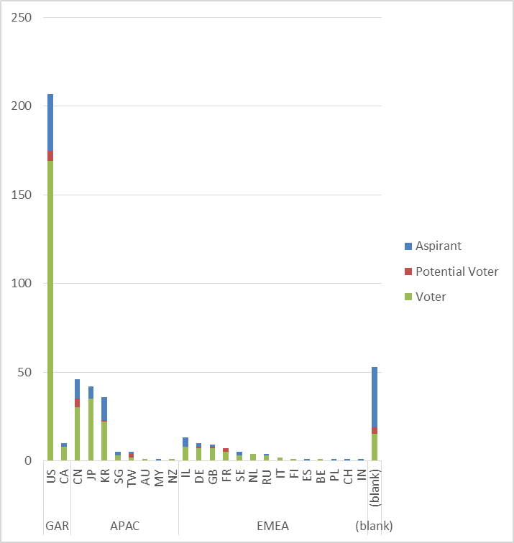
Membership by Country and Region

Slide 24
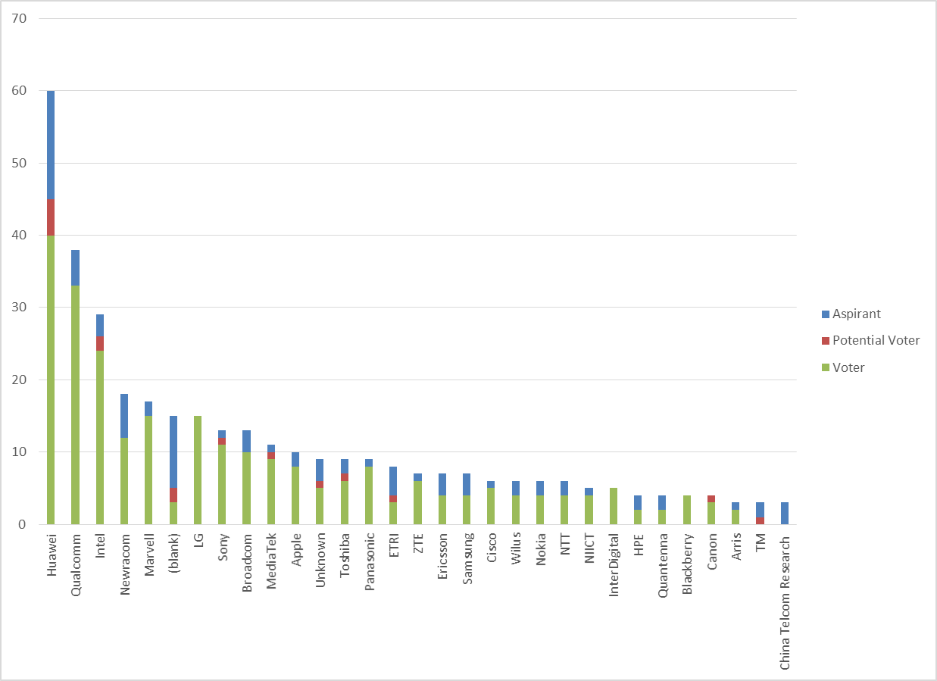
Members by Affiliation

Slide 25
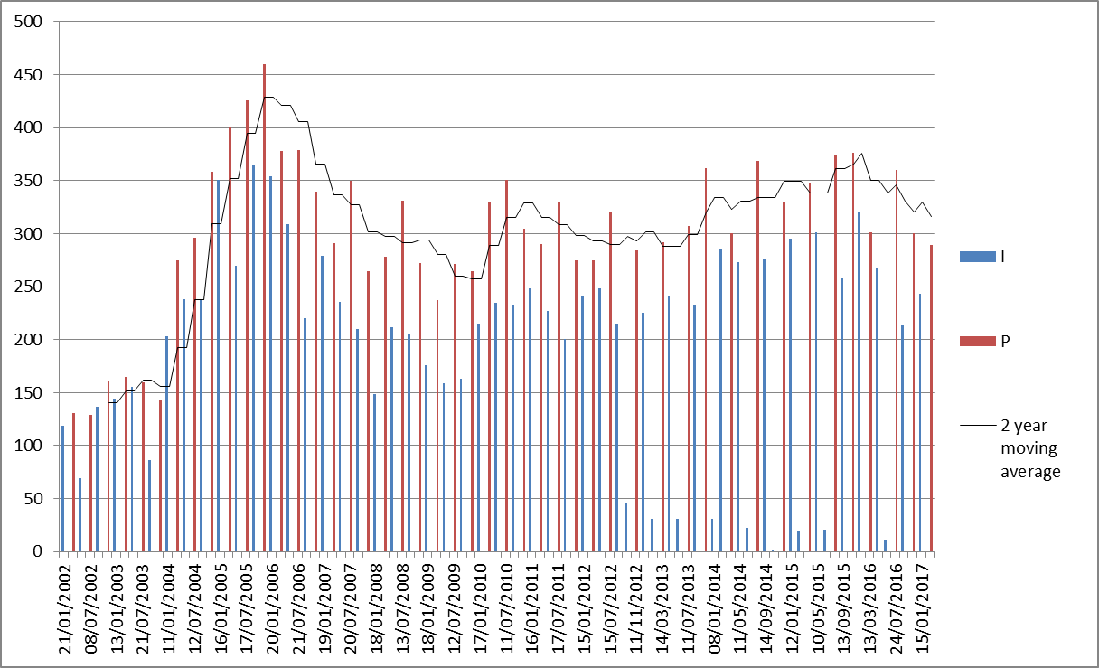
Meeting Attendance – Historic Data

Slide 26
Membership – Historic Data

