Slide 1
Light Communication Use-Cases
Authors:

Slide 2
Proposed use-cases for light communications
Enterprise
Home
Fast setup
IoT
Home
Smart cities
Factories of the future - Industrial and manufacturing
Healthcare

Slide 3
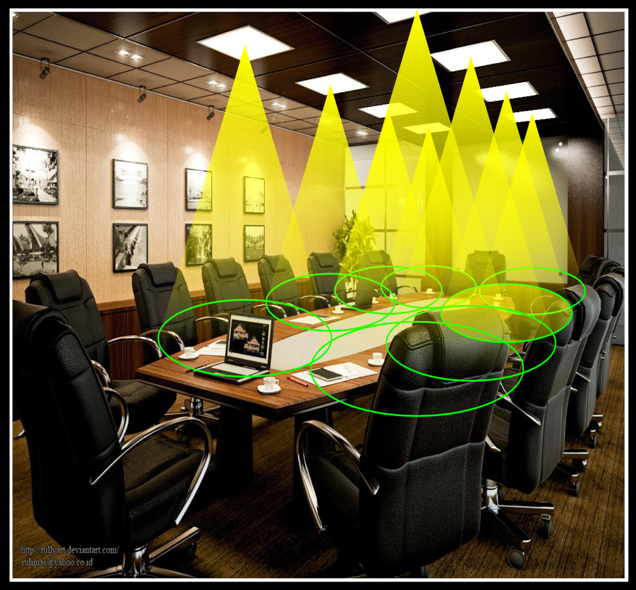
Enterprise wireless can use LC to provide contained and dedicated network access
Cellular network in a room: optical atto-cell network.
Each light functions as a base station covering a very small area (typically 1-10 sqm).
Inherent properties of light reduce interference:
No signals outside the room
Easy beamforming with optics
Enhanced security

Slide 4
LC can improve the data density in the Enterprise and Home environments
50 m
10 m
802.11 Coverage
LC Coverage

Slide 5
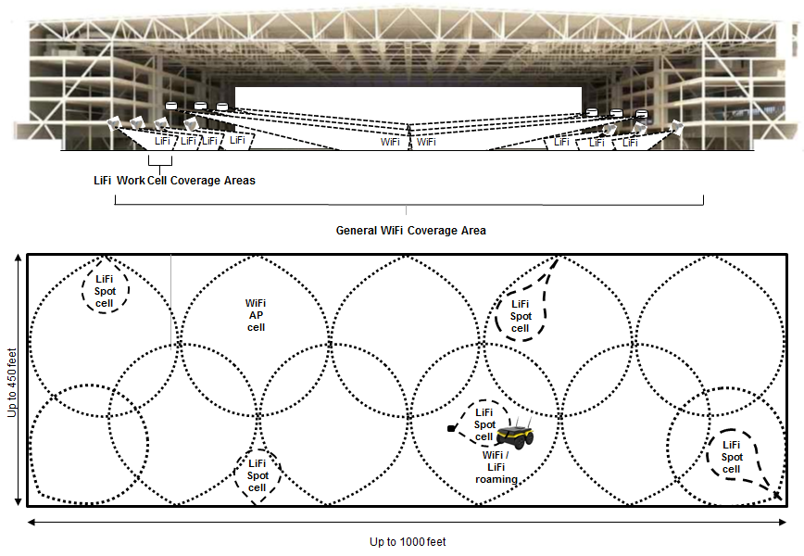
LC may provide RF interference free, deterministic, communications within industrial and automated work cell areas

Slide 6
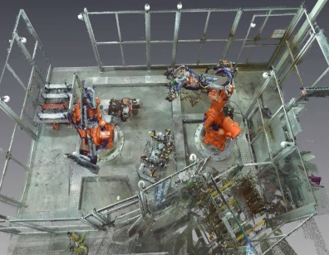
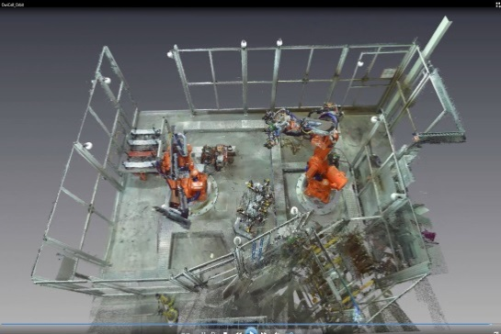
LC can operate in unused optical spectrum. Reliable connectivity can be realized with distributed MIMO to overcome an eventually blocked line-of sight.
When mobile robots move in a manufacturing environment, a single line-of sight can be blocked due to various objects
Multiple links can help to solve that issue
Emulate omni-directional beam at the robot
Distribute transceivers at the walls

Slide 7
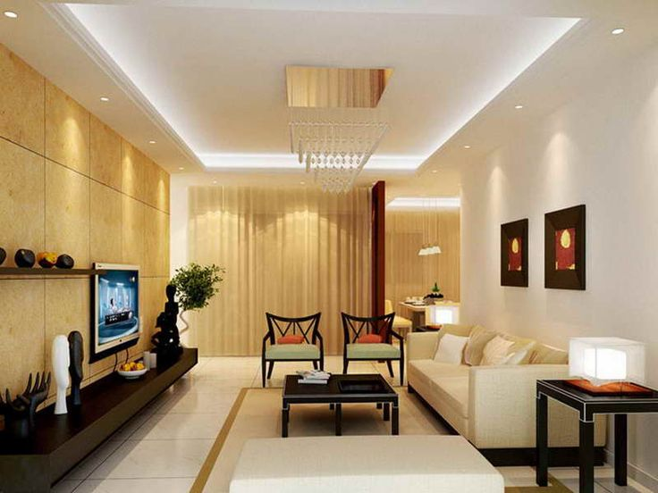
LC is relevant in the home market to provide a more secure and intuitive connectivity solution as well as possible connection between various IoT devices
Users can intuitively understand the best coverage locations.
Energy efficient wireless communications with intuitive utility can complement existing wireless solutions
The confined signal propagation ensures data privacy and security
The availability of lighting sources and density of lights as well as the ability to use solar cells as receivers means that energy harvesting devices could use LC

Slide 8
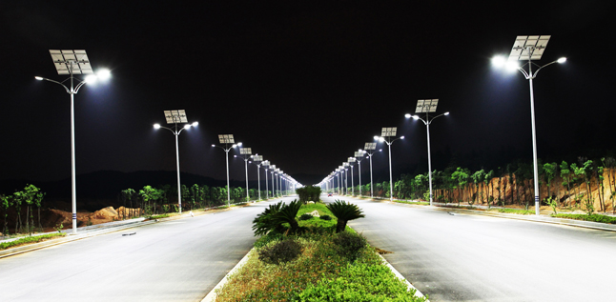
Example Scenario: IoT Application Requirements
Solar powered street lamps
The solar cell is the detector
20 mW laser diode can achieve over 20m coverage distance in line-of-sight
10 Mbps can be easily achieved with known systems
Ideal for Smart Cities
Slide 8
Nikola Serafimovski, pureLiFi
Notes:
doc.: IEEE 802.11-yy/xxxxr0
Month Year
John Doe, Some Company
Page 8

Slide 9
Proposals: to include the following text in to “Light Communications (LC) for 802.11: Use Cases and Functional Requirements: Guidelines for PAR and CSD Development”
Enterprise
Data access: where network connections are based on LC for daily work, conference, etc. streaming remote desktops along with potential video. Enhanced data security can be achieved for organizations that require high level of confidentiality. The directionality of light propagation can effectively reduce interferences in heavily populated offices. Wireless off-loading to light releases spectrum for connecting other devices.
Use cases for RF sensitive facilities: for RF sensitive facilities such as hospital and mining, LC can provide safe data access where RF may not be allowed
Home
Data access: where mobile devices use LC for high data rate network access. Especially for heavily populated apartments so that reduced interference and enhanced privacy can be achieved.
Home theater: Indoor use cases where high definition video and audio equipment connect to a LC AP
Virtual reality (VR): use cases where VR goggles are connected to a LC AP

Slide 10
Proposals: to include the following text in to “Light Communications (LC) for 802.11: Use Cases and Functional Requirements: Guidelines for PAR and CSD Development”
IoT
Home: smart home
Connecting devices that convey sensitive information like CCTV cameras, baby monitors, etc. to a more private and secure LC network.
Smart cities: provide high accuracy positioning
LC AP can be installed on street furniture and ease congestion on spectrum resources by off-loading and releasing RF spectrum for increased connectivity of moving vehicles to the backbone.
Factories of the future - Industrial and manufacturing
Why is RF potentially not suitable for use in this environment?
In certain industrial and manufacturing scenarios, RF systems cannot be deployed because of security concerns and reliability. Specifically, it is possible for actors to easily jam the entire RF spectrum from great distances with very inexpensive devices. This has a significant impact on the risk of operating entirely wireless facilities. In addition, the propagation environment such as a steel mill or nuclear power plant may not be suitable for RF propagation due to strong EMI emanating from different processes.
LC can be used to delivery wireless communications in the most EMI hostile environments as well as complement existing RF schemes to provide data off-loading in locations where security or safety are not at risk.
Healthcare
Providing the same reliability and security as a wired connection with the flexibility of a wireless solution for indoor communications, including reliable and precise indoor positioning for patient/doctor/asset tracking as well as wireless connectivity in EMI sensitive environments like operating theaters or MRI rooms.

