Slide 1
LiFi – light communications for 802.11
Date: 2016-11-08
Authors:

Slide 2
It is proposed that a TIG or a SG be formed to consider LiFi standardization in 802.11 WG
The aim is to gauge the interest in starting a Topic Interest Group (TIG) or a Study Group (SG) for:
LiFi
This meeting will not:
  Fully explore the problem
  Debate strengths and weaknesses of solutions
  Choose a solution
  Create a PAR, CSD or Objectives,
  Create a standard or specification

Slide 3
LiFi will expand the reach of IEEE 802.11 into new applications and markets
  LiFi is high speed, bidirectional and networked wireless communications using light. It provides users with similar functionality as other 802.11 solutions, including multiple access and handover, except that it uses the light spectrum.
  Application areas include:
    Enterprise and home wireless deployments to provide increased security, data rates and complementary capacity,
    IoT exploitation due to improved security and localized communications.
  Market research indicates that LiFi will become a $75 billion industry by 2023. Minimal changes to the existing 802.11 protocols will increase their reach into this new market.
  Over 1 Billion LED lights sold annually with 13% CAGR
    Every light can be LiFi enabled.
  LiFi has comparable computational energy efficiency to existing 802.11. The energy already required for illumination is used for LiFi communications.

Slide 4
Agenda
  What is LiFi?
  The problem and possible solutions
  LiFi advantages
  LiFi standardization efforts
  Differences with existing 802.11
  Technical considerations
  Application areas and market relevance
  Q & A
  Straw Polls

Slide 5
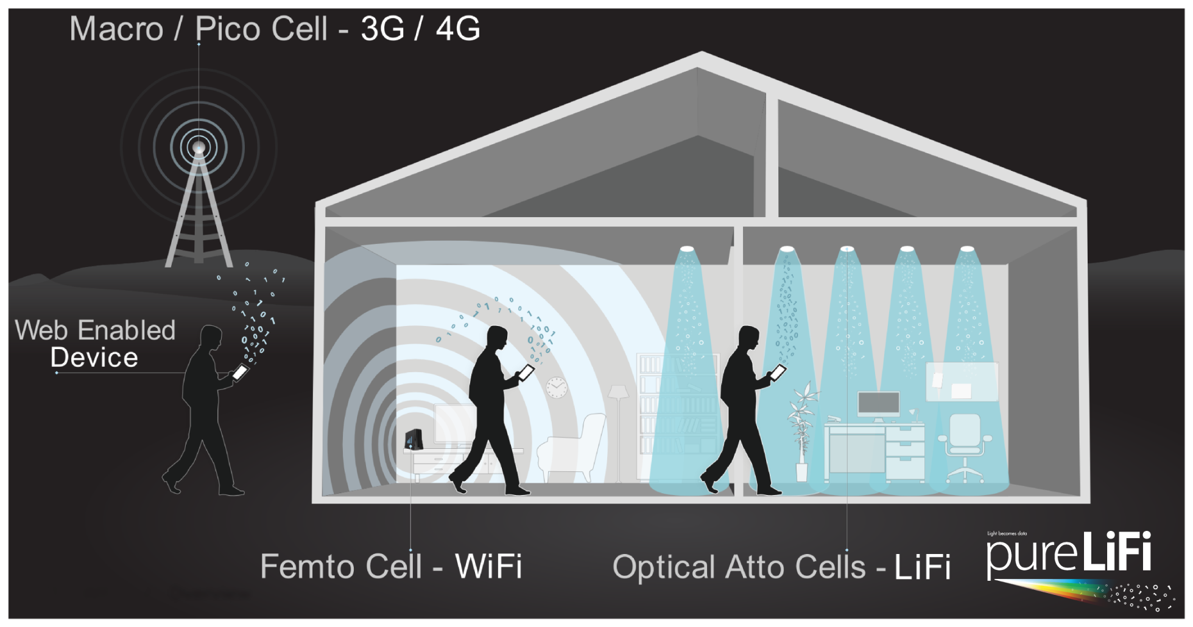
LiFi is high speed, bidirectional and networked wireless communications using light

Slide 6
Wi-Fi is great, but cannot solve all problems and is a victim of its own success
  Situation
    Wi-Fi is one of the most common communication mediums in Enterprise and Home environments
  Problems
    Wi-Fi signals are difficult to confine to specific areas, which has potential security implications in some environments
    Wi-Fi cannot operate in some safety critical and hostile RF environments
    Wi-Fi capacity is limited by the available unlicensed spectrum
  Question
    What can solve these issues?
  Answer
    Multiple solutions solve the problems, including WiGig and LiFi.

Slide 7
LiFi complements Wi-Fi and WiGig in a similar manner to how WiGig complements Wi-Fi
 | Problem Source | Alternative solutions
 | Wi-Fi | WiGig | LiFi
Confinement | ✗ | ✓ | ✓
RF interference | ✗ | Mostly ok | ✓
Spectrum | Increasingly Crowded | Additional in 60GHz | Additional in light/IR

Slide 8
  LiFi has unique features that are beneficial in some environments
LiFi spectrum is globally harmonised & unlicensed
Spectrum is complementary and non-interfering to all existing and emerging 802.11 technologies
LiFi operates with no extra energy requirements
Energy used for illumination is reused for communications
Global lighting standards provide guaranteed signal strength, e.g., mandatory office lighting levels
Spectrum
Energy
LiFi provides new connectivity at low marginal cost
New wave in Power over Ethernet provides connectivity to the LEDs
The “transmit antenna” (LEDs) and access to power already available at installation site
LiFi piggybacks on the lighting market
Over 1 Billion lights sold annually with 13% CAGR
Drive to provide energy efficiency and wireless communications can be combined
Infrastructure
Volumes

Slide 9
IEEE 802.11 can make Li-Fi more successful than other SDOs
802.11 has the opportunity to “own” the light spectrum
Existing Standardization Efforts
ITU-T Study Group G.vlc
802.15.7r1
Problem
Neither effort has the comprehensive ecosystem of partners required for the global success of LiFi.
Proposed – 802.11 has unique ecosystem
Chipset vendors
Network Infrastructure
Based on G.hn – Home Networking standard
Originally based on 802.15.4 - Not designed for networking, e.g., NO 48 bit MAC address, different security suites,…
Device Integrators
End Customer and Operators
Customer Premises Equipment may use G.hn

Slide 10
LiFi integration into the 802.11 specification should be straight forward
  A LiFi standard can be produced in less than 12 months using the existing 802.11 specifications as a basis
Network Layer
Network/MAC Interface
Similar/same as existing 802.11
“Upper MAC”
Different from existing 802.11
“Lower MAC”
LiFi Specific MAC Modifications.
MAC/PHY Interface
PHY Layer
LiFi Specific PHY Modifications

Slide 11
Minor changes in the PHY and lower MAC are required with most aspects unaffected
 | 802.11 | LiFi
Medium | RF | Visible Light and IR
Signal Modulation | Coherent | Intensity Modulation & Direct Detection
Duplex | Half | Full
Hidden Node | Can Occur | By Design CSMA/CA does not work
PHY/MAC interface | 802.11 PPDU | Identical
MAC/Network Layer interface | MLME | Identical
Security | 802.1X | 802.1X

Slide 12
LiFi has a natural place in 802.11 using the same/similar PHY/MAC/Network Layer Interfaces
  Common
    Authentication, security protocols, addressing and MAC frame structure are preserved from the 802.11 protocol.
    The PPDU and PHY layer processing algorithms are preserved.
  Different
    The CSMA/CA algorithm is replaced to address the hidden node problem in the uplink.
    Hermitian symmetry is imposed on the modulated subcarriers in order to generate a real time-domain signal. Hence, the sampling rate and the baseband are doubled to preserve the data rate.
    No frequency up-conversion is required as electrical baseband modulation of the light source translates into intensity modulation of the optical wave carrier.
Slide 12
Nikola Serafimovski, pureLiFi
Notes:
doc.: IEEE 802.11-yy/xxxxr0
Month Year
John Doe, Some Company
Page 12

Slide 13
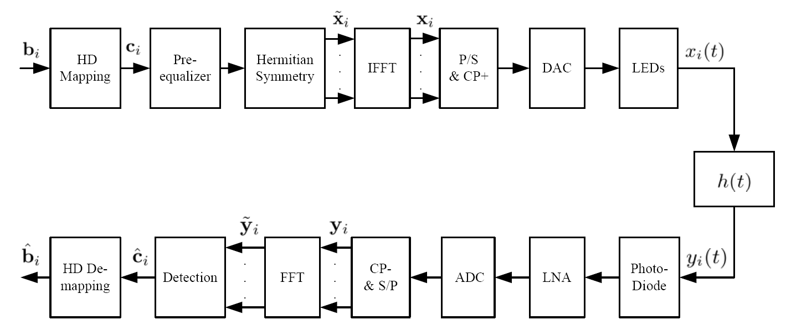
LiFi has a natural home in 802.11
Example: Optical OFDM in 802.11a-based PHY
Sym.
Map
No Up-conversion
Sym.
DE-Map
TIA

Slide 14

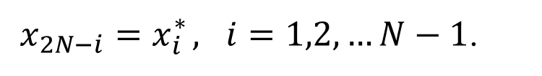
LiFi has a natural home in 802.11
Example: DC-biased Optical-OFDM
$x_{2N−i}=x_{i}^{∗} , i=1,2,…N−1$.
Hermitian Symmetry
$$x_{0}^{}$$
is the DC biased

Slide 15
LiFi has a place in many application spaces
Added capacity for
802.11-off-loading
Security – intuitive understanding of signal propagation
Industrial automation
Non-interference
Intuitive utility
Users can see where the high data rates spots are located
Enterprise
Home
EMI sensitive areas
802.3 CFI for 10 Mb/s over twisted pair – putting light nodes at the end in a non-interfering spectrum
IoT hub with self powered sensors
Localization and location based services
Data density and virtual/augmented reality
IoT
Retail

Slide 16
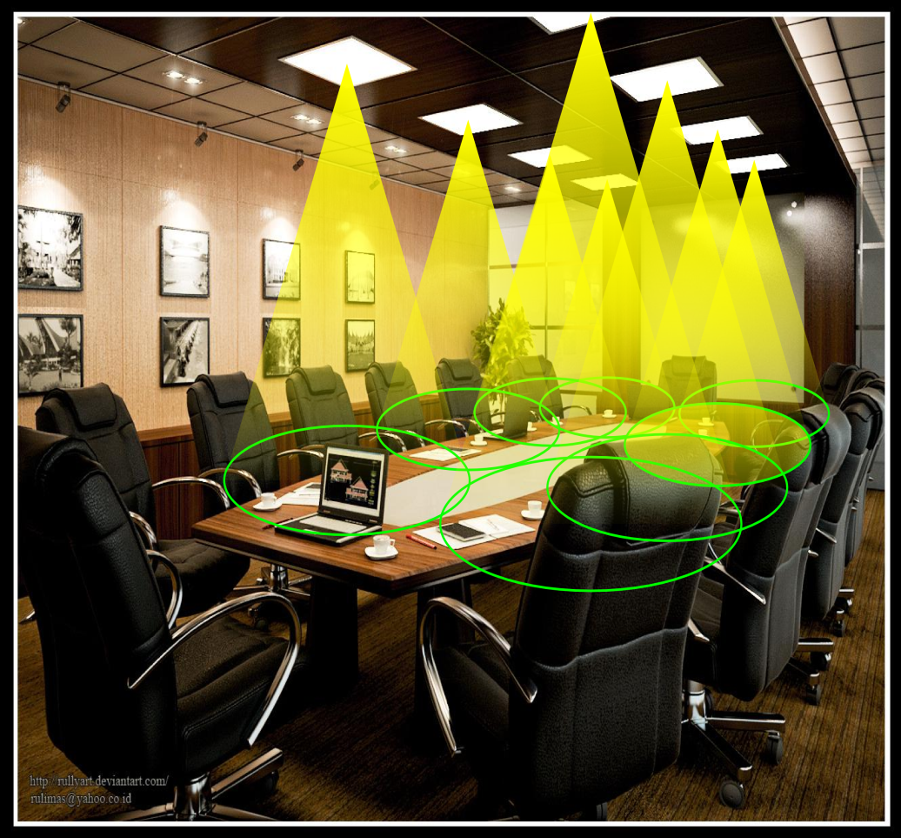
LiFi is relevant to the enterprise wireless market to provide contained and dedicated network access
Cellular network in a room: optical atto-cell network.
Each light functions as a base station covering a very small area (typically 1-10 sqm).
Inherent properties of light reduce interference:
  No signals outside the room
  Easy beamforming with optics
  Enhanced security

Slide 17
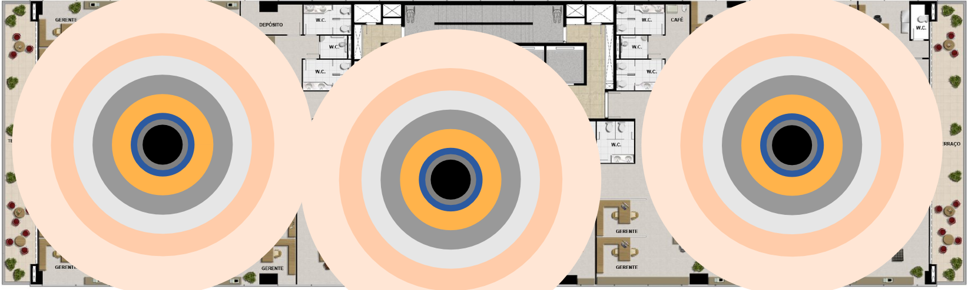
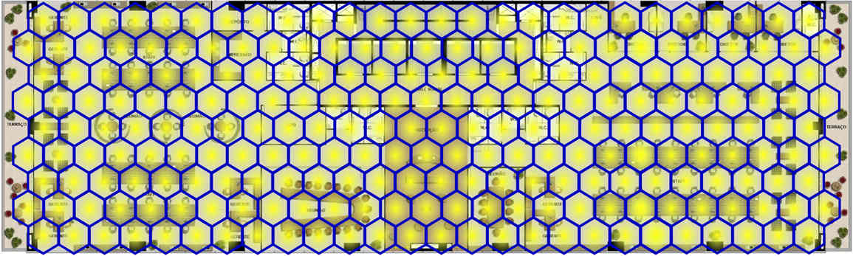
LiFi can improve the data density
50 m
10 m
802.11 Coverage
LiFi Coverage

Slide 18
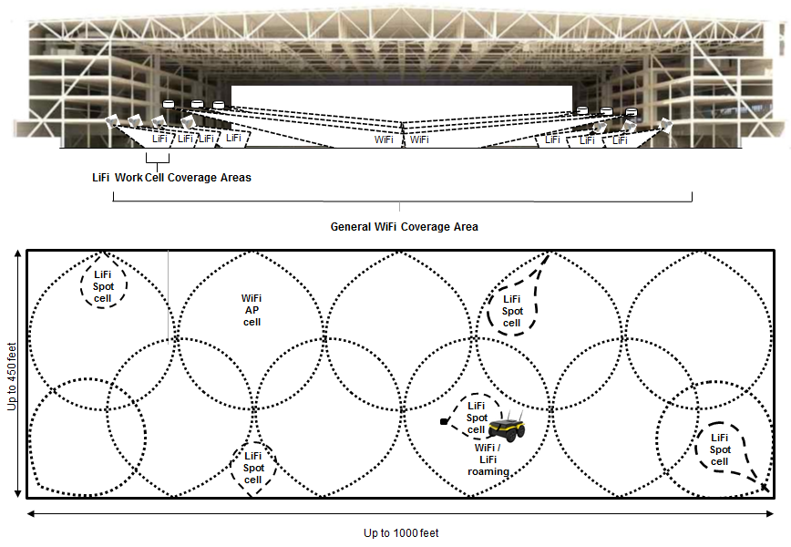
LiFi may provide RF interference free, deterministic, communications within industrial and automated work cell areas

Slide 19

LiFi is relevant in the home market to provide a more secure and intuitive connectivity solution
Users can intuitively understand the best coverage locations.
  Energy efficient wireless communications with intuitive utility can complement existing wireless solutions
  The confined signal propagation ensures data privacy and security

Slide 20

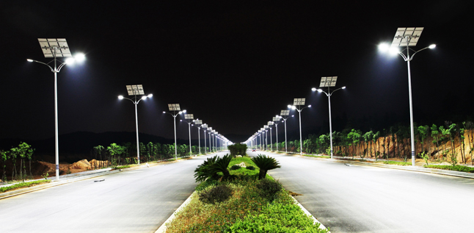
LiFi can open more verticals to 802.11 within the Internet of Things
  Sensors in sensitive environments
    The worldwide condition monitoring market for Nuclear Power is estimated at between $1Bn and $1.5Bn, with a CAGR of 5% to 10%.
    Similarly restricted areas such as mining and Oil & Gas would increase the potential market value several times over.
  Broad use of LiFi will lower overall 2.4 GHz noise floors in dense environments such as apartment buildings and multi-tenant offices and hospitals
  Simplifies and reduces cost in building build-out because no separate power drops are required unlike Wi-Fi APs.
  Use solar cells to create self-powered sensor nodes for smart cities

Slide 21
LiFi offers significant market growth potential with over 1 Billion lights sold annually and 13% CAGR
  The prevalence of lights and integration of LiFi with the lighting system opens an entirely new market segment for 802.11
    “The LiFi market is expected to grow to $75.5 Billion by 2023 with CAGR of 80%.” – Global Market Insights, Inc.
    “The VLC market is expected to grow from USD 327.8 Million in 2015 to USD 8,502.1 Million by 2020, at a CAGR of 91.8% between 2015 and 2020.” – MarketsAndMarkets
  Every light source can be a data communication node using 802.11 as the underlying connection protocol, from streaming media to an IoT hub and devices.

Slide 22
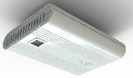
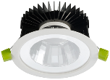

The Architecture: Visible Light used for downlink and Infrared used for uplink
Power & Data
Switch
Gateway
VL for Downlink
Internet
IR for Uplink
*RF could also be used as an optional medium for uplink

Slide 23
LiFi network integration challenges are similar to existing 802.11 & will leverage existing solutions
  Standardization
    Seamless handover between different channels/802.11 flavours
    Integration with 3GPP for holistic 5G Het. Net. Integration (LWA, LWA-IP, etc.)
  Deployment
    Management of hundreds or thousands of connected devices
    Reliable backbone connectivity
    Current lighting is connected using traditional power-lines. Potential use of Power Line Communications to address retrofit market.
    Link with IEEE Std 1901-2010 or with G.hn, etc.

Slide 24
Mobile Device integration is technically possible and rapidly scalable
  Digital signal processing
    Single device can support multiple different analogue front ends 11ac, 11ad and LiFi due to common MAC architecture.
  Analogue part options:
    Facebook experimenting with optical omni-directional receivers
    Solar-cell could be used for signal detection and power generation
    TX/RX module would be integrated similarly to the optical camera module

Slide 25
LiFi leverages the energy used for illumination to provide wireless communications
  There is a global shift to LED lighting, which can be used for communications.
  Technology has improved:
    High power devices can be produced to communicate at high data rates on visible light with clear guidelines in regulation as well as health & safety
    IR receiver technology is more developed today to create sensitive receivers for uplink, lowering power requirements for the uplink
    Optical OFDM can be used to improve spectral efficiency without impacting the ambient lighting
    Networking systems supporting Handover & Multiple Access have been developed

Slide 26
Link Budget – LiFi has almost no constraints on downlink transmit power with guaranteed signal strength at the receiver
  LiFi technology is based on incoherent optical modulation and detection.
  LiFi link budget varies based on the detector technology and detector size.
  Typical transmission power for off-the-shelf white luminaires is in the order of
  30 dBm to 40 dBm.
  Typical transmission power for off-the-shelf IR emitters is in the order of 20 dBm.
  Typical received optical power for a PHY based on the 802.11a is in the order of:
    –30 dBm for positive-intrinsic-negative (PIN) photodiodes;
    –40 dBm for avalanche photodiodes (APDs);
    –60 dBm for single-photon avalanche photodetectors (SPADs).
Slide 26
Nikola Serafimovski, pureLiFi
Notes:
doc.: IEEE 802.11-yy/xxxxr0
Month Year
John Doe, Some Company
Page 26

Slide 27
Example Scenario:
Achieving 10 Gbps with LiFi
Power & Data
20 W
  400 Lux is the approximate Light Level
    Mandatory signal strength for office illumination
  20 W is the approximate Electrical Power consumption
  4 W is the approximate Optical Transmit Power
  3 m distance from light source to receiver in line-of-sight
  -40 dBm is the approximate Receiver Sensitivity
  4 communication wavelengths (Red, Green, Blue, Amber)
  4 Avalanche Photodiodes tuned to the relevant wavelengths
  500 MHz is the approximate optical/baseband bandwidth
  per wavelength
  Theoretical throughput of over 100 Gbps* with more wavelengths
4 W output
3 m
400 Lux level
-40 dBm sensitivity
http://spectrum.ieee.org/tech-talk/semiconductors/optoelectronics/laser-lifi-could-blast-100-gigabits-per-second
Slide 27
Nikola Serafimovski, pureLiFi
Notes:
doc.: IEEE 802.11-yy/xxxxr0
Month Year
John Doe, Some Company
Page 27

Slide 28
Example Scenario:
IoT Application Requirements
  Solar powered street lamps
  The solar cell is the detector
  20 mW laser diode can
  achieve over 20m coverage
  distance in line-of-sight
  10 Mbps can be easily
  achieved with known systems
  Ideal for Smart Cities
Slide 28
Nikola Serafimovski, pureLiFi
Notes:
doc.: IEEE 802.11-yy/xxxxr0
Month Year
John Doe, Some Company
Page 28

Slide 29
LiFi has comparable energy efficiency to 802.11 and more available energy for the downlink
Energy Requirements
Available
Computational
Radiated
Lighting is already present and consuming power
Regulation requires minimum indoor illumination levels
Similar complexity as existing 802.11 PHY and MAC protocols
More energy is required to achieve the same distance as RF due to smaller wavelengths

Slide 30
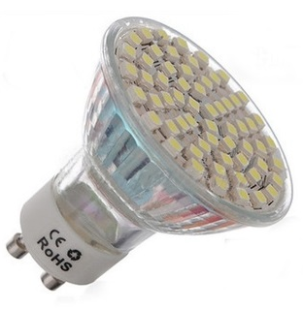
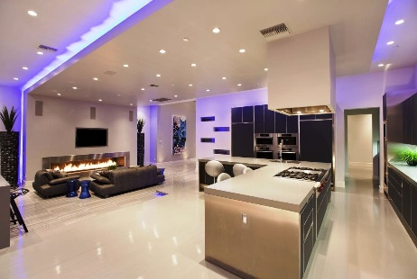

LiFi does not have the same constraints as the original 802.11 IR PHY in the operating environment
Time has changed key factors relative to 802.11 IR PHY
Components
Energy
Use-Cases
Improved Components have created a global drive to use LEDs offering better energy efficiency, range and data rates.
LEDs are being used for illumination and not just communications, removing constraints on the transmit power for the downlink.
Complementary deployments to Wi-Fi with:
  Data off loading
  IoT
  Localization
  Etc.

Slide 31
LiFi has no impact on the Colour Rendering Index & Lifetime of LEDs
“Provided adequate thermal management is used, the average drive current dictates the emitted light quality (CRI, CCT and chromaticity) but not the instantaneous drive current. Hence to preserve the expected light quality of LEDs used for LiFi, the modulating signal must be balanced.”
  W. O. Popoola, “Impact of VLC on Light Emission Quality of White LEDs,” Journal of Lightwave Technology, Vol. 34, No. 10, May15, 2016.

Slide 32
LiFi creates no added interference and can easily co-exist and complement with 802.11 solutions

Slide 33

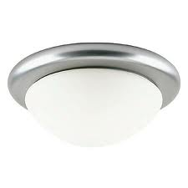

LiFi in 802.11 would facilitate seamless co-existence and channel aggregation
Network
  LiFi offloading for 802.11 and/or cellular traffic in a 3-tier HetNet
  LiFi and/or RF for uplink
  Data aggregation with LiFi and RF
  Seamless connectivity in a mobile multiuser access scenario
  Illumination functionality
  Colour tuneable
  Dimmable
  No impact on the quality of lighting
Router and 802.11 AP
RF
Optical
Optical
User 1
Cell 1
Cell 2
Handover

Slide 34
Straw Polls and Counts
Room count:
The proposal is promising, is relevant to 802.11, and may have good market potential. Would you support the formation of a Study Group for LiFi to evaluate and to develop a PAR proposal?
Yes: 20
No: 44
Abstain: 33

Slide 35
Straw Polls and Counts
The proposal may be relevant to 802.11, but the feasibility is not clear yet. Would you support the formation of a Topic Interest Group (TIG) for LiFi to clarify further technical aspects of the proposal?
Yes: 76
No: 4
Abstain: 24
Would you attend and contribute to a TIG for LiFi?
Yes: 29
No: 11
Abstain: 23

Slide 36
References
      I. Stefan, H. Burchardt, and H. Haas, “Area spectral efficiency performance comparison between VLC and RF femtocell networks,” ICC, 2013.
      G. W. Marsh, J. M. Kahn, “Channel Reuse Strategies for Indoor Infrared Wireless Communications,” IEEE Trans. on Commun., 1997.
      B. Ghimire and H. Haas, “Self Organising Interference Coordination in Optical Wireless Networks,” in EURASIP Journal on Wireless Communications and Networking, 2012.
      C. Chen, et. al., “ Fractional frequency reuse in optical wireless networks,” in PIMRC, 2013.
      H. Haas, L. Yin, Y. Wang, and C. Chen, "What is LiFi?," in Journal of Lightwave Technology , vol.PP, no.99, 2016
      C. Chen, D. A. Basnayaka, and H. Haas, "Downlink Perormance of Optical Attocell Networks," in IEEE Journal of Lightwave Technologies, vol. 34, no. 1, pp. 137-156, Jan. 2016.
      Dobroslav Tsonev, Stefan Videv, and Harald Haas, "Towards a 100 Gb/s visible light wireless access network," Opt. Express 23, 1627-1637 (2015)
      M. Ayyash, H. Elgala, A. Khreishah, V. Jungnickel, T. Little, S. Shao, M. Rahaim, D. Schulz, Coexistence of WiFi and LiFi towards 5G: Concepts, Opportunities, and Challenges, IEEE Communiations Magazine, Optical Communications Series, vol. 54, no. 2, pp. 64-71, February 2016.
      Yunlu Wang and Harald Haas, “Dynamic Load Balancing with Handover in Hybrid Li-Fi and RF Networks”, Journal of Lightwave Technology, vol. 33, no. 22, pp.4671-4682, 2015.

