Slide 1
Analysis of Near-far Problem’s Impact in UL MU-MIMO with Residual CFO
Date: 2017-02-28

Slide 2
Motivation
Analyze the near-far problem’s impact for UL MU-MIMO
Study the inter-STA interference in the channel estimation caused by the residual CFO
Use numerical results to evaluate the degradation of the ToA estimation accuracy using interference polluted channels estimation

Slide 3
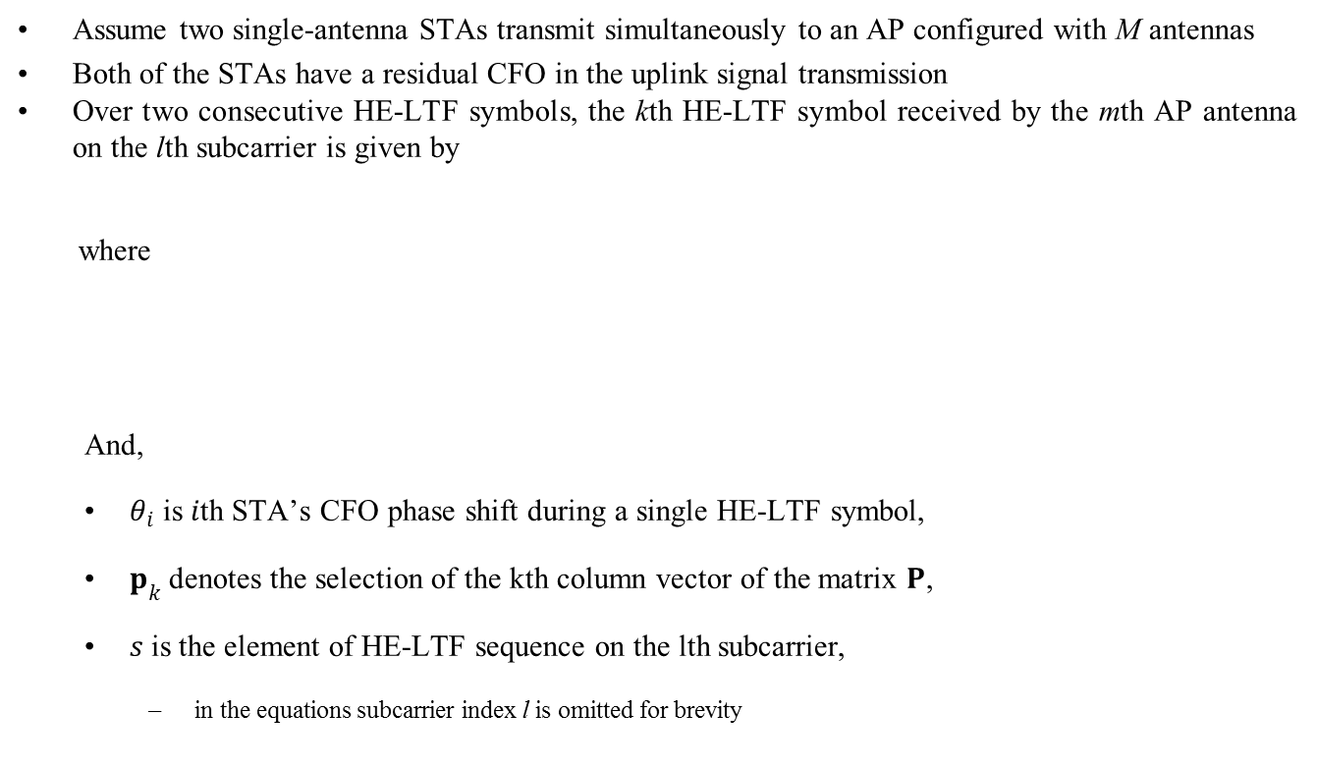
Signal Model
Assume two single-antenna STAs transmit simultaneously to an AP configured with M antennas
Both of the STAs have a residual CFO in the uplink signal transmission
Over two consecutive HE-LTF symbols, the kth HE-LTF symbol received by the mth AP antenna on the lth subcarrier is given by
where
And,
$θ_{i}$ is $i$th STA’s CFO phase shift during a single HE-LTF symbol,
$p_{k}$denotes the selection of the kth column vector of the matrix $P$,
$s$ is the element of HE-LTF sequence on the lth subcarrier,
  in the equations subcarrier index l is omitted for brevity

Slide 4
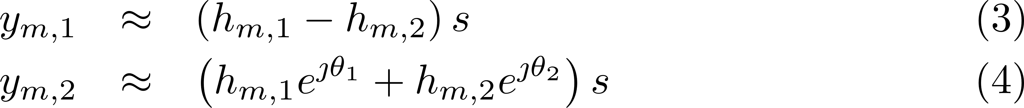
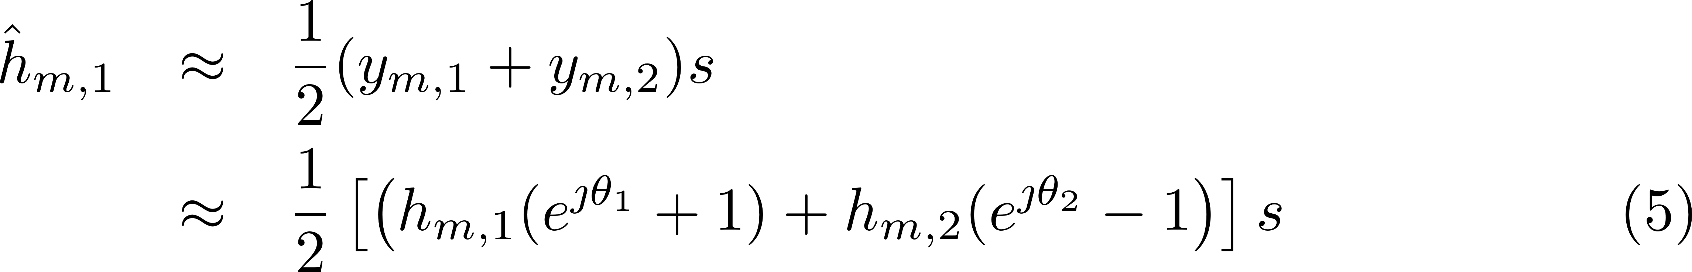

Approximate Analysis
Assume the additive noise level is low enough, then the term $n_{m,k}$ can be neglected, and the received signal at the mth AP antenna during the HE-LTF symbols can be approximated as
thus, the channel estimation for STA 1 can be calculated as,

Slide 5
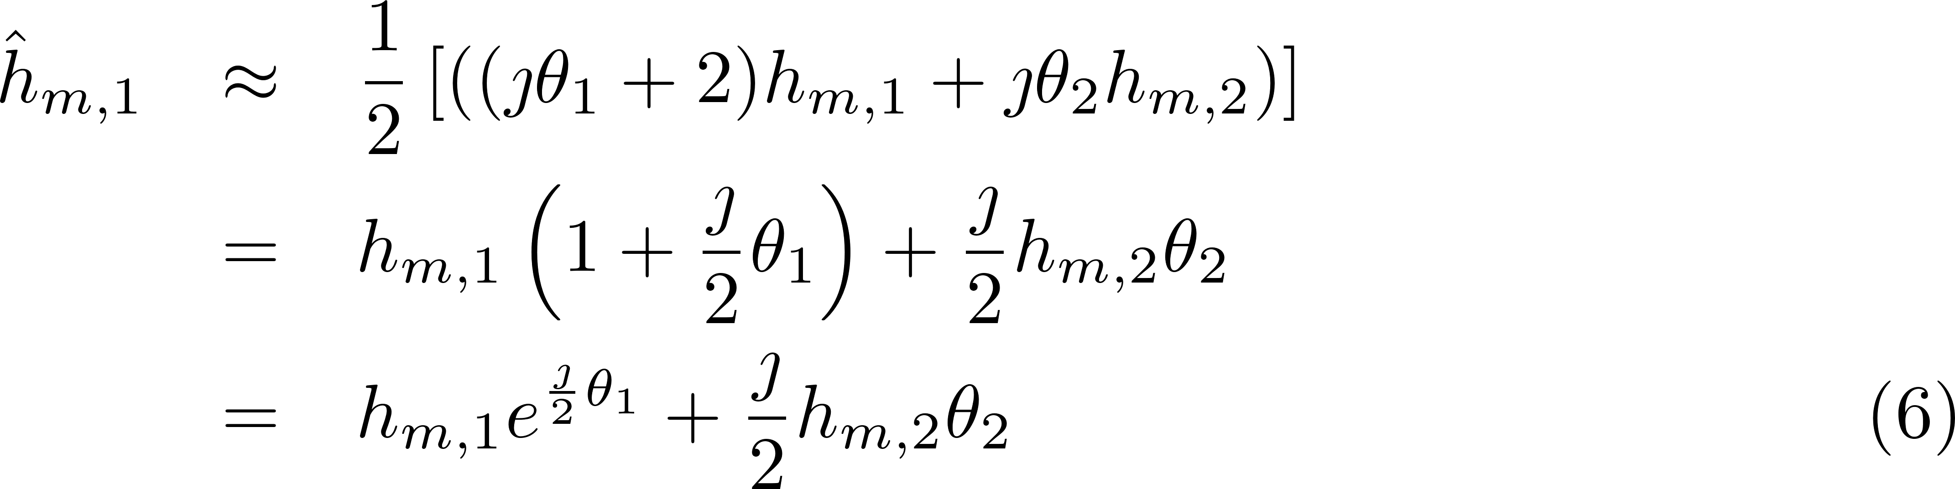
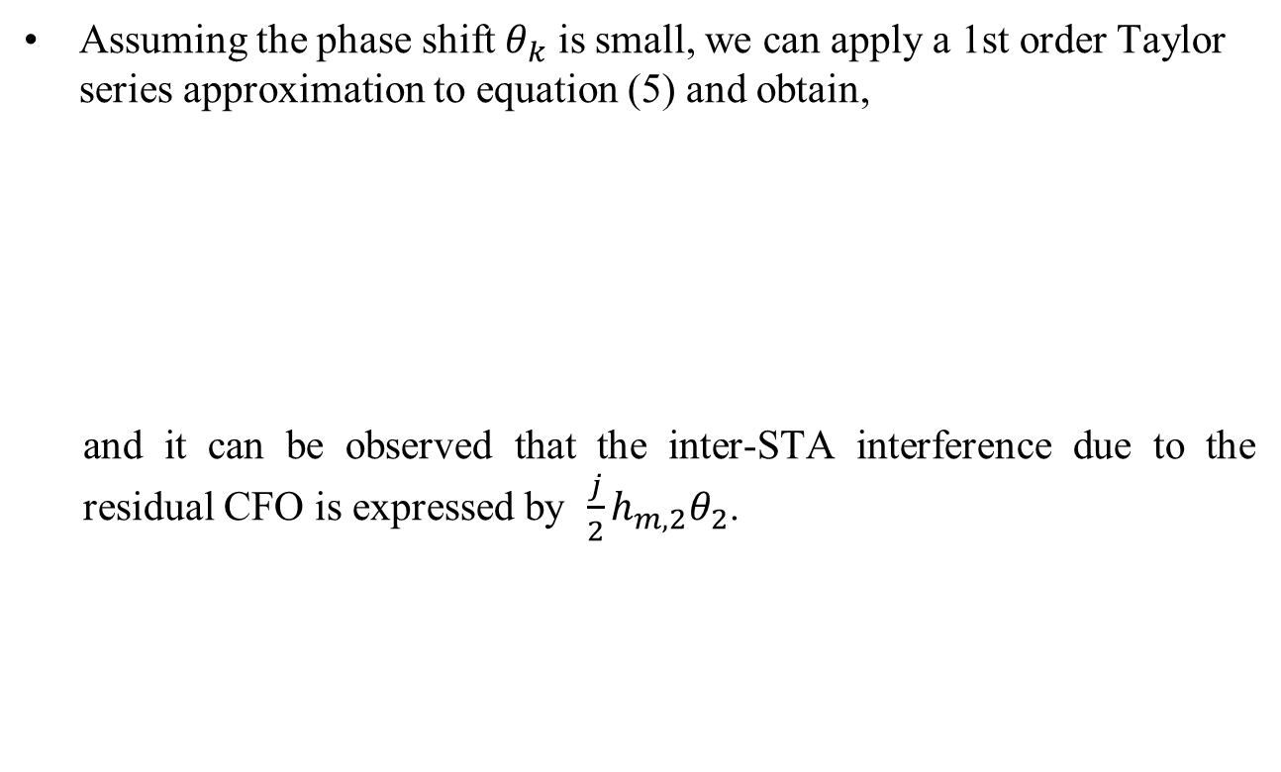
Approximate Analysis – cont’d
Assuming the phase shift $θ_{k}$ is small, we can apply a 1st order Taylor series approximation to equation (5) and obtain,
and it can be observed that the inter-STA interference due to the residual CFO is expressed by $\frac{j}{2}h_{m,2}θ_{2}$.

Slide 6
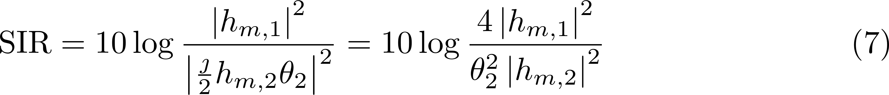
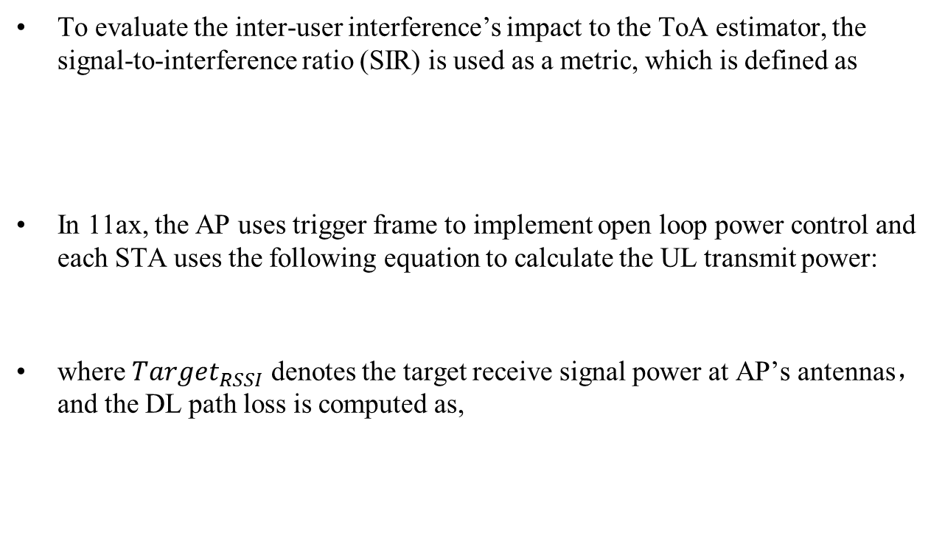
Inter-user Interference Evaluation
To evaluate the inter-user interference’s impact to the ToA estimator, the signal-to-interference ratio (SIR) is used as a metric, which is defined as
In 11ax, the AP uses trigger frame to implement open loop power control and each STA uses the following equation to calculate the UL transmit power:
where $Target_{RSSI}$ denotes the target receive signal power at AP’s antennas， and the DL path loss is computed as,

Slide 7
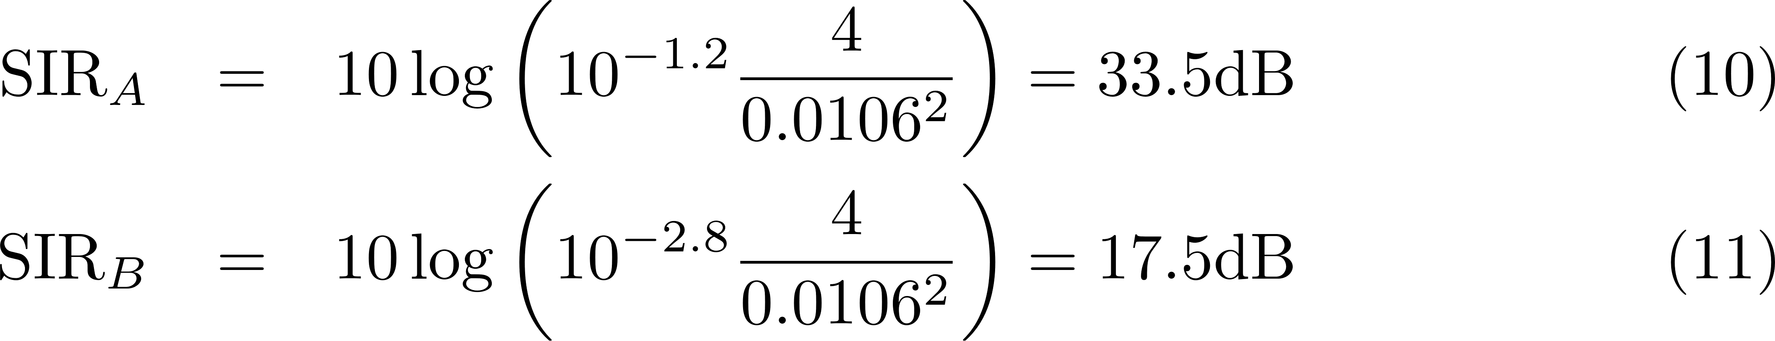
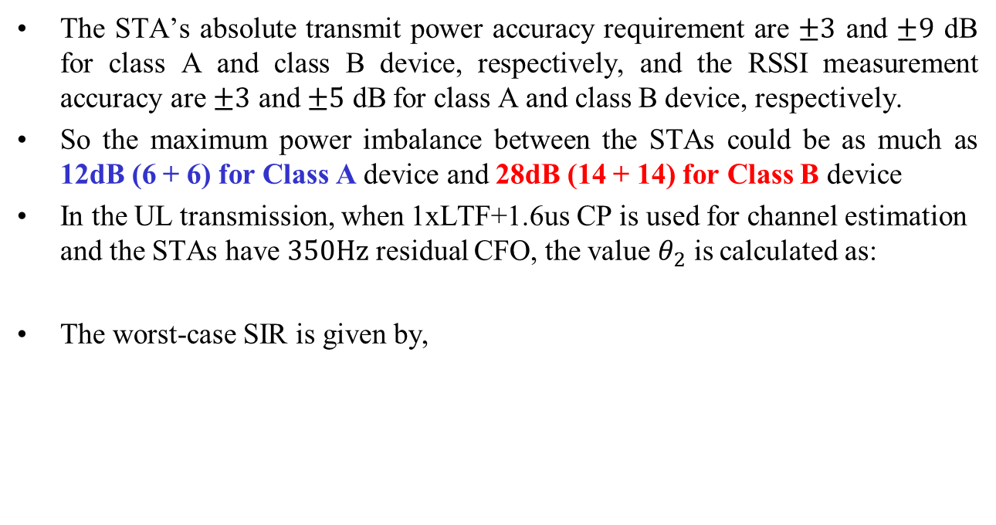
Inter-user Interference Evaluation (Cont’d)
The STA’s absolute transmit power accuracy requirement are $±3$ and $±9$ dB for class A and class B device, respectively, and the RSSI measurement accuracy are $±3$ and $±5$ dB for class A and class B device, respectively.
So the maximum power imbalance between the STAs could be as much as 12dB (6 + 6) for Class A device and 28dB (14 + 14) for Class B device
In the UL transmission, when 1xLTF+1.6us CP is used for channel estimation and the STAs have $350Hz$ residual CFO, the value $θ_{2}$ is calculated as:
The worst-case SIR is given by,

Slide 8
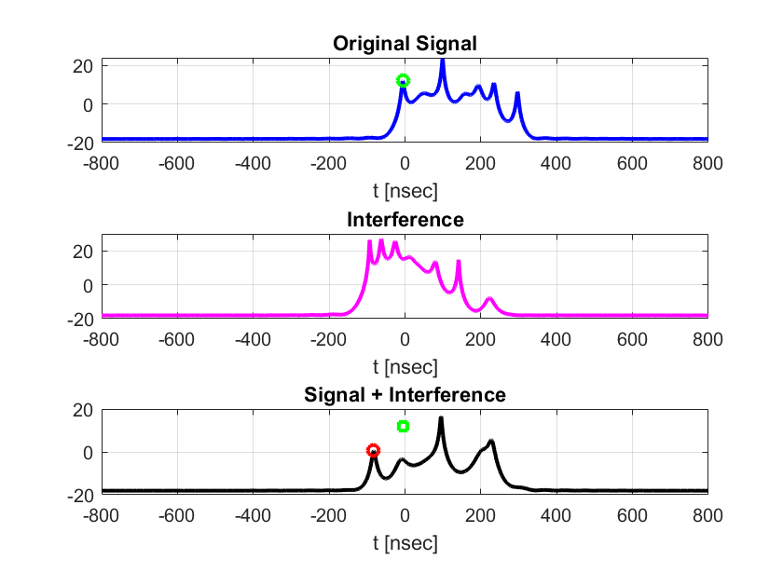
Numerical Results – Example Effect on CIR
Channel-D NLoS
SNR = 20dB
CFO = 350Hz
SIR = 17.5dB
Distance between STAs: 30m
23.2m Error

Slide 9
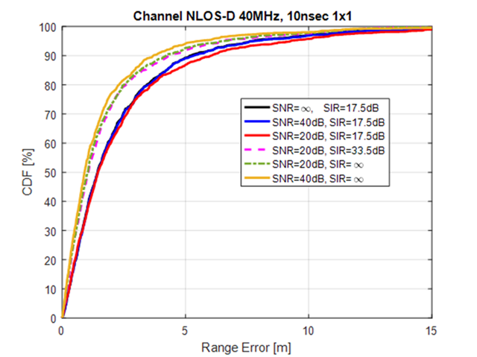
Numerical Results – Range Estimation Accuracy

Slide 10
Conclusions
Derived an closed-form equation to show that the residual CFO will cause additive inter-STA interference in the channel estimation
The inter-STA interference will increase with the signal power of the interfering STA
The numerical results show that the inter-STA interference could degrade the ToA estimation accuracy significantly
  Degradation is observed for SIR lower than ~33.5dB.
  Performance @ typical SNR level, seem to be dominated by SIR.
It’s necessary to design the UL sounding sequence to avoid the inter-STA interference and guarantee the ToA estimation accuracy

