Slide 1
11az NDP Announcement
Date: 2017-03-12
Name | Affiliation | Address | Phone | Email
Liwen Chu

Slide 2

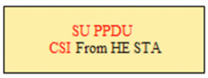
Why Defining New 11az NDPA and Trigger
  11az MU NDP ranging has sequence Trigger + UL NDP + NDPA + DL NDP.^{[1]}
  11az SU NDP ranging has sequence NDPA + NDP + reverse direction NDP.^{[2]}
DL
UL
DL
DL
UL
UL
DL
Trigger
Multiple
NDP
NDPA
NDP
NDPA
NDP
NDP
SIFS
SIFS
SIFS
SIFS
SIFS
SU NDP ranging
MU NDP ranging
  802.11 ax defines the following different sounding sequence.
SIFS
SIFS
SIFS
11ax MU Sounding
SIFS
SIFS
SIFS
SIFS
11ax SU Sounding
  The feedback information of 11az NDP ranging and 11ax sounding are different.
  In order for a TXOP responder correctly prepare a responding PPDU and prepare the measurement feedback, 11az NDPA and 11az Trigger should be redefined.
    This presentation discusses 11az NDPA.

Slide 3

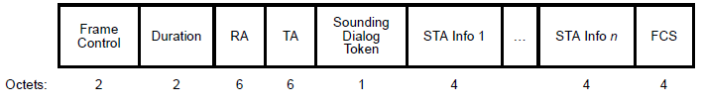



Recap: 11ax/11ac NDPA
  11ax and 11ac define NDP Announcement (NDPA) separately since the feedback info and frame exchange sequence are different:
    NDPA + NDP + sounding feedback for VHT sounding and HE single-user sounding.
    NDPA + NDP + Trigger + sounding feedback for HE multiple-user sounding.
VHT NDP Announcement
HE NDP Announcement
B0
B1
B2
B7
Reserved
1
Sounding Dialog Token Number
HE NDP Announcement Sounding Dialog Token
VHT NDP Announcement Sounding Dialog Token
STA Info subfield format in an VHT NDP Announcement frame
STA Info subfield format in an HE NDP Announcement frame

Slide 4
11az NDPA Indication
  11az NDP Announcement can be identified by different methods:
    Option 1: B0 of Sounding Dialog Token being set to 1 and B1 of Sounding Dialog Token being set to 0 indicates 11az NDP Announcement. Option 2: new control type for 11az NDPA.
      We prefer option 1.
  the number of STA Info field (or unicast/broadcast RA) in NDP Announcement decides the 11az NDP sequence:
    NDP Announcement + NDP + reverse NDP (unicast for SU 11az NDP measurement), or
    NDP Announcement + NDP (broadcast for MU 11az NDP measurement).
      Since VHT doesn’t support Trigger and UL MU, NDP Announcement + VHT NDP within MU 11az NDP sounding should be disallowed.

Slide 5


11az NDPA User Info
  One or multiple 4-byte User Info field in 11az NDP Announcement includes:
    AID subfield indicates the receiver of the User Info field.
    Disambiguation subfield prevents a VHT STA from wrongly determining it's AID in the HE STA Info
    Feedback Type includes the measurement feedback information, e.g. timing feedback, AoA feedback, AoD feedback.
B26
Reserved
Reserved
Feedback
Type

Slide 6
Straw Poll 1
  Do you agree to add the following text to 11az SFD:
    In 11az NDP ranging measurement phase, the NDPA has the following properties
      B0 B1 bits value of the Sounding Dialog Token field shall be set to 0b10 to indicate 11az sequence
      AID will be used to indicate the receiver participating in the sounding exchange
      Supported format will be the 4 byte per STA info field
.

Slide 7
Motion 1
  Move to adopt the following text to the SFD and instruct the SFD editor to include in TGAZ SFD working draft under subsection 3.2 and grant editorial license:
    In 11az NDP ranging measurement phase, the NDPA has the following properties
      B0 B1 bits value of the Sounding Dialog Token field shall be set to 0b10 to indicate 11az sequence
      AID field will be used to indicate the receiver participating in the sounding exchange
      Feedback Type field will be in 4-byte per STA info field (refer to the figure below)
      Moved: Liwen Chu
      Seconded: Naveen Kakani
      Y: 12
      N: 0
      A: 3
.
B26
Reserved
Reserved
Feedback
Type

Slide 8
Reference
  [1] 11-17/50 NDP Based Measurement Proposal.
  [2] 11-17/

Slide 9
Backup Slides

Slide 10

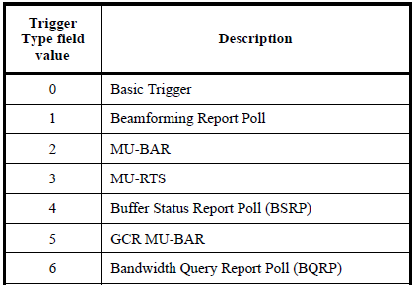


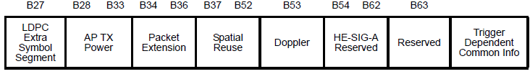


EFTM Trigger Design----Common Info
  In order to carry feedback type in Trigger frame, some reserved bits or Trigger dependent Common Info field in Common Info or some reserved bits or Trigger Dependent User Info field in User Info can be used to indicate the feedback types.
    The feedback type is gotten from MU EFTM negotiation and EFTM Trigger doesn’t carry the feedback type information.
  A specific value in Trigger Type indicates that the Trigger frame is used for soliciting UL MU NDP.
Trigger frame
Reserved
7
EFTM Trigger
Reserved
Reserved
Reserved
8-15
Common Info
Trigger Type Definition
DL Trigger
UL NDP
DL NDPA
DL NDP
(1 to N)
Reserved
User Info
SIFS
SIFS
SIFS

Slide 11
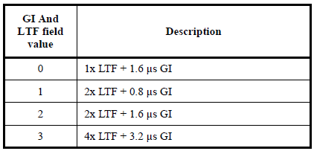
EFTM Trigger Design----Common Info
  Length in Common Info is the value of L-SIG Length of the solicited NDP.
  BW is the bandwidth of the solicited NDP.
  GI and LTF Mode is the GI and LTF mode of the solicited NDP.
  MU-MIMO LTF Mode indicates the LTF mode of the solicited NDP. (Reserved?)
  Number of HE-LTF Symbols indicates the number of the HE LTF symbols of the solicited NDP.
Reserved
GI and LTF Mode
  AP Tx Power indicates the combined average power per 20 MHz bandwidth of all transmit antennas used to transmit the trigger frame at the HE AP.
  Packet Extension indicates the packet extension duration of the solicited NDP. (Reserved since 4us is always used?)
  HE-SIG-A Reserved indicate the values of the reserved bits in HE-SIG-A2 of the solicited NDP.
Reserved
Reserved
Reserved
Reserved
Common Info

Slide 12
EFTM Trigger Design----User Info
  AID12 indicates the STA’s AID that sends the solicited NDP.
  SS Allocation defines the spatial streams that the STA uses for the solicited NDP.
  Target RSSI indicates the target received signal power of the solicited NDP.
Reserved
User Info

