Slide 1
Modified Channel Model For Outdoor Open Area Hotspot Access Scenario
Date: 2017-03-13
Authors:

Slide 2
Abstract
This contribution proposes a modified channel model for Open Area Outdoor Hotspot Access scenario considering dominant reflected paths from sur-rounding walls

Slide 3
Introduction
Our previous contribution (IEEE802.11-16/0342r0 [1])
  Measurement campaign in an outdoor Open Area Hotspot Access scenario
  Investigation of dominant propagation mechanisms
  Channel model parameter extraction (Q-D model)
This contribution
  Propose simple and more realistic model considering dominant reflected paths from sur-rounding walls
  Channel model parameters revised
  SU-MIMO (Conf #1) performance evaluation

Slide 4
Channel Modeling

Slide 5

IEEE802.11ay Q-D Channel Model
Quasi-deterministic model based on MiWEBA [2]
Deterministic components (D-Ray)
  LoS, Ground reflection, Near-wall reflection
  Determined by the location of Tx and Rx in the surrounding environment
Random components (R-Ray)
  Reflection from far-away static objects
  and random objects
  Statistically modeled
Tx
Tx
ランダム成分
H_{Tx}
直接波
地面反射
Rx
Rx
φ
H_{Rx}
L
Open Area Hotspot Access Scenario [2]
Notes:
IEEE802.11ay outdoor channel models are based on Quasi-deterministic model based on MiWEBA.
In this model, the approach builds on the representation of the millimeter-wave channel impulse response comprised of a few strong deterministic components (called D-rays) and a number of relatively weak random rays (called R-rays).
The deterministic components make the major contribution into the signal power, usually can be clearly identified as reflection from scenario-important macro objects, e.g., LoS, Ground reflection, and Near-wall reflection which are determined by the location of Tx and Rx in the surrounding environment.
On the other hand, the random components includes the reflections from far-away static objects and random objects which are statistically modeled.

Slide 6
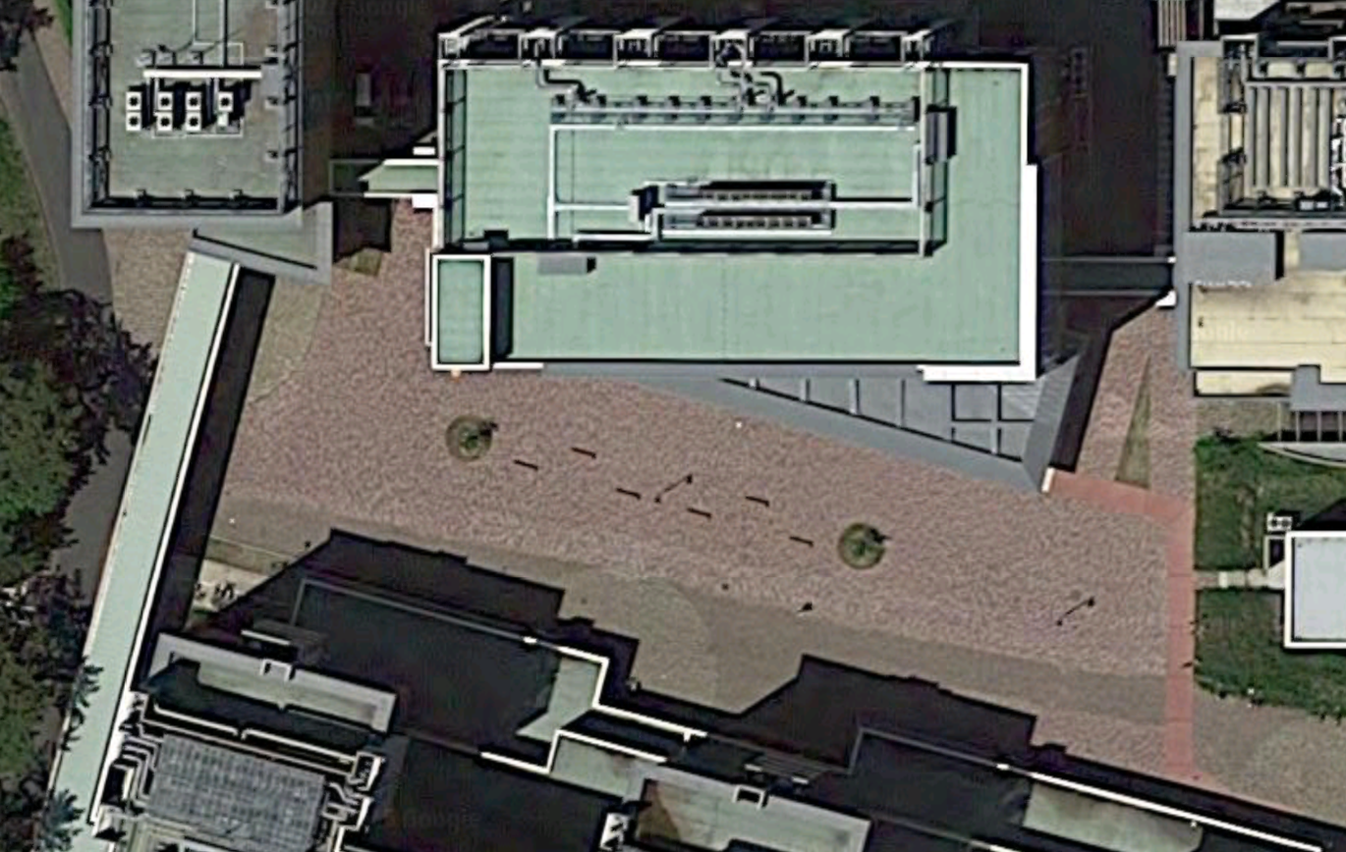
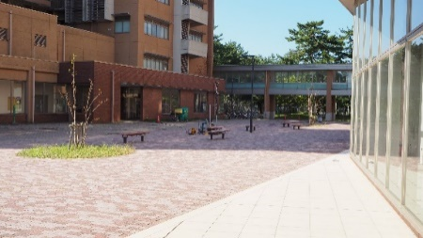
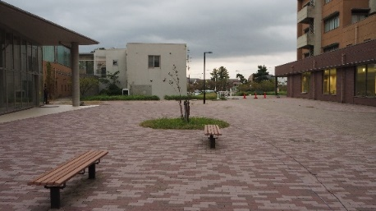
Problem of Existing Open Area Hotspot Channel Model
In most cases, the environment are surrounded by a few buildings
Dominant wall reflection should be counted as a D-Ray
Map data @Google,ZENRIN

Slide 7
Modified Channel Model: D-Ray
New D-ray components are calculated by the first order reflection from the surrounding walls of the specific environment as
Wall B
Wall B
BS
BS
MS
Wall C
Wall A
Wall A
Notes:
In our modified channel model, in addition to LoS and ground reflection, new D-ray components are calculated by the first order reflection from the surrounding walls of the specific environment as you can see here.
In this case, two simplified walls are introduced to represent dominant reflected paths in more realistic manner.

Slide 8
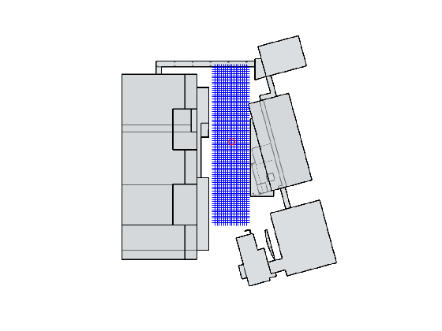

Modified Channel Model: R-Ray
Statistical parameters of R-Ray were extracted from ray tracing simulations
RT sim (Ref. cnt <=2)
16
Elimination of LoS and GR
Wall B
Removal of first-order wall reflection
（>-10dB LoS)
RT sim
（Ref. cnt<=1)
75
Bandwidth limit &
Peak detection
Wall C
Wall A
  $1200 (16×75)$ points ($1$ m spacing)
R-Ray Parameterization
Notes:
For extraction of statistical R-Ray channel parameters, the ray-tracing simulation calibrated by some measurement results was used to increase the number of channel realizations.
As you can see in this figure, the RT results were collected from uniformly distributed 1200 MS points.
In the right side, the data processing flow is shown.
From the ray tracing simulation with reflection counts up to 2, the LoS, GR and dominant wall reflections are removed.
Then, the statistical properties of the other random components were parameterized with the obtained paths from bandwidth limit and peak detection.

Slide 9
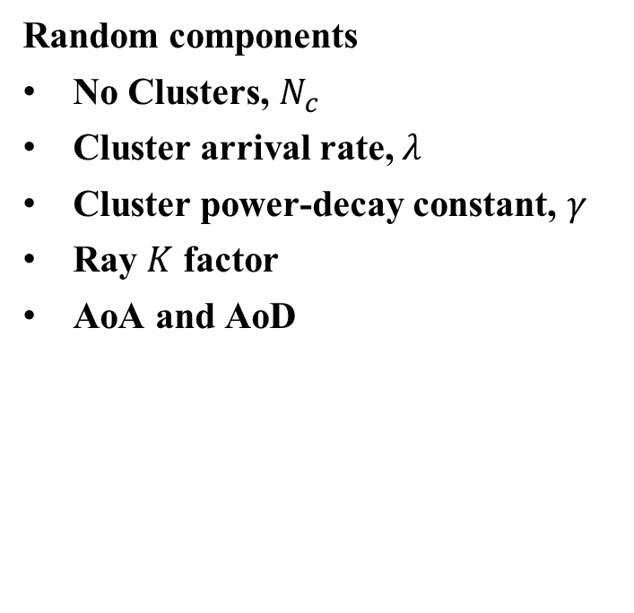
Channel Parameters
Deterministic components
Loss is calculated by Friis equation and Fresnel reflection equation
AoA (Angle-of-arrival), AoD (Angle-of-departure) and delay are determined by the location of Tx and Rx
Random components
No Clusters, $N_{c}$
Cluster arrival rate, $λ$
Cluster power-decay constant, $γ$
Ray $K$ factor
AoA and AoD
D-Ray
LoS Ray
R-Ray Cluster
Power
K
R-Ray
τ₀
τ₀+τ₁
time
1/λ
Notes:
The channel parameters of these two components are as following.
For deterministic components, loss is calculated by Friis equation and Fresnel reflection equation and
AoA (Angle-of-arrival), AoD (Angle-of-departure) and delay are determined by the location of Tx and Rx
The parameters of the random components includes No Clusters, 𝑁_𝑐, Cluster arrival rate, 𝜆, Cluster power-decay constant, 𝛾, Ray 𝐾 factor, AoA and AoD

Slide 10
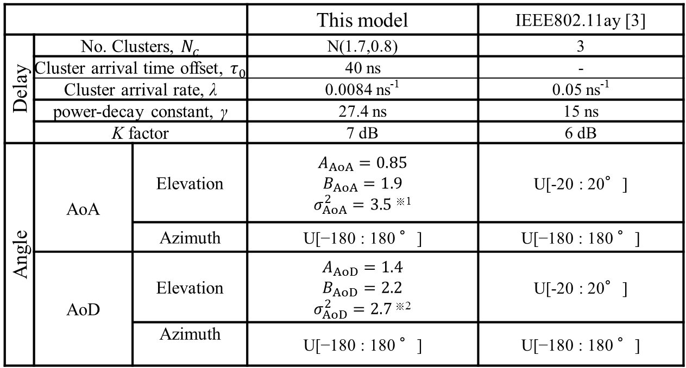


R-Ray Parameters
 |  |  | This model | IEEE802.11ay [3]
Delay | No. Clusters, $N_{c}$ |  | N(1.7,0.8) | 3
 | Cluster arrival time offset, $τ_{0}$ |  | 40 ns | -
 | Cluster arrival rate, λ |  | 0.0084 ns⁻¹ | 0.05 ns⁻¹
 | power-decay constant, γ |  | 27.4 ns | 15 ns
 | K factor |  | 7 dB | 6 dB
Angle | AoA | Elevation | $$A_{AoA}=0.85$$ $$B_{AoA}=1.9$$ $σ_{AoA}^{2}=3.5$ ^{※1} | U[-20 : 20°]
 |  | Azimuth | U[−180 : 180 °] | U[−180 : 180 °]
 | AoD | Elevation | $$A_{AoD}=1.4$$ $$B_{AoD}=2.2$$ $σ_{AoD}^{2}=2.7$ ^{※2} | U[-20 : 20°]
 |  | Azimuth | U[−180 : 180 °] | U[−180 : 180 °]
※1: ${10}^{−A_{AoA}×D−B_{AoA}}+N(0,σ_{AoA}^{2})$
※2 :$−{10}^{−A_{AoD}×D−B_{AoD}}+N(0,σ_{AoD}^{2})$
[3] MiWEBA, FP7 ICT-2013-EU-Japan, http://www.miweba.eu
Notes:
This table summarizes the R-Ray parameters of proposed and existing models.
Regarding delay domain characteristic, the power decay constant of the proposed model is smaller than existing model.
Further, in the angular characteristic, the proposed model introduces the BS-MS position dependent model for the elevation angles as below.

Slide 11
Evaluation

Slide 12
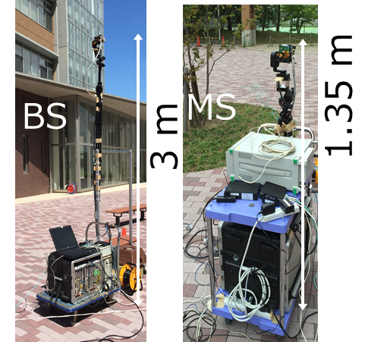

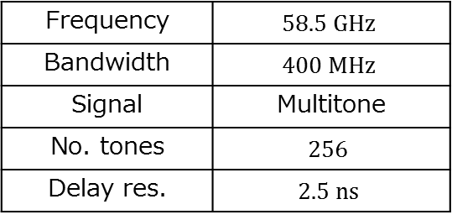
Measurement Campaign
Frequency | $$58.5 GHz$$
Bandwidth | $$400 MHz$$
Signal | Multitone
No. tones | $$256$$
Delay res. | $$2.5 ns$$
$8$ Points ($2 m$ spacing)
BS
MS
Notes:
The measurement campaign was conducted in the area as shown here where some buildings are located at 20~30m far away from the BS antenna.
BS was located at around the center of the area and the channel transfer functions were measured at 8 MS positions along the route.
The carrier frequency and bandwidth are 58.5 GHz and 400 MHz, respectively.
The antenna heights were 3 m for BS and 1.35 m for MS.

Slide 13
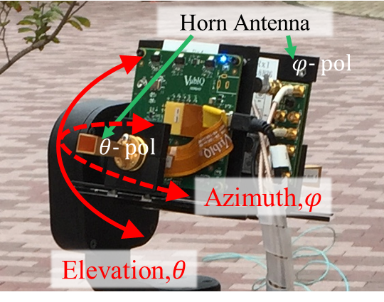
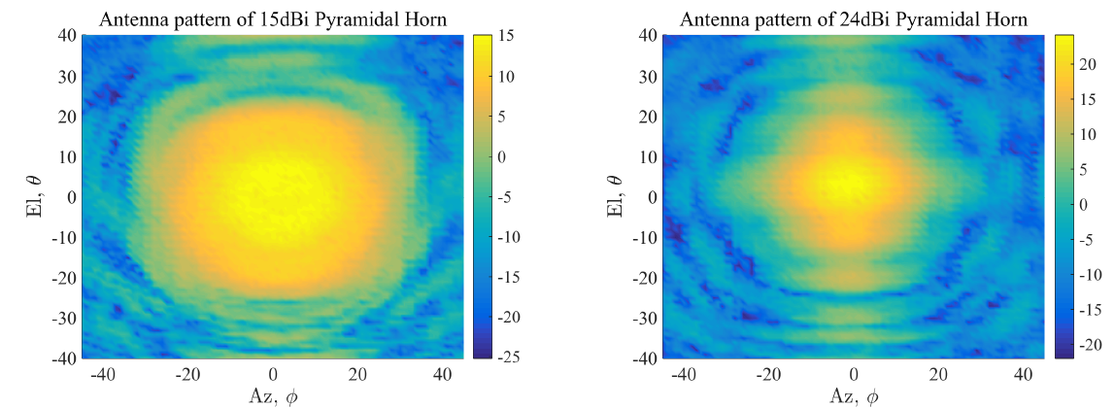
Measurement Campaign (cont’d)
Full polarimetric double-directional measurement [4]
Tx Antenna | 15dBi Pyramidal Horn
Rx Antenna | 15dBi Pyramidal Horn
Tx Antenna Rotation | Az:-180~+180, El:-30~+30 Step:30 deg.
Rx Antenna Rotation | Az:-180~+180, El:-30~+30 Step:30 deg.
Notes:
As in the right figure, two antennas in different polarization are mounted for dual-polar measurement.
For directional channel acquisition, pyramidal horn antennas at both sides of Tx and Rx were panned and tilted in azimuth and elevation directions for obtaining channel transfer function for the specific angle.
The gains and beam width (HPBW) are 24 dBi and 12 degrees.
The antenna radiation patterns are shown in these figures.

Slide 14


Data Processing
Double directional channel impulse response
Double directional angle delay power spectrum (DDADPS)
AoA
AoD
Polarization
$$h_{qp}\left(τ,θ_{i},φ_{j},θ_{m}^{′},φ_{n}^{′}\right)=ℱ^{−1}\left\{H_{qp}\left(f,θ_{i},φ_{j},θ_{m}^{′},φ_{n}^{′}\right)\right\}$$
$$p∈\left\{θ,φ\right\}$$
$$q∈\left\{θ,φ\right\}$$
$$P_{qp}\left(τ,θ_{i},φ_{j},θ_{m}^{′},φ_{n}^{′}\right)={\left|h_{qp}\left(τ,θ_{i},φ_{j},θ_{m}^{′},φ_{n}^{′}\right)\right|}^{2}$$
Notes:
I would like to briefly explain the data processing.
From measured angle-resolved channel transfer function for each polarization combination, the double directional channel impulse response is obtained by Fourier transform.
Double directional angle delay power spectrum (DDADPS) is defined as its power value.

Slide 15
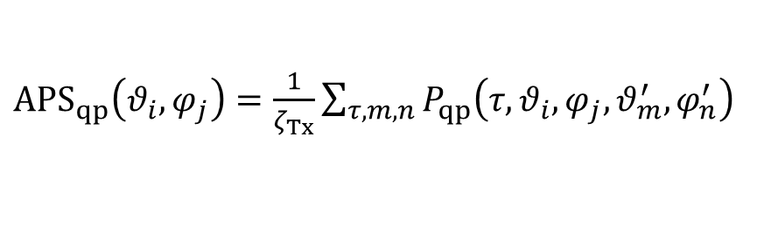
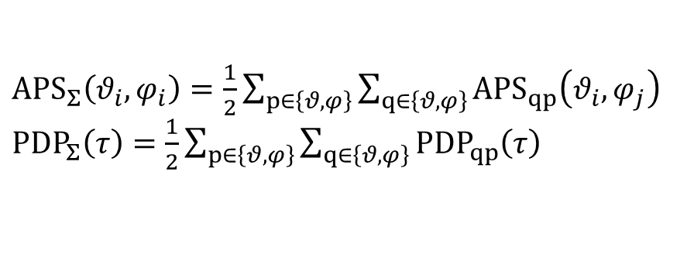
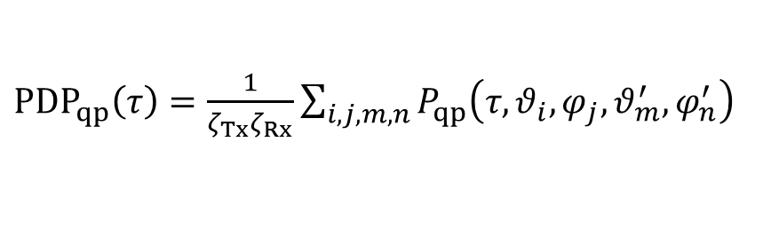
Data Processing (cont’d)
Synthetic spectrum (omni-directional)
Polarization combination
Angular power
spectrum
${APS}_{qp}\left(θ_{i},φ_{j}\right)=\frac{1}{ζ_{Tx}}\sum_{τ,m,n}{P_{qp}\left(τ,θ_{i},φ_{j},θ_{m}^{′},φ_{n}^{′}\right)}$
Power delay profile
${PDP}_{qp}\left(τ\right)=\frac{1}{ζ_{Tx}ζ_{Rx}}\sum_{i,j,m,n}{P_{qp}\left(τ,θ_{i},φ_{j},θ_{m}^{′},φ_{n}^{′}\right)}$
Gain correction
${APS}_{Σ}\left(θ_{i},φ_{i}\right)=\frac{1}{2}\sum_{p∈\left\{θ,φ\right\}}{\sum_{q∈\left\{θ,φ\right\}}{{APS}_{qp}\left(θ_{i},φ_{j}\right)}}$
${PDP}_{Σ}\left(τ\right)=\frac{1}{2}\sum_{p∈\left\{θ,φ\right\}}{\sum_{q∈\left\{θ,φ\right\}}{{PDP}_{qp}\left(τ\right)}}$
Notes:
Then, the omni-directional angular power spectrum (APS) at MS and the power delay profile (PDP) are synthesized by summing up the angle and delay domains as you can see this equations
Finally, we obtained APS and PDP combined by full polarimetric components.

Slide 16
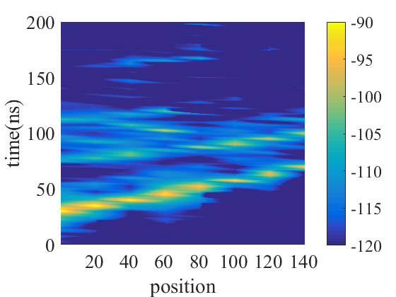
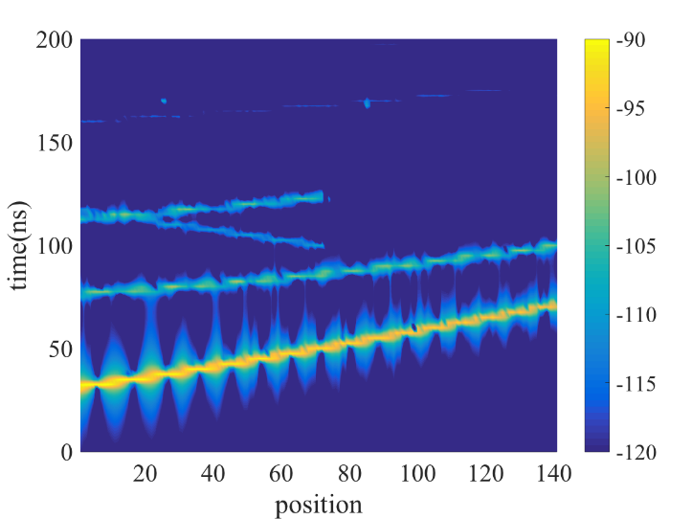
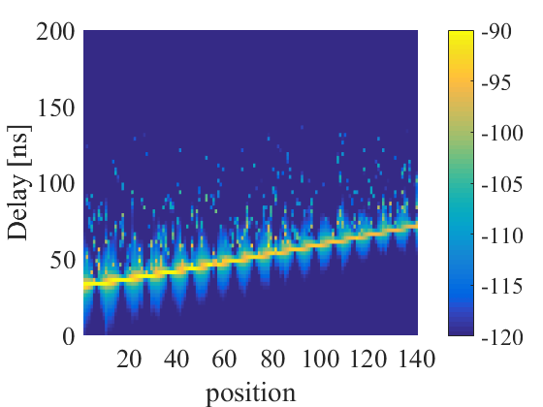
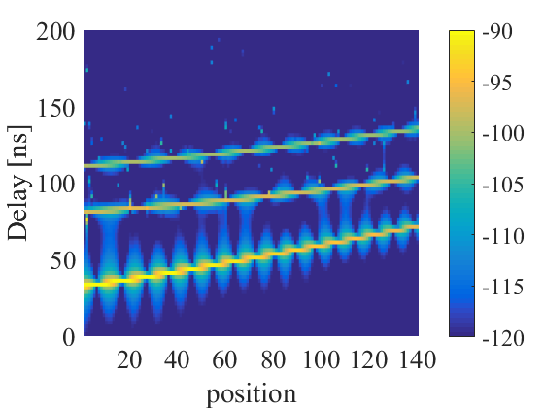
Channel Reconstruction
Measurement
Ray Tracing
#Wall B
#Wall B
#Wall A
#Wall A
#LoS
#LoS
BS
Wall B
1
141
IEEE802.11ay
Proposed
MS
Wall A
#Wall B
#Wall A
#LoS
#LoS
Notes:
As a channel model validation, this slide shows the channel impulse responses produced by measurement, ray tracing, IEEE existing model, and proposed model with respect to the MS position.
While the measurement has only the results obtained at these 8 MS positions, 141 channel impulse responses for others were reconstructed at every 10 cm.
First, LoS path is shown as you can see.
Second, the reflected path from wall A is shown in three cases other than IEEE existing model.
Third, the reflected path from wall B appears.
Even though some discrepancy occurs due to the simplification of the wall, the proposed model describes the dominant wall reflection well comparing with IEEE existing model.

Slide 17
MIMO Beamforming (MIMO BF)
IEEE802.11ay SU-MIMO [3]
  Single polar (V-pol) 2×2 MIMO transmission → 2 Streams
Configuration #1
Phased Antenna Array
Notes:
The channel model is evaluated by MIMO beamforming based on single polar 2x2 SU-MIMO transmission (configuration #1)
which is assumed for two stream parallel transmission by beamforming.

Slide 18
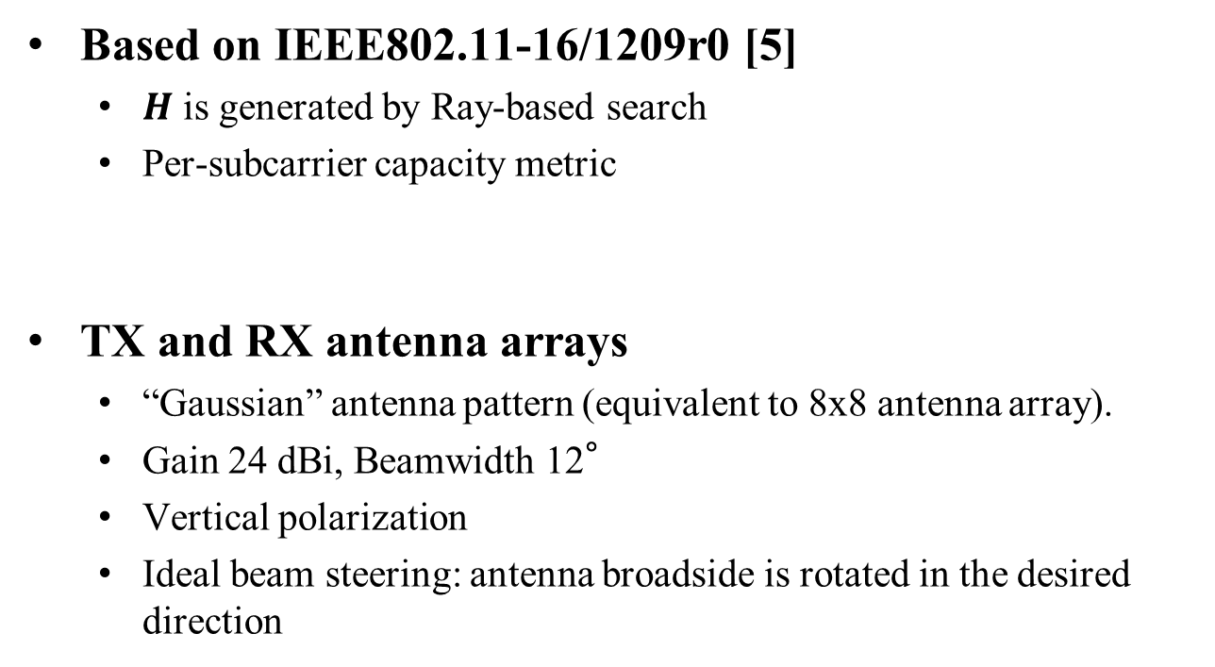
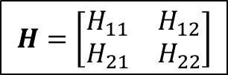
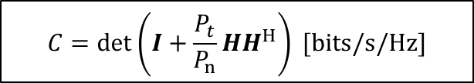
MIMO Channel Selection Metric
Based on IEEE802.11-16/1209r0 [5]
  $H$ is generated by Ray-based search
  Per-subcarrier capacity metric
TX and RX antenna arrays
  “Gaussian” antenna pattern (equivalent to 8x8 antenna array).
  Gain 24 dBi, Beamwidth 12°
  Vertical polarization
  Ideal beam steering: antenna broadside is rotated in the desired direction
$$H=\left[\begin{matrix}H_{11} & H_{12} \\ H_{21} & H_{22}\end{matrix}\right]$$
$$C=det\left(I+\frac{P_{t}}{P_{n}}HH^{H}\right) [bits/s/Hz]$$
Notes:
Based on this document, MIMO channel is generated by Ray-based search from the channel model.
Then, per-subcarrier capacity metric was employed to select the best channel matrix.
For Tx and Rx antenna arrays, “Gaussian” antenna pattern (equivalent to 8x8 antenna array) was used.
The Gain and beamwidth are 24 dBi, and 12° , respectively, and polarization was vertical.
Further, it was assumed that ideal beam steering can achieved, namely, antenna broadside is rotated in the desired direction exactly.

Slide 19
Average Channel Capacity
R-ray selected
BS
A壁
MS
C壁
Raytracing
BS
MS
IEEE 802.11ay
IEEE 802.11ay
  LoS and GR paths are used for parallel channels
  Some times strong R-ray is employ for the 2nd path
Proposed model
  Wall-A or Wall-B are realistically selected for the 2nd path
  Channel capacity is well matched to those of RT results
B壁
BS
MS
A壁
This model
Notes:
This slide shows the average channel capacity along with the BS position.
Left figures illustrate two parallel paths in Ray tracing model, IEEE existing model and this proposed model from the top.
From the results, we can see that in the IEEE existing model, LoS and GR paths are used for establishing two parallel channels, but some times strong R-ray is unrealistically employed for the 2nd path.
However, in the proposed model, wall-A or wall-B are realistically selected for the 2nd path, thus the channel capacity is well matched to those of RT results.

Slide 20
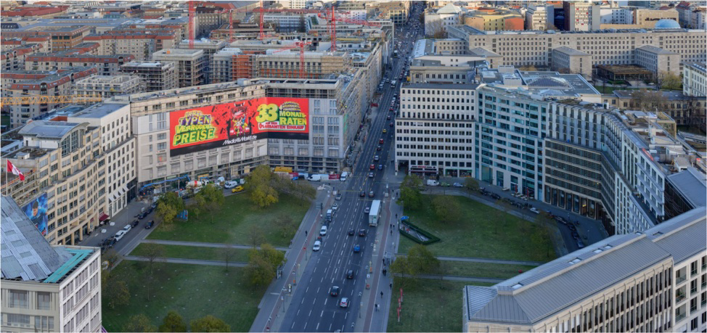
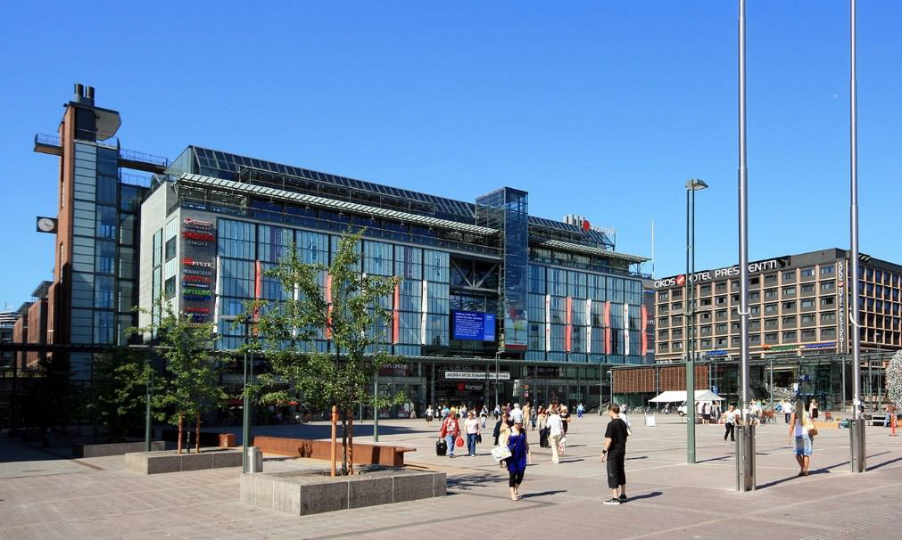
Summary
Existing open area hotspot channel model doesn’t consider surrounding walls
This contribution proposed a modified model including dominant first-order wall reflection as D-Ray
SU-MIMO Capacity Evaluation
  Proposed model is well matched to that by detail Ray tracing
  Simply adding the wall reflected paths in site-specific manner provide better representation
Our environment
Open square in Berlin (MiWEBA)
Open square in Helsinki
(METIS, ,mmMAGIC)

Slide 21
References
[1] “Channel Model for Outdoor Open Area Access Scenarios,” IEEE Document 802.11-16/0342r0, Mar. 2016.
[2] MiWEBA, FP7 ICT-2013-EU-Japan, http://www.miweba.eu
[3] “Channel Models for IEEE 802.11ay,” IEEE Document 802.11-15/1150r2, Sept. 2015.
[4] Karma Wangchuck, Minseok Kim, Kento Umeki, Kento Umeki, Kentaro Saito, and Jun-ichi Takada, ``Polarimetric Millimeter Wave Propagation Channel Measurement and Cluster Properties in Outdoor Urban Pico-cell Environment,'' The 27th Annual IEEE International Symposium on Personal, Indoor and Mobile Radio Communications (PIMRC2016), Sept. 2016.
[5] “Hotel lobby SU-MIMO channel modeling: 2x2 golden set generation,” IEEE Document 802.11-16/1209r0, Sept 2016.

