Slide 1
LB225, CR for CIDs 3215, 3216 and 9333
Date: 2017-03-12
Authors:
Reza Hedayat, Newracom

Slide 2
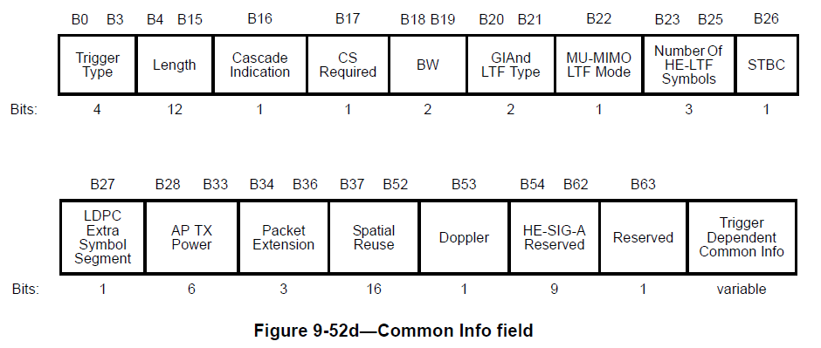
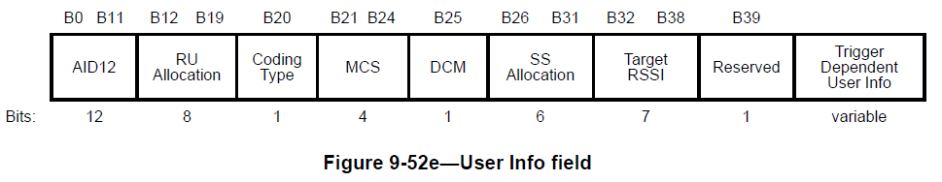
Background: Trigger Frame Format
User Info field has 5-byte length, plus possible additional Trigger-dependent User Info

Slide 3
CIDs: 3215, 3216, and 9333
27.4.4.5 | 162.20 | "The control response frames for each STA shall be sent in the allocated RU that is identified by the AID of each STA." This is not clear; what is the relation between "allocated RU" and "AID of a STA"? Also there would be one control response frame for each STA, so it should be "The Control response frame for each STA ..." | As in the comment
27.5.2.6 | 172.33 | Identfying each RU for RA by a subfield with AID12=0 is too redundant particularly considering that 5-byte (out of 6-byte) User Info would practically be the same for all RA RUs. Suggest to allow indication of multiple RA RUs using a single Per-User Info. "An RU for random access shall be identified by an AID12 subfield equal to 0 contained in a User Info field of a Trigger frame." | As in the comment
9.3.1.23 | 41.34 | Most of the User Info subfields in the Trigger frame can be the same for RUs for UL OFDMA-based random access. This means the Trigger frame can be shorter and more efficient | Limit the RU size that can be used for UL OFDMA-based random access in each Trigger frame and reduce the redundancy.

Slide 4
Multiple RA RU indication in Trigger frame
There are many use cases where an AP wants to assign multiple RUs for RA, or even maybe a whole 20MHz sub-channel in an UL MU PPDU assigned for RA
If there are multiple RUs for RA, their User Info would be the same
  Except for the RU indication, there is no reason for the AP to set e.g. MCS/NSS/RSSI/etc differently across RA User Info fields. Hence an AP would set e.g. MCS to the same value across all RA User Info fields. Similarly RSSI, NSS, etc.
  Therefor practically multiple 6-byte User Info gets almost repeated.
  Given that practically Trigger frames with RA need to be sent with low MCS, this would result in an unnecessarily lengthy PPDU
  It’d be best if repetition of multiple User Info fields are avoided or reduced to minimum
Common Info
User Info
AID for STA1
User Info
AID of STAn
RA User Info AID=0
RA User Info AID=0
RA User Info AID=0
Except the RU Indication, all subfields are the same

Slide 5
Multiple RA RU indication in Trigger frame
We suggest to indicate multiple RA RUs with one User info
What is the gain? The saving for assigning N RA RUs is up to 6x(N-1) bytes:
    2 RA RUs: Trigger frame is 6 bytes shorter
    3 RA RUs: Trigger frame is 12 bytes shorter
    4 RA RUs: Trigger frame is 18 bytes shorter, …
One option to do so is to indicate a set of contiguous RA RU by:
  the starting RU (whose size also indicates the size or remaining RA RUs)
  the number of RA RUs that follows the first RA RU
Among the subfields in User Info, “SS Allocation” is always zero. Hence for RA RUs it can be reused to indicate the number of RA RUs that follows the first RA RU
  When “SS Allocation=0”, it indicates a single RA RU. This is also compatible with D1.0 interpretation of “SS Allocation” subfield
  When “SS Allocation>0”, it indicates the number of RA RUs that follows the first RA RU (indicated by “RU Allocation” subfield)

Slide 6
Proposed text to resolve 3215, 3216 and 9333
TGax Editor: Change the “SS Allocation” subfield in 9-52e to “SS Allocation/RA RU Number”
TGax Editor: Change the caption of Figure 9-52f to “SS Allocation subfield format if AID12 in User info subfield is not equal to 0”
TGax Editor: Add the following at P47L22 after Figure 9-52f
The Random Access RU Number subfield indicates the number of continuous RUs allocated for random access, where all the random access RUs have the same size as the first random access RU indicated in the RU allocation subfield. Both the STARTING_SS_NUM and NUM_SS of the HE trigger-based PPDU transmitted on each random access RU are set to 1.
TGax Editor: Make the following changes on P45L40:
The RU Allocation subfield of the User Info field indicates the RU used by the HE trigger-based PPDU of the STA identified by the AID12 subfield. When AID12 in User info subfield is set to 0 the RU Allocation subfield indicates the RU used by the first UL OFDMA based random access transmission. The rest of the UL OFDMA based random access allocation use subsequent RUs with the same RU size. The RU Allocation subfield is 8 bits in length. The first bit, B12, indicates the allocated RU is located in the primary or non-primary 80 MHz (zero for primary and one for non-primary). The mapping of the subsequent 7 bits, B19-B13, indices to the RU allocation is defined in Table 9-25f (The encoding of B19-B13 of the RU Allocation subfield).
For example if the AID12 in the User info subfield is set to 0, the BW subfield indicates 20 MHz, the RU allocation is 0000000 and the Random Access RU Number subfield is 3 then 26 tone RU 1 [-121: -96], RU 2[-95: -70], RU 3 [-68:-43] are assigned to AID12=0 transmission.

