Slide 1
Summery of Channel Measurement for the 802.11ay Channel Model Document
Date: 2017-03-15
Authors:
Name | Affiliation | Address | Phone | Email
Jian Luo, Yan Xin, George Calcev Kun Zeng Naveed Iqbal | HUAWEI Technologies |  |  | Jianluo@Huawei.com Yan.xin@Huawei.com George.Calcev@huawei.com kun.zeng@huawei.com
Robert Müller, Diego Dupleich, Sergii Skoblikov, Stephan Häfner, Reiner Thomä | Technische Universität Ilmenau |  |  | Mueller.Robert@tu-Ilmenau.de Reiner.thomae@tu-ilmrnau.de

Slide 2
Abstract
In this presentation, we summarize the contribution for channel measurement for the 802.11ay channel model document. Large-scale and intra-cluster results from a large indoor scenario and a rooftop to street outdoor scenario are presented. The estimated parameters from the measurement campaigns help to parametrize the 802.11ay channel model for these scenarios.

Slide 3
Outline
60 GHz Outdoor Measurement Setup
Large-Scale and Intra-Cluster Parameters for Outdoor
60 GHz Large Indoor Measurement Setup
Large-Scale and Intra-Cluster Parameters for Outdoor
Preview Path Loss Measurements at 60 GHz Indoor/Outdoor
Conclusion

Slide 4
Outdoor Measurements at 60 GHz:
User Access Scenario
Measurement Setup

Slide 5
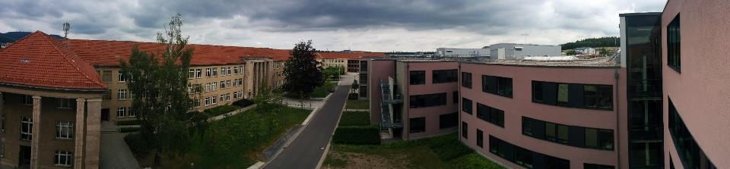
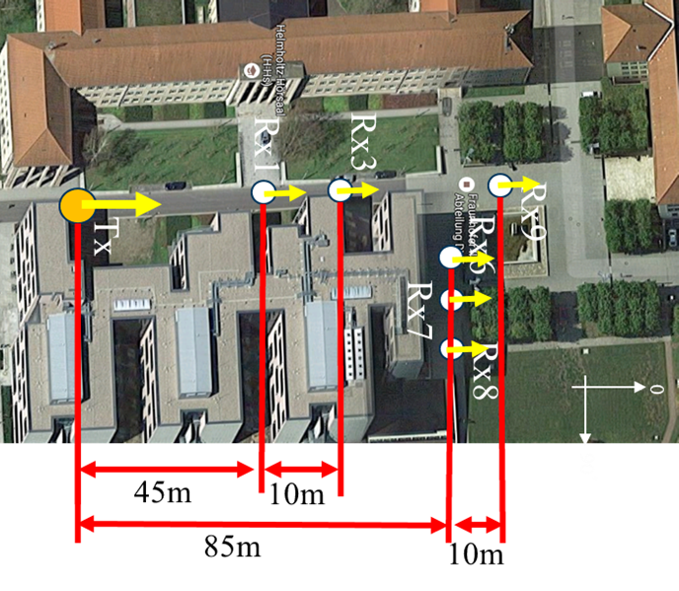
Outdoor Measurements
Measurement Setup
30°HPBW at Tx and Rx → Az: -150°:30°:180°
El: -30° :30°:30°
User Access Scenario
Tx located at a rooftop level (14m)
Rx located at person level (1.5m)
LOS and NLOS
Measurement Parameters
7 GHz bandwidth
Dual polarization measurement capability
25 dB AGC (Automatic Gain Control) with 3.5 dB steps
High instantaneous dynamic range: up to 75 dB
Multi-Link and Massive MIMO capabilities
Double directional measurements
Max. 23 dBm output power per polarization
Minimum cross polarization decoupling of 25 dB
Minimum receive power level approx. -105 dBm

Slide 6
Outdoor Measurements at 60 GHz:
User Access Scenario
Measurement Results

Slide 7
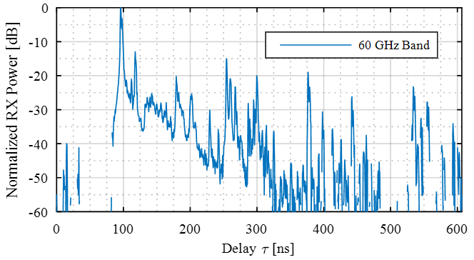
Definition of Channel Model Parameters
Line of Sight
Strong Rays
Random Rays
Strong ray region (SR) that represents other D-Rays than the Direct-Ray: All the samples within a dynamic range of -20 dB to the largest peak
Random rays (RR): All the samples within -20 to -40 dB to the largest peak

Slide 8
Outdoor Measurements
Large Scale Parameters
Position | DS* [ns] | ED* [ns] | AS at Tx [°] | Es at Tx [°] | As at Rx [°] | Es at Rx [°] | Received Power [dB] | Visibility Condition
Rx1 | 20.31 | 278.57 | 20.94 | 15.76 | 45.15 | 19.28 | -120.26 | LOS
Rx3 | 20.67 | 115.95 | 18.40 | 15.75 | 41.49 | 18.24 | -123.23 | LOS
Rx6 | 86.14 | 594.11 | 20.81 | 12.59 | 50.22 | 13.98 | -147.56 | NLOS
Rx7 | 50.43 | 395.92 | 20.62 | 15.30 | 42.02 | 14.98 | -152.45 | NLOS
Rx8 | 41.03 | 584.87 | 43.92 | 17.06 | 38.38 | 12.69 | -150.65 | NLOS
Rx9 | 56.37 | 317.84 | 20.83 | 17.30 | 77.31 | 17.90 | -128.84 | LOS
* Considering 20 dB dynamic range

Slide 9
Outdoor Measurements
Intra-Cluster Parameters
 |  |  | LOS |  | Strong Rays |  | Random Rays
 | Tx | Rx | Mean γ-factor | Std. γ-factor | Mean γ-factor | Std. γ-factor | Mean γ-factor | Std. γ-factor
Per position | 1 | 1 | 1.4 | - | 1.1 | 0.55 | 3.0 | 4.8
 | 1 | 3 | 0.8 | - | 2.9 | 4.9 | 2.5 | 3.6
 | 1 | 9 | 1.4 | - | 2.6 | 4.2 | 3.8 | 10.1
Overall |  |  | 1.2 | 0.35 | 2.2 | 3.2 | 3.1 | 6.2
 |  |  | LOS |  | Strong Rays |  | Random Rays
 | Tx | Rx | Mean Delay Spread | Var Delay Spread | Mean Delay Spread | Var Delay Spread | Mean Delay Spread | Var Delay Spread
Per position | 1 | 1 | 1.11 ns | - | 1.19 ns | 0.36 ns | 1.46 ns | 0.75 ns
 | 1 | 3 | 0.95 ns | - | 1.14 ns | 0.10 ns | 1.14 ns | 0.42 ns
 | 1 | 9 | 1.17 ns | - | 1.27 ns | 0.49 ns | 1.30 ns | 0.74 ns
Overall |  |  | 1.08 ns | 0.01 ns | 1.22 ns | 0.38 ns | 1.34 ns | 0.70 ns
 |  |  | LOS |  | Strong Rays |  | Random Rays
 | Tx | Rx | Mean K-factor [dB] | Std. K-factor [dB] | Mean K-factor [dB] | Std. K-factor [dB] | Mean K-factor [dB] | Std. K-factor [dB]
Per position | 1 | 1 | 2.0 | - | 4.5 | 5.0 | 4.1 | 5.8
 | 1 | 3 | 4.8 | - | 5.1 | 4.9 | 5.6 | 6.8
 | 1 | 9 | 1.44 | - | 6.3 | 10.0 | 5.9 | 8.4
Overall |  |  | 2.74 | 1.8 | 5.3 | 6.7 | 5.2 | 7.0

Slide 10
Large Indoor Measurements at 60 GHz:
Entrance Hall Scenario
Measurement Setup

Slide 11
Indoor Measurements
User access scenario at 60 GHz
Tx located at ground and first floor as access point
Rx located at person level
LOS, OLOS and NLOS
30°HPBW at Tx and Rx
  Az: -150°:30°:180°
  El: -30°:30°:30°
Tx at ground floor
Tx at
first
floor
 | Visivility
Rx | Tx1 | Tx2
Rx1 | LOS | LOS
Rx2 | LOS | LOS
Rx3 | OLOS | OLOS
Rx4 | OLOS | NLOS
Rx5 | - | NLOS
Rx6 | LOS | NLOS
Rx7 | - | -
Rx8 | - | NLOS
Rx9 | LOS | NLOS

Slide 12
Large Indoor Measurements at 60 GHz:
Entrance Hall
Measurement Results

Slide 13
Indoor Measurements
Large Scale Parameters
Position | DS* [ns] | ED* [ns] | AS at Tx [°] | Es at Tx [°] | As at Rx [°] | Es at Rx [°] | Received Power [dB]
Tx1
Rx1 | 11.98 | 60.94 | 37.11 | 15.71 | 54.96 | 16.92 | -132.72
Rx2 | 20.38 | 282.70 | 35.47 | 14.84 | 56.61 | 16.40 | -132.88
Rx3 | 25.19 | 282.70 | 40.52 | 15.86 | 63.01 | 21.37 | -1344.96
Rx4 | 31.40 | 134.55 | 55.09 | 18.71 | 84.43 | 20.66 | -136.98
Rx6 | 12.45 | 283.17 | 22.40 | 16.49 | 47.38 | 17.95 | -129.50
Rx9 | 2.46 | 13.59 | 23.58 | 19.69 | 27.02 | 18.20 | -132.96
Tx2
Rx1 | 19.79 | 94.23 | 42.32 | 22.49 | 76.15 | 24.22 | -138.73
Rx2 | 20.45 | 87.67 | 43.73 | 20.93 | 70.34 | 25.47 | -137.25
Rx3 | 28.37 | 126.58 | 45.03 | 22.09 | 79.68 | 21.62 | -138.83
Rx4 | 32.31 | 143.46 | 40.75 | 20.62 | 76.47 | 19.43 | -141.20
Rx5 | 38.19 | 157.05 | 51.31 | 19.98 | 64.79 | 20.91 | -145.35
Rx6 | 33.90 | 167.37 | 43.63 | 18.12 | 50.05 | 18.70 | -145.72
Rx8 | 25.54 | 138.77 | 56.29 | 18.96 | 33.94 | 18.70 | -148.72
Rx9 | 25.54 | 124.24 | 49.44 | 20.34 | 45.13 | 19.24 | -149.75
* Considering 20 dB dynamic range

Slide 14
Indoor Measurements
Intra Cluster Parameters
 |  | LOS |  | Strong Rays |  | Random Rays
Tx | Rx | Mean Delay Spread | Var Delay Spread | Mean Delay Spread | Var Delay Spread | Mean Delay Spread | Var Delay Spread
1 | 1 | 1.05 | - | 1.32 | 0.30 | 1.90 | 0.55
1 | 2 | 0.69 | - | 1.05 | 0.35 | 1.27 | 0.53
1 | 3 | - | - | 1.27 | 0.33 | 1.36 | 0.49
1 | 4 | - | - | 1.38 | 0.31 | 1.49 | 0.61
1 | 6 | 0.86 | - | 0.92 | 0.12 | 1.22 | 0.62
1 | 9 | - | - | 1.16 | 0.29 | 1.29 | 0.47
2 | 1 | 0.95 | - | 1.29 | 0.37 | 1.36 | 0.58
2 | 2 | - | - | 1.36 | 0.29 | 1.30 | 0.68
2 | 3 | - | - | 1.38 | 0.33 | 1.47 | 0.76
2 | 4 | - | - | 1.08 | 0.14 | 1.37 | 0.56
2 | 5 | - | - | 1.42 | 0.61 | 0.73 | 0.96
2 | 6 | - | - | 1.39 | 0.59 | 1.15 | 0.91
2 | 8 | - | - | 0.96 | 0.32 | 0.73 | 0.78
2 | 9 | - | - | 1.23 | 0.59 | 0.32 | 0.51
 | Mean | 0.84 | - | 1.23 | 0.02 | 1.17 | 0.11

Slide 15
 |  |  | LOS |  | Strong Rays |  | Random Rays
 | Tx | Rx | Mean γ-factor | Std. γ-factor | Mean γ-factor | Std. γ-factor | Mean γ-factor | Std. γ-factor
Per position | 1 | 1 | 1.0 | - | 1.2 | 0.8 | 2.0 | 2.5
 | 1 | 2 | 0.8 | - | 2.1 | 2.64 | 1.7 | 1.2
 | 1 | 3 | - | - | 1.6 | 1.2 | 1.6 | 1.4
 | 1 | 4 | - | - | 1.3 | 0.7 | 3.7 | 11
 | 1 | 6 | 0.7 | - | 3.67 | 11.0 | 3.8 | 13.1
 | 1 | 9 | - | - | 4.0 | 13.4 | 3.3 | 8.5
 | 2 | 1 | 0.68 | - | 2.7 | 7 | 2.4 | 3.4
 | 2 | 2 | - | - | 2.0 | 1.5 | 4.4 | 11.1
 | 2 | 3 | - | - | 4.1 | 11.2 | 5.5 | 17.7
 | 2 | 4 | - | - | 5.1 | 17.7 | 2.8 | 7.0
 | 2 | 5 | - | - | 3.0 | 4.3 | 19.6 | 145.8
 | 2 | 6 | - | - | 21.4 | 158.5 | 3.3 | 3.1
 | 2 | 8 | - | - | 3.0 | 2.7 | 4.3 | 4.9
 | 2 | 9 | - | - | 3.5 | 4.1 | 21.5 | 79.0
 |  |  | LOS |  | Strong Rays |  | Random Rays
 | Tx | Rx | Mean K-factor [dB] | Std. K-factor [dB] | Mean K-factor [dB] | Std. K-factor [dB] | Mean K-factor [dB] | Std. K-factor [dB]
Per position | 1 | 1 | 4.74 | - | 5.9 | 5.5 | 4.2 | 5.7
 | 1 | 2 | 5.5 | - | 8.6 | 6.3 | 4.3 | 5.9
 | 1 | 3 | - | - | 7.3 | 6.4 | 4.0 | 4.9
 | 1 | 4 | - | - | 5.5 | 4.8 | 3.8 | 5.2
 | 1 | 6 | 11.56 | - | 6.9 | 5.8 | 5.9 | 9.4
 | 1 | 9 | - | - | 6.4 | 6.0 | 4.9 | 6.9
 | 2 | 1 | 5.14 | - | 5.0 | 5.5 | 4.0 | 4.2
 | 2 | 2 | - | - | 4.4 | 3.8 | 4.2 | 5.0
 | 2 | 3 | - | - | 4.73 | 4.2 | 4.0 | 5.5
 | 2 | 4 | - | - | 4.32 | 4.3 | 3.7 | 4.7
 | 2 | 5 | - | - | 4.12 | 5.2 | 3.0 | 4.5
 | 2 | 6 | - | - | 4.3 | 5.4 | 3.4 | 4.8
 | 2 | 8 | - | - | 4.3 | 5.3 | 3.9 | 5.3
 | 2 | 9 | - | - | 4.3 | 5.2 | 3.2 | 3.9
Overall |  |  | 5.7 | 3.23 | 5.5 | 5.3 | 4.2 | 5.8

Slide 16
Conclusions
Large-Scale and Intra-Cluster parameters were present for a large indoor and outdoor scenario
The results show that outdoor transmission distance about 100m in NLOS with 20 dBm output power and 14 dBi antennas are possible
Multiple reflections are identified and NLOS transmission scenario is still possible due to the good reflections on metallic structures
Relative power of the scatters depends on the visibility condition (Light-reflecting scatters also reflect better mmWaves) such as LOS and NLOS
Note that the influence of the antenna pattern is not fully removed in the above results. This can lead to limitations of the application of the results discussed above. The main limitation is that the results above are only applicable to communication systems (802.11ay WLAN) with an antenna half power beam width (HPBW) of 30°or an integer multiple of 30°

Slide 17
Preview
Path Loss Measurements at 60 GHz:
Indoor/Outdoor Scenario
Measurement Setup

Slide 18
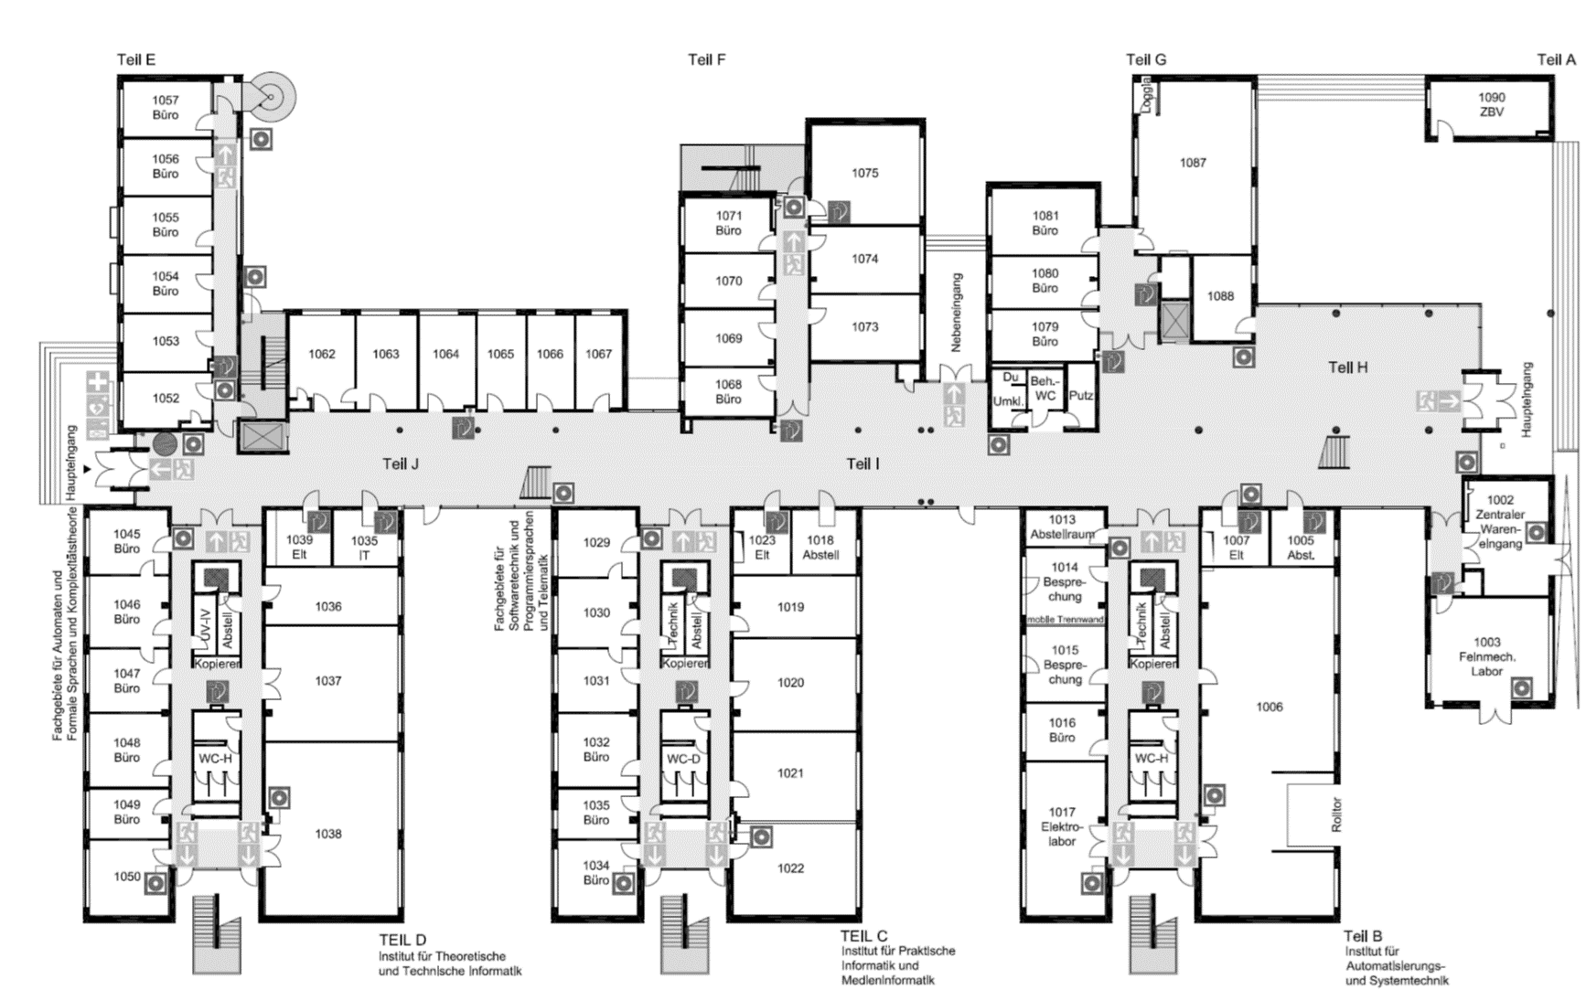
Path Loss Measurements at 60 GHz Indoor
TX 2
TX 1
Illustration of the locations of the transceivers in the entrance hall, the RX will be move in 2m stepwise along the red arrow up the end of the hall (90m)

Slide 19
Pathloss Large Indoor 57-64 GHz vs. 3-10 GHz

Slide 20
Path Loss Measurements at 60 GHz Outdoor
Illustration of the locations of the transceivers at the roof top (15m height) of the Zusebau building, the Rx will be move in 5m stepwise along the red arrow up the end of street (300m)

