Slide 1
WUR MAC and Wakeup Frame
Date: 2017-01-16
Authors:
Name | Affiliation | Address | Phone | Email
Liwen Chu | Marvell | 5488 Marvell Lane, Santa Clara, CA, 95054 | 408-222-2500 | liwenchu@marvell.com

Slide 2
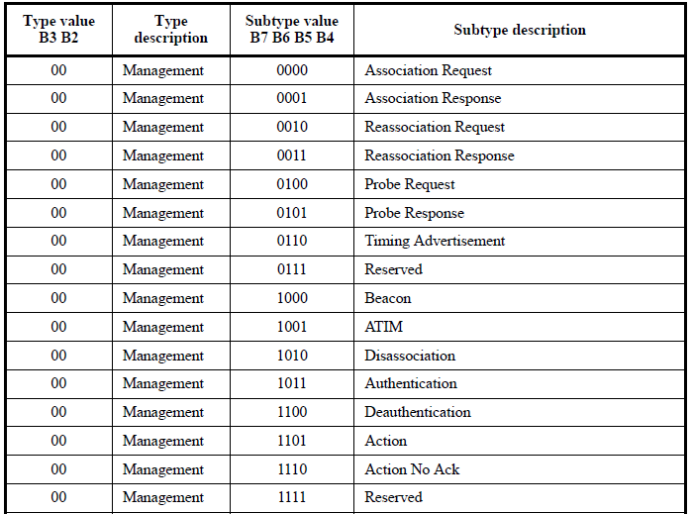
Analysis of Management Frames
Some management frames are used for inter-BSS communication, e.g. public action frame.
Public action should be forwarded by non WUR STAs in the BSS if a BSS includes non WUR STAs.
If a BSS only has WUR STAs, WUR STAs should be able to forward public action frames.
Public action frames include: broadcast public action frames and unicast action frames.

Slide 3
LP Announcement for Broadcast Public Action
A low power STA (STA with .11 radio and low power radio) may need to receive public action frame, e.g. when an ESS whose BSSs only have low power STAs.
A specific BSS identifier, e.g. all “1” BSS identifier or all “0” BSS identifier can be defined to announce broadcast Public Action frame.
  When a LP STA receives a LP WUR with the specific BSS identifier will try to receive the following Public Action frame.

Slide 4
LP Announcement for Unicast Public Action
As other unicast management frame, an unicast public Action frame has unique destination.
  When the transmitter and the receiver of unicast Public Action frame is not in same BSS, the transmitter may not know the receiver’s AID. In this case AID can be specific defined value, e.g. related to the receiver’s partial MAC address.
AID or Partial Addr definition can be identified by
  option 1: Type or other field (, e.g. Token) indicate whether AID or Partial Addr carries 11-bit AID or 11-bit partial MAC address.
  option 2: one bit of AID or Partial Addr field, e.g. Partial Addr Indication subfield being set to 1 indicates the AID or Partial Addr field include 11-bit partial address of the receiver’s MAC address. Partial Addr Indication being set to 0 indicates the AID or Partial Addr field include the AID 11-bit LSB of the receiver.
  If WUR announces unicast public action, partial MAC address indicates partial receiver’s address. If WUR announces the BSS starting, partial MAC address indicates partial AP’s Address .
Type
BSS Identifier
AID or Partial Addr
Payload (Optional)
FCS
Bits:
4
12
12
TBD
4
Unassociation Indication
AID
Bits:
1
11

Slide 5
AID in LP WUR for Broadcast Announcement
AID field may not be needed if each VAP (virtual AP) has its own BSS identifier.
  With this, a transmitted BSS identifier should be defined. When transmitted BSS identifier is in BSS Identifier field, STAs associated with all VAPs of an AP device wakes up to receive the following 802.11 broadcast frames. When the BSS Identifier of a STA’s associated VAP is in BSS Identifier field, STAs associated with all VAPs of an AP device wakes up to receive the following 802.11 broadcast frames.
  The VAPs announce the transmitted BSS Identifier in Beacon, Probe Response, (Re-)Association Response.
Type
BSS Identifier
Payload (Optional)
FCS
Bits:
4
12
TBD
4
AID field is needed if all VAPs of an AP device have same BSS identifier.
  AID with specific value, e.g. 2047 announces broadcast frame for STAs associated with multiple VAPs.
  AID with value of 0 to 2^{n}-1 (n is the value in Max BSSID Indicator field) announces broadcast frame for STAs associated with VAP with related AID.
Type
BSS Identifier
AID
Payload (Optional)
FCS
Bits:
4
12
11
TBD
4

