Slide 1
WUR MAC and Wakeup Frame
Date: 2017-01-16
Authors:
Name | Affiliation | Address | Phone | Email
Liwen Chu | Marvell | 5488 Marvell Lane, Santa Clara, CA, 95054 | 408-222-2500 | liwenchu@marvell.com

Slide 2
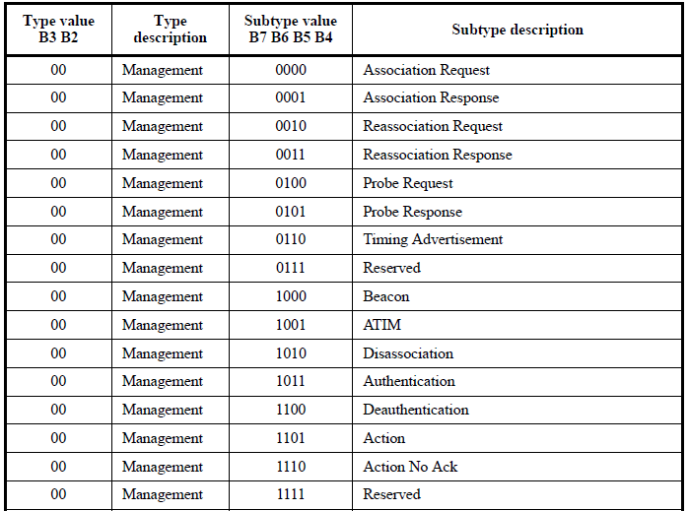
Analysis of Management Frames
Some management frames are used for announcing new BSS operation parameters.
  Such frames include Channel Switch Announcement, Operation Mode Notification etc. A low power needs to wake up to receive such frames.
Some management frames may be used announcing new BSS operation parameters.
  Such frames include Beacon, Probe Response etc. A low power needs to wake up to receive such frames when the frames announce the new BSS operation parameter.

Slide 3
Analysis of Management Frames
When a broadcast management frame is not used for announcing new BSS operation parameters, a power save STA doesn’t need to wake up for the frame reception.
  Such frames include Beacon, Probe Response etc.
Some management frames are transmitted for inter-BSS communication.
  For unicast public Action whose destination is outside the BSS of the transmitter, no AID exists.
Some management frames are transmitted to unassociated STAs for association.

Slide 4
LP Announcement for Broadcast Management
For the management frame which includes no new BSS operation information and is not public action frame, there are two options:
  Option 1: no low power (LP) Wakeup Request (WUR) announces the transmission of the management frame whose content includes no new BSS operation information.
    A STA which wants to associate with an AP needs to do normal operation (passive scanning, active scanning).
  Option 2: a low power (LP) Wakeup Request (WUR) announces the transmission of the management frame whose content includes no new BSS operation information.
    A STA which wants to associate with an AP doesn’t need to do normal operation (passive scanning, active scanning).
A low power (LP) Wakeup Request (WUR) announcement announces the transmission of the management frame whose content includes new BSS operation information.
  A new type is defined for such announcement.
Type
BSS Color
AID
BSI Token
FCS
4
12
11
4
4
LP Wakeup Request
LP WUR
Beacon/Action with new info
Bits:

Slide 5
New BSS Operation Parameters through LP Wakeup Frame
When the BSS operation parameters or other announced information is short enough, the announced information can be in LP Wakeup frame instead of a separate 802.11 Action frame.
  The potential information could include:
    New BSS Operation channel.
    Partial TSF time, e.g. 4 –byte TSF time for notifying AP’s workability, synchronization.
Type
BSS Color
AID
Additional Ctl Info
BSI Token
=0
FCS
Bits:
4
12
11
TBD
4
4
LP WUR with new management information

Slide 6
Group Management
A group STAs can wake up together to receive group frames, receive DL MU PPDU.
Static groups (group ID, group member) which are similar to 11ac’s DL MU group are maintained through Action frame.
  An AP can allocates some AIDs which are not used by associated STAs as group ID.
Dynamic group (multicast group without group announcement/negotiation) are defined through different methods:
  Part of multicast MAC address is put in AID field of LP Wakeup frame.
  The hash result of multicast MAC address is put in AID field of LP Wakeup frame.
  AID bit map which is similar to AID bitmap of TIM element is in LP Wakeup frame and/or sequential multiple LP Wakeup frames with SIFS inter-frame space.
  AID set which includes multiple AIDs is in LP Wakeup frame and/or sequential multiple LP Wakeup frames with SIFS inter-frame space.
It seems that part of multicast MAC address or hash result of multicast MAC address being put in AID field of LP Wakeup frame is better for the reception of group frames. AID set/bitmap and/or sequential multiple LP Wakeup frames is better for DL MU reception.

Slide 7
Starting/Recovering BSS and WUR with partial MAC Address
An AP that starts a BSS (may also recover a BSS) transmits Beacons which are announced by LP WUR for several times.
  Option 1: LP WUR includes BSS Operation Token 0, or Option 2: LP WUR with specific Type
  When such LP WUR is transmitted in multiple channels, the primary channel field is needed.
If the broadcast LP WUR frame with 0 value in BSS Operation Token or type value for starting BSS, the AID field include 11-bit AP’s MAC address or hash value of BSSID.
  The 11-bit MAC address is used for STAs to find recovery AP since the recovery AP may select a new BSS color/identifier.
IF a STA associates with an AP and receives LP WUR that announces the BSS starting, the STA compares the related 11 bits of its associated AP’s MAC address with the value of LP WUR AID field.
  If they matches, the STA receives the following Beacon.
    If the received Beacon is from its associated AP, i.e. its associated AP recovers from error, the STA may do re-association with the AP.
    If the received Beacon is not from its associated AP, the STA discards the Beacon.
If a STA which is not associated with any AP wants to join a BSS, the STA can decode the Beacon.
LP Wakeup Request option 1
Type
BSS Color
AID
BSI Token
=0
FCS
Bits:
4
12
11
4
4
Partial MAC address (may be removed)
LP Wakeup Request option 2
Type
BSS Color
AID
FCS
Bits:
4
12
11
4

Slide 8
AID field for Unassociated STA
If frames transmitted by AP during association is announced by LP WUR frame, AID should be:
  partial MAC address of the receiving STA, or
  hash value of the MAC address of the receiving ST.
Type
BSS Color
AID
FCS
Bits:
4
12
11
4

Slide 9
Reference
[1] 11-16-1460-01-wur-MAC consideration

Slide 10
Backup Slides

Slide 11
BSS Operation Info Token in LP Announcement
In order for all associated STAs to receive the updated BSS operation parameters, a management frames with same BSS operation info will be transmitted multiple times. Decoding one of them is enough.
  LP WUR frame include BSS Operation Info Token (BSI Token), e.g. 4-bit field can be added to LP Wakeup Request.
    The value in Dialog Token is start from 0 and each time the BSS operation parameters change, the Dialog Token is increased by 1. If the value in Dialog Token is 16, it becomes 0
    Each time a LP STA receives a LP Wakeup Request that announces the management frames which carry the updated BSS operation parameters and the STA correctly receives the following management frame, the STA records the dialog token value. If the STA receives LP Wakeup Request with same token value as STA’s record, the STA can ignore the LP Wakeup Request. If the STA receives LP Wakeup Request whose token value is different from the STA’s token record, the STA shall receive the following management frame.
    Option 1: A specific dialog token value, e.g. 0, can be used to indicate that an AP starts/recovers a BSS.
      The value in Dialog Token is start from 0 and each time the BSS operation parameters change, the Dialog Token is increased by 1. If the value in Dialog Token is 16, it becomes 1.
    Option 2: A specific Type can be used to indicate that an AP starts/recovers a BSS. Token is not needed.
LP Wakeup Request option 1
Type
BSS Color
AID
BSI Token
=0
FCS
Bits:
4
12
11
4
4
LP Wakeup Request option 2
Type
BSS Color
AID
FCS
Bits:
4
12
11
4

