Slide 1
Protocols for Hybrid Beamforming in 802.11ay
Date: 2017-03-12
Authors:

Slide 2
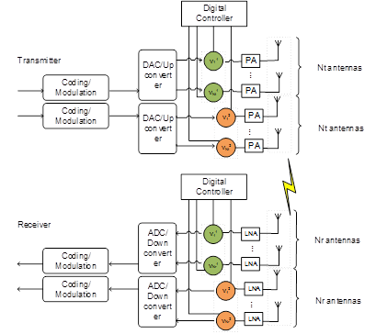
Hybrid Beamforming in 802.11ay
Hybrid beamforming has been proposed in 802.11ay to enable transmission of multiple streams for SU and MU-MIMO [1].
  It combines baseband beamforming with analog beamforming to improve performance
In this contribution, we show the performance gain of hybrid beamforming over analog beamforming with and without feedback in SU-MIMO Tx.
Finally, we present protocols to enable hybrid beamforming in SU/MU-MIMO.
Hybrid Beamforming Architecture
Analog Beamforming Architecture

Slide 3
Current Specification (D1.1)
10.38.9.2.1 General
An EDMG STA may support hybrid precoding (defined as a combination of analog beamforming and digital baseband precoding) for SU-MIMO.
An EDMG STA may support hybrid precoding (defined as a combination of analog beamforming and digital baseband precoding) for MU-MIMO.
Editor Note: need to define the mechanisms to achieve the above.

Slide 4
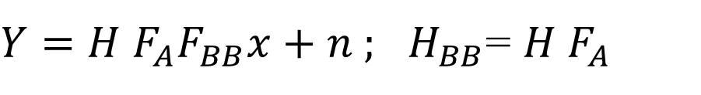
Hybrid Beamforming
$Y=H F_{A}F_{BB}x+n ;$ $H_{BB}$= $H F_{A}$
H = channel; H_{BB} = effective baseband channel
F_{A} = Analog beamformer; F_{BB} = Baseband beamformer
F = Ideal baseband precoder; F_{A}F_{BB} = Hybrid beamformer; F_{A}F_{BB} ≈ F
Case 1: F_{A} and F_{BB} unknown
  Estimate H
  Design F for H
  Design F_{A} / F_{BB} from F
Case 2: F_{A} and F_{BB} unknown
  Estimate H
  Design F_{A} and calculate H_{BB}
  Design F_{BB} from H_{BB}

Slide 5
Beamforming Performance in 802.11ay
We will compare the relative performance of three beamforming methods in 802.11ay
Analog Beamforming with Random Selection:
  Design analog beamformer
  Randomly select N of the M Antenna Weighting Vectors (AWVs)
  No channel knowledge needed at transmitter
Analog Beamforming with Selection:
  Design analog beamformer
  Select the best N of the M AWVs
  Channel knowledge needed at transmitter
Hybrid Beamforming with ideal feedback:
  Design analog beamformer
  Feed back M-dimensional effective digital baseband channel.
  Use SVD based on the time domain channel matrix of the strongest path to transmit N streams

Slide 6
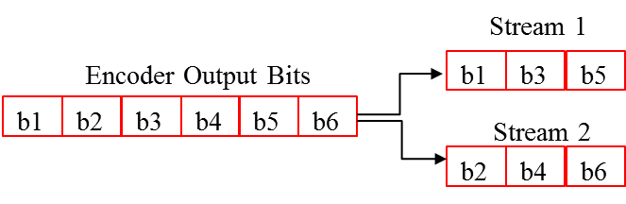
Simulation Assumptions
Based on 11ad/ay SC PHY [2]
2 spatial streams with spatial stream parser
  Vertical Encoding
MCS index is the same for all streams per PPDU, single CRC per PPDU (use MCS 14: π/2 16QAM, rate ¾) [2]
MMSE receiver
Enterprise Cubicle (CB) scenario in 11ay/ad channel model [3]
STAs located on the table at a height of 0.7m in the cubicle
AP positioned in the middle below the ceiling at a height of 2.9 m
Real channel estimation at receiver
Detailed assumptions can be found in the appendix

Slide 7
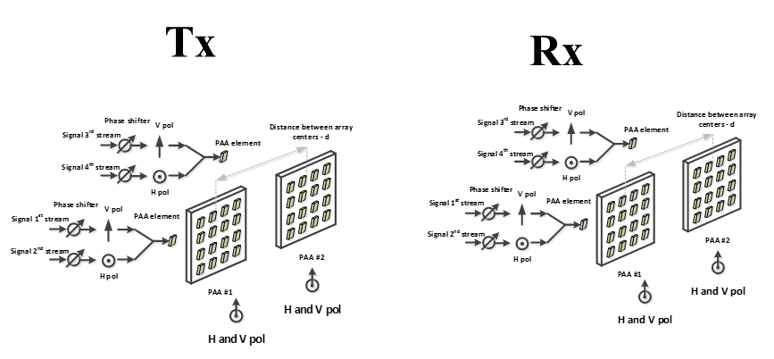
Simulated SU-MIMO Configurations
We implement the following beamformers:
  Analog beamforming random selection
  Analog beamforming with selection
  Hybrid beamforming
We simulate Configuration #4 of the SU-MIMO PAA configurations [3]
  4x4 channel, 2 PAAs with dual polarization on each side

Slide 8
Numerical Results
Hybrid beamforming shows gain over both types of analog beamforming

Slide 9
Protocols for Hybrid BF in 802.11ay
To implement hybrid BF in 802.11ay, we need the following:
  Initiator and Responder to agree on hybrid BF support.
    Indicate that initiator can perform hybrid BF
    Indicate that responder can feed back detailed information for a given configuration needed to support hybrid BF
      Note that the actual use of the HB is transparent to the responder
  Explicit baseband channel feedback for baseband precoder design. However, explicit feedback to enable HB is required.
Proposed protocol extends current procedures for SU-MIMO and MU-MIMO in D0.2 [4]

Slide 10
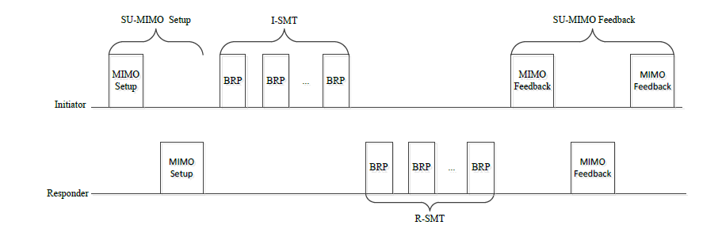
SU-MIMO Hybrid BF Protocol
Exchange hybrid beamforming capabilities
  AP indicates support for hybrid BF
  STA indicates ability to feed back detailed channel information
AP indicates need for detailed feedback during MIMO setup
  Option 1: Detailed channel feedback occurs during MIMO feedback for SU-MIMO
    (D1.1: the feedback type for the responder link (e.g., SINR or time domain channel response)).
Option 2: Detailed feedback occurs after MIMO feedback: H_{BB} feedback

Slide 11
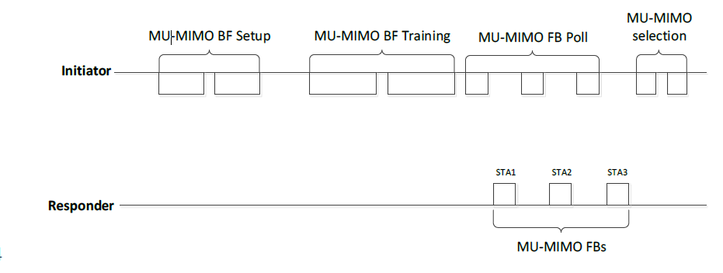

MU-MIMO Hybrid BF Protocol
Option 1: (No change between the BF setup and MU-MIMO selection): MU-MIMO FB Poll feeds back all channel details
  D1.1: The BF Feedback frame carries the list of received initiator’s transmit DMG antennas/sectors, each with its corresponding responder’s receive DMG antenna/sector and the associated quality indicated
  Indicate need for detailed feedback during setup
Option 2: (No change between the BF setup and MU-MIMO selection): request for detailed feedback after MU-MIMO selection : Digital Baseband Tracking (see [5])
Option 3: MU-MIMO selection different from BF setup : Digital Baseband Tracking (see [5])

Slide 12
Conclusion
In this contribution, we have shown that hybrid beamforming performs better than analog beamforming in SU-MIMO transmission.
We have also presented hybrid beamforming protocols for SU-MIMO and MU-MIMO transmission in 802.11ay based on the existing protocols in P802.11ay D0.2

Slide 13
References
[1] K. Oteri et. al., “Beam Tracking for 802.11ay”, IEEE doc. 11-16/0040r2
[2] IEEE Std 802.11-2016, December 2016
[3] A. Maltsev, et al, “Channel models for IEEE 802 11ay”, IEEE doc. 11-15/1150r8
[4] IEEE P802.11ay™/D0.2, January 2017
[5] K. Oteri et. al., “Further Discussion on Beam Tracking for 802.11ay”, IEEE doc. 11-17/0426r0

Slide 14
Straw Poll 1
Do you agree to the proposed hybrid beamforming protocol for SU-MIMO and MU-MIMO in the 802.11ay specification draft ?

