Slide 1
Protocols for Hybrid Beamforming in 802.11ay
Date: 2017-03-12
Authors:

Slide 2
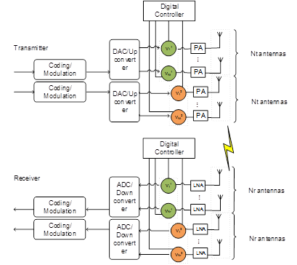
Hybrid Beamforming in 802.11ay
Hybrid beamforming has been proposed in 802.11ay to enable transmission of multiple streams for SU and MU-MIMO [1].
It combines baseband beamforming with analog beamforming to improve performance
In this contribution, we show the performance gain of hybrid beamforming over analog beamforming with and without feedback in SU-MIMO Tx.
Finally, we present protocols to enable hybrid beamforming in SU/MU-MIMO.
Hybrid Beamforming Architecture
Analog Beamforming Architecture

Slide 3
Beamforming Performance in 802.11ay
We will compare the relative performance of three beamforming methods in 802.11ay
Analog Beamforming with Random Selection:
Design analog beamformer
Randomly select N of the M Antenna Weighting Vectors (AWVs)
No channel knowledge needed at transmitter
Analog Beamforming with Selection:
Design analog beamformer
Select the best N of the M AWVs
Channel knowledge needed at transmitter
Hybrid Beamforming with Ideal Feedback:
Design analog beamformer
Feed back M-dimensional effective digital baseband channel.
Use SVD based on the time domain channel matrix of the strongest path to transmit N streams

Slide 4
Simulation Assumptions
Based on 11ad/ay SC PHY [2]
2 spatial streams with spatial stream parser
Vertical Encoding
MCS index is the same for all streams per PPDU, single CRC per PPDU (use MCS 14: π/2 16QAM, rate ¾) [2]
MMSE receiver
Enterprise Cubicle (CB) scenario in 11ay/ad channel model [3]
STAs located on the table at a height of 0.7m in the cubicle
AP positioned in the middle below the ceiling at a height of 2.9 m
Real channel estimation at receiver
Detailed assumptions can be found in the appendix

Slide 5
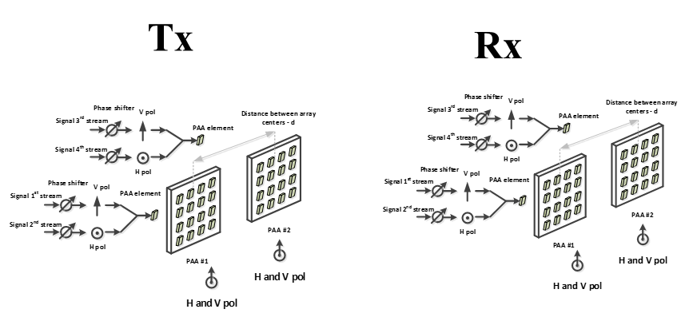
Simulated SU-MIMO Configurations
We implement the following beamformers:
Analog beamforming random selection
Analog beamforming with selection
Hybrid beamforming
We simulate Configuration #4 of the SU-MIMO PAA configurations [3]
4x4 channel, 2 PAAs with dual polarization on each side

Slide 6
Numerical Results
Hybrid beamforming shows gain over both types of analog beamforming

Slide 7
Protocols for Hybrid BF in 802.11ay
To implement hybrid BF in 802.11ay, we need explicit baseband channel feedback for baseband precoder design
Proposed protocol should extend current procedures for SU-MIMO and MU-MIMO in D0.2 [4]

Slide 8
Conclusion
In this contribution, we have shown that hybrid beamforming performs better than analog beamforming in SU-MIMO transmission.
We have also discussed hybrid beamforming protocols for SU-MIMO and MU-MIMO transmission in 802.11ay based on the existing protocols in P802.11ay D0.2

Slide 9
References
[1] K. Oteri et. al., “Beam Tracking for 802.11ay”, IEEE doc. 11-16/0040r2
[2] IEEE Std 802.11-2016, December 2016
[3] A. Maltsev, et al, “Channel models for IEEE 802 11ay”, IEEE doc. 11-15/1150r8
[4] IEEE P802.11ay™/D0.2, March 2017

