Slide 1
Throughput and Coverage Improvements with DFT-s-OFDM for 802.11ay
Date: 2017-03-16
Authors:

Slide 2
Abstract
In [1-3], we evaluated the DFT-spread OFDM for 802.11ay from different angles (e.g., its benefit in fading, low PAPR, and channel-wise orthogonal multiple access in frequency domain)
In this contribution,
  We quantify the benefit of DFT-spread OFDM by using a majority of 11ay MCSs for two different simulation scenarios

Slide 3



Background
A typical SC TX and RX for 802.11ad/ay may employ up-sampling, filtering, and down-sampling operations to match the sampling rate
In [3], we show that the up-sampling, filtering, down-sampling operation is equivalent to a weighted combination in frequency domain, which is not optimal in 802.11ay channels
448
448
$$↑$$
2
Filter
$$↓$$
3
Data
$$≡$$
Weighted Comb.
Data
S
/
P
DFT
(512)
EQ
IDFT
(512)
DFT
(768)
EQ
IDFT
(512)
768
64
64
RS
RS
SC receiver (time domain representation)
SC receiver (frequency domain representation)

Slide 4






SC versus DFT-spread OFDM
As shown in the appendix, SC transmitter can also be presented in frequency by using a weighted expansion block
DFT-spread OFDM basically removes the expansion and combination operations and achieves better PER and throughput performance
The references [4] and [5] show that DFT-spread OFDM can be implemented with mixed radix (e.g., radix-3 & radix-2) FFT implementation
Single carrier:
$$G_{H}$$
DFT
(512)
Weighted expan.
Weighted comb.
IDFT
(512)
$$G_{H}$$
Data
IDFT
(768)
DFT
(768)
EQ
Data
448
512
512
448
$$G_{T}$$
$$G_{T}$$
Filter coef.
DFT-spread OFDM:
Filter coef.
$$G_{H}$$
DFT
(512)
IDFT
(768)
DFT
(768)
IDFT
(512)
$$G_{H}$$
Data
448
EQ
448
Data
$$G_{T}$$
512
512
$$G_{T}$$

Slide 5
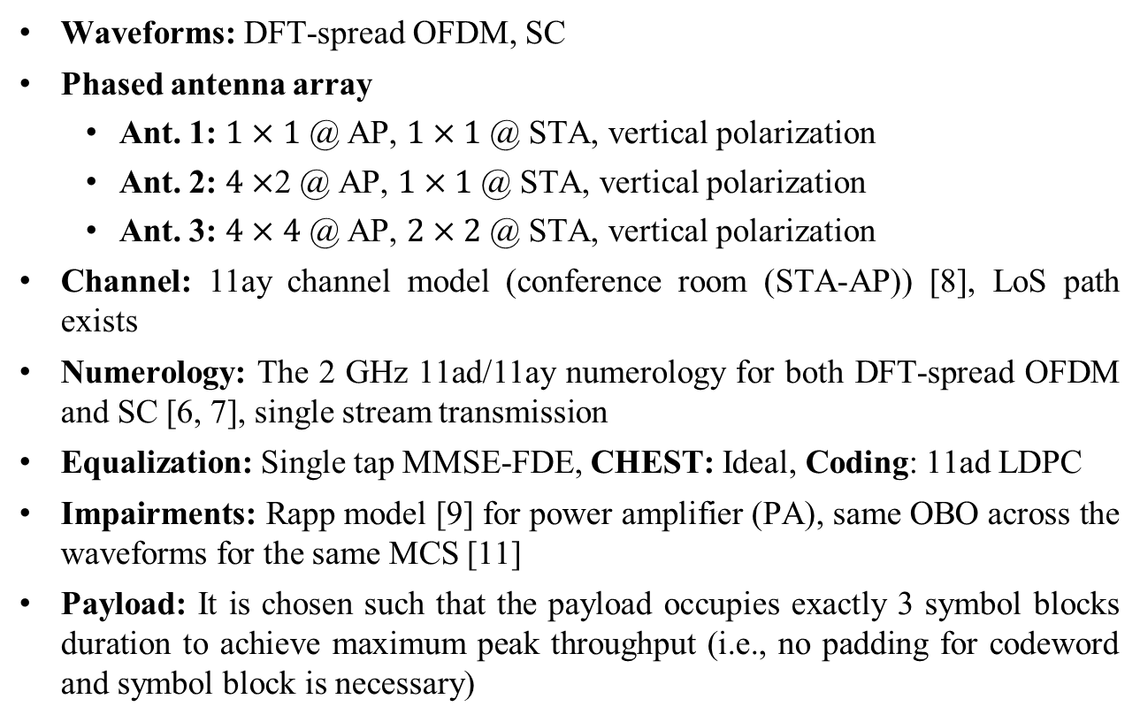
Simulation Assumptions [11]
Waveforms: DFT-spread OFDM, SC
Phased antenna array
    Ant. 1: $1×1$ @ AP, $1×1$ @ STA, vertical polarization
    Ant. 2: $4×$2 @ AP, $1×1$ @ STA, vertical polarization
    Ant. 3: $4×4$ @ AP, $2×2$ @ STA, vertical polarization
Channel: 11ay channel model (conference room (STA-AP)) [8], LoS path exists
Numerology: The 2 GHz 11ad/11ay numerology for both DFT-spread OFDM and SC [6, 7], single stream transmission
Equalization: Single tap MMSE-FDE, CHEST: Ideal, Coding: 11ad LDPC
Impairments: Rapp model [9] for power amplifier (PA), same OBO across the waveforms for the same MCS [11]
Payload: It is chosen such that the payload occupies exactly 3 symbol blocks duration to achieve maximum peak throughput (i.e., no padding for codeword and symbol block is necessary)

Slide 6
Throughput Results (Conference Room, STA-AP, Ant. 3)
DFT-s OFDM provides more than 20% throughput gain in certain SNR ranges
On average, DFT-spread OFDM introduces approximately 15% throughput as compared to SC
The results for the aforementioned scenarios, provided in appendices, show similar improvement

Slide 7
Coverage Range (STA-AP, Ant. 3)
Assumptions: TX power: 10 dBm; Noise figure: 5 dB; Path loss: Friis formula; Method: calculate SNR for a given link distance and find the best MCS
DFT-s OFDM improves the coverage range approximately by 10% as compared to SC

Slide 8
Conclusion
In this contribution, we demonstrate that DFT-spread OFDM brings approximately 15% throughput gain for a given link distance and 10% coverage gain as compared to SC by using the MCS adopted in 802.11ay

Slide 9
References
[1] “On the Single Carrier Waveforms for 11ay”, IEEE 802.11-16/01455r0
[2] “Performance Evaluation of Multi-DFT-spread OFDM for 802.11ay ”, IEEE 802.11-17/0048r0
[3] "Further Evaluation of Single Carrier Waveforms”, IEEE 802.11-17/0274r0
[4] “Software Optimization of DFTs and IDFTs Using the StarCore SC3850 DSP Core” http://www.nxp.com/assets/documents/data/en/application-notes/AN3680.pdf, 2010
[5] J. Lofgren and P. Nilsson “On Hardware Implementation of Radix 3 and Radix 5 FFT Kernels for LTE systems”, IEEE NORCHIP, Lund, 2011
[6] “Wireless LAN Medium Access Control (MAC) and Physical Layer (PHY) Specifications Amendment 3: Enhancements for Very High Throughput in the 60 GHz Band,” IEEE Std 802.11ad-2012, pp. 1–628, Dec. 2012.
[7] “Specification Framework for TGay,” IEEE 802.11-15/01358r6
[8] “Channel Models for IEEE 802.11ay,” IEEE 802.11-15/1150r7
[9] “11ay evaluation methodology,” IEEE 802.11-16/866r4
[10] K. R. Rao at al., “Fast Fourier Transform - Algorithms and Applications”, Signals and Communication Tech., Springer, 2010
[11] “PHY Simulations and Methodology”, IEEE 802.11-10/0431r3

Slide 10
Appendix - Simulation Results

Slide 11
Throughput Results (STA-AP, Ant. 1)

Slide 12
Throughput Results (STA-AP, Ant. 2)

Slide 13
Throughput Results (STA-AP, Ant. 3)

Slide 14
Coverage Range (STA-AP, Ant. 2)

Slide 15
Coverage Range (STA-AP, Ant. 3)

Slide 16
PER Results (STA-AP, Ant. 1)

Slide 17
PER Results (STA-AP, Ant. 2)

Slide 18
PER Results (STA-AP, Ant. 3)

Slide 19










Representations of Single Carrier TX and RX in Frequency
+
time
+
time
time
=
$$G_{H}$$
$$↑$$
3
Filter
$$↓$$
2
$$↑$$
2
Filter
$$↓$$
3
DFT
(512)
IDFT
(512)
$$G_{H}$$
Data
Data
448
P
/
S
S
/
P
EQ
448
$$G_{T}$$
768
$$G_{T}$$
[10]
[10]
[10]
[10]
IDFT
($512×3$)
DFT
($768×2$)
IDFT
($768×2$)
DFT
($512×3$)
IDFT
(512)
DFT
(512)
DFT
(512)
IDFT
(768)
DFT
(768)
768
768
Cancels each other
Filter
coef.
Cancels each other
Filter
coef.
Cancels each other
$$≡$$
$$≡$$
$$G_{H}$$
DFT
(512)
Weighted expan.
Weighted comb.
IDFT
(512)
$$G_{H}$$
Data
IDFT
(768)
DFT
(768)
EQ
Data
448
512
512
448
$$G_{T}$$
$$G_{T}$$
Filter coef.
Filter coef.

