Slide 1
Further Discussion on Beam Tracking for 802.11ay
Date: 2017-03-12
Authors:

Slide 2
Introduction
A consolidated BF training protocol for use during the DTI period of the beacon interval has been agreed for SU/MU MIMO beamforming in [1]. The protocol is comprised of:
  Phase 1: SISO phase (mandatory): collects feedback on one or more suitable initiator’s TX and responder’s RX DMG antennas and sectors between the initiator and each responder intended to be part of the SU/MU group.
  Phase 2: MIMO phase (mandatory): Enables the training of transmit and receive sectors and DMG antennas to determine best combinations of transmit and receive sectors and DMG antennas for SU/MU-MIMO operation.
Hybrid beamforming has also been proposed and accepted [1][2]
In this contribution, we propose Analog Beam (AB) tracking and Digital Baseband Channel (DBC) tracking as tracking mechanisms for hybrid beamforming.
We show simulation results that demonstrate the benefits of DBC tracking for hybrid beamforming in scenarios where the channel changes e.g. due to blockage.
Finally, we propose a protocol to enable both AB and DBC tracking.

Slide 3
Beam Tracking in 802.11ad
In 802.11ad, the beam identification phases are:
  SLS
  BRP
  Beam Tracking
Beam tracking is used for identifying the best beam for transmission after beam refinement and comprises setup, training and feedback sub-phases:
  Setup: Initiator requesting Tx beam tracking sets parameters in transmitted packet:
    BEAM_TRACKING_REQUEST: Beam tracking requested
    Packet Type: TRN-T-PACKET
    TRN-LEN: number of TRN-T fields
  Training: Initiator appends an AGC field and TRN-T subfields to the packet
  Feedback: Responder feeds back channel to the initiator.
    The feedback type is the same as the feedback type in the last BRP frame that was transmitted from the initiator to the responder with TX-TRN-REQ equal to 1.
    If the responder has never received a BRP frame from the initiator with TX-TRN-REQ equal to 1, the responder shall respond with the best sector.

Slide 4
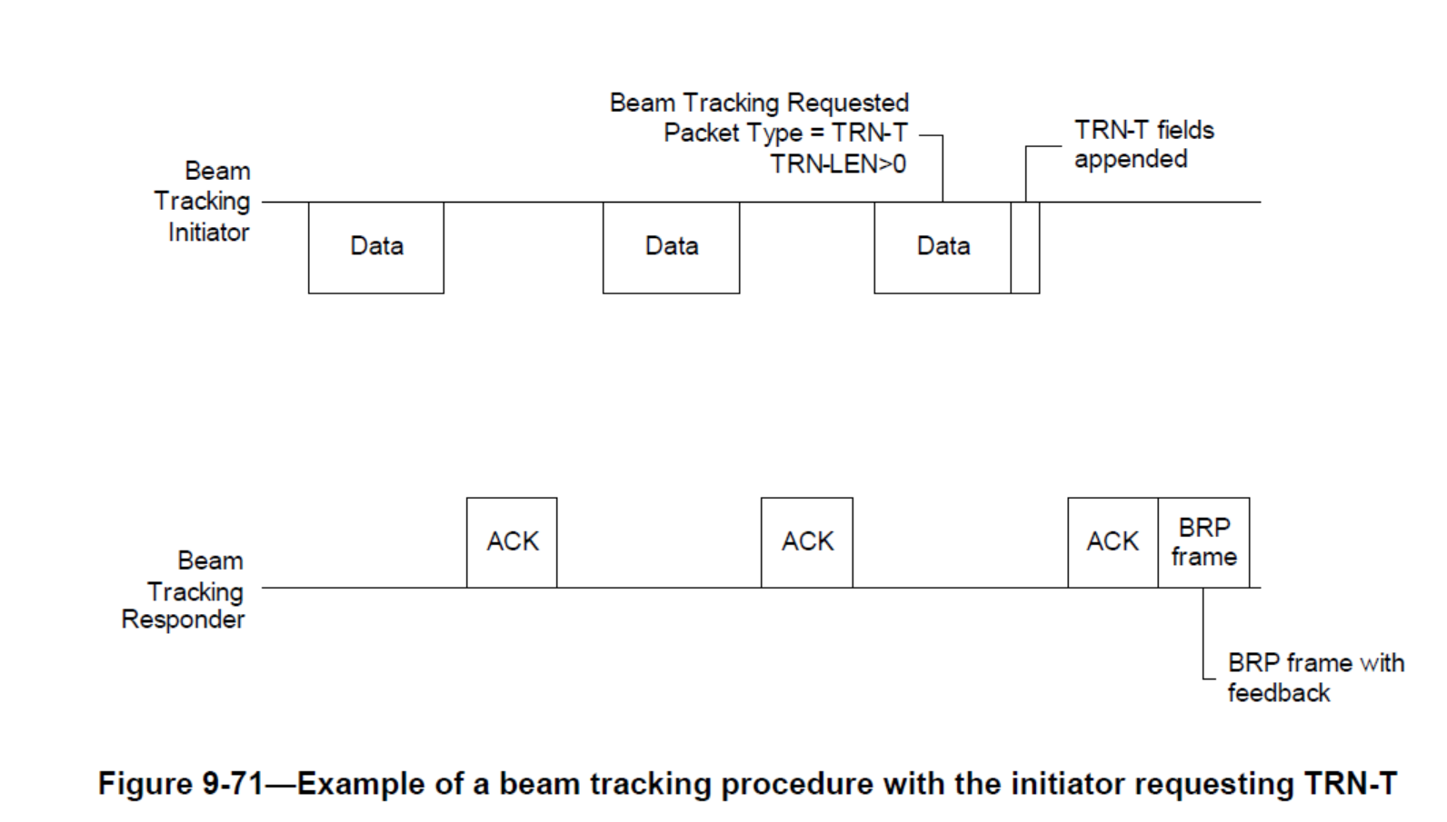
Beam Tracking with Initiator Requesting TRN-T [3]

Slide 5
Hybrid Beamforming in 802.11ay
Hybrid precoding has been proposed in 802.11ay to enable transmission of multiple streams for SU and MU-MIMO [1][2].
  It adds digital baseband beamforming to analog beamforming to improve overall performance
This may require a change to the tracking mechanism
Protocol in 802.11ay [2]:
  Generate the best analog beamformer
  Feedback analog beamformer and the effective digital base band channel.
  Design the baseband channel
  Transmit data
Hybrid Beamforming Architecture

Slide 6
Beam Tracking for 802.11ay
For 802.11ay, two types of beam tracking can be defined:
  Analog Beam Tracking (AB): used to track the change in analog beams e.g. due to STA rotation, movement or blockage.
    Similar to 802.11ad tracking but updated for SU/MU-MIMO
  Digital Baseband Channel Tracking (DBC): used to track the change in the baseband channel for a fixed set of analog beams e.g. due to beam blockage when using hybrid beamforming.
    Requires feedback of new baseband channel based on original analog beams (skips the analog tracking procedure).
    Simplifies tracking by
      Simplifying setup
      Enabled by the use of the CEF and a feedback request.
We will compare the performance with DBC tracking to ideal hybrid BF in a blockage scenario

Slide 7
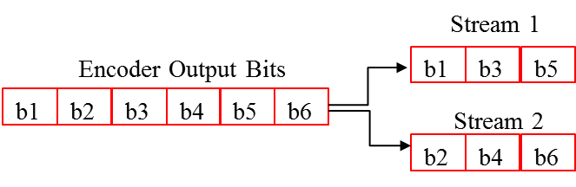
Simulation Assumptions
Based on 11ad/ay SC PHY [3]
2 spatial streams with spatial stream parser
  Vertical Encoding
MCS index is the same for all streams per PPDU, single CRC per PPDU (use MCS 14: π/2 16QAM, rate ¾) [3]
MMSE receiver
Enterprise Cubicle (CB) scenario in 11ay/ad channel model [4]
STAs located on the table at a height of 0.7m in the cubicle
AP positioned in the middle below the ceiling at a height of 2.9 m
Real channel estimation at receiver
Detailed assumptions can be found in the appendix

Slide 8
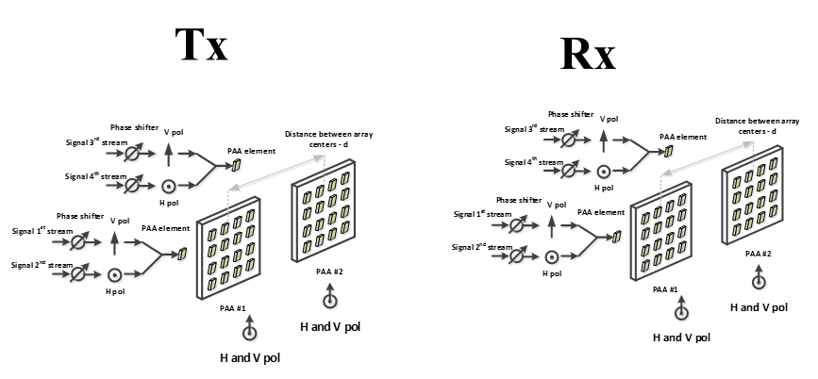
Simulated SU-MIMO Configurations
Channel generated using desired scenario (CB)
One of the LOS paths is randomly selected and blocked
  We simulate Configuration #4 of the SU-MIMO PAA configurations [3]
  Note there are 4 LOS paths in this configuration due to the 4 antenna pairs
Original hybrid beamformer is designed based on the original channel
  Scheme 1: Transmission with no change in hybrid beamformer (No tracking)
  Scheme 2: Transmission with no change in analog beamformer but redesigned baseband digital beamformer (baseband digital tracking only).
  4x4 channel, 2 PAAs with dual polarization on each side

Slide 9
Numerical Results
Hybrid precoding with DBC tracking recovers most of the performance loss due to LOS blockage

Slide 10
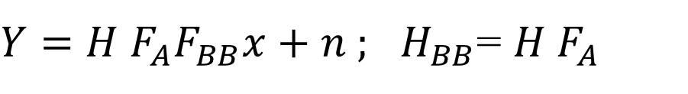
Hybrid Beamforming
$Y=H F_{A}F_{BB}x+n ;$ $H_{BB}$= $H F_{A}$
H = channel; H_{BB} = effective baseband channel
F_{A} = Analog beamformer; F_{BB} = Baseband beamformer
F = Ideal baseband precoder; F_{A}F_{BB} = Hybrid beamformer; F_{A}F_{BB} ≈ F
Case 1: F_{A} and F_{BB} unknown
  Estimate H
  Design F for H
  Design F_{A} / F_{BB} from F
Case 2: F_{A} and F_{BB} unknown
  Estimate H
  Design F_{A} and calculate H_{BB}
  Design F_{BB} from H_{BB}
Case 3: F_{A} known and F_{BB} unknown
  Estimate H_{BB}
  Design F_{BB} from H_{BB}
Case 1/Case 2 discussed in [2]

Slide 11
Hybrid Beamformer Tracking
Can estimate H_{BB} efficiently by eliminating additional TRN fields

Slide 12
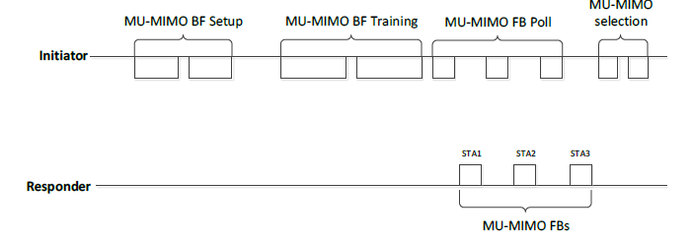
Use Cases
For link adaptation to estimate H_{BB} before full blown tracking e.g. beam blockage (SU/MU-MIMO)
In MU-MIMO scenario to estimate H_{BB} when a different sub-set of STAs selected for transmission (MU-MIMO selection) after MU-MIMO BF Training

Slide 13
Beam Tracking Protocol for 802.11ay
802.11ay beam tracking Protocol can be split into three sub-phases: setup, training and feedback:
  Setup: Needs to signal the tracking type, antenna configuration needs to be set up.
  Training: based on the BRP (using TRN-T/R fields) or the CEF.
  Feedback: channel feedback is needed for DBC tracking while any one of the best beam, SNR, or channel feedback is suitable for AB tracking.

Slide 14
Beam Tracking for 802.11ay

Slide 15
Steps for Beam Tracking in 802.11ay
Setup or Announcement
  Indicate if analog beam (AB) or digital baseband channel (DBC) tracking request : (AB or DBC)
    Indicate if SU or MU (AB or DBC)
  SU-MIMO/MU-MIMO BF setup :
    Indicate information similar to MU-MIMO BF setup sub-phase : (AB or DBC)
    Indicate SU/MU transmission configuration or use parameter to indicate keep current configuration : (DBC)
  Training Type
    Indicate use of TRN-T/R and TRN_length and set baseband precoder to Identity matrix : (AB or DBC)
    Indicate the use of CEF based training and set baseband precoder to Identity matrix: (DBC only)
  Indicate Feedback type required
    Best Beam(s), SNR(s): (AB only)
    Channel feedback : (AB or DBC)

Slide 16
Steps for Beam Tracking in 802.11ay (ctd)
Training
  TRN-T/R based training: (AB or DBC)
  CEF based training : (DBC only)
Feedback
  Based on simple polling (AB or DBC)
  Other methods are TBD

Slide 17
Conclusion
The beam tracking for hybrid beamforming in 802.11ay may be :
  Analog Beam tracking
  Digital Baseband Channel tracking
Simulation results show that with digital baseband channel tracking, performance lost due to channel blocking may be mostly recovered.
A protocol for beam tracking in 802.11ay is also introduced.

Slide 18
References
[1] IEEE P802.11ay™/D0.2, January 2017
[2] K. Oteri et. al., “Protocols for Hybrid Beamforming in 802.11ay”, IEEE doc. 11-17/0429r0
[3] IEEE Std 802.11-2016, December 2016
[4] A. Maltsev, et al, “Channel models for IEEE 802 11ay”, IEEE doc. 11-15/1150r8

Slide 19
Straw Poll 1
Do you agree to include mechanisms that support Digital Baseband Channel Tracking in addition to Analog Beam Tracking for SU-MIMO and MU-MIMO for 802.11ay to enable robust channel tracking ?

Slide 20
Appendix

Slide 21
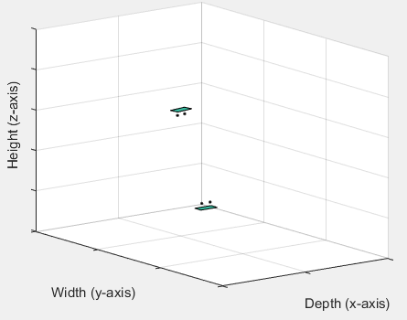
Channel parameters
For channel with LOS components [3],
  TX/RX analog beamforming for both polarizations of PAA#i are based on the LOS direction between TX PAA#i ↔ RX PAA#i
For channel without LOS components
  Beam forming based on the AoD/AoA of strongest signal path between TX PAA#i ↔ RX PAA#i
Channel bandwidth 2.64 GHz, center frequency 60.48 GHz
Each PAA has 16 elements (8 X 2)
Distance between antenna elements 0.0025m
Distance between center of PAAs 10cm
For AP-STA scenario, STA is placed at a plane 2m below AP in the cubicle 1. Random rotation around z-axis between STA/AP.

