Slide 1
Fixed Inter Frame Spacing for BRP in 802.11ay
Date: 2017-03-12
Authors:

Slide 2
Introduction
In 802.11ay, enhancements to the 802.11ad beamforming training procedures have been agreed on for complexity reduction, efficiency and to enable MIMO BF training [1][2][3][4].
In [5][6] and [7], we proposed and studied the implementation of a multi-stage, multi-resolution beamforming training (MR BFT) framework based on the 802.11ad Beam Refinement Protocol (BRP) and proposed improvements to the BRP procedure to enable efficient BRP. The improvements concluded that :
  11ay BRP protocol should allow negotiation of the value of aBRPminSCblocks <=18 [4]
In this contribution, we discuss further improvement by proposing the restriction of the IFS between the BRP frame and the response from the STA.
  The 11ay BRP protocol may transmit a response at a SIFS duration after reception of the BRP frame

Slide 3
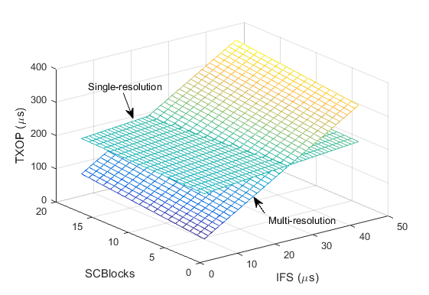
IFS Optimization
IFS has a very large effect on the efficiency of BRP feedback. As such there is a need to optimize IFS to improve efficiency of BRP [6].
There are two options to optimize the IFS for the BRP:
  Negotiate the values of the IFS : Improves BRP efficiency (not agreed) [7]
  Restrict the IFS to SIFS only :
    Eliminates channel access ambiguity (further discussion)

Slide 4
Restrict the IFS to SIFS only
The responder transmits a response to the initiator after a SIFS duration on reception of the BRP measurement frame.
If the response is available, the STA sends the response at a SIFS duration after the frame is received.
If the response is not available:
  Option 1: The responder may respond by transmitting one or more PPDUs to the requesting STA (e.g. ACK) at a SIFS duration after the frame is received.
    STA may contend for the channel at a later time
    AP may poll the STA at a later time
  Option 2: The STA may transmit dummy information until information is ready e.g L-STF

Slide 5
Response Transmission with SIFS only

Slide 6
Summary
We present details on IFS Optimization by proposing to:
  Restrict the IFS to SIFS only to eliminate channel access ambiguity while optimizing the IFS for the beam refinement procedure.
  We also propose different schemes to recover in the event the response from the responder is not ready

Slide 7
References
IEEE 802.11-16/0100r3, MIMO BF Training Enhancements, Wang et. al., Jan 2016
IEEE 802.11-16/0316r0, Low Complexity Beamtraining for Hybrid MIMO, Fellhauer et. al., March 2016
IEEE 802.11-16/0420r1, BF Training for SU MIMO, Huang et. al., March 2016
IEEE 802.11-15/1358r5, Specification Framework for TGay, Cordeiro, August 2016
IEEE 802.11-16/1175r0, Multi-Stage, Multi-Resolution Beamforming Training for 802.11ay, Oteri et. al., September 2016
IEEE 802.11-16/1447r1, Further Details on Multi-Stage, Multi-Resolution Beamforming Training in 802.11ay, Oteri et. al., November 2016
IEEE 802.11-17/0041r1, BRP Optimization in 802.11ay, Oteri et. al., January 2017

Slide 8
Straw Poll 1
Do you agree to add a mechanism to the 802.11ay specification to perform the following ?
  In the 11ay BRP protocol there shall be an option for the BRP frame to function as an action ACK frame.
    The procedure to recover feedback if the response is not ready is TBD

Slide 9
Appendix

Slide 10
TxOP Comparison Assumptions
Tc=0.57 ns
MAC data=42 Bytes (assumes no channel measurement feedback)
  Using any MCS would lead to a codeword less than the minimum block requirement
  Zero padding to aBRPminSCblocks=18 (this affects BRP_training frame size)
AGC and TRN-T
  Training length N:1<= N<= 32 (N~5 bits)
  AGC=4N*64*5=1280N
  TRN-T=(CE+TRN_subfield*4)*N=(1024+128+128*5*4)*N=3712N
IFS (Interframe spacing)
  At least a SIFS interval and at most a BRPIFS interval to ensure sufficient time for the complete transmission of frames
  SIFS=3 us; BRPIFS=44 us
Analysis will compare SR BRP with MR BFT
  Vary number of beams and MR levels: 16 beams ( 2 level), 64 beams (3 level), 256 beams (4 level)
    Note: 802.11ad BRP packet supports up to 32*4=128 beams. However, we assume 256 beams can be trained within one packet here. Otherwise, two separate BRP training packets are needed for SR’
  Study effect of IFS (3 usec <= IFS <= 44 usec) and BRP_training size (1 <= SCBlock <= 18)
  Assume BRP feedback frame size will stay the same

Slide 11
TxOP Comparison
Multi-resolution beamforming training
  TXOP_SIFS=# of levels*(BRP_training+SIFS+BRP_feedback+SIFS)-SIFS
  TXOP_BRPIFS=# of levels*(BRP_training+BRPIFS+BRP_feedback+BRPIFS)-BRPIFS
Single-resolution beamforming training
  TXOP_SIFS=BRP_training+SIFS+BRP_feedback
  TXOP_BRPIFS=BRP_training+BRPIFS+BRP_feedback
Observations
  Multi-resolution beamforming training has a shorter training packet but a larger number of training and feedback packets
  IFS, BRP_training and BRP feedback have impact on the time duration

Slide 12
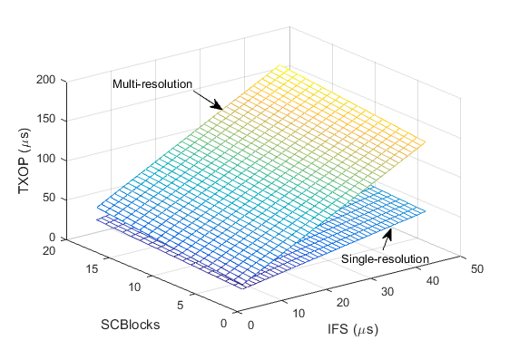
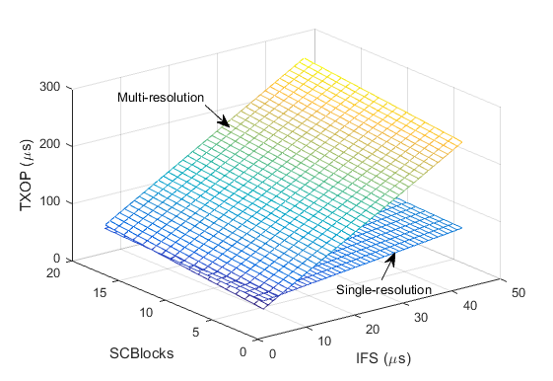
Results
2-Level Results: 16 beams
3-Level Results: 64 beams
MR BFT with existing BRP parameters
Parameters
BRP_training size: 1 <= SCBlocks <=18
IFS duration: SIFS (3) <= IFS<=BRPIFS (44)
Observation
As resolution increases, MR BFT shows improved performance over SR BFT if BRP_training size and IFS are modified
4-Level Results: 256 beams

Slide 13
Results Summary
Observations
Observation 1 (O1): Optimizing both IFS and BRP training frame size show improvements for both SR and MR BFT.
  SR drops from 241 usec to 215 usec
  MR drops from 381 usec to 213 usec
Observation 2 (O2): MR BFT shows improved performance over SR BFT as the beam resolution increases
  Note that up to 2048 beams may be supported
O1
O2

