Slide 1
Passive Location
Date: 2017-03-14
Authors:

Slide 2
Abstract
This presentation discusses passive location for 802.11az, including scheduling methodology as well as multi-user and multi-antenna ranging as it pertains to the passive ranging case.

Slide 3
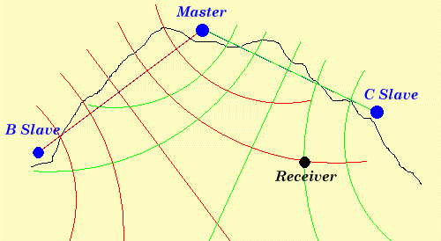
TDOA - Hyperbolic Navigation
Source: http://asadahmedansari6395.blogspot.ca/2016_04_01_archive.html

Slide 4
Introduction
By arranging (E)FTM exchanges between stationary stations, call them ‘anchor stations’ (AS), one can enable a ‘client station’ to derive its differential distance to the two stations.
With multiple such (E)FTM exchanges between multiple pairs of anchor stations, the location of the client station can be derived in a hyperbolic navigation scheme.
These anchor stations can, say, be stationary devices such as:
  WiFi access points
  Wireless speakers
  Security cameras
  Printers
  Electronic locks/access control devices
  Alarm system components
  Appliances and appliance controls
  Etc.
Your average venue will contain a large multitude of such devices, many of them WiFi enabled and powered, that can be used to enable passive WiFi location.

Slide 5
Passive Location
‘Anchor Station’
AS1
AS2
‘Access Point 0’
AS
TDOA
AP0
Client
AP
AS3
AS

Slide 6
SU Legacy FTM Based Passive Ranging
- Recap

Slide 7
Timing Relations
Note that all these transmissions, as depicted here, take place in the channel of AP0.
Ranging periodicity
Ranging periodicity
FTM procedure
FTM procedure
FTM procedure
AP0 transmissions
ACK
FTM
FTM
t1, t4
SIFS
Neighboring AS transmissions
FTM Request
ACK
ACK
Transmitted at times t1
Received at time t2 by AS1
Received at time t5 by the client
Transmitted at time t3
Received at time t4 by AP0
Received at time t6 by the client

Slide 8
Propagation paths and time stamps
Illustrating timing diagram:
AP0
AS1
Client
t1
FTM
t2
ACK
t3
t4
t5
t6

Slide 9
Calculation of differential distance
The differential distance between a client station and two ASs exchanging EFTM messages can be calculated as follows.
The client station listens to the EFTM exchange between the two ASs and records the time t5 when it receives the FTM from AP0 and the time t6 when it receives the (FTM) ACK from AS1.
Furthermore the client listens to the reporting of t1 and t4 from AP0.
The differential distance from the client to AP0 and AS1 can then be calculated as:
  D_delta_client_01 = [t5 – t6 – (t4 – t1-T_01) ]* c
  where T_01 is the time of flight for a signal between AP0 and AS1 and c is the speed of light

Slide 10
MU-MIMO EFTM Based Passive Ranging

Slide 11
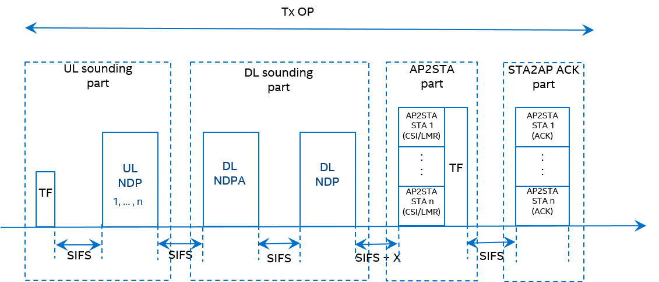
MU-MIMO EFTM Based Passive Ranging
Use MU-MIMO EFTM measurement sequence proposed in [1]:

Slide 12
MU-MIMO EFTM Based Passive Ranging
Beacon Interval
Beacon Interval
MU-MIMO EFTM Procedure
Beacon
MU-MIMO EFTM Procedure
Beacon
MU-MIMO EFTM Procedure
Beacon
AP0 transmissions
Trigger Frame
DL NDPA+NDP
AP2STA: t_2k:s and t_3
Trigger Frame
SIFS
SIFS
SIFS
SIFS
Neighboring ASs transmissions
UL MU NPD
STA2AP UL MU ACK
t1_k:s and t4_k:s
SIFS
DL NDP transmitted at time t3
Received at time t4_k by ASk
Received at time t6 by the client
Possibly preceded by a ‘polling’ step
Transmitted at times t1_k
Received at time t2_k by AP0
Received at time t5_k by the client

Slide 13
‘Staggered UL MU NDP’
As in [2]:
AP0
Trigger
Frame
SIFS
SIFS
Neighbor AS1
NDP
SIFS
Neighbor AS2
NDP
SIFS
Neighbor AS3
NDP
Staggered NDP
TOD t1_1
TOA t2_1
TOD t1_2
TOA t2_2
TOD t1_3
TOA t2_3

Slide 14
‘Symbol Interleaved UL MU NDP’ option
As in [2]:
AP0
Trigger
Frame
SIFS
SIFS
SIFS
Neighbor AP1
MU
-
NDP
Neighbor AP2
MU
-
NDP
Neighbor AP3
MU
-
NDP
Compressed NDP
TOD t1_1
TOA t2_1
TOD t1_2
TOA t2_2
TOD t1_3
TOA t2_3
Note: The idea is that the header in the packet reserves the media for the duration of the packet, especially as it is transmitted by all responding STAs and thus is likely to be heard quite well.

Slide 15
Propagation paths and time stamps
Illustrating timing diagram:
AP0
AS1
Client
UL MU NDP
t1_1
t2_1
t5_1
t3
DL NDP
t4_1
‘AP to STA feedback’
t2_1, t3
t6
t1_1, t4_1
‘STA to AP feedback’

Slide 16
Differential Distance Calculation
The client STA listens to the exchanges between the AP0 and AS1 and records the time t5_1 when it receives the UL MU NDP from AS1 and the time t6 when it receives the DL NDP from AP0.
The client also listens to the relayed t2_k:s and t3 from AP0 and the relayed t1_k:s and t4_k:s in the feedback from the neighboring ASs.
The differential distance between the client STA and AP0 vs. AS1 can now be calculated as follows:
  D_01 = [t6 – t5_1 – (t3 – t2_1 + T_01)] * c
  Using T_01 = [(t4_1 – t1_1) – (t3 – t2_1)]/2
  We get D_01 = [t6 – t5_1 – (t3 – t2_1 + 0.5*t4_1 – 0.5*t1_1 – 0.5*t3 + 0.5*t2_1)]*c
  Or finally:
Note that the above expression for the differential distance D_01 does not depend on the ToF between AP0 and AS1. Thus this method of calculating D_01 is insensitive to LOS obstructions between AP0 and AS1.
D_01 = [t6 – t5_1 – 0.5*t3 + 0.5*t2 – 0.5*t4_1 + 0.5*t1_1]*c

Slide 17
Rough Estimates of Overhead
Assume:
  we do the passive ranging once per second
  a channel switching time of 100 us
  each AP does ranging with 5 other APs
  a generic ‘packet/frame length’ of 100 us
  about 25 us extra per user in the ‘symbol interleaved’ UL MU NDP
Using the ‘staggered’ UL MU NDP option:
  Overhead is about 5*(2*100e-6+ (7+5)*100e-6)/1 = 0.70 %
Using the ‘symbol interleaved’ UL MU NDP option:
  Overhead is about 5*(2*100e-6+7*100e-6+5*25e-6)/1 = 0.51 %

Slide 18
Schedule Setup and Signaling for Passive Ranging

Slide 19
Scheduling of (E)FTM Transmissions
The (E)FTM exchanges may be scheduled in the vicinity of a selection of beacons which may minimize the disruptions to operations.
  May minimize disruptions in an communications
  May minimize clients expended power as they can listen to beacon at same time
In general, when the ASs are APs, the APs need periodically switch to the channels of their neighboring AP(s) to do (E)FTM exchanges.
The client does not necessarily need to hop around to the channels of other APs BSSs.
  The client may choose to only snoop the (E)FTM exchanges on a single APs channel. (E.g. its ‘own’ AP, here AP0.)

Slide 20
Schedule negotiation
The schedule and operation of the (E)FTM transmissions between the AP/ASs need to be negotiated and signaled.
  In 802.11Revmc the ranging schedule is negotiated by the Initiator STA suggesting a ranging periodicity and start time phase. The responding STA may then override this schedule.
  To enable an AP to setup (E)FTM exchanges on its own channel with it is helpful to have an (E)FTM negotiation process where the initiator has the final say:
    Initiator STA is the one that could be possibly advertising the Passive Ranging Service
    Allows STAs that are able to listen to the service can remain on the same channel for Passive Ranging Service
  To facilitate a version of the negotiation where the initiating STA has the final say in the negotiation, consider enabling an (E)FTM negotiation that uses the same (E)FTM negotiation with the following change:
    Add bit to indicate in the FTM Request to signal that the initiator has the final say for some of the parameters -→ this is limited to Passive Ranging Functionality only
    the (E)FTM may take place on a different channel (Ex: Initiator is on the Channel of the Responder for negotiation) and bandwidth than the actual negotiation.

Slide 21
Schedule Content (1)
One can define two levels of Signaling the schedule for the (E)FTM exchanges
  The first level is for the case where the schedule an AP conveys is only for (E)FTM exchanges taking place in the channel of its BSS:
    Schedule of (E)FTM Exchanges that includes the AP that is conveying the schedule
    The Schedule is signaled with times on the clock domain of the AP signaling the Schedule
  The second level is for the case where the AP conveys schedule of (E)FTM exchanges taking place in channels of neighboring APs and that include the AP sending the schedule
    The schedule signaled by the AP can be with respect to the times defined in the neighboring APs clock domains.

Slide 22
Schedule Content (2)
Components that need to be conveyed in first level of complexity of schedule:
  When are the (E)FTM exchanges scheduled
    Time phase and periodicity (in the schedule announcing APs clock domain
  ASs involved and their role (initiators or responders)
    STA ID/BSSID, STA is AP/Client, Responder/Initiator role
  Parameters for the (E)FTM exchanges, like
      Type of (E)FTM, Number of antennas used, Support for AOD estimation, etc.
  LCI information of the APs involved
Additional components needed for the second level of complexity of the schedule:
  Channels and bandwidths of the (E)FTM exchanges
  The AS clock domains the (E)FTMs are scheduled in
  Mappings of the neighboring ASs clocks onto the schedule announcing APs clock domain.

Slide 23
Conveying the Schedule
The signaling of the schedule can be periodically broadcast in an APs beacons.
In every beacon the AP can advertise a counter. This counter indicates how many more beacons until the APs beacon contains the (E)FTM exchange schedule for the passive ranging support.
The AP includes the schedule in the beacon when the counter reaches 0.
In addition, the schedule can be included in a Probe Response (to a Probe Request from a client STA).

Slide 24
Promises and Challenges

Slide 25
Scalability
Relies on broadcast to clients to be located
Clients do not need to transmit
=> Unlimited Scalability

Slide 26
Synchronization
Clock offsets errors gets cancels in calculations
Uses temporally localized time-stamped frame exchanges => Limited susceptibility to clock stability
No Synchronization nor
Extremely Stable Clocks Needed

Slide 27
Client Calibration
No Tx group delay calibration needed
  Client is not transmitting (E)FTM frames
Possibly no Rx group delay calibration needed
  Each set of (E)FTM frames are received on the same channel and bandwidth
  Group delay differences due to Rx gain change may be present but can be designed to be small
=> Possibly No Calibration Needed

Slide 28
Security
No encryption needed
  Client stations only listen
Possibly no authentication needed
  Service is broadcast => In general attacker does not know who he is attacking
  Hard to spoof signals to provide a false location
=> Possibly No Security Needed

Slide 29
Summary of Promises and Challenges
Promises
  Passive location for unlimited number of clients
  No synchronization of anchor stations clocks needed
  Possibly no calibration needed
  No encryption needed
  Possibly no authentication needed
Challenges
  Scheduling of (E)FTM exchanges
  AP/ASs time-outs due to do (E)FTM exchanges with other AP/ASs
  Some constraint due to supported reception of broadcast frames

Slide 30
References
[1] “NDP-Based Measurement Protocol”, IEEE 11-17-0050-02-00az-ndp-based-measurement-protocol.
[2] “HE-FTM Measurement Phase”, IEEE 11-17-0144-00-00az-he-ftm-mesurement-phase.pptx.

