Slide 1
Use Cases for WUR in ITS
Date: March 16 2017
Authors:
Name | Affiliations | Address | Phone | Email
James Lepp | BlackBerry Limited | 1001 Farrar Road, Ottawa, ON, Canada | (+1) 613-595-4156 | jlepp@blackberry.com
Stephen McCann | BlackBerry Limited |  |  | smccann@blackberry.com

Slide 2
Background on 802.11ba (WUR)
802.11ba Wake-up Radio (WUR) is a low power mechanism to enable power saving in 802.11 stations.
In January 2017 it was decided to compile a Usage Model Document for 802.11ba.
This presentation contains Usage Models for the 802.11ba task group to consider when designing the WUR protocol.

Slide 3
Background on 802.11 ITS systems
802.11-OCB (developed in 802.11p TG) is used as the basis of Intelligent Transportation Systems.
Outside the context of a BSS devices transmit 802.11 frames between vehicle onboard units (OBUs) and infrastructure roadside units (RSUs).
Current 802.11-based ITS systems use a significant amount of energy to operate. To enable a third class of system for pedestrians and cyclists, as a group called vulnerable road users (VRUs), mechanisms to enable power saving are desired.

Slide 4
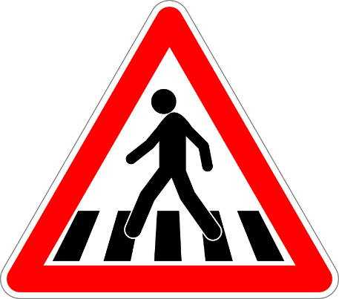
Use Case 1: Wake Up Vehicle-to-Pedestrian (V2P) Radio
Scenario
Pedestrian carrying portable device with V2P capability.
To conserve power, the V2P mode isn’t always operating.
Roadside infrastructure such as an intersection or an oncoming vehicle sends WUR wake-up trigger frame.
Pedestrian device wakes up and operates 802.11-OCB based V2P
Wakeup operation
ITS infrastructure sends WUR wake-up trigger frame
Pedestrian device wakes up and operates 802.11-OCB
Requirements
Low power and low latency

Slide 5
Usage Model 1: Wake Up Vehicle-to-Pedestrian (V2P) Radio
Environment
Vehicles, Road Infrastructure and Pedestrian/Cyclist carried device.
Applications
Trigger other devices to turn on (or off) automotive safety radio operation
Traffic Conditions
802.11-OCB traffic, 802.11 traffic depending on channels used
Use Case
Pedestrian/cyclist approaches dangerous intersection or moving vehicle
Infrastructure or vehicle sends WUR wakeup frame
Pedestrian/cyclist carried device turns on automotive safety radio operation (802.11-OCB)
Challenges and requirements
Operation outside the context of a BSS
Addressing as broadcast/unicast
If used in 5.9Ghz band, coexistence, channel choice

Slide 6
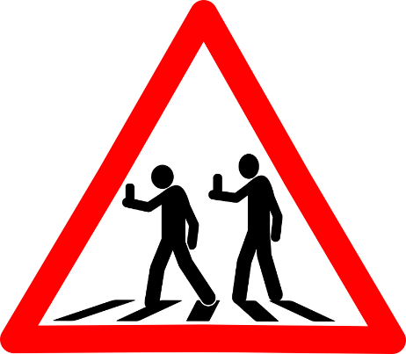
Use Case 2: WUR Vehicle-to- Pedestrian (V2P)
Scenario
Pedestrian carrying portable device.
Roadside infrastructure such as an intersection or an oncoming vehicle sends WUR wake-up trigger frame containing ITS information.
Wakeup operation
ITS infrastructure sends WUR wake-up trigger frame
Pedestrian device receives and decodes ITS related information in the WUR wake-up trigger frame
Requirements
Low power and low latency
WUR trigger frame contains small amount of data

Slide 7
Usage Model 2: WUR Vehicle-to- Pedestrian (V2P)
Environment
Vehicles, Road Infrastructure and Pedestrian/Cyclist carried device.
Applications
Transmit ITS related information to very low power devices
Traffic Conditions
802.11-OCB traffic, 802.11 traffic depending on channels used
Use Case
Vehicle approaches pedestrian/cyclist
Vehicle transmits WUR wakeup frame
Pedestrian/cyclist receives ITS related information
Challenges and requirements
Operation outside the context of a BSS
Addressing as broadcast/unicast
If used in 5.9Ghz band, coexistence, channel choice
Vendor Specific element an option in WUR Wakeup Trigger Frame

Slide 8
Additional thoughts
Previous power-saving mechanisms in 802.11 were created with expense of high latency.
The combination of low power and low latency means WUR is capable of is applicable to more than just IoT.
Can WUR be transmitted in the DSRC channels 172-178 (aka 5.9 GHz band) and used to enhance V2X communications.

Slide 9
Straw Poll
Should the 802.11ba task group add the above usage models to WUR?
Yes
No
Abstain

