Slide 1
EDMG CEF Enhancements
Date: 2017-03-15
Authors:

Slide 2
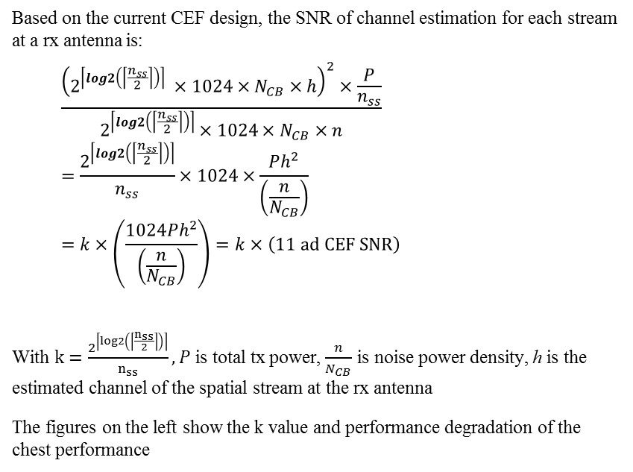
Problem
Based on the current CEF design, the SNR of channel estimation for each stream at a rx antenna is:
  $$\frac{{\left(2^{\left\lceil log2\left(\left\lceil \frac{n_{ss}}{2}\right\rceil \right)\right\rceil } ×1024×N_{CB}×h\right)}^{2}×\frac{P}{n_{ss}}}{2^{\left\lceil log2\left(\left\lceil \frac{n_{ss}}{2}\right\rceil \right)\right\rceil }×1024×N_{CB}×n}=\frac{2^{\left\lceil log2\left(\left\lceil \frac{n_{ss}}{2}\right\rceil \right)\right\rceil }}{n_{ss}}×1024×\frac{Ph^{2}}{\left(\frac{n}{N_{CB}}\right)}=k×\left(\frac{1024Ph^{2}}{\left(\frac{n}{N_{CB}}\right)}\right)=k×\left(\text{11 }\text{ad} \text{CEF} \text{SNR}\right)$$
With $k=\frac{2^{\left\lceil log2\left(\left\lceil \frac{n_{ss}}{2}\right\rceil \right)\right\rceil }}{n_{ss}}, P$ is total tx power, $\frac{n}{N_{CB}}$ is noise power density, h is the estimated channel of the spatial stream at the rx antenna
The figures on the left show the k value and performance degradation of the chest performance

Slide 3
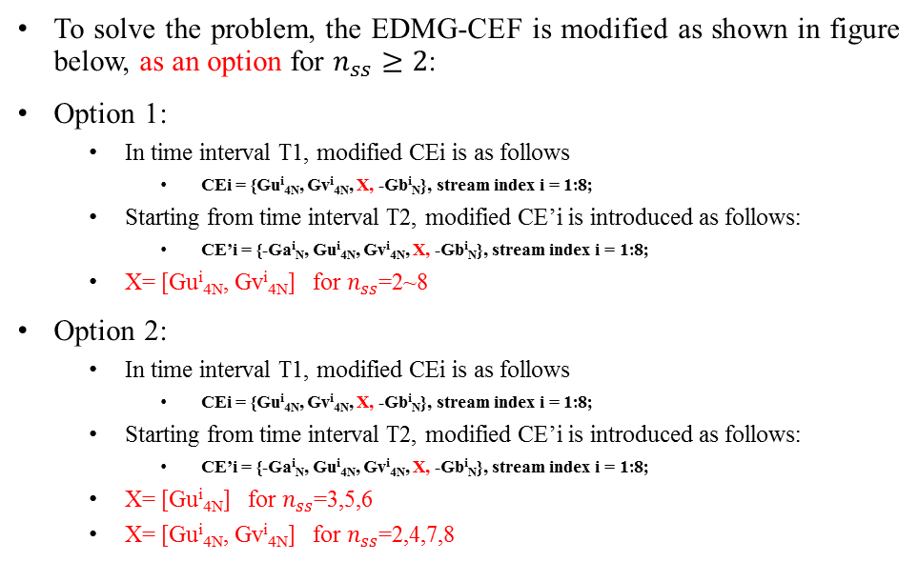
Proposed Change: CEF
To solve the problem, the EDMG-CEF is modified as shown in figure below, as an option for $n_{ss}≥2$:
Option 1:
  In time interval T1, modified CEi is as follows
    CEi = {Gu^{i}_{4N}, Gv^{i}_{4N}, X, -Gb^{i}_{N}}, stream index i = 1:8;
  Starting from time interval T2, modified CE’i is introduced as follows:
    CE’i = {-Ga^{i}_{N}, Gu^{i}_{4N}, Gv^{i}_{4N}, X, -Gb^{i}_{N}}, stream index i = 1:8;
  X= [Gu^{i}_{4N}, Gv^{i}_{4N}] for $n_{ss}$=2~8
Option 2:
  In time interval T1, modified CEi is as follows
    CEi = {Gu^{i}_{4N}, Gv^{i}_{4N}, X, -Gb^{i}_{N}}, stream index i = 1:8;
  Starting from time interval T2, modified CE’i is introduced as follows:
    CE’i = {-Ga^{i}_{N}, Gu^{i}_{4N}, Gv^{i}_{4N}, X, -Gb^{i}_{N}}, stream index i = 1:8;
  X= [Gu^{i}_{4N}] for $n_{ss}$=3,5,6
  X= [Gu^{i}_{4N}, Gv^{i}_{4N}] for $n_{ss}$=2,4,7,8

Slide 4

Channel estimation SNR after extension
$$\frac{{\left(2^{\left\lceil log2\left(\left\lceil \frac{n_{ss}}{2}\right\rceil \right)\right\rceil } ×1024α×N_{CB}×h\right)}^{2}×\frac{P}{n_{ss}}}{2^{\left\lceil log2\left(\left\lceil \frac{n_{ss}}{2}\right\rceil \right)\right\rceil }×1024α×N_{CB}×n}=\frac{2^{\left\lceil log2\left(\left\lceil \frac{n_{ss}}{2}\right\rceil \right)\right\rceil }}{n_{ss}}×1024α×\frac{Ph^{2}}{\left(\frac{n}{N_{CB}}\right)}=kα×\left(\frac{1024Ph^{2}}{\left(\frac{n}{N_{CB}}\right)}\right)=kα×\left(\text{11 }\text{ad} \text{CEF} \text{SNR}\right)$$
α=2 for option 1 and option 2 $n_{ss}$=2,4,7,8
α=1.5 for option 2, $n_{ss}$=3,5,6
kα values are shown on the right figure:

Slide 5
Performance evaluation

Slide 6
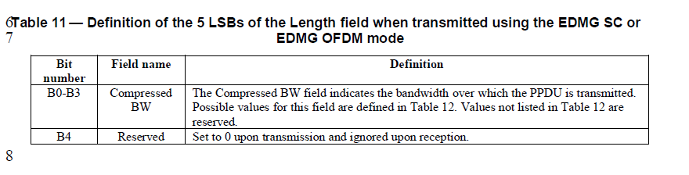
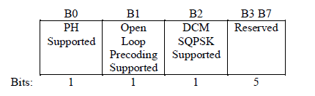
Proposed change: Signaling of the extended CEF
Currently DMG L-header length can carry 5 bits of information
  B4 is currently reserved
  Propose to use B4 to signal whether the CEF extension is used.
One bit to signal rx capability of extended CEF in one of the reserve bits in the PHY Capability field

Slide 7
Straw Poll
Do you agree to add the proposed mechanisms in slide 3 option 2, and slide 6 in 11ay D0.2?

Slide 8
Appendix

Slide 9
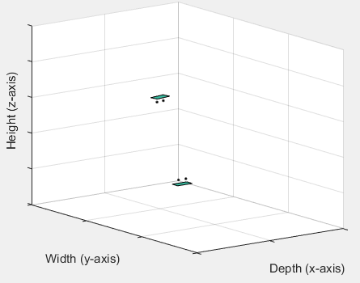
Channel parameters
For channel with LOS components [3],
  TX/RX analog beamforming for both polarizations of PAA#i are based on the LOS direction between TX PAA#i ↔ RX PAA#i
For channel without LOS components
  Beam forming based on the AoD/AoA of strongest signal path between TX PAA#i ↔ RX PAA#i
Channel bandwidth 2.64 GHz, center frequency 60.48 GHz
Each PAA has 2 elements
Distance between antenna elements 0.0025m
Distance between center of PAAs 10cm
For AP-STA scenario, STA is placed at a plane 2m below AP in the cubicle 1. Random rotation around z-axis between STA/AP.

Slide 10
Simulation Assumptions
Stream 1
Based on 11ad SC PHY
Spatial stream parser:
MCS index is the same for all streams per PPDU, and a single CRC is used per PPDU
2 spatial streams, configuration 4 in [1]
MMSE receiver with FDE
Enterprise cubicle scenario in 11ay/ad channel model [1]
STAs are randomly placed in the cubicle 1 in the center of the CR, 0.9m above the floor
AP is positioned at x=2.8, y=6, z=2.9m on the ceiling
b1
b3
b5
Encoder Output Bits
b1
b2
b3
b4
b5
b6
Stream 2
b2
b4
b6

Slide 11
References
A. Maltsev, et al, “Channel models for ieee 802 11ay”, IEEE doc. 11-15/1150r7

