Slide 1
Waveform Generation for Waveform Coding
Date: 2017-03-13
Authors:

Slide 2
Authors (continued):

Slide 3
Background
Waveform Coding (WFC, e.g. Manchester Coding) is necessary
  Performance gain over the OOK without WFC
  No need to have an adaptive threshold for Envelope detection
  Ensured 50% duty cycle → Avoid long periods of zero waveform
    Co-existence with 802.11 frames
    Easier for symbol timing recovery
WFC is alternate in ON/OFF position of a pulse according to data
  Data mapping is done during the WFC in time-domain
  WUR frame detection is processed in time-domain
  All the WUR related procedures are completed in time-domain for both TX and RX, if a customized waveform is ready-made
    ON/OFF duration of a customized waveform and its BW are the minimum parameters which needs to be specified for the waveform to be generated
16 QAM Constellation with Gray-mapping

Slide 4
System block diagram when WFC is applied
Bandwidth
ON/OFF Duration
Waveform
Generation
Waveform Coding
& Data Mapping
Forward Error
Correction Coding
OOK Source
May not be generated
every transmission time.
- one time generated
and stored in advance
Channel
Energy Detection
Hard Decision
Time domain
Recovered Source
FEC Decoding

Slide 5
Waveform generation case 1:
Occupying middle 13 tones out of 64 sub-carriers with all ones
-32 -31 -30 … -8 -7 -6 -5 -4 -3 -2 -1 0 1 2 3 4 5 6 7 8 … 30 31
IFFT
GI
t
t
0
63
0
79
Waveform Coding
t
t
0
39
79
0
39
79
Data 1
Data 0
Junghoon Suh, et. al, Huawei

Slide 6
Waveform generation case 2:
Occupying middle 7 alternate tones out of 64 sub-carriers with all ones [1]
-32 -31 -30 … -8 -7 -6 -5 -4 -3 -2 -1 0 1 2 3 4 5 6 7 8 … 30 31
Waveform Coding
CP
CP
GI
OFF sub-symbol
GI
OFF sub-symbol
CP
CP
GI
ON sub-symbol
GI
ON sub-symbol
0us 0.4us 2.0us 2.4us 4us
0us 0.4us 2.0us 2.4us 4us
Data “1”
Data “0”

Slide 7
Waveform generation case 3:
Occupying middle 13 tones out of 64 sub-carriers with L-LTF Sequence
-32 -31 -30 … -8 -7 -6 -5 -4 -3 -2 -1 0 1 2 3 4 5 6 7 8 … 30 31
IFFT
GI
t
t
0
63
0
79
Waveform Coding
t
t
0
39
79
0
39
79
Data 1
Data 0
Junghoon Suh, et. al, Huawei

Slide 8
Receiver Procedure and RF impairment model
Receiver Procedure
  RX filtering of the baseband received signal
  GI Removal in case GI is pre-pended to WFC symbol
  For N received samples per symbol after GI removal,
RF impairments
Carrier
Freq
Offset
Phase
Noise
AWGN
Baseband
Signal
X
X
+
Phase
Noise
AWGN
CFO is 200 ppm of 2.4 GHz, i.e., -240 KHz ~ 240 KHz
  Linearly shifts every 4 usec (based on 802.11 residual CFO model)
    “n” varies linearly every 4 usec in
    4 usec is the data rate, 250 KHz
Phase noise based on 802.11 phase noise model

Slide 9
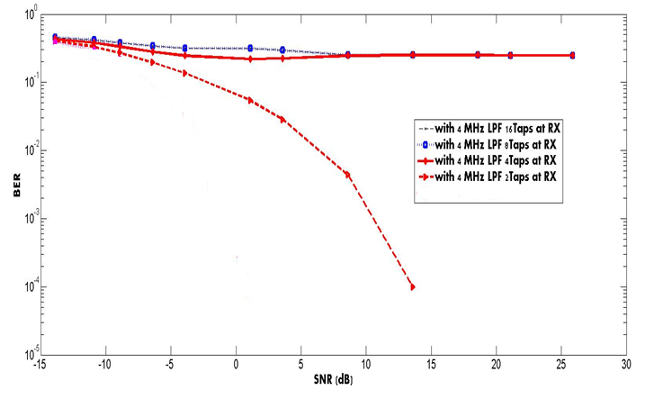
Performance with different RX filter Taps: Case 1
Waveform generated with middle 13 tones out of 64 sub-carriers occupied with all ones
AWGN and RF impairments (CFO and Phase noise) considered

Slide 10
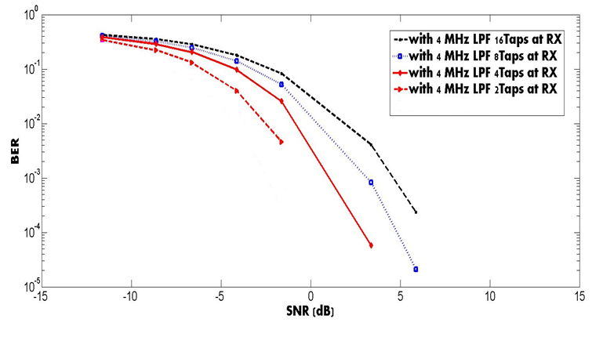
Performance with different RX filter Taps: Case 2
Waveform generated with middle 7 alternate tones out of 64 sub-carriers occupied with all ones [1]
AWGN and RF impairments (CFO and Phase noise) considered

Slide 11
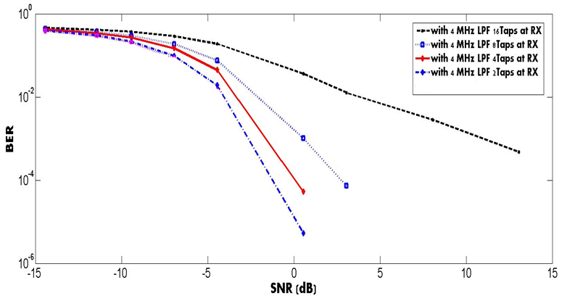
Performance with different RX filter Taps: Case 3
Waveform generated with middle 13 tones out of 64 sub-carriers occupied with L-LTF Seq.
AWGN and RF impairments (CFO and Phase noise) considered

Slide 12
Inter Symbol Interference
…….
X
…….
X
X
X
X
X
X
The larger the taps, the larger ISI occurs
Filter Output

Slide 13
Simple Analysis of Adjacent Band Interference for Waveform Generation Methods
After RX filtering and GI removal (in case GI is pre-pended to each WFC symbol) of the baseband received signal are done, we examine the energy distribution in freq domain
Large size of RX filter order requires more power consumption and experiences more severe ISI whereas the small size of filter order may not be sharp enough to filter the interference
Freq domain analysis after RX filtering according to different RX filter Taps and different waveform generation are given in the following slides
  Adjacent band interferences with small number of taps does not look severe when the waveform is generated by occupying the tones with L-LTS

Slide 14
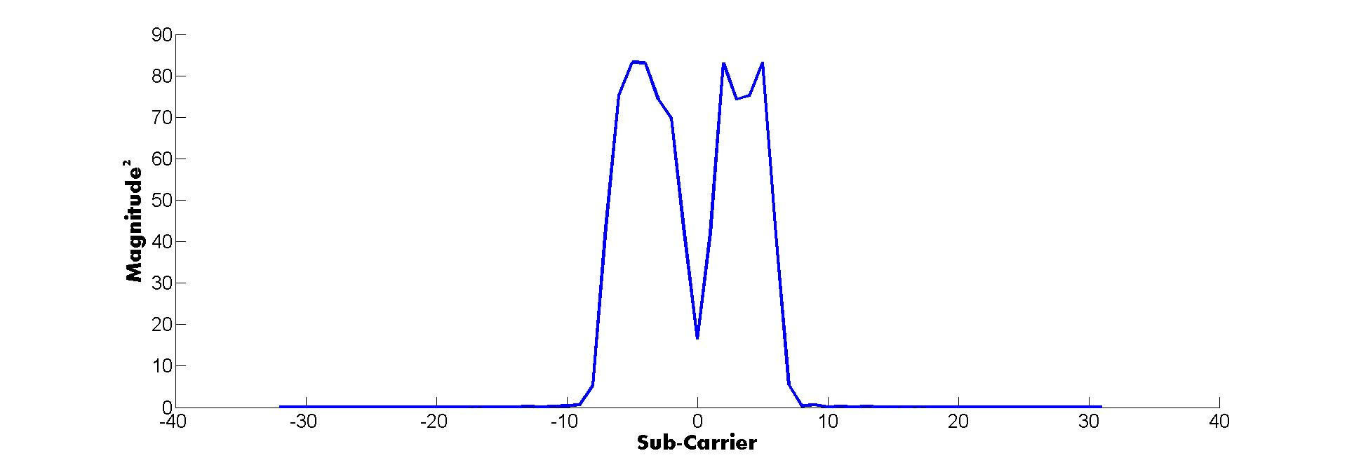
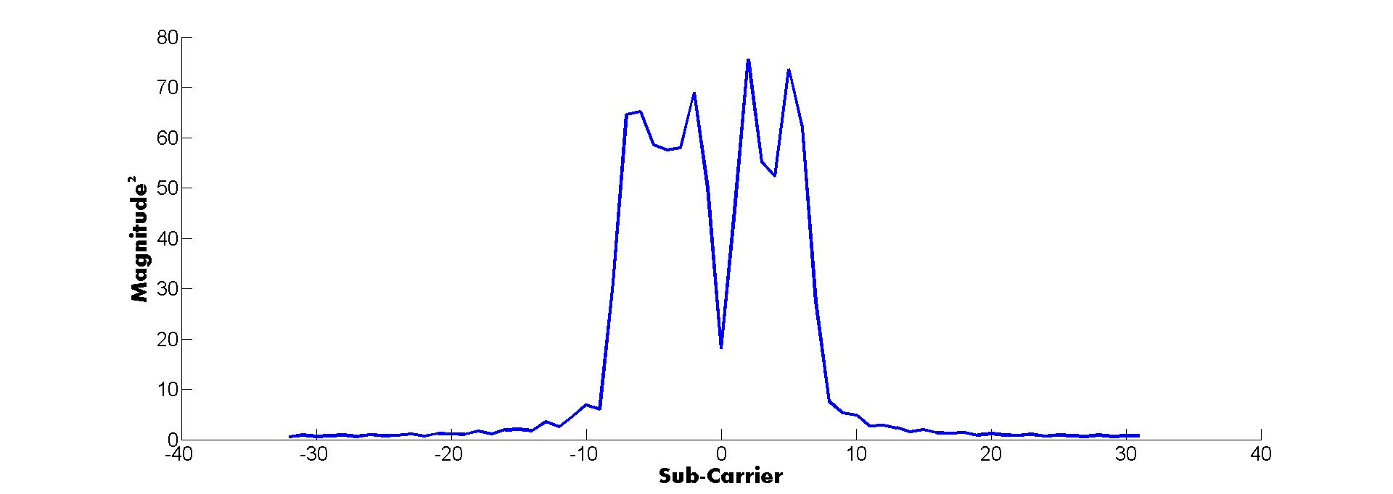
13 middle tones out of 64 sub-carriers occupied with ones: Case 1 for data 1
16 taps
2 taps

Slide 15
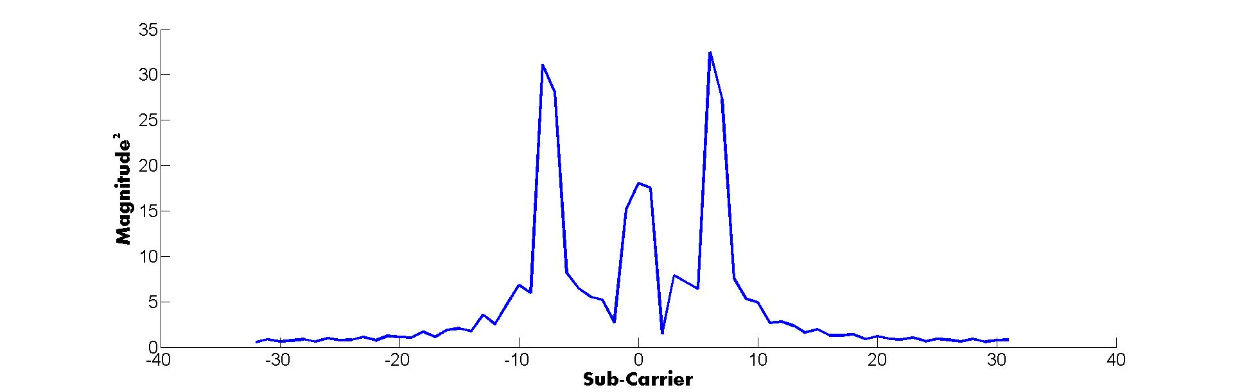
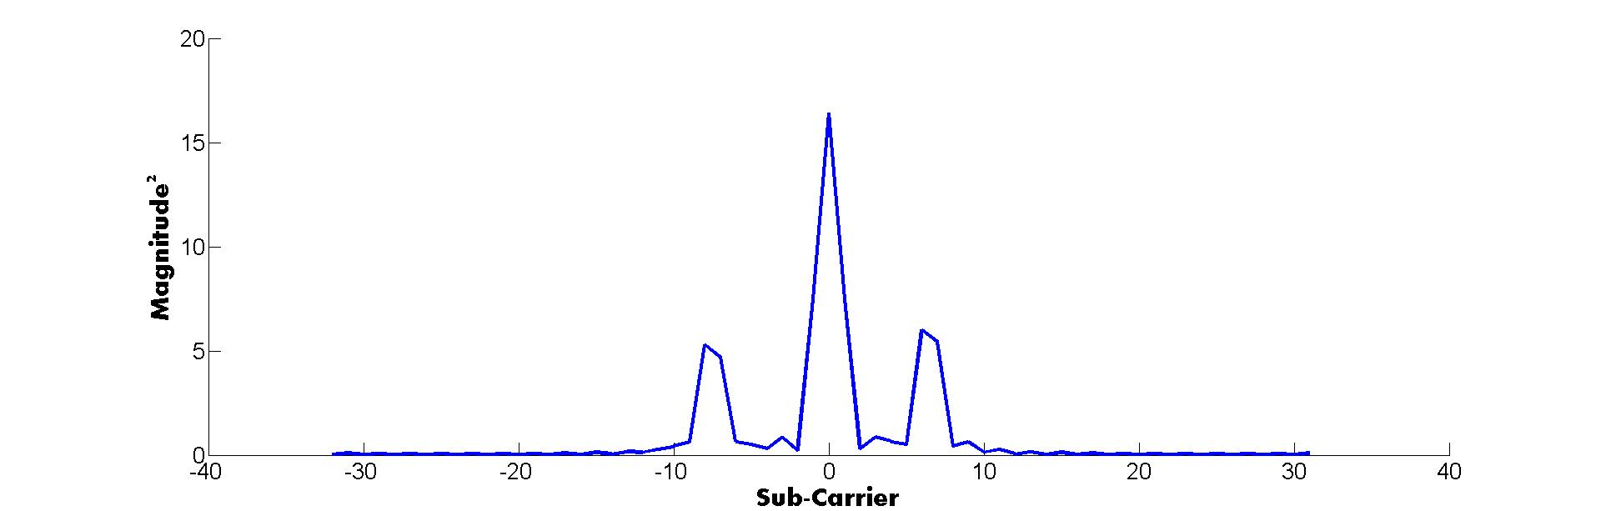
13 middle tones out of 64 sub-carriers occupied with ones: Case 1 for data 0
16 taps
2 taps

Slide 16
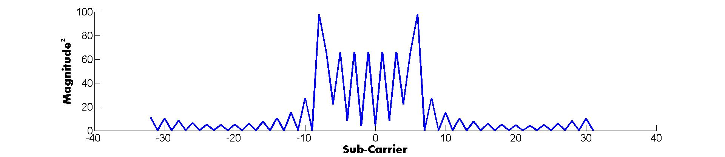
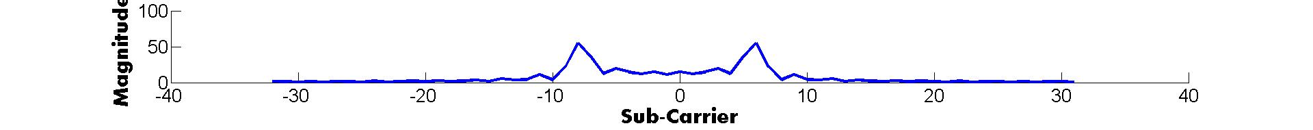
7 middle alternate tones out of 64 sub-carriers occupied with ones: Case 2 for data 1
16 taps
2 taps

Slide 17
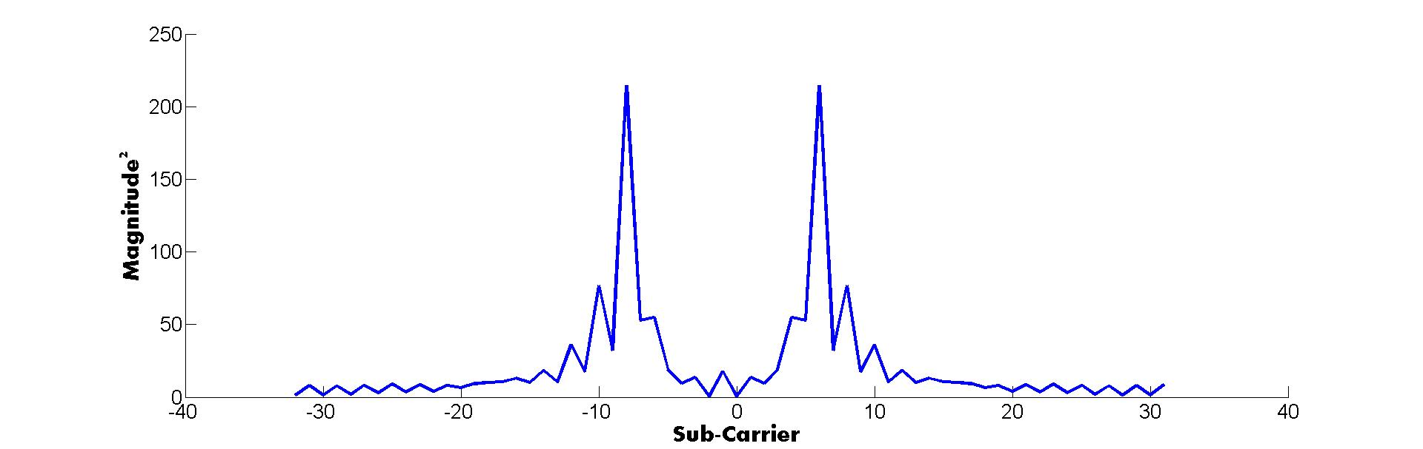
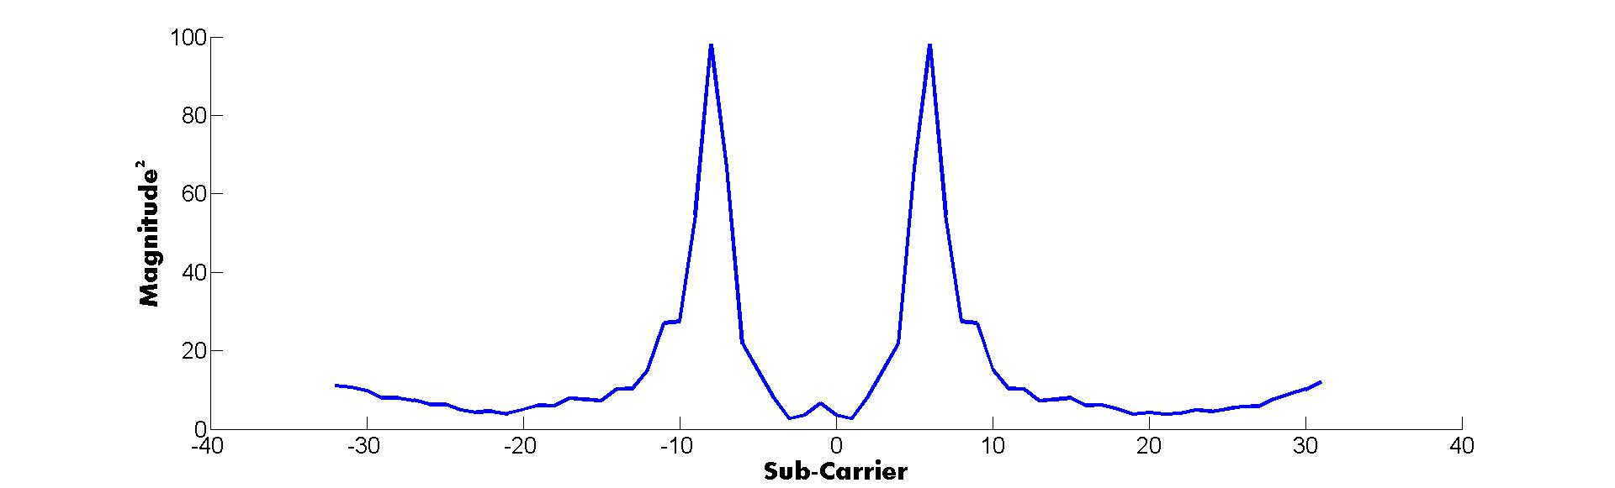
7 middle alternate tones out of 64 sub-carriers occupied with ones: Case 2 for data 0
16 taps
2 taps

Slide 18
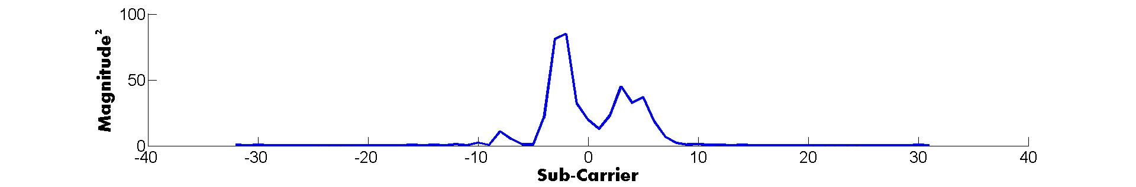
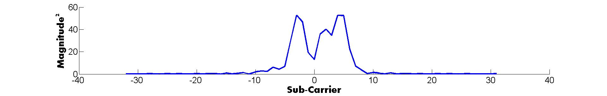
13 middle tones out of 64 sub-carriers occupied with L-LTS : Case 3 for data 1
16 taps
2 taps

Slide 19
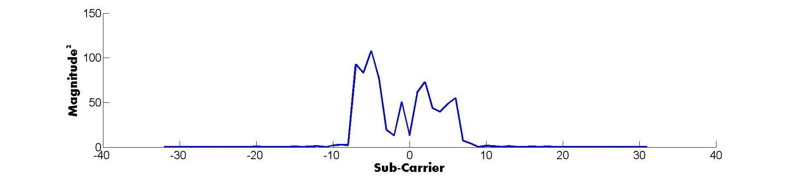
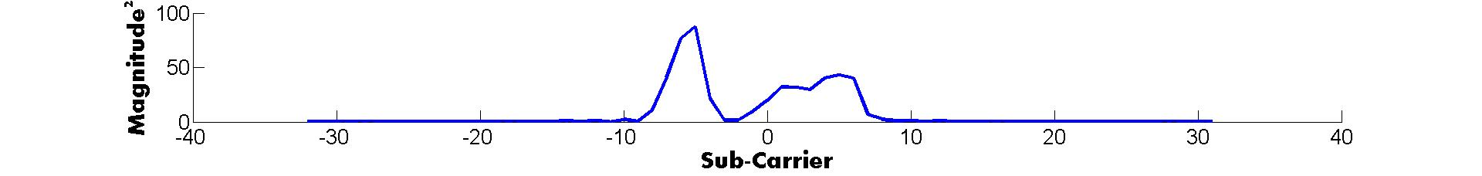
13 middle tones out of 64 sub-carriers occupied with L-LTS : Case 3 for data 0
16 taps
2 taps

Slide 20
Conclusion
Waveform generation is not a regular process
  WUR frame transmission process is done in time domain when a waveform is ready
ISI occurs during the receiver filtering process
  Right filter choice is necessary
  RX filter choice is a trade-off between Power consumption, ISI and Filtering sharpness
Different freq domain response of WUR frame according to how waveform is generated
  Adjacent-band interference is least severe when the waveform is generated by occupying the middle 13 tones with L-LTS

Slide 21
References
[1] LG “16/1144r0 Further Investigation on WUR Performance”, IEEE 802.11 WUR-SC, Sep 2016, Warsaw Poland

