Slide 1
Performance Investigations on Single-carrier and Multiple-carrier-based WUR
Date: 2017-03-16
Authors:
Name | Affiliation | Address | Phone | Email
Justin Jia Jia | Huawei |  |  | justin.jia@huawei.com
Ross Jian Yu |  |  |  | ross.yujian@huawei.com
Ming Gan
Tao Wu
David Xun Yang
Xin Zuo

Slide 2
Introduction
In this contribution, WUR simulation results based on narrow band assumption using different transmission scheme are compared:
  13-tone OFDM multicarrier (MC)-based OOK modulation scheme without waveform coding
  13-tone OFDM multicarrier-based OOK modulation scheme with waveform coding (WFC)
  Single carrier (SC) and spectrum spreading-based OOK modulation scheme

Slide 3
MC OOK Symbol Generation
OOK symbol for 13-tone multicarrier OFDM-based scheme without waveform coding
  Subcarrier width = 312.5kHz
  4us OFDM symbol period
  OOK information bit “1”: 13 subcarriers out of 64 subcarriers, where the 13 tones are at the indices [-6,6] of the L-LTF sequence
  OOK information bit “0”: all subcarriers are set to null value
  CP is utilized for OFDM symbol

Slide 4
WFC OOK Symbol Generation (1)
OOK symbol for 13-tone multicarrier OFDM-based scheme with 4us waveform coding
  Subcarrier width = 312.5kHz
  OFDM symbol period: 4us
  Basic narrowband OFDM symbol: 13 subcarriers out of 64 subcarriers, where the 13 tones are [-6,6] of the L-LTF sequence
  Masking is applied on the basic symbol to represent OOK bit “0” and “1”
  CP is utilized at the 4us OFDM symbol level

Slide 5
WFC OOK Symbol Generation (2)
OOK symbol for 13-tone multicarrier OFDM-based scheme with 8us waveform coding
  Subcarrier width = 312.5kHz
  OFDM symbol period: 4us
  Basic narrowband OFDM symbol: 13 subcarriers out of 64 subcarriers, where the 13 tones are [-6,6] of the L-LTF sequence
  4us blank energy period with the basic narrow band OFDM symbol represents the OOK bit “0”, the reverse of order represents the OOK bit “1”
  CP is utilized at the 4us OFDM symbol level

Slide 6
SC OOK Symbol Generation
OOK symbol for Single carrier and spectrum spreading-based OOK modulation scheme
  250 kbps bit rate of information bits
  Spectrum spreading factor-8, resulting in 2M chip/s
  [ 1, 0, 0, 1, 0, 1, 1, 0] indicates the information source bit “0”
  [ 0, 1, 1, 0, 1, 0, 0, 1] indicates the information source bit “1”
Other arrangements
  Pulse shaping & matched filter:
    Type: Squared-root raised cosine
    Upsampling rate: 50x in AWGN and ChD/40x in UMi
    Rolloff factor: 0.4
    Span symbols: 4

Slide 7
Simulation Configurations (1)
13-tone multicarrier OFDM-based scheme without waveform coding
  Wake-up packet structure
    Wake-up packet preamble (10 bits) + data bits(100 bits)
    Wake-up packet preamble sequence is set to [1 0 1 0 1 0 1 0 1 0] in the simulation
      The preamble is considered as a training sequence for the threshold detection. Synchronization is assumed to be perfect and hence not simulated
  Symbols without waveform coding are used as introduced in previous page
    OFDM symbol’s power is normalized
  Channel models for the simulation
    AWGN, TGn ChD, UMi NLOS
  No CFO, STO, Phase Noise
  No channel coding, No channel equalizing
  Rx procedure
    CP is removed firstly for the following OOK detection
    Wake-up packet preamble is used to estimate the signal power and to determine the threshold. Then simply compare the total power per symbol with the threshold for decision making
    The threshold is determined by the average power of the preamble sequence
    Rx calculates the power at 4 MHz passband for the 13 tones (16-order FIR)
    OOK bit detection is only performed in the time domain.

Slide 8
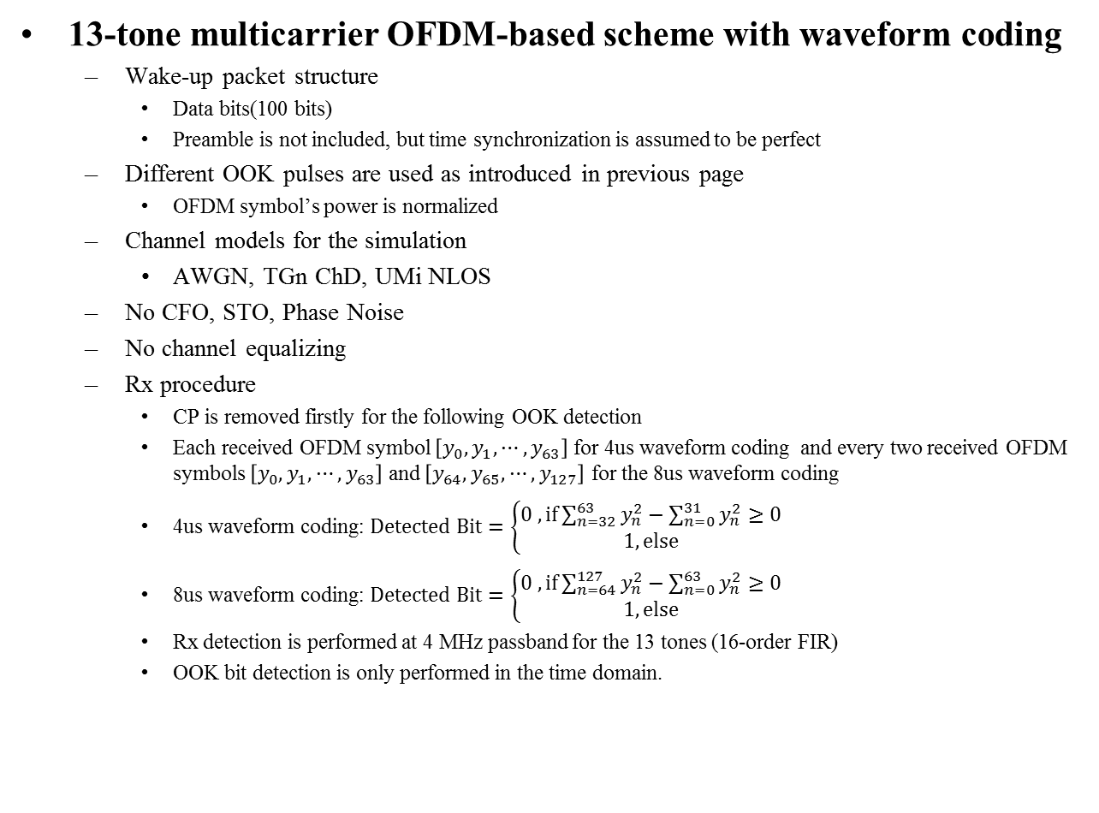
Simulation Configurations (2)
13-tone multicarrier OFDM-based scheme with waveform coding
  Wake-up packet structure
    Data bits(100 bits)
    Preamble is not included, but time synchronization is assumed to be perfect
  Different OOK pulses are used as introduced in previous page
    OFDM symbol’s power is normalized
  Channel models for the simulation
    AWGN, TGn ChD, UMi NLOS
  No CFO, STO, Phase Noise
  No channel equalizing
  Rx procedure
    CP is removed firstly for the following OOK detection
    Each received OFDM symbol $\left[y_{0},y_{1},⋯,y_{63}\right]$ for 4us waveform coding and every two received OFDM symbols $\left[y_{0},y_{1},⋯,y_{63}\right]$ and $\left[y_{64},y_{65},⋯,y_{127}\right]$ for the 8us waveform coding
    4us waveform coding: $Detected Bit=\left\{\begin{matrix}0 , if\sum_{n=32}^{63}{y_{n}^{2}}−\sum_{n=0}^{31}{y_{n}^{2}}≥0 \\ 1, else\end{matrix}\right.$
    8us waveform coding: $Detected Bit=\left\{\begin{matrix}0 , if\sum_{n=64}^{127}{y_{n}^{2}}−\sum_{n=0}^{63}{y_{n}^{2}}≥0 \\ 1, else\end{matrix}\right.$
    Rx detection is performed at 4 MHz passband for the 13 tones (16-order FIR)
    OOK bit detection is only performed in the time domain.

Slide 9
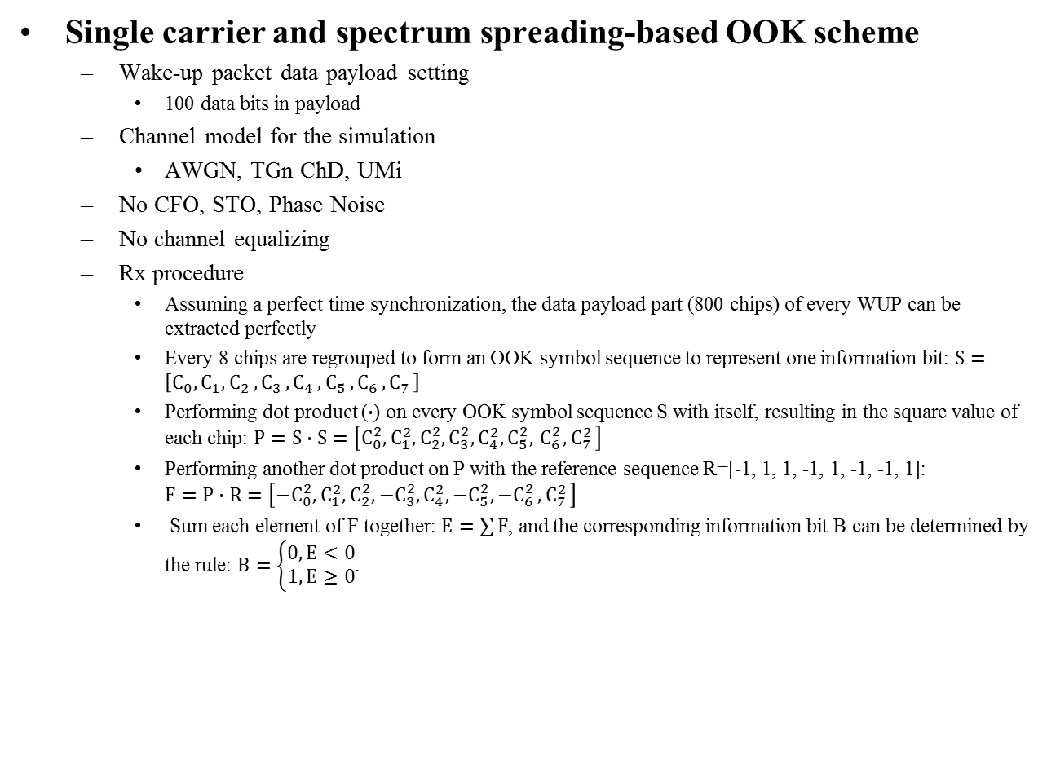
Simulation Configurations (3)
Single carrier and spectrum spreading-based OOK scheme
  Wake-up packet data payload setting
    100 data bits in payload
  Channel model for the simulation
    AWGN, TGn ChD, UMi
  No CFO, STO, Phase Noise
  No channel equalizing
  Rx procedure
    Assuming a perfect time synchronization, the data payload part (800 chips) of every WUP can be extracted perfectly
    Every 8 chips are regrouped to form an OOK symbol sequence to represent one information bit: $S=\left[{C_{0},C}_{1}{, C}_{2}{, C}_{3}{, C}_{4}{, C}_{5}{, C}_{6}{, C}_{7}\right]$
    Performing dot product ($∙$) on every OOK symbol sequence S with itself, resulting in the square value of each chip: $P=S∙S=\left[{C_{0}^{2},C}_{1}^{2}, C_{2}^{2}, C_{3}^{2}, C_{4}^{2}, C_{5}^{2},{ C}_{6}^{2}{, C}_{7}^{2}\right]$
    Performing another dot product on P with the reference sequence R=[-1, 1, 1, -1, 1, -1, -1, 1]: $F=P∙R=\left[−{C_{0}^{2},C}_{1}^{2}, C_{2}^{2}, {−C}_{3}^{2}, C_{4}^{2}, {−C}_{5}^{2}{, −C}_{6}^{2}{, C}_{7}^{2}\right]$
    Sum each element of F together: $E=\sum{F}$, and the corresponding information bit B can be determined by the rule: $B=\left\{\begin{matrix}0, E<0 \\ 1, E≥0\end{matrix}\right.$.

Slide 10
PER Performance Comparison in AWGN

Slide 11
PER Performance Comparison in ChD

Slide 12
PER Performance Comparison in UMi

Slide 13
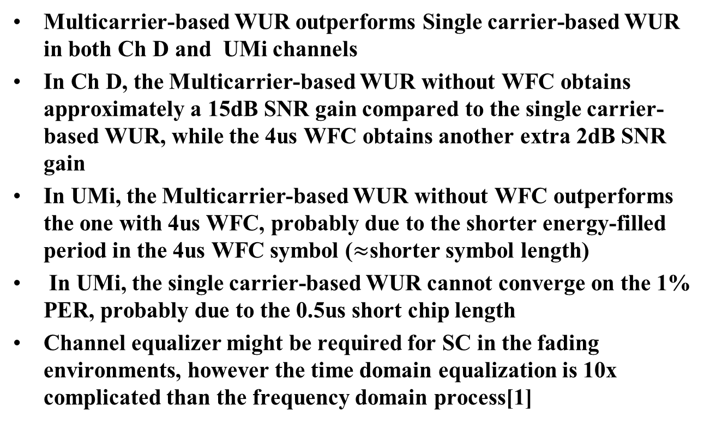
Conclusions
Multicarrier-based WUR outperforms Single carrier-based WUR in both Ch D and UMi channels
In Ch D, the Multicarrier-based WUR without WFC obtains approximately a 15dB SNR gain compared to the single carrier-based WUR, while the 4us WFC obtains another extra 2dB SNR gain
In UMi, the Multicarrier-based WUR without WFC outperforms the one with 4us WFC, probably due to the shorter energy-filled period in the 4us WFC symbol ($≈$shorter symbol length)
In UMi, the single carrier-based WUR cannot converge on the 1% PER, probably due to the 0.5us short chip length
Channel equalizer might be required for SC in the fading environments, however the time domain equalization is 10x complicated than the frequency domain process[1]

Slide 14
Straw Poll
Do you agree that the waveform of wake-up packet shall use OFDM-based OOK modulation?
  The WUR preamble part is TBD
  Y
  N
  A

Slide 15
Motion
Move to add the following to the 802.11ba SFD:
  To generate the OOK waveform of wake-up packet by populating multiple TBD number of tones
    The WUR preamble part is TBD

Slide 16
References
[1] Eldad Perahia, et al. - Next Generation Wireless LANs 2nd Ed.

Slide 17
Appendix: Fractionally Spaced Equalizer Design Parameters
Linear equalizer and Decision Feedback Equalizer (DFE).
Least Mean Squares (LMS) and Recursive Least Squares (RLS) updating algorithms.
#ff taps | #fb taps
Linear and DFE | DFE
1x5 | 5
10x5 | 5
50x5 | 5
step
LMS | RLS
0.1 | 1
0.01 | 1
1e-6 | 1

Slide 18
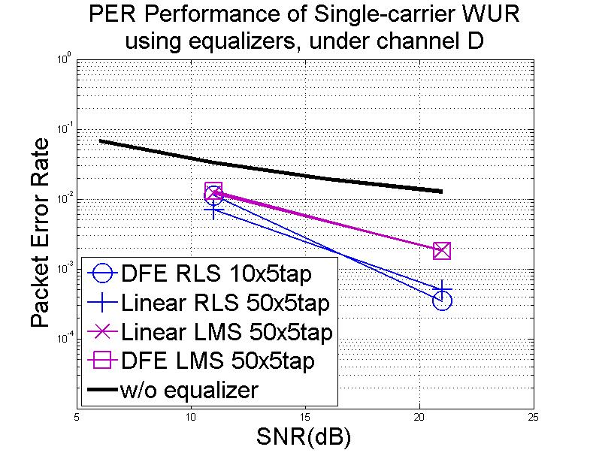
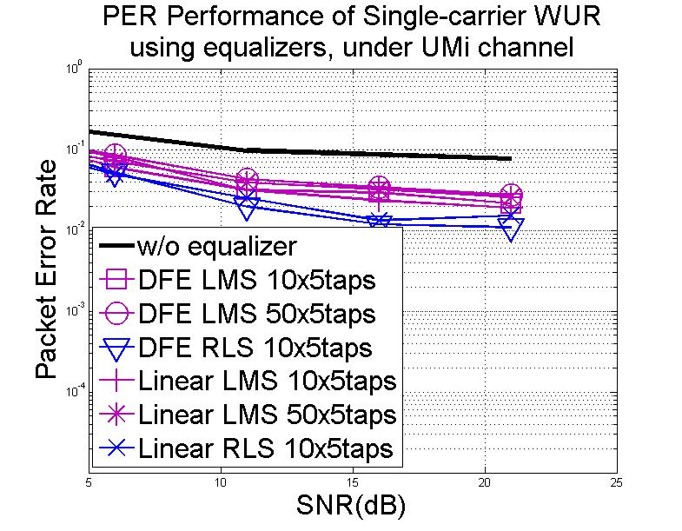
Appendix: Performance of SC-based WUR with Time-domain Equalizers

