Slide 1
Additional usage models for WUR
Date: 2017-03-12
Authors | Affiliations | Address | Phone | email
Eduard Garcia-Villegas | Universitat Politècnica de Catalunya (UPC) |  |  | eduardg@entel.upc.edu
Elena López-Aguilera | Universitat Politècnica de Catalunya (UPC) |  |  | elopez@entel.upc.edu
Ilker Demirkol | Universitat Politècnica de Catalunya (UPC) |  |  | ilker.demirkol@entel.upc.edu
Josep Paradells-Aspas | Fundació i2CAT |  |  | josep.paradells@entel.upc.edu
Eduard Garcia-Villegas (UPC)

Slide 2
Background
Document 11-17/0029r4 (approved draft TGba Usage Models document) lists several usage models:
  Smart Home
  Warehouse
  Outdoor Cattle Farms
  Sensor Network Synchronized Wake Up
  Wearable Devices Unsynchronized Wake Up
  Wearable Devices Reconnection
  Moving Goods Tracking Wake Up
The present document is intended to extend that list with new ideas for new use cases.
Eduard Garcia-Villegas (UPC)

Slide 3
Terminology from 11-17/0029r4:
Usage Model – A usage model is the combination of all the things below; not to be confused with a use case which is the specific set of steps to accomplish a particular task.
Application – A source and/or sink of wireless data that relates to a particular type of user activity. Examples are streaming video and VoIP.
Environment – The type of place in which the network of the use case is deployed, such as home, outdoor, hot spot, enterprise, metropolitan area, etc.
Traffic Conditions – General background traffic or interference that is expected while the use case steps are occurring. Overlapping BSSs, existing video streams, and interference from cordless phones are all examples of traffic conditions.
Use Case – A use case is task oriented. It describes the specific step-by-step actions performed by a user or device. One use case example is a user starting and stopping a video stream.
Eduard Garcia-Villegas (UPC)

Slide 4
List of new Usage Models proposed
Model # | Usage Model
8 | Put to Sleep packet
9 | Wake-up AP
10 | WUP Forwarding
11 | Out-of-band Signaling
12 | Beyond IEEE 802.11
Eduard Garcia-Villegas (UPC)

Slide 5
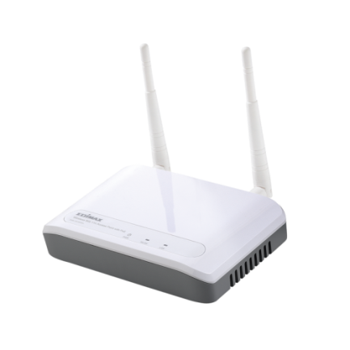
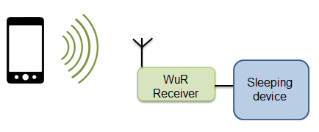


Usage Model 8: Put to sleep packet
Environment
Smart home/office (cf. usage model 1), warehouse (cf. usage model 2 and 7) or outdoor sensor deployment (cf. usage model 3) where (one or several) WUR-enabled devices do not go to sleep automatically or are executing (irrelevant) tasks preventing them to move to sleep.
Applications
  Force energy-saving state on battery-driven “things” equipped with a compatible WUR.
  Remotely turn off the AP (or any other WUR-equipped STA) for energy savings, reduced interference, increased security and privacy.
Traffic Conditions
Interference with wake up packet transmission. Interference with neighboring legacy 802.11 transmissions in dense environments.
Use case
Upon user’s request (or pre-configured automatic process) , a TGba STA sends Sleep Packet to one or multiple WUR-enabled devices.
Recipient/s of the Sleep Packet react by entering sleep mode to save energy/reduce interference/improve security/privacy.
  Sleep Packet may include configuration parameters (e.g. next wake-up time).
  Sleep Packets are just like WUPs (only differ in given flag(s)/header fields(s))
Requirements
  The SP transmission should enable coexistence with legacy IEEE 802.11 devices operating in the same band.
  SP transmission should be secured to prevent DoS.
  Targeted WUR-enabled devices have unique identifiers
  Support of different types of messages (e.g. WUP and SP).
Sleep now!!
Eduard Garcia-Villegas (UPC)

Slide 6

Usage Model 9: Wake-Up AP
Environment
Domestic and small-office/home-office (SOHO) IEEE 802.11 deployments where network is in use only during office hours (or morning/evening hours in the case of domestic users).
Applications
Wake-up of IEEE 802.11 APs for energy savings, reduced interference, increased security and privacy.
Traffic Conditions
Interference with WUP/SP transmission. Interference with neighboring legacy 802.11 transmissions in dense environments.
Use case
After TBD time of inactivity (or after Sleep Packet) , AP1 is put to sleep in order to save energy, to reduce interference with neighboring WLANs (no beacons, no probe responses, etc.) and to improve security (turning off Wi-Fi reduces the chances of an intruder to access the network).
When user of STA1 requires network services, STA1 sends WUP to AP1.
  WUP may include initial configuration parameters (e.g. channel, bandwidth, power level, etc.) for the AP.
Once AP1 is up, regular IEEE 802.11 is established between AP1 and STA1 (and other STAs).
Requirements
  The WUP transmission should enable coexistence with legacy IEEE 802.11 devices operating in the same band.
  WUR-enabled AP has unique identifier
  Optionally, WUP carries control information (e.g. initial config. parameters).
zZzZz
Wake up!!
Eduard Garcia-Villegas (UPC)

Slide 7
Usage Model 10:Wake-Up (or Sleep) Packet Forwarding
Environment
IEEE 802.11-based wireless mesh network where multi-hop communication is required (e.g. infrastructure-less sensor network, distributed wireless backbone).
AP-run BSS in SOHO environments where direct communication of WUP/SP may not be possible (only AP reaches all STAs).
Applications
Energy savings in multi-hop wireless mesh networks with on-demand routing/forwarding (data paths are created upon request) where inactive routers remain in sleep mode when not needed.
Two-hop WUP/SP transmission in AP-based BSS.
Traffic Conditions
Interference with WUP/SP transmission. Interference with neighboring legacy 802.11 transmissions in dense environments.
Use case 1 (multihop mesh)
After TBD time of inactivity (or after Sleep Packet), mesh routers are put to sleep in order to save energy and to improve security (turning off Wi-Fi reduces the chances of an intruder to access the network).
Upon activation of a new data flow, the multi-hop path is created on-demand according to source routing or reactive routing approach (e.g. AODV, IEEE 802.11s’s HWMP).
  Sleeping nodes along such path must be woken-up by forwarding WUP
Once all mesh nodes in the new path are awake, regular IEEE 802.11 is used to transport the data flow.
Requirements
  The WUP transmission should enable coexistence with legacy IEEE 802.11 devices operating in the same band.
  WUR-enabled mesh STAs have unique identifiers
  Optionally, WUP carries control information (e.g. freq. channel, destination node’s IP/MAC, etc.).
  STAs capable of transmitting and receiving WUPs.
Eduard Garcia-Villegas (UPC)

Slide 8
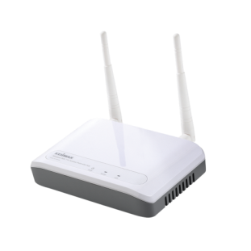

Usage Model 10:Wake-Up (or Sleep) Packet Forwarding
Use case 1 (multihop mesh)
After TBD time of inactivity (or after Sleep Packet), mesh routers are put to sleep in order to save energy and to improve security (turning off Wi-Fi reduces the chances of an intruder to access the network).
Upon activation of a new data flow, the multi-hop path is created on-demand according to source routing or reactive routing approach (e.g. AODV, IEEE 802.11s’s HWMP).
  Sleeping nodes along such path must be woken-up by forwarding WUP
Once all mesh nodes in the new path are awake, regular IEEE 802.11 is used to transport the data flow.
Active node
Sleeping node
WUP transmission
Simplified example: paths are pre-configured (i.e. no discovery phase)
Legacy IEEE 802.11
Eduard Garcia-Villegas (UPC)

Slide 9
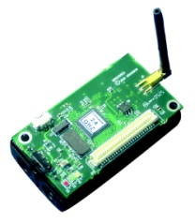
Usage Model 10:Wake-Up (or Sleep) Packet Forwarding
Use case 2 (two-hop WUP/SP)
STA1 associated to AP1 wants to wake-up (or put to sleep) a WUR-compatible device, which is not necessarily within direct reach.
STA1 sends WUP/SP to a given (multicast/unicast) address.
The AP, upon detecting WUP/SP from associated STA and with destination different from the AP’s address, retransmits the WUP/SP, thus extending the reach of the original packet.
zZzZz

Slide 10
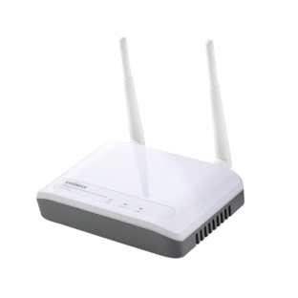
Usage Model 11: out of band signaling
Environment
Enterprise-level WLAN, composed of multiple APs, where neighboring APs use non-overlapping channels. APs may also be anchors of a multilateration positioning system (e.g. IEEE 802.11az?)
Applications
Transmit out-of band signaling information among APs/STAs through secondary radio to, e.g.:
Provide initial configuration for primary radio (channel number, bandwidth, ESSID, etc.)
Neighbor/Service discovery
Transmit synchronization beacons (e.g. for anchors in time measurement-based positioning).
Traffic Conditions
Interference with wake up packet transmission. Interference with neighboring legacy 802.11 transmissions in dense environments.
Use case
AP1 is serving STAs on channel x and AP2 on channel y. Channel x and y do not overlap.
Both AP1 and AP2 use their MR to send Beacon messages decodable by TGba-compatible WUR at precise intervals.
  Beacon may include information on the transmitting AP (e.g. channel of MR, bandwidth, power level, etc.).
AP1 and AP2 become aware of each other without switching their MR’s channels.
  Optionally, APs use those beacons to synchronize their clocks
Requirements
  The WUP transmission should enable coexistence with legacy IEEE 802.11 devices operating in the same band.
  WUP (or beacon) carries control information (e.g. initial config. parameters).
  WUR is capable of receiving transmissions in any IEEE 802.11 channel (e.g. through envelope detector over whole ISM band)
Ch.1
@2.4GHz
Ch.6
@2.4GHz
Eduard Garcia-Villegas (UPC)

Slide 11
Usage Model 12: beyond IEEE 802.11
Environment
Smart home/office (cf. usage model 1), warehouse (cf. usage model 2 and 7) or outdoor sensor deployment (cf. usage model 3) where a collection of sensors/actuators and other “things” are not necessarily Wi-Fi compatible but are equipped with low-power WUR.
Applications
Use Wi-Fi compatible device (e.g. tablet, smartphone, smartwatch, etc.) to remotely control (e.g. switch on/off) sensors/actuators that are not necessarily Wi-Fi compatible.
Transmit simple messages (WUP, initial configuration, discovery, etc.) to wireless devices with non-compatible primary radios (but with compatible TGba WUR).
Traffic Conditions
Interference with wake up packet transmission. Interference with neighboring legacy 802.11 transmissions in dense environments.
Requirements
  The WUP transmission should enable coexistence with legacy IEEE 802.11 devices operating in the same band.
  WUR-enabled devices have unique identifiers.
  Low-power recipients of WUP are equipped with TGba compatible WUR, but do not necessarily have an IEEE 802.11 primary radio (nor any other primary radio whatsoever).
Eduard Garcia-Villegas (UPC)

Slide 12
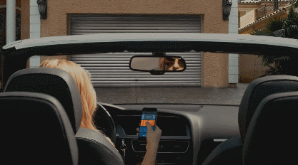
Usage Model 12: beyond 802.11
Use case 1 (“things”)
STA sends WUP/SP to actuator (e.g. garage door opener, window blinds, thermostat, etc.)
  Optionally, the WUP carries control information (e.g. new temperature for thermostat, open/close command to door opener, etc.).
Recipient of the WUP reacts accordingly, not being required to provide any feedback message to the originator of the WUP.
Use case 2 (different primary radios)
STA with IEEE 802.11 or IEEE 802.15.4 (or other) primary radio sends WUP/SP to wireless device with non-compatible primary radio
Recipient of the WUP, equipped with TGba WUR reacts accordingly, not being required to provide any feedback message to the originator of the WUP.
Out of the scope of TGba
IEEE 802.11
IEEE 802.15.4
TGba-compatible
Eduard Garcia-Villegas (UPC)

Slide 13
Summary
Jan 2017
We provide several new usage models following the format of 11-17/0029r4.
The goal of the usage models presented is to make the most of a (low-power) secondary radio capable of receiving messages from IEEE 802.11-compatible devices.
Intention is to include those new usage models to the WUR Usage Model Document.
Eduard Garcia-Villegas (UPC)

Slide 14
References
Jan 2017
11-17/0029r4, “WUR Usage Model Document”
11-17/0065r0, “Usage Model for Power Saving AP”
Eduard Garcia-Villegas (UPC)

