Slide 1
Link Adaptation Feedback for Combating Interferences
Date: 2017-03-06
Authors:

Slide 2
Problem statement (1/3)
Interferences cause throughput drop and even link loss
Interference
Throughput with legacy link adaptation
Low average
throughput
Time
Throughput knowing presence of interference
High average
throughput
Time

Slide 3
Problem statement (2/3)
Unlike noise, interferences usually concentrate in part of frequency or time
Narrow band interference (NBI) e.g. clock harmonics and Bluetooth
On-off interference (OOI) e.g. microwave oven, Bluetooth, and USB bus
Freq
Freq
On-off interference
Narrow band interference
…
…
MPDU corrupted by interference
Time
Time

Slide 4
Problem statement (3/3)
Reducing MCS doesn’t help
Narrow band interference still corrupts the same percentage of signal
On-off interference causes a vicious cycle: with lower MCS, MPDU duration becomes longer and more vulnerable to interference
Freq
On-off interference
On-off interference
…
MPDU corrupted by interference
Time

Slide 5
Solutions
DCM and short MPDU are efficient for NBI and OOI
However, Tx doesn’t even know the presence of interference at Rx
Survived MPDU
Freq
Freq
On-off interference
Narrow band interference
…
…
Duplicated DCM copies
Time
Time

Slide 6
Adaptation via feedback
Link adaption feedback can tell transmitter to use DCM and short MPDU for combating narrow band interference and on-off interference, respectively
CID 9619, “The HE-MCS defined in 28.5 varies depending on DCM. The HE link adaptation mechanism should also include a recommendation of the DCM.”

Slide 7
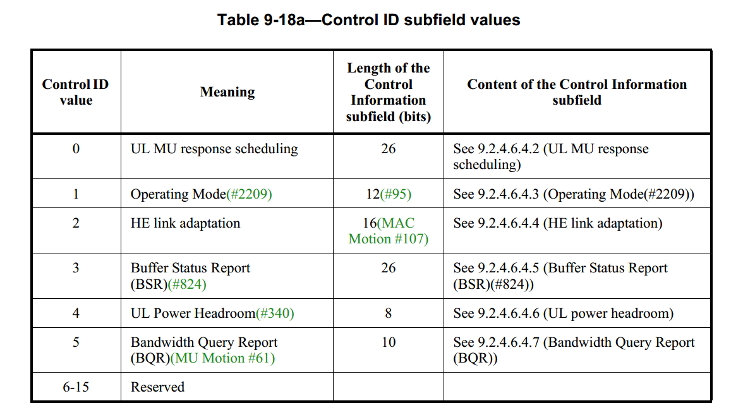
Link adaptation feedback
Currently, link adaptation parameters i.e. Nss and MCS are piggybacked in Aggregated Control subfield of HE variant HT control field in MAC header

Slide 8
Available feedback field
Control Information subfield of link adaptation still has 9 reserved bits currently

Slide 9
Feedback for DIM
Use 1 reserved bit for Rx to recommend DCM
Combat NBI by sending data over two sets of tones
B0
B2
B3
B6
B7
B8
B15
NSS
HE-MCS
DCM
Reserved
Bits:
3
4
1
8

Slide 10
Feedback for short MPDU
Use 1 reserved bit for Rx to recommend short MPDU duration (SMD)
Combat OOI by shortening MPDU duration e.g. down to 0.2 ms
Indicate the presence of OOI such that Tx knows RSSI is not reliable for link adaptation
A-MPDU
MPDU 1
MPDU 2
…
MPDU 64
B0
B2
B3
B6
B7
B8
B9
B15
NSS
HE-MCS
DCM
SMD
Reserved
Bits:
3
4
1
1
7

Slide 11
Summary
Reducing MCS is not efficient to combat interference
Tx needs to tell Rx about the presence of interference
A-Control field still has 9 bits available for link adaptation
Propose to use 1 reserved bits for DCM and 1 reserved bit for short MPDU duration

Slide 12
Straw Poll 1
Do you support using one reserved bit in Control Info subfield of HE link adaptation for DCM?
For example
Y: N: A:
B0
B2
B3
B6
NSS
HE-MCS
DCM
…
Bits:
3
4
1

Slide 13
Straw Poll 2
Do you support using one reserved bit in Control Info subfield of HE link adaptation for short MPDU duration?
Recommend to use short MDPU duration e.g. 0.2 ms
For example
Y: N: A:
B0
B2
B3
B6
NSS
HE-MCS
SMD
…
Bits:
3
4
1

