Slide 1
Link Adaptation Feedback for Combating Interferences
Date: 2017-03-06
Authors:

Slide 2
Problem statement (1/2)
Interferences cause packet losses and even link loss
Unlike noise, interferences usually concentrate in frequency or time
  Narrow band interference (NBI) e.g. clock harmonics and Bluetooth
  On-off interference (OOI) e.g. microwave oven
Freq
Freq
On-off interference
Narrow band interference
…
…
Packet corrupted by interference
Time
Time

Slide 3
Problem statement (2/2)
Reducing MCS doesn’t help
  Narrow band interference still corrupts the same percentage of signal
  On-off interference causes a vicious cycle: with lower MCS, MPDU duration becomes longer and more vulnerable to interference
Freq
On-off interference
On-off interference
…
Packet corrupted by interference
Time

Slide 4
Solutions
DCM and fragmentation are efficient for NBI and OOI
However, Tx doesn’t even know the presence of interference at Rx
Survived fragment
Freq
Freq
On-off interference
Narrow band interference
…
…
Duplicated DCM copies
Time
Time

Slide 5
Adaptation via feedback
Link adaption feedback can tell Tx to use DCM and shorter MPDU for combating narrow band interference and on-off interference, respectively

Slide 6
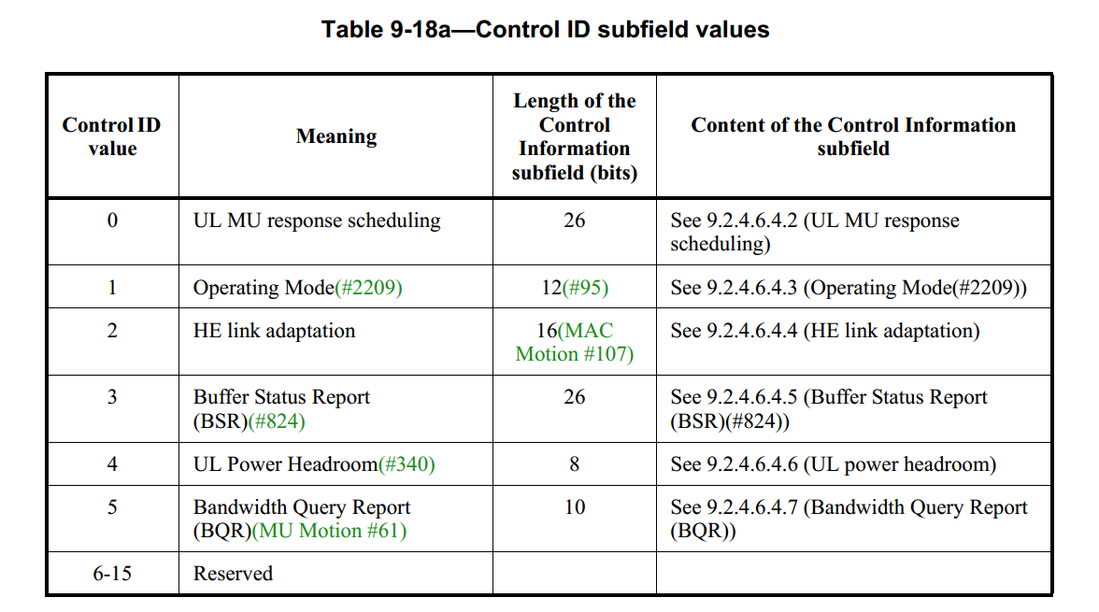
Link adaptation feedback
Currently, link adaptation parameters i.e. Nss and MCS are piggybacked in Aggregated Control subfield of HE variant HT control field in MAC header

Slide 7
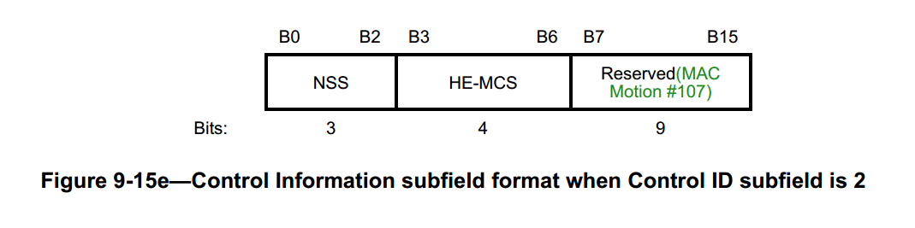
Available feedback field
Control Information subfield of link adaptation still has 9 reserved bits currently

Slide 8
Feedback for DIM
Use 1 reserved bit for Rx to recommend DCM
  Combat NBI by sending data over two sets of tones
B0
B2
B3
B6
B7
B8
B15
NSS
HE-MCS
DCM
Reserved
Bits:
3
4
1
8

Slide 9
Feedback for fragmentation
Use 1 reserved bit for Rx to recommend fragmentation
  Combat OOI by shortening MPDU duration e.g. down to 500 bytes
  Indicate the presence of OOI such that Tx knows RSSI is not reliable for link adaptation
B0
B2
B3
B6
B7
B8
B9
B15
NSS
HE-MCS
DCM
Frag.
Reserved
Bits:
3
4
1
1
7

Slide 10
Summary
Reducing MCS is not efficient to combat interference
Tx needs to tell Rx about the presence of interference
A-Control field still has 9 bits available for link adaptation
Propose to use 1 reserved bits for DCM and 1 reserved bit for fragmentation

Slide 11
Straw Poll 1
Do you support using one reserved bit in Control Info subfield of HE link adaptation for DCM?
  For example
Y: N: A:
B0
B2
B3
B6
NSS
HE-MCS
DCM
…
Bits:
3
4
1

Slide 12
Straw Poll 2
Do you support using one reserved bit in Control Info subfield of HE link adaptation for fragmentation?
  For example
Y: N: A:
B0
B2
B3
B6
NSS
HE-MCS
Frag.
…
Bits:
3
4
1

