Slide 1
BSS Load Information Element for 11ax
Date: 2017-09-10
Authors:

Slide 2
11ax D1.0 CID of BSS Load
CID | Commenter | P.L | Clause | Comment | Proposed Change
5917 | James Yee | 67.01 | 9.4.2.139 | With the introduction of new features such as OFDMA and UL MU MIMO, the existing BSS load elements (9.4.2.160 & 9.4.2.28), which address STA numbers, primary/secondary channel busy condition and DL MU-MIMO underutilization (11ac) are not sufficient for addressing the BSS load status in a 11ax BSS. A further enhanced BSS Load element needs to be defined. | Add a new information element to define 11ax BSS Load. The new IE shall address utilization status of OFDMA as well as UL/DL MU MIMO, as well as provisions to allow future extensions.
8165 | Ming Gan | 67.01 | 9.4.2. | BSS load element provides the channel utilization such that the unassociated STA can choose the proper AP┤+ε and extended BSS load element further provides the the spatial stream underutilization given the busy channel such that unassociated STA with MU-MIMO capability can choose the proper AP. Now 11ax introduce a OFDMA, there is the probability of frequence underutilization given the busy channel. | Define a HE BSS load element considering frequency utilization such to help unassociated STA to choose a best AP

Slide 3
Summary
802.11-2016 [1] defines two BSS load information elements containing:
information of current STA population and traffic level in the BSS (9.4.2.28 BSS Load element)
information of MIMO spatial stream underutilization and bandwidth utilization (9.4.2.160 Extended BSS Load element)
11ax introduces MU OFDMA and UL MIMO, but current BSS load IEs do not reflect true loading of 11ax HE BSSs
In this presentation, we propose defining new information element contents for conveying HE BSS load information. These contents can be carried either in a new element or in the extension of the legacy BSS load element.

Slide 4
HE BSS Load
Propose to define IE contents containing three categories of information:
STA Count Report: HE capable STA count and active STA count
HE Utilization Report: MU/SU PPDU utilization percentages
HE Underutilization Report: Mean available RU sizes for different spatial streams and OFMA only to reflect potential capacity in an HE BSS

Slide 5
HE BSS Load Element Contents(1/5)
STA Count Report
Total number of HE STAs
Motivation: Let STAs know how many HE STAs are within the BSS competing for resource.
Active STA counts
Motivation: Some associated STA may not have been active for a long time
An active STA: a STA from which the AP receives a MPDU during an observation period.
Where observation periods are in units of beacon intervals
Two active STA counts are proposed
Active STA count
Active HE capable STA count

Slide 6
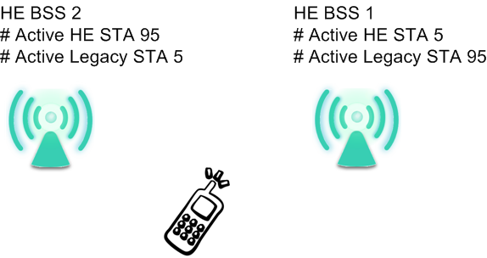
HE BSS Load Element Contents(2/5)
Usage Example:
Example: HE BSS1 has 100 active STAs with 5 active HE capable STAs, and HE BSS2 has 100 active STAs with 95 active HE capable STAs. An unassociated HE STA may choose HE BSS2 for more transmit and receive opportunities

Slide 7
HE BSS Load Element Contents(3/5)
2. HE Utilization Report
Motivation: A STA with specific UL/DL requirements and can better assess BSS based on recent UL/DL and SU/MU PPDU occupancy times.
Report on MU/SU PPDU Utilization percentages includes measurements over observation periods:
MU: Reports separate UL and DL utilization
SU: Reports DL utilization
Where an Observation period: the time interval, in units of beacon intervals, an AP made the most recent measurement.
Usage Example: High percentage UL PPDU time means a heavily MU UL loaded BSS

Slide 8
HE BSS Load Element Contents(4/5)
3. HE Underutilization Report
Report of mean Available RU size for OFDMA only and Nss = 1, 2, …, 7
Mean Available RU Size measured during the observation period across the channel BW
Quantize the average to closest RU size
3 octets required for Nss 1 to 7 (3-bit per case and 8 cases total)

Slide 9
HE BSS Load Element Contents(5/5)
Mean Available RU size (UL 1SS example)
is to truncate the average tone size to the closest legal RU size.
For OFDMA only, if the average is less than 26, then there is no available RU for this case
For 1SS~7SS, if the average is less than 106, then there is no available RU for these cases
3 bits required
K_{1SS,i}: Maximum available tones for 1SS
T_{MUUL,i}: Period of ith MU UL PPDU
T_{MUUL}: Sum of periods of MU UL PPDU
Maximum available tones: max tones of the unused RU can be allocated within the transmitted PPDU
Encoding of 3 bit subfield
0 indicates no available RU for this case
1 indicates 26-tone RU
2 indicates 52-tone RU
3 indicates 106-tone RU
4 indicates 242-tone RU
5 indicates 484-tone RU
6 indicates 996-tone RU
7 indicates 2×996-tone RU

Slide 10
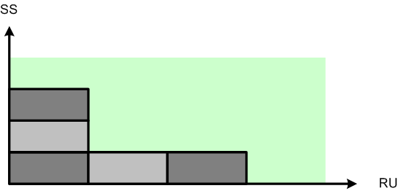
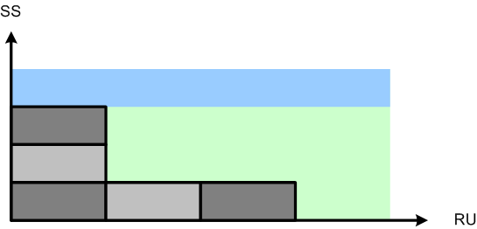
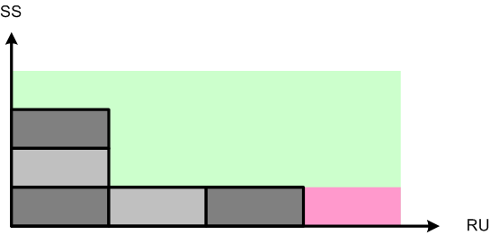
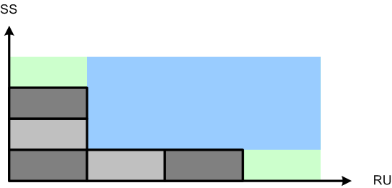
Example of Available RU of Spatial Streams
█ Available Capacity
█ Occupied RU
█ Available RU of 1 Spatial Stream
█ Available RU of OFDMA only and of
Maximum SS for SU MIMO
█ Available RU of 3 Spatial Streams

Slide 11
UL and DL Separation
For utilization and underutilization reports, we propose to separate UL and DL:
11ax adds UL MU MIMO as a key feature
11ax uses trigger frames to initiate MU UL and DL transmission. AP in general controls MU UL and DL traffic. Precise statistics is available .
A STA can identify more suitable HE BSS for its traffic requirements if it has specific UL/DL information

Slide 12
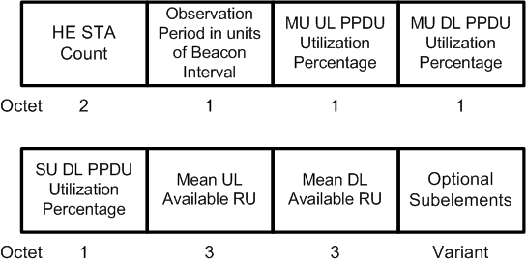
HE BSS Load Information Element Contents (1/2)
For HE Utilization
Separate UL MU and DL (MU and SU) percentage
For HE Underutilization
Separate UL/DL Mean Available RU
Element Format
Mean UL/DL Available RU subfields (3 bytes each)
 | Mean RU for OFDMA only | Mean RU for 1SS | Mean RU for 2SS | Mean RU for 3SS | Mean RU for 4SS | Mean RU for 5SS | Mean RU for 6SS | Mean RU for 7SS
bits: | 3 | 3 | 3 | 3 | 3 | 3 | 3 | 3

Slide 13
HE BSS Load Information Element Contents (2/2)
Optional Subelements
Active STA counts
Legacy BSS load elements
BSS load (9.4.2.28)
Extended BSS load (9.4.2.160)
Example: Active STA count subelements
Subelement ID | Name | Extensible
0 | Reserved
1 | Active STA count | Yes
2 | Active HE STA count | Yes
3 | BSS load
4 | Extended BSS load
5-255 | Reserved
 | Subelement ID | Length | Observation period in units of beacon intervals | Active STA count
Octets: | 1 | 1 | 2 | 1
 | Subelement ID | Length | Observation period in units of beacon intervals | Active HE STA count
Octets: | 1 | 1 | 2 | 1

Slide 14
Straw poll 1
Do you support to define the 11ax BSS load content either in a new BSS load element or in the extension of the legacy BSS load element
Y
N
A
Accepted with no objection in the ad hoc ax meeting in May, 2017

Slide 15
Straw poll 2
Do you support that HE BSS load content should include separate statistics to reflect DL and UL loading of the HE BSS instead of combined DL and UL loading information?
Y
N
A

Slide 16
Straw poll 3
Do you support including the STA count report as described on slide 5 into the HE BSS load content?
Y
N
A

Slide 17
Straw poll 4
Do you support including the HE Utilization Report described on page 7 into the HE BSS content
Y
N
A

Slide 18
Straw poll 5
Do you support including the HE Underutilization Report described on page 8 and 9 to the HE BSS load content? The HE Underutilization Load report includes
Mean available RU size during the observation period for OFDMA only and Nss = 1, 2, …8
Y
N
A

Slide 19
Straw poll 6
Do you support defining HE BSS load IE contents as described by example on page 12 and 13
Y
N
A

Slide 20
Straw poll 7
Do you prefer defining a new Information Element to carry the HE BSS load content instead of defining an Extension of the existing Extended BSS Load element?
Option A: A new information element
Option B: Extension of Extended BSS Load element

Slide 21
References
P802.11 2016

Slide 22
backup

Slide 23
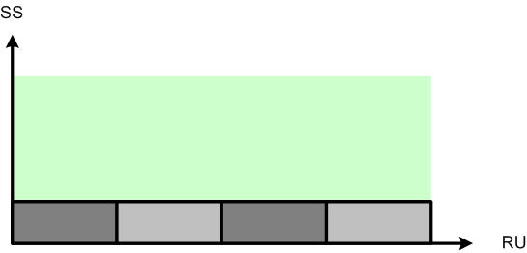
Underutilization Percentage and Available RU of Spatial Streams
Underutilization percentages provide a general picture of available resources. However, in some cases, STAs may not interpret the information correctly. Available RU of different spatial streams can help STAs to assess BSS loading.
Case 1: 75% underutilization percentage is reported, but for OFDMA only STAs, there is no resource for them in the BSS
A)
B)
Case 2: Similar underutilization percentages are reported in A and B. For a STA capable of supporting 3 spatial streams, underutilization percentage alone reveals little information.

Slide 24
Underutilization Percentage RU Weights
RU weights example of report per 20 MHz BW
RU26: 1/9
RU52: 2/9
RU106: 4/9
RU242: 9/9
RU484: 9/9 (half on the target 20MHz)

Slide 25
MU UL/DL PPDUTime Definitions
UL MU by TF
DL MU
Cascaded MU

Slide 26
Legacy BSS Load IEs
BSS load element
Extended BSS load element

Slide 27
dot11ChannelUtilizationBeaconIntervals
dot11ChannelUtilizationBeaconIntervals (50 beacon intervals default)
May not transmitted by the AP
Currently defined in Annex C

