Slide 1
BSS Load Information Element for 11ax
Date: 2017-07-10
Authors:

Slide 2
11ax D1.0 CID of BSS Load
CID | Commenter | P.L | Clause | Comment | Proposed Change
5917 | James Yee | 67.01 | 9.4.2.139 | With the introduction of new features such as OFDMA and UL MU MIMO, the existing BSS load elements (9.4.2.160 & 9.4.2.28), which address STA numbers, primary/secondary channel busy condition and DL MU-MIMO underutilization (11ac) are not sufficient for addressing the BSS load status in a 11ax BSS. A further enhanced BSS Load element needs to be defined. | Add a new information element to define 11ax BSS Load. The new IE shall address utilization status of OFDMA as well as UL/DL MU MIMO, as well as provisions to allow future extensions.
8165 | Ming Gan | 67.01 | 9.4.2. | BSS load element provides the channel utilization such that the unassociated STA can choose the proper AP┤+ε and extended BSS load element further provides the the spatial stream underutilization given the busy channel such that unassociated STA with MU-MIMO capability can choose the proper AP. Now 11ax introduce a OFDMA, there is the probability of frequence underutilization given the busy channel. | Define a HE BSS load element considering frequency utilization such to help unassociated STA to choose a best AP

Slide 3
Summary
802.11-2016 [1] defines two BSS load information elements containing:
  information of current STA population and traffic level in the BSS (9.4.2.28 BSS Load element)
  information of MIMO spatial stream underutilization and bandwidth utilization (9.4.2.160 Extended BSS Load element)
11ax introduces MU OFDMA and UL MIMO, but current BSS load IEs do not reflect true loading of 11ax HE BSSs
In this presentation, we propose defining new information element contents for conveying HE BSS load information. These contents can be carried either in a new element or in the extension of the legacy BSS load element.

Slide 4
HE BSS Load
Propose to define IE contents containing three categories of information:
  STA Count Report: HE capable STA count and active STA count
  HE Utilization Report: MU/SU PPDU utilization percentages
  HE Underutilization Report: Underutilization rate of MU PPDU to reflect potential capacity in an HE BSS

Slide 5
HE BSS Load Element Contents(1/5)
STA Count Report
Total number of HE STAs
  Motivation: Let STAs know how many HE STAs are within the BSS competing for resource.
Active STA counts
  Motivation: Some associated STA may not have been active for a long time
  An active STA: a STA from which the AP receives a MPDU during an observation period.
    Where observation periods are in units of beacon intervals
  Two active STA counts are proposed
    Active STA count
    Active HE capable STA count

Slide 6
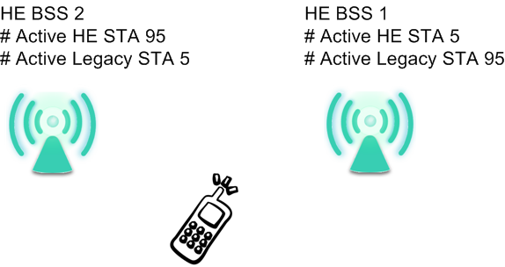
HE BSS Load Element Contents(2/5)
Usage Example:
  Example: HE BSS1 has 100 active STAs with 5 active HE capable STAs, and HE BSS2 has 100 active STAs with 95 active HE capable STAs. An unassociated HE STA may choose HE BSS2 for more transmit and receive opportunities

Slide 7
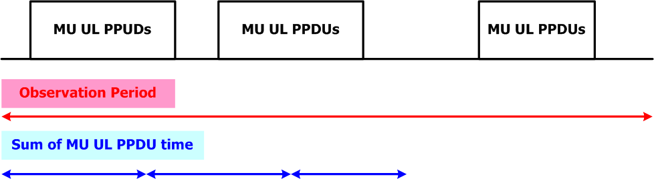
HE BSS Load Element Contents(3/5)
2. HE Utilization Report
  Motivation: A STA with specific UL/DL requirements and can better assess BSS based on recent UL/DL and SU/MU PPDU occupancy times.
  Report on MU/SU PPDU Utilization percentages includes measurements over observation periods:
    MU: Reports separate UL and DL utilization
    SU: Reports DL utilization
    Where an Observation period: the time interval, in units of beacon intervals, an AP made the most recent measurement.
  Usage Example: High percentage UL PPDU time means a heavily MU UL loaded BSS

Slide 8
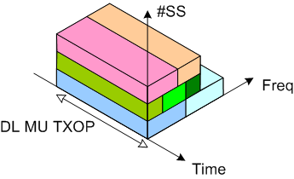
HE BSS Load Element Contents(4/5)
3. HE Underutilization Report
  Underutilization percentage over space & frequency
    Information of available BW and SS
      Interfered, punctured and used RUs are not included
  Separate DL & UL reports
  Report of channel BW
  Reports of underutilization per 20 MHz BW
  Report on Available RU size for OFDMA only and Nss = 1, 2, …, 8
    Mean Available RU Size measured during the observation period across the channel BW
    Quantize the average to closest RU size
    4 octets required for Nss 1 to 8 (3-bit per case and 9 cases total)

Slide 9
HE BSS Load Element Contents(5/5)
Underutilization percentage formula (MU DL example)
N_{max_SS}: Max supported spatial stream
RU_{Busy}: Occupied RU weight (Used or interfered)
RU_{max}: RU weight of the available BW
T_{Busy(MUDL)}: Time of busy period for MU DL PPDU

Slide 10
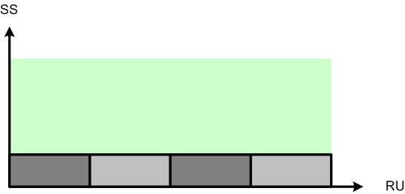
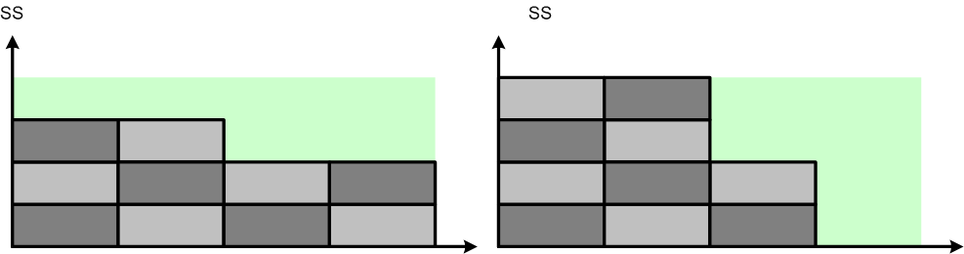
Underutilization Percentage and
Available RU of Spatial Streams
Underutilization percentages provide a general picture of available resources. However, in some cases, STAs may not interpret the information correctly. Available RU of different spatial streams can help STAs assess BSS loading.
Case 1: 75% underutilization percentage is reported, but for OFDMA only STAs, there is no resource for them in the BSS
A)
B)
Case 2: Similar underutilization percentages are reported in A and B. For a STA capable of supporting 3 spatial streams, underutilization percentage alone reveals little information.

Slide 11
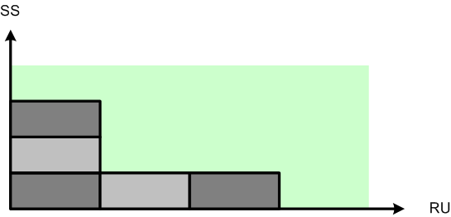
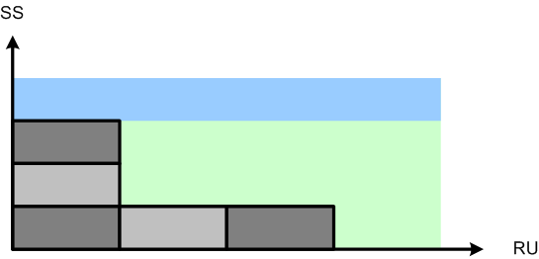
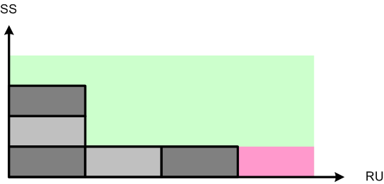
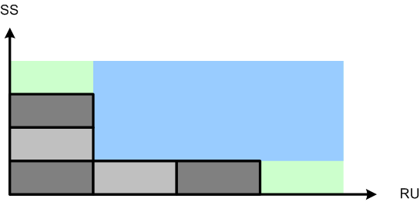
Example of Available RU of Spatial Streams
█ Available Capacity
█ Occupied RU
█ Available RU of 1 Spatial Stream
█ Available RU of OFDMA only
█ Available RU of 3 Spatial Streams

Slide 12
UL and DL Separation
For utilization and underutilization reports, we propose to separate UL and DL:
  11ax adds UL MU MIMO as a key feature
  11ax uses trigger frames to initiate MU UL and DL transmission. AP in general controls MU UL and DL traffic. Precise statistics is available .
  A STA can identify more suitable HE BSS for its traffic requirements if it has specific UL/DL information

Slide 13
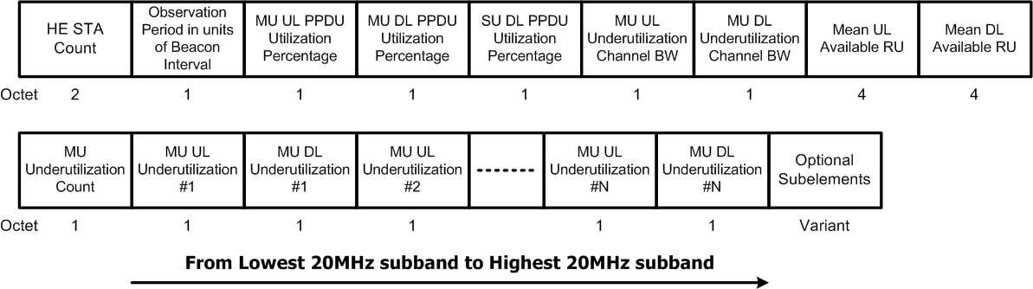
HE BSS Load Information Element Contents (1/2)
For UL/DL underutilization
  Variable length dependening on the channel bandwidth
Optional subelements carry active STA counts and legacy BSS load IEs (defined on the next page)

Slide 14
HE BSS Load Information Element Contents (2/2)
Subelements
  Optional active STA counts
  Able to carry legacy BSS load elements
    BSS load (9.4.2.28)
    Extended BSS load (9.4.2.160)
Active STA count subelements
Subelement ID | Name | Extensible
0 | Reserved
1 | Active STA count | Yes
2 | Active HE STA count | Yes
3 | BSS load
4 | Extended BSS load
5-255 | Reserved
 | Subelement ID | Length | Active STA count | Observation period in units of beacon interval s
Octets: | 1 | 1 | 2 | 1
 | Subelement ID | Length | Active HE STA count | Observation period in units of beacon intervals
Octets: | 1 | 1 | 2 | 1

Slide 15
Straw poll 1
Do you support to define the 11ax BSS load content either in a new BSS load element or in the extension of the legacy BSS load element
  Y
  N
  A
Accepted with no objection in the ad hoc ax meeting in May, 2017

Slide 16
Straw poll 2
Do you support that HE BSS load content should include separate statistics to reflect DL and UL loading of the HE BSS?
  Y
  N
  A

Slide 17
Straw poll 3
Do you support to add the HE STA count to the HE BSS load content?
  Y
  N
  A

Slide 18
Straw poll 4
Do you support to add PPDU time percentages described on page 7 to the HE BSS content
  Y
  N
  A

Slide 19
Straw poll 5
Do you support to add the load report described on page 8 to the HE BSS load content? The load report includes
    DL/UL underutilization rates per 20 MHz
    DL/UL underutilization rates of the channel bandwidth
    Mean available RU size during the observation period for OFDMA only and Nss = 1, 2, …8
  Y
  N
  A

Slide 20
Straw poll 6
Do you support to add active STA counts described on page 5 to the HE BSS load content as optional subelements?
  Y
  N
  A

Slide 21
Straw poll 7
Do you support to define HE BSS load content described on page 12
  Y
  N
  A

Slide 22
Straw poll 8
Which format do you prefer to carry the HE BSS load content
  New information element
  Extension of the Extended BSS load element

Slide 23
References
P802.11 2016

Slide 24
backup

Slide 25
Underutilization Percentage RU Weights
RU weights example of report per 20 MHz BW
  RU26: 1/9
  RU52: 2/9
  RU106: 4/9
  RU242: 9/9
  RU484: 9/9 (half on the target 20MHz)

Slide 26
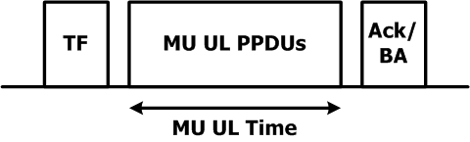
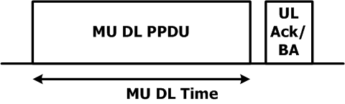
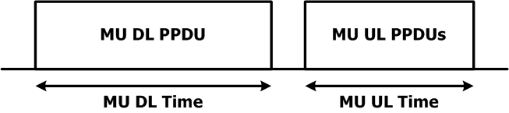
MU UL/DL PPDUTime Definitions
UL MU by TF
DL MU
Cascaded MU

Slide 27
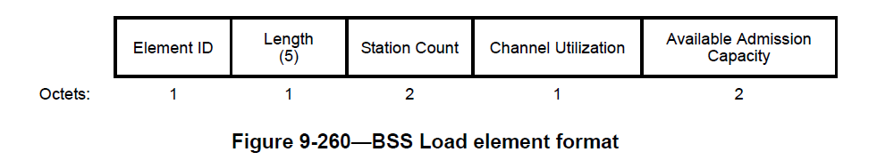
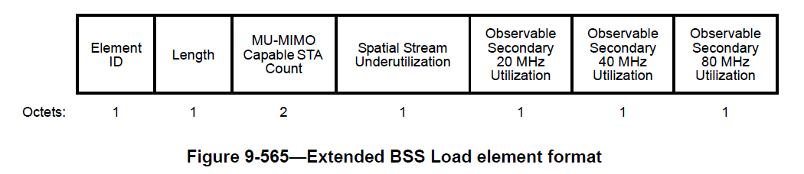
Legacy BSS Load IEs
BSS load element
Extended BSS load element

Slide 28
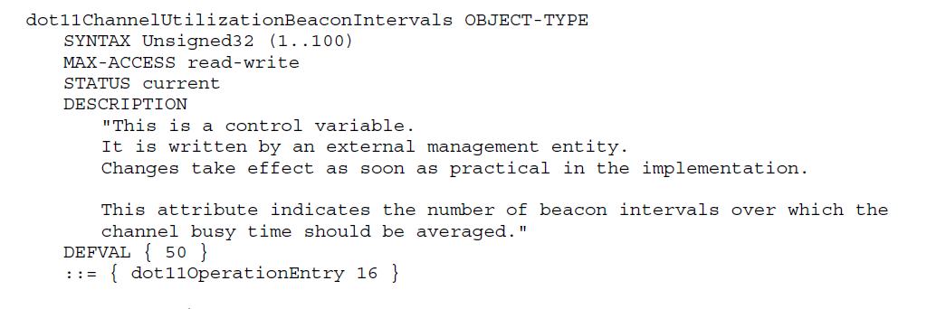
dot11ChannelUtilizationBeaconIntervals
dot11ChannelUtilizationBeaconIntervals (50 beacon intervals default)
  May not transmitted by the AP
  Currently defined in Annex C

