Slide 1
BSS Load Information Element for 11ax
Date: 2017-03-15
Authors:

Slide 2
11ax D1.0 CID of BSS Load
CID | Commenter | P.L | Clause | Comment | Proposed Change
5917 | James Yee | 67.01 | 9.4.2.139 | With the introduction of new features such as OFDMA and UL MU MIMO, the existing BSS load elements (9.4.2.160 & 9.4.2.28), which address STA numbers, primary/secondary channel busy condition and DL MU-MIMO underutilization (11ac) are not sufficient for addressing the BSS load status in a 11ax BSS. A further enhanced BSS Load element needs to be defined. | Add a new information element to define 11ax BSS Load. The new IE shall address utilization status of OFDMA as well as UL/DL MU MIMO, as well as provisions to allow future extensions.
8165 | Ming Gan | 67.01 | 9.4.2. | BSS load element provides the channel utilization such that the unassociated STA can choose the proper AP┤+ε and extended BSS load element further provides the the spatial stream underutilization given the busy channel such that unassociated STA with MU-MIMO capability can choose the proper AP. Now 11ax introduce a OFDMA, there is the probability of frequence underutilization given the busy channel. | Define a HE BSS load element considering frequency utilization such to help unassociated STA to choose a best AP

Slide 3
Summary
802.11 defines two BSS load information elements[1] containing
information of current STA population and traffic level in the BSS (BSS load element)
information of MIMO spatial stream underutilization and bandwidth utilization (Extended BSS load element)
11ax introduces MU of OFDMA and UL MIMO, but current BSS load IEs cannot reflect true loading of 11ax HE BSSs
In this presentation, we propose defining new information element contents for conveying HE BSS load information. These contents can be carried either in a new element or in the extension of the legacy BSS load element.

Slide 4
11ax MU BSS Load
Propose to define IE contents containing three categories of information
11ax MU capable STA count and active STA counts
TXOP time percentages over an observation period
Load Report: Underutilization rate of MU TXOP to reflect potential capacity of an 11ax BSS

Slide 5
11ax MU BSS Load Element Contents(1/4)
STA count
Total number of MU capable STAs
MU includes MU MIMO and OFDMA
Let STAs know how many MU competitors are within the BSS
Active STA counts
Some associated STA may not be active for a long time
AP can monitor STA’s activities during an observation period
Propose to define independent observation periods in units of beacon intervals
An active STA: if the AP receives any MPDU from that STA during the observation period.
Two active STA counts are proposed.
Active STA count
Active MU capable STA count

Slide 6
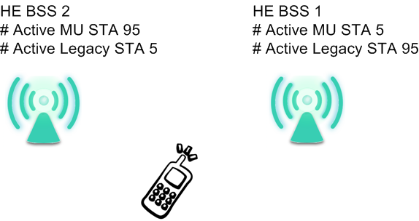
11ax MU BSS Load Element Contents(2/4)
Usage Example:
Example: HE BSS1 has 100 active STAs with 5 active MU capable STAs, and HE BSS2 has 100 active STAs with 95 active MU capable STAs. An unassociated HE STA may choose HE BSS2 for more transmit and receive opportunities

Slide 7
11ax MU BSS Load Element Contents(3/4)
2. MU/SU TXOPs Time percentages
Let STAs know the traffic trend of TXOPs during the observation period. STA may have specific UL/DL requirements. The report includes
Observation period in units of beacon intervals: the time interval AP making the measurement most recently
MU: Report UL and DL separately
SU: Report DL
Usage Example:
High percentage UL TXOP means heavily MU UL loaded BSS
Illustration

Slide 8
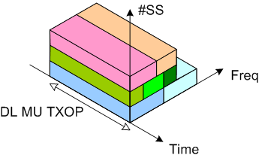
11ax MU BSS Load Element Contents(4/4)
3. Load report of MU TXOPs
Underutilization percentage over space & frequency
Information of available BW and SS
Interfered and used RUs shall not be included
Separate DL & UL reports
Report of channel BW
Reports of per 20 MHz BW
Underutilization percentage formula (MU DL example)
N_{max_SS}: Max supported spatial stream
RU_{Busy}: Occupied RU weight(Used or interfered)
RU_{max}: RU weight of the available BW
T_{Busy(MUDL)}: Time of busy period for MU DL (MU DL TXOP)

Slide 9
UL and DL Separation
For underutilization and TXOP percentage reports, we propose to separate UL and DL
11ax adds UL MU MIMO as the key feature
11ax uses trigger frames to initiate MU UL and DL transmission. AP in general controls MU UL and DL traffic. Precise statistics is available.
STA needs specific UL/DL information according to their transmission requirement

Slide 10
11ax MU BSS Load Information Element Contents (1/2)
For UL/DL underutilization
Variable length dependent on the channel bandwidth
Optional subelements carry active STA counts and legacy BSS load IEs (defined on the next page)

Slide 11
11ax MU BSS Load Information Element Contents (2/2)
Subelements
Optional active STA counts
Able to carry legacy BSS load elements
BSS load (9.4.2.28)
Extended BSS load (9.4.2.160)
Active STA count subelements
Subelement ID | Name | Extensible
0 | Reserved
1 | Active STA count | Yes
2 | Active MU capable STA count | Yes
3 | BSS load
4 | Extended BSS load
5-255 | Reserved
 | Subelement ID | Length | Active STA count | Observation period in units of beacon interval s
Octets: | 1 | 1 | 2 | 1
 | Subelement ID | Length | Active MU Capable STA count | Observation period in units of beacon intervals
Octets: | 1 | 1 | 2 | 1

Slide 12
Straw poll 1
Do you support to define the 11ax BSS load content either in a new BSS load element or in the extension of the legacy BSS load element
Y
N
A

Slide 13
Straw poll 2
Do you support to add the MU capable STA count to the 11ax BSS load content?
Y
N
A

Slide 14
Straw poll 3
Do you support to separately report underutilization rates of DL and UL in the 11ax BSS load content?
Y
N
A

Slide 15
Straw poll 4
Do you support to add TXOP time percentages described on page 7 to the 11ax BSS content
Y
N
A

Slide 16
Straw poll 5
Do you support to add the load report described on page 8 to the 11ax BSS load content? The load report includes
DL/UL underutilization rates per 20 MHz
DL/UL underutilization rates of the channel bandwidth
Y
N
A

Slide 17
Straw poll 6
Do you support to add active STA counts described on page 5 to the 11ax BSS load content as optional subelements?
Y
N
A

Slide 18
Straw poll 7
Do you support to define 11ax BSS load content described on page 10
Y
N
A

Slide 19
Straw poll 8
Which format do you prefer to carry the 11ax BSS load content
New information element
Extension of the legacy BSS load element

Slide 20
References
P802.11 2016

Slide 21
backup

Slide 22
Underutilization Percentage RU Weights
RU weights example of report per 20 MHz BW
RU26: 1/9
RU52: 2/9
RU106: 4/9
RU242: 9/9
RU484: 9/9 (half on the target 20MHz)

Slide 23
MU UL/DL Time Definitions
UL MU by TF
DL MU
Cascaded MU

Slide 24
Legacy BSS Load IEs
BSS load element
Extended BSS load element

Slide 25
dot11ChannelUtilizationBeaconIntervals
dot11ChannelUtilizationBeaconIntervals (50 beacon intervals default)
May not transmitted by the AP
Currently defined in Annex C

