Slide 1
BSS Load Information Element for 11ax
Date: 2017-03-15
Authors:

Slide 2
11ax D1.0 CID of BSS Load
CID | Commenter | P.L | Clause | Comment | Proposed Change
5917 | James Yee | 67.01 | 9.4.2.139 | With the introduction of new features such as OFDMA and UL MU MIMO, the existing BSS load elements (9.4.2.160 & 9.4.2.28), which address STA numbers, primary/secondary channel busy condition and DL MU-MIMO underutilization (11ac) are not sufficient for addressing the BSS load status in a 11ax BSS. A further enhanced BSS Load element needs to be defined. | Add a new information element to define 11ax BSS Load. The new IE shall address utilization status of OFDMA as well as UL/DL MU MIMO, as well as provisions to allow future extensions.
8165 | Ming Gan | 67.01 | 9.4.2. | BSS load element provides the channel utilization such that the unassociated STA can choose the proper AP┤+ε and extended BSS load element further provides the the spatial stream underutilization given the busy channel such that unassociated STA with MU-MIMO capability can choose the proper AP. Now 11ax introduce a OFDMA, there is the probability of frequence underutilization given the busy channel. | Define a HE BSS load element considering frequency utilization such to help unassociated STA to choose a best AP

Slide 3
Summary
802.11 defines two BSS load information elements[1] containing
  information of current STA population and traffic level in the BSS (BSS load element)
  information of MIMO spatial stream underutilization and bandwidth utilization (Extended BSS load element)
11ax introduces MU of OFDMA and UL MIMO, but current BSS load IEs cannot reflect true loading of 11ax HE BSSs
In this presentation, we propose defining a new information element for conveying HE BSS load information

Slide 4
11ax MU BSS Load Element
Propose to add a new IE containing three categories of information
  11ax MU capable STA count and active STA counts
  TXOP/Idle time percentages over an observation period
  Load Report: Underutilization rate of MU TXOP to reflect potential capacity of an 11ax BSS

Slide 5
11ax MU BSS Load Element Contents(1/4)
STA count
Total number of MU capable STAs
  MU includes MU MIMO and OFDMA
  Let STAs know how many MU competitors are within the BSS
Active STA counts
  Some associated STA may not be active for a long time
  AP can monitor STA’s activities during an observation period
    Propose to define independent observation periods in units of beacon intervals
  An active STA: if the AP receives any MPDU from that STA during the observation period. Two active STA counts are defined.
    Active STA count
    Active MU capable STA count

Slide 6
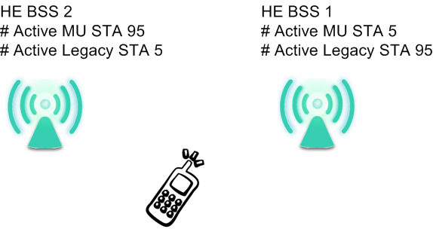
11ax MU BSS Load Element Contents(2/4)
Usage Example:
  Example: HE BSS1 has 100 active STAs with 5 active MU capable STAs, and HE BSS2 has 100 active STAs with 95 active MU capable STAs. An unassociated HE STA may choose HE BSS2 for more transmit and receive opportunities

Slide 7
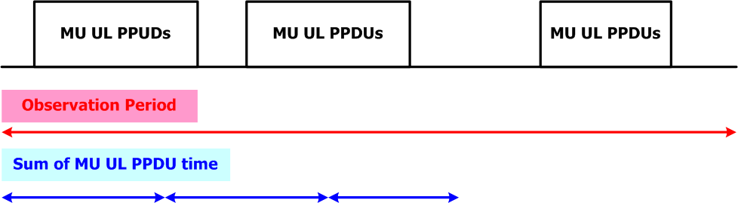
11ax MU BSS Load Element Contents(3/4)
2. MU/SU TXOPs and Idle Time percentages
  Let STAs know the traffic trend of TXOPs during the observation period. STA may have specific UL/DL requirements. The report includes
    Observation period in units of beacon intervals: the time interval AP making the measurement most recently
    MU: Report UL and DL separately
    SU: Report DL
    Idle air time: measured only after backoff = 0 and medium continues to be idle
  Usage Example:
    High percentage UL TXOP means heavily MU UL loaded BSS
  Illustration

Slide 8
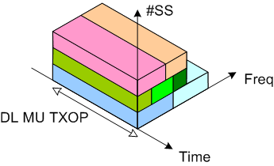
11ax MU BSS Load Element Contents(4/4)
3. Load report of MU TXOPs
  Underutilization percentage over space & frequency
    Information of available BW and SS
      Interfered and used RUs shall not be included
    Separate DL & UL reports
  Report BW
    Reports of per 20 MHz BW
  Underutilization percentage formula (MU DL example)
N_{max_SS}: Max supported spatial stream
RU_{Busy}: Occupied RU weight(Used or interfered)
RU_{max}: RU weight of the available BW
T_{Busy(MUDL)}: Time of busy period for MU DL (MU DL TXOP)

Slide 9
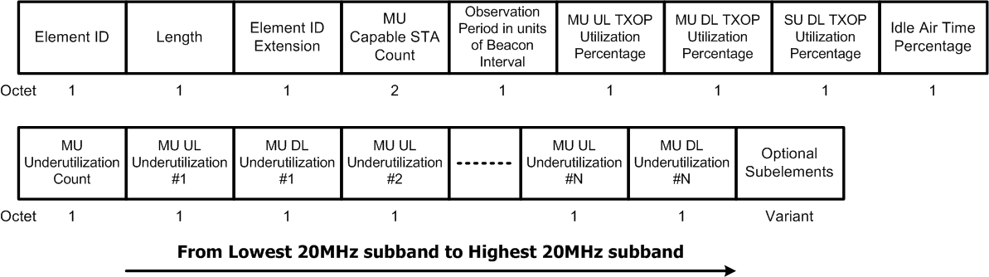
11ax MU BSS Load Information Element (1/2)
Define a new BSS Load information element for 11ax
For UL/DL underutilization
  Variable length dependent on the channel bandwidth
Optional subelements carry active STA counts and legacy BSS load IEs (defined on the next page)

Slide 10
11ax MU BSS Load Information Element (2/2)
Subelements
  Optional active STA counts
  Able to carry legacy BSS load elements
    BSS load (9.4.2.28)
    Extended BSS load (9.4.2.160)
Active STA count subelements
Subelement ID | Name | Extensible
0 | Reserved
1 | Active STA count | Yes
2 | Active MU capable STA count | Yes
3 | BSS load
4 | Extended BSS load
5-255 | Reserved
 | Subelement ID | Length | Active STA count | Observation period in units of beacon interval s
Octets: | 1 | 1 | 2 | 1
 | Subelement ID | Length | Active MU Capable STA count | Observation period in units of beacon intervals
Octets: | 1 | 1 | 2 | 1

Slide 11
Straw poll 1
Do you support to define an 11ax BSS load information element?
  Y
  N
  A

Slide 12
Straw poll 2
Do you support to add the MU capable STA count to the 11ax BSS load information element?
  Y
  N
  A

Slide 13
Straw poll 3
Do you support to add TXOP/Idle time percentages described on page 7 to the 11ax BSS load information element?
  Y
  N
  A

Slide 14
Straw poll 4
Do you support to add the load report described on page 8 to the 11ax BSS load information element?
  Y
  N
  A

Slide 15
Straw poll 5
Do you support to add active STA counts described on page 5 to the 11ax BSS load information element as optional subelements?
  Y
  N
  A

Slide 16
Straw poll 6
Do you support to define the 11ax MU BSS load information element as the formant on page 9~10?
  Y
  N
  A

Slide 17
References
P802.11 2016

Slide 18
backup

Slide 19
Underutilization Percentage RU Weights
RU weights example of report per 20 MHz BW
  RU26: 1/9
  RU52: 2/9
  RU106: 4/9
  RU242: 9/9
  RU484: 9/9 (half on the target 20MHz)

Slide 20
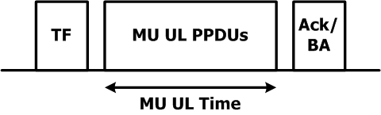
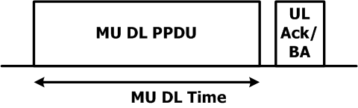
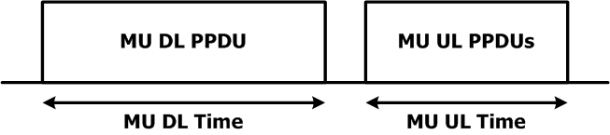
MU UL/DL Time Definitions
UL MU by TF
DL MU
Cascaded MU

Slide 21
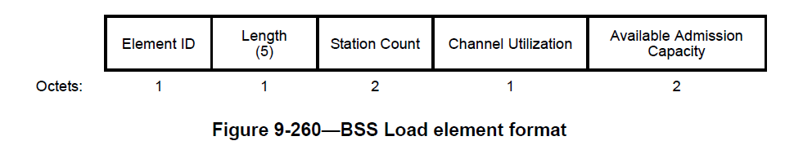
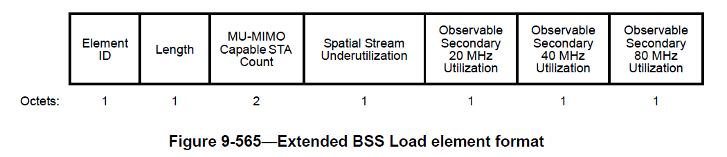
Legacy BSS Load IEs
BSS load element
Extended BSS load element

Slide 22
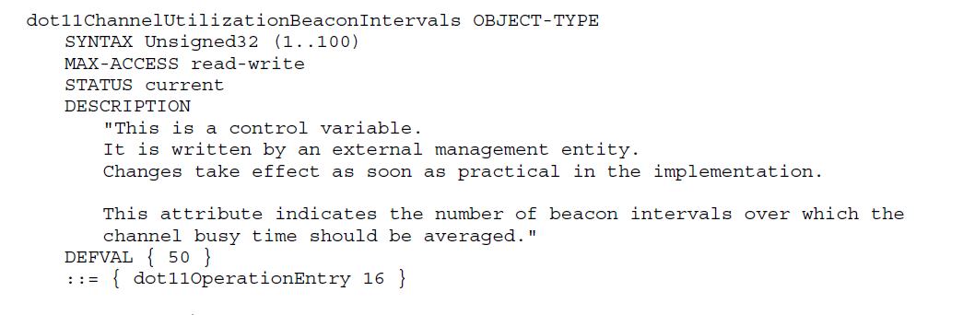
dot11ChannelUtilizationBeaconIntervals
dot11ChannelUtilizationBeaconIntervals (50 beacon intervals default)
  May not transmitted by the AP
  Currently defined in Annex C

