Slide 1
Further Evaluations on Single Carrier Waveforms
Date: 2017-03-01
Authors:

Slide 2
Abstract
In [1] and [2], we introduced a DFT-spread operation to 802.11ay and evaluated the throughput performance in comparison to the ones with OFDM and SC waveforms
In this contribution,
  We provide more clarifications on the receiver structures for SC waveforms in [2]
  We discuss why SC receivers degrades the PER performance
  Additional simulation results are also provided

Slide 3
Background (1/2)
In 802.11ad [3], both OFDM and SC waveforms are adopted and similar waveforms are expected to be adopted for 802.11ay [4]
In 802.11ad, the numerologies for SC and OFDM are chosen such that both SC and OFDM can operate at the same nominal sample rate
The nominal sample rate for a single channel is 2.64 GHz

Slide 4







Background (2/2)
802.11ad OFDM TX and RX do not need to employ extra upsampling and downsampling operations [3]
On the other hand, a typical SC TX and RX for 802.11ay/ad may employ an upsampling, filtering, and a downsampling operations to match the sampling rate
SC receiver operates on a block where the channel’s impact is a circular convolution to exploit 1-tap freq. domain equalization
336
OFDM TX and RX:
Data
352
16
M
a
p
IDFT
(512)
P
/
S
DAC
RF
RF
ADC
S
/
P
DFT
(512)
EQ
Data
Pilot
0
0
$$f_{s}=2.64 GHz$$
$$f_{s}=2.64 GHz$$
SC TX and RX:
448
448
Data
$$↑$$
3
Filter
$$↓$$
2
$$↑$$
2
Filter
$$↓$$
3
Data
DAC
RF
RF
DAC
S
/
P
DFT
(512)
EQ
IDFT
(512)
P
/
S
64
64
GI
GI
$$f_{s}=2.64 GHz$$
$$f_{s}=2.64 GHz$$

Slide 5
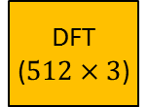
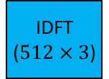


Equivalent Representation of SC (1/2)
Upsampling, filtering, and downsampling operations for single carrier can expressed in frequency. For example, the equivalent operations for single channel are given as follows:
  Upsampling: DFT of 768, repeat in frequency, IDFT of 1536 [7, p238]
  Downsampling: DFT of 1536, combine in frequency, IDFT of 512 [7, p235]
  Filtering: Windowing in frequency domain (corresponds to 1536 filter coefficients)
SC receiver
Output of DFT
$$↑$$
2
Filter
$$↓$$
3
DFT
(512)
IDFT
(512)
Data
S
/
P
EQ
448
768
GI
Output of DFT
64
Filter coef.
IDFT
($512×3$)
DFT
($512×3$)
$$≡$$
Weighted Comb.
DFT
(768)
IDFT
(512)
DFT
(512)
DFT
(768)
768
512
Cancels each other
Filter
coef.
Cancels each other
Filter coef.

Slide 6


Equivalent Representation of SC (2/2)
The equivalent frequency domain representation of 11ay/ad SC receiver includes for single channel
  A 768-DFT operation in front and a weighted combination before the equalization
This receiver is optimal in AWGN with a matched filter
However, one can show that this receiver is suboptimal in fading channel
448
$$≡$$
448
$$↑$$
2
Filter
$$↓$$
3
DFT
(512)
IDFT
(512)
Data
Weighted Comb.
IDFT
(512)
Data
S
/
P
EQ
DFT
(768)
EQ
64
64
RS
RS
SC receiver
Output of DFT
Amplitude
Complex coefficients
Non-coherent additions before equalization!
Output of DFT
frequency
Channel frequency response
Filter coef.

Slide 7
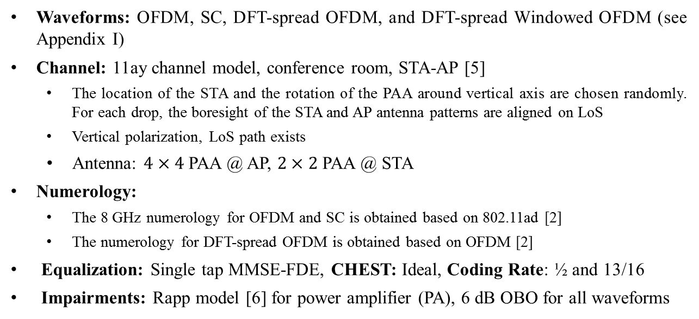
Simulation Assumptions
PAA
Fixed location
and orientation
AP
PAA
Random location
and orientation
STA
Waveforms: OFDM, SC, DFT-spread OFDM, and DFT-spread Windowed OFDM (see Appendix I)
Channel: 11ay channel model, conference room, STA-AP [5]
  The location of the STA and the rotation of the PAA around vertical axis are chosen randomly. For each drop, the boresight of the STA and AP antenna patterns are aligned on LoS
  Vertical polarization, LoS path exists
  Antenna: $4×4$ PAA @ AP, $2×2$ PAA @ STA
Numerology:
  The 8 GHz numerology for OFDM and SC is obtained based on 802.11ad [2]
  The numerology for DFT-spread OFDM is obtained based on OFDM [2]
Equalization: Single tap MMSE-FDE, CHEST: Ideal, Coding Rate: ½ and 13/16
Impairments: Rapp model [6] for power amplifier (PA), 6 dB OBO for all waveforms

Slide 8
BER Results without PA Impairment
SC receiver performs
~ 1 dB worse than others in the channel
a) AWGN
b) 11ay channel
In AWGN, all waveforms are aligned with Gaussian BER bound
In fading channel, conventional SC receiver degrades BER performance approximately 1 dB due to aforementioned non-coherent combinations

Slide 9
BER Results with PA Impairment
1 dB
SC is ~1dB better than OFDM
SC receiver loses its PAPR advantage for low SNR
a) AWGN
b) 11ay channel
In AWGN, SC and DFT-spread OFDM outperform OFDM due to their low PAPRs
In 11ay channel, SC receiver does not capture the PAPR advantage as compared to DFT-spread OFDM for low SNR

Slide 10
PER Results in 11ay Channel
~1 dB
~0.8 dB
a) Without PA impairment (13/16 coding rate)
b) With PA impairment (13/16 coding rate)
With or without PA impairment, the SC receiver is ~1 dB worse than DFT-spread OFDM
With PA impairment, both SC and OFDM are ~0.8 dB worse than DFT-spread OFDM for 13/16 coding rate. Throughput result is provided in Appendix II
The results for ½ coding rate is provided in Appendix III and IV

Slide 11
Conclusion
In this contribution, we discuss the upsampling-filtering downsampling operation at the SC receiver
We showed that the upsampling-filtering downsampling operation at the SC receiver is equivalent to a weighted combination in frequency domain, which is not optimal in fading channel
Simulations show that
  The SC receiver degrades the FER performance as compared to DFT-spread OFDM
  With high coding rate and PA impairments, DFT-spread OFDM is superior to OFDM

Slide 12
References
[1] “On the Single Carrier Waveforms for 11ay”, IEEE 802.11-16/01455r0
[2] “Performance Evaluation of Multi-DFT-spread OFDM for 802.11ay ”, IEEE 802.11-17/00048r0
[3] “Wireless LAN Medium Access Control (MAC) and Physical Layer (PHY) Specifications Amendment 3: Enhancements for Very High Throughput in the 60 GHz Band,” IEEE Std 802.11ad-2012, pp. 1–628, Dec. 2012.
[4] “Specification Framework for TGay,” IEEE 802.11-15/01358r6]
[5] “Channel Models for IEEE 802.11ay,” IEEE 802.11-15/1150r7
[6] “11ay evaluation methodology,” IEEE 802.11-16/866r4
[7] K. R. Rao at al., “Fast Fourier Transform - Algorithms and Applications”, Signals and Communication Tech., Springer, 2010

Slide 13









Appendix I - Waveforms
Data
336x4
352x4
OFDM
M
a
p
IDFT
(2048)
P
/
S
CP+
256
DAC
RF
RF
ADC
CP-
256
S
/
P
DFT
(2048)
EQ
Data
Pilot
0
16x4
0
$$f_{s}=4×2.64 GHz$$
$$f_{s}=4×2.64 GHz$$
448x4
448x4
Data
$$↑$$
3
RRC
$$↓$$
2
$$↑$$
2
RRC
$$↓$$
3
Data
DAC
RF
RF
ADC
S
/
P
DFT
(2048)
EQ
IDFT
(2048)
SC
P
/
S
64x4
$$ρ=0.3$$
$$ρ=0.3$$
GI
$$f_{s}=4×2.64 GHz$$
$$f_{s}=4×2.64 GHz$$
Data
299x4
352x4
DFT-S-OFDM *
DFT
IDFT
(2048)
P
/
S
DAC
RF
RF
ADC
S
/
P
DFT
(2048)
EQ
IDFT
Data
GI
0
53x4
0
$$f_{s}=4×2.64 GHz$$
$$f_{s}=4×2.64 GHz$$
Data
299x4
DFT
Window
IDFT
(2048)
DAC
ADC
DFT
(2048)
Phase EQ
Weighted Comb.
Amplitude EQ
IDFT
Data
GI
P
/
S
RF
RF
S
/
P
DFT-S-W-OFDM *
53x4
0
$$f_{s}=4×2.64 GHz$$
$$f_{s}=4×2.64 GHz$$
0
*Numerology is selected such that it has the same throughput of SC and OFDM approximately

Slide 14
Appendix II - Throughput Results in 11ay Channel (16QAM, 13/16)
~1 dB
~0.8 dB
a) Without PA impairment (13/16 coding rate)
b) With PA impairment (13/16 coding rate)

Slide 15
Appendix III - PER Results in 11ay Channel (16QAM, 1/2)
~1 dB
~0.9 dB
a) Without PA impairment (½ coding rate)
b) With PA impairment (½ coding rate)

Slide 16
Appendix IV - Throughput Results in 11ay Channel (16QAM, 1/2)
~1 dB
~0.9 dB
a) Without PA impairment (½ coding rate)
b) With PA impairment (½ coding rate)

