Slide 1
Quasi-deterministic Model for Doppler Spread
Date: 2017-03
Authors:
Name | Affiliations | Address | Phone | email
Camillo Gentile | NIST | Gaithersburg, MD, USA | +1 (301) 975-3685 | camillo.gentile@nist.gov
Jian Wang | NIST | Gaithersburg, MD, USA | +1 (301) 975-8012 | jian.wang@nist.gov
Peter Papazian | NIST | Boulder, CO, USA | +1 (303) 497-7078 | peter.papazian@nist.gov
Jae-Kark Choi | NIST | Gaithersburg, MD, USA | +1 (301) 975-6049 | jae-kark.choi@nist.gov
Jelena Senic | NIST | Boulder, CO, USA | +1 (303) 497-6166 | jelena.senic@nist.gov

Slide 2
Abstract
This document presents a parameterized model for Doppler spread in mmWave systems. The model is based on measurements with our 83 GHz channel sounder. The model is linked to the Quasi-deterministic (QD) propagation channel model adopted by this work group

Slide 3
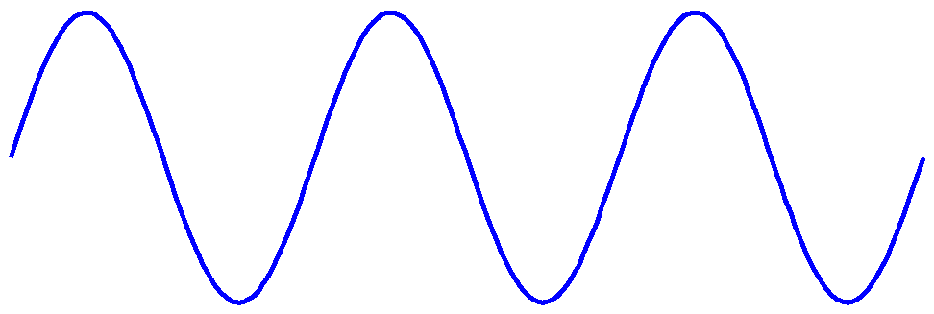










Doppler Frequency Shift
$$F_{c}$$
TX
RX
$$v$$
$$f^{D}=\frac{v}{c}⋅F_{c}$$
$$v$$
$$f^{D}=−\frac{v}{c}⋅F_{c}$$
$$v$$
$$f^{D}=0$$
$$θ$$
$$v$$
$$f^{D}=\frac{v}{c}{cos θ⋅F}_{c}$$
Doppler frequency shift is equivalent to the observed rate of the phase rotation at the RX
This rate is what our channel sounder can measure

Slide 4
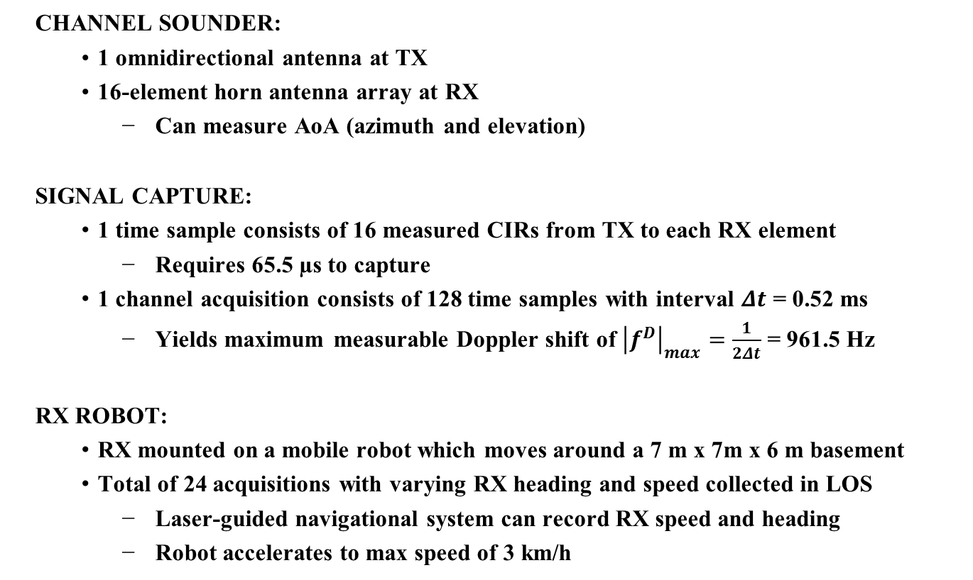
83 GHz Channel Sounder
CHANNEL SOUNDER:
  1 omnidirectional antenna at TX
  16-element horn antenna array at RX
    Can measure AoA (azimuth and elevation)
SIGNAL CAPTURE:
  1 time sample consists of 16 measured CIRs from TX to each RX element
    Requires 65.5 µs to capture
  1 channel acquisition consists of 128 time samples with interval $Δt$ = 0.52 ms
    Yields maximum measurable Doppler shift of ${\left|f^{D}\right|}_{max}=\frac{1}{2Δt}$ = 961.5 Hz
RX ROBOT:
  RX mounted on a mobile robot which moves around a 7 m x 7m x 6 m basement
  Total of 24 acquisitions with varying RX heading and speed collected in LOS
    Laser-guided navigational system can record RX speed and heading
    Robot accelerates to max speed of 3 km/h

Slide 5




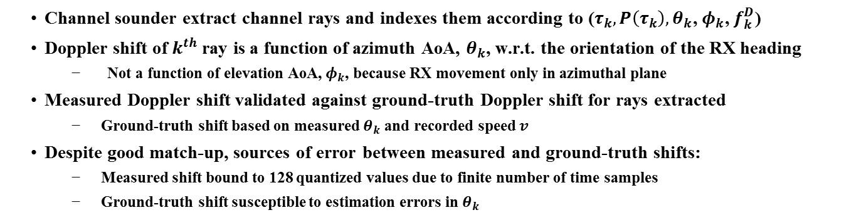

Ray Doppler Frequency Shift
$$v$$
$$θ_{k}$$
$$θ_{1}$$
$$θ_{3}$$
RX
$$θ_{2}$$
$f_{k}^{D}=\frac{v}{c}{cos θ_{k}⋅F}_{c}$
Channel sounder extract channel rays and indexes them according to ($τ_{k}{, P\left(τ_{k}\right),θ}_{k}$, $φ_{k}$, $f_{k}^{D}$)
Doppler shift of $k^{th}$ray is a function of azimuth AoA, $θ_{k}$, w.r.t. the orientation of the RX heading
  Not a function of elevation AoA,${ φ}_{k}$, because RX movement only in azimuthal plane
Measured Doppler shift validated against ground-truth Doppler shift for rays extracted
  Ground-truth shift based on measured $θ_{k}$ and recorded speed $v$
Despite good match-up, sources of error between measured and ground-truth shifts:
  Measured shift bound to 128 quantized values due to finite number of time samples
  Ground-truth shift susceptible to estimation errors in $θ_{k}$

Slide 6

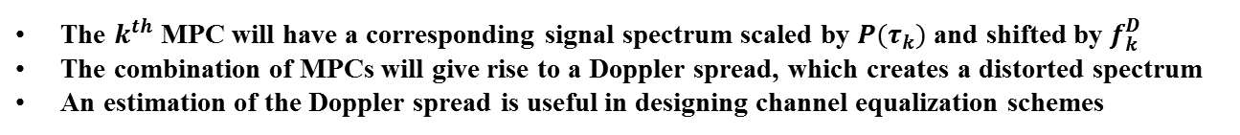









Doppler Frequency Spread
$$v$$
Distorted spectrum
$$P(τ_{1})$$
$$θ_{1}$$
$$θ_{3}$$
RX
$$P(τ_{2})$$
$$θ_{2}$$
$$P(τ_{3})$$
$$f_{k}^{D}=\frac{v}{c}{cos θ_{k}⋅F}_{c}$$
$$F_{c}+Δf_{1}$$
$$F_{c}+Δf_{2}$$
$$F_{c}+Δf_{3}$$
The $k^{th}$ MPC will have a corresponding signal spectrum scaled by $P(τ_{k})$ and shifted by $f_{k}^{D}$
The combination of MPCs will give rise to a Doppler spread, which creates a distorted spectrum
An estimation of the Doppler spread is useful in designing channel equalization schemes

Slide 7

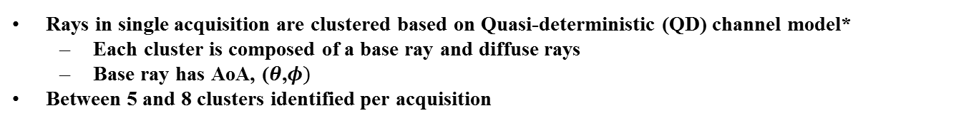



Ray Clustering
$$k$$
base ray
P
diffuse
rays
$$θ$$
$$k$$
$$k$$
QD CLUSTER MODEL
1 CHANNEL ACQUISITION
Rays in single acquisition are clustered based on Quasi-deterministic (QD) channel model*
  Each cluster is composed of a base ray and diffuse rays
  Base ray has AoA, ($θ$,$φ)$
Between 5 and 8 clusters identified per acquisition
*“Quasi-deterministic Approach to mmWave Channel Modeling in Non-stationary Environment,” Maltsev, Pudeyev, Karls, Bolotin, Morozov, Weiler, Peter, Keusgen, Globecom 2014.

Slide 8
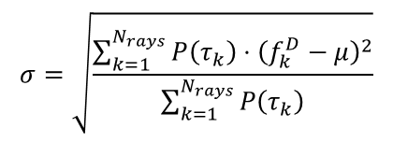

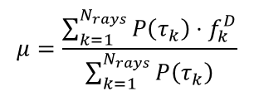
Doppler Spread Computation
RMS Doppler spread is computed from $N_{rays}$ rays within cluster:
$$σ=\sqrt{\frac{\sum_{k=1}^{N_{rays}}{P\left(τ_{k}\right)⋅{\left(f_{k}^{D}−μ\right)}^{2}}}{\sum_{k=1}^{N_{rays}}{P\left(τ_{k}\right)}}}$$
where $μ$ is the mean Doppler shift of the cluster:
$$μ=\frac{\sum_{k=1}^{N_{rays}}{P\left(τ_{k}\right)⋅f_{k}^{D}}}{\sum_{k=1}^{N_{rays}}{P\left(τ_{k}\right)}}$$
Because $σ$ will be scaled by $μ$, in order to combine the spreads from all the clusters from the 24 acquisitions, we compute the coefficient of variation:
$$CV=\frac{σ}{\left|μ\right|}$$

Slide 9
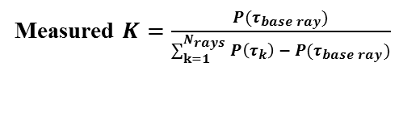



Quasi-deterministic K-factor
base ray
$$K$$
P
diffuse
rays
$$θ$$
Measured $K=\frac{P(τ_{base ray})}{\sum_{k=1}^{N_{rays}}{P\left(τ_{k}\right)} − P(τ_{base ray})}$
Model $\hat{CV}=\frac{20.8 dB}{\hat{K}(dB) +2.0 dB}+𝓝\left(0, 0.51\right)$
K-factor of QD model* measures the relative strength of the base ray w.r.t. the diffuse rays
Clusters with high K-factors have narrower spread because the diffuse rays are much weaker compared to base ray
Cluster with low K-factors have wider spread because the diffuse rays are comparable in strength to base ray

Slide 10

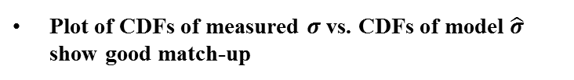





Doppler Spread Model
Measured coefficient of variation
$$CV=\frac{σ}{\left|μ\right|}$$
From measurements to model
$$\hat{σ}=\hat{CV}⋅\left|\hat{μ}\right|$$
$$\hat{μ} ≈\frac{v}{c}\cos{\hat{θ}⋅F_{c}}$$
From paper*
$$\hat{σ}=\hat{CV}⋅\frac{v}{c}|cos \hat{θ}{|⋅F_{c}}$$
$$\hat{CV}=\frac{20.8 dB}{\hat{K}(dB) +2.0 dB}+𝓝\left(0,0.51\right)$$
From measurements to model
$$\hat{σ}=\left[\frac{20.8 dB}{\hat{K}(dB)+2.0 dB}+𝓝\left(0,0.51\right)\right]⋅\frac{v}{c}|cos \hat{θ}{|⋅F_{c}}$$
Complete Doppler model
Plot of CDFs of measured $σ$ vs. CDFs of model $\hat{σ}$ show good match-up
*“Quasi-deterministic Model for Doppler Spread in Millimeter-wave Communication Systems,” J. Wang, C. Gentile, P.B. Papazian, J.-K. Choi, J. Senic, Submitted to IEEE Antennas and Wireless Propagation Letters.

