Slide 1
Ultra Low Power Strategies for Selective Wake-Up from Receiver Prospect
Date: 2017-01-16
Authors:

Slide 2
Abstract
This presentation shows:
sampling wake-up receivers offer ultra-low power consumptions below 10 µW
proposed 2-stage protocol for wake-up packet benefits from scalability of sampling WURs
combination of very low power capability with very high data rate (e.g. 250 kbps) is feasible
selective wake-up of groups (multicast/broadcast)

Slide 3
Relevant Proposed Issues
WUR Requirements [1]:
  Target power consumption of Wake-up radio < 100 µW
  OOK modulation scheme
  Narrow bandwidth (e.g. < 5 MHz)
  Latency < 100 ms
  Recent WUR publications exhibit power consumptions > 200 µW for 250 kbps data rate. Too high for many IoT applications [5].
Selective Wake-Up [3]:
  Not only individual, but group wake-up required (esp. for large networks)
  Keeps both latency and power consumption at a low value

Slide 4
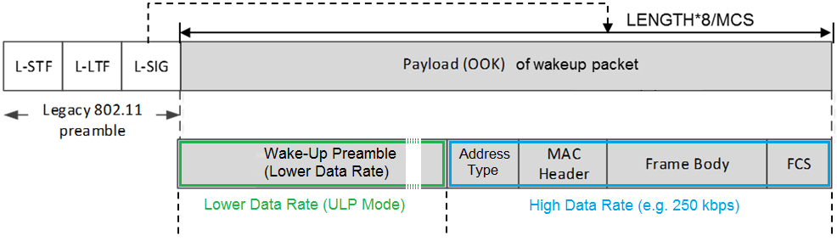
2-Stage Protocol: Two Different Data Rates
802.11 Compliant Wake-Up Packet scheme [2], [4]:
  OOK Wake-Up Packet with 250 kbps within OFDM scheme using 13 subcarriers, bandwidth: 4.06 MHz
Modification of wake-up packet, cf. [2]: Two data rates
    Preamble: lower data rate (reduces WUR listening power), e.g. 31-bit PN sequence for correlation.
    WUR ‘data’ (MAC address etc.): at 250 kbps

Slide 5
2-Stage Protocol: Two Different Data Rates
Modified wake-up packet:
  Slow WUR preamble is followed by high data rate block:
    Address type: individual/group/broadcast address mode (e.g. 8 bit)
    MAC header: MAC address (48 bit)
    Frame body: optional command code (e.g. 16 bit)
    FCS: e.g. 32 bit CRC
in total: e.g. 104 bit, 416 µs

Slide 6
Superregenerative Receiver
Operation [8]:
  Feedback within RF oscillator is periodically tuned from positive (stable) to negative feedback (oscillation) by quench signal
  Amplified RF antenna signal is fed into RF oscillator and shifts turnover
  point (start of oscillation)
  Good selectivity (RF BW < 10 MHz)
  Acts as always-on receiver,
  P_{WUR} = 200 .. 500 µW

Slide 7
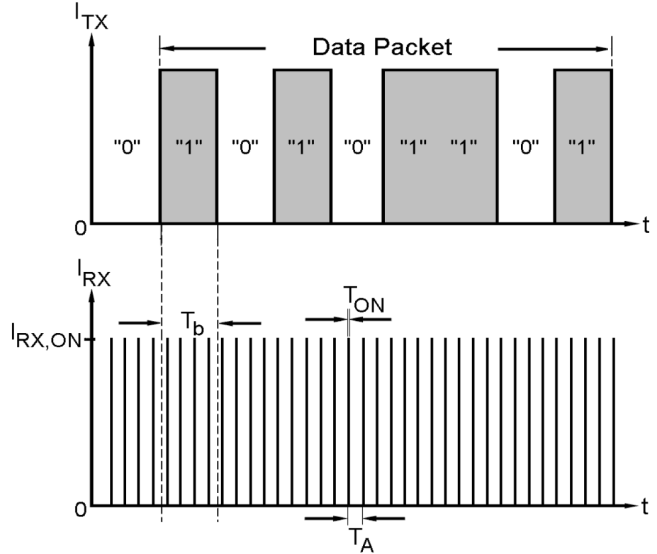
Sampling Receiver
Function Principle [9]:
  RF receiver front-end samples RF antenna signal within a very short
  period, e.g. 100 ns, and performs an
  OOK demodulation for each sample
  Between two samples the RX
  front-end is turned OFF
  The ratio of on-duty time interval
  T_{ON} and period T_{A} is chosen
  at a very low value, e.g. 0.1%
  power consumption ↓ : 1000
  Suitable for various data rates
  Internal RF oscillators calibrated
  XTAL oscillator at 32.768 kHz
  as reference needs ~ 1 µW

Slide 8
Dutycycling WUR vs. Sampling WUR (I/III)
  [6]: Superregenerative receiver, 215 µW @ 250 kbps. Dutycycling of WUR according to [1], slide 14.
  [7]: Sampling receiver with scalable data rate, suitable for ultra-low power consumption applications, but at lower data rates.
  [8]: Sampling Superregenerative WUR, scalable data rate. Extension to 250 kbps yields in 220 µW power consumption.
Cycle or Latency | DutyCycled WUR [6] incl. 1 µW XTAL Osc. 32 kHz | Sampling WUR [7] incl. 1 µW XTAL Osc. 32 kHz | Sampling Superregenerative WUR [8] incl. 1 µW XTAL Osc. 32 kHz
8 ms | 56 µW | 14 µW | 4.5 µW
15 ms | 30 µW | 7.4 µW | 2.8 µW
30 ms | 15 µW | 4.2 µW | 1.9 µW
60 ms | 8.2 µW | 2.6 µW | 1.4 µW

Slide 9
Dutycycling WUR vs. Sampling WUR (II/III)
CCI
2 ms
2 ms
2 ms
LP-WUR on
WUR off
LP-WUR on
WUR off
LP-WUR on
Dutycycling of Wake-Up Receiver (packetwise):
  e.g. WUR 2 ms ON, 98 ms OFF (cf. [1], pp. 12-14)
    reduces average WUR power consumption, but inserts new latency
    in case of interfered 2-ms-packets (CCI): packet lost/missed,
    latency becomes N · 100 ms
Sampling Wake-Up Receiver:
  data reception spread over multiple, short samples
  in case of a 2-ms-interferer: only parts of packet lost, errors are tolerable due to FEC → higher robustness
WUR active: Short samples
...
Wake-Up packet (LDR)

Slide 10
Dutycycling WUR vs. Sampling WUR (III/III)
CCI
2 ms
2 ms
2 ms
LP-WUR on
WUR off
LP-WUR on
WUR off
LP-WUR on
Dutycycling of Wake-Up Receiver (packetwise):
  shortest on-duty time limited due to settling time (~ 1 µs)
    of analog components (filters, amplifiers, bandgap ref.s)
    of low frequency oscillators (XTAL, RC ..)
Sampling Wake-Up Receiver:
  on-duty time optimized to low values < 100 ns
  use of fast-settling components (filters, oscillators, amplifiers)
  with settling times of 10 ns .. 30 ns
  power consumption gets lower
WUR active:
Short samples
...
Wake-Up packet (LDR)

Slide 11
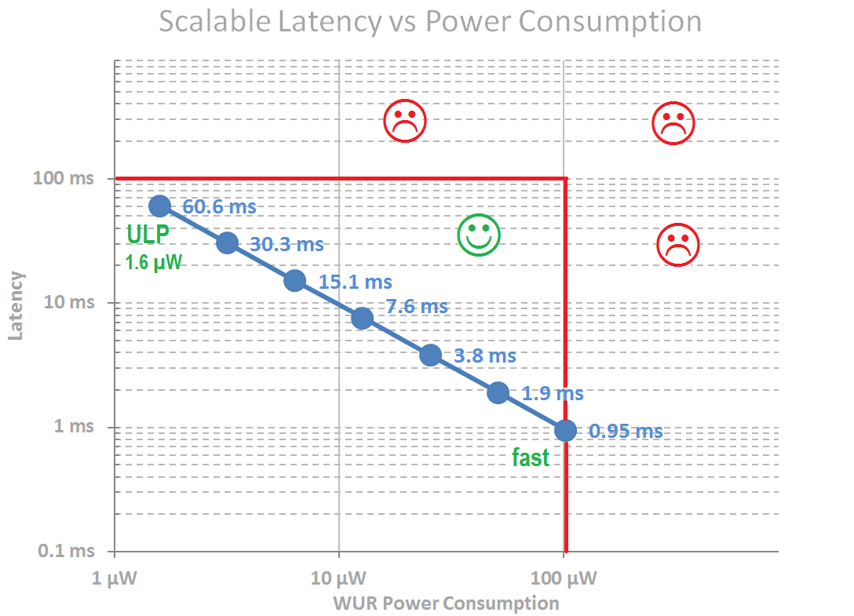
Scalability of Power Consumption and Data Rate
Sampling receiver [7]
  Wake-up preamble duration vs
  power consumption trade-off
  Data rate can be freely chosen
  and extended up to 250 kbps
  Preamble detection is tolerant
  towards bit
  Suitable for 2-stage protocol:
    Ultra-low power mode for e.g.
    15.1-ms-wake-up preamble: 6.4 µW
    high data rate mode for residual
    wake-up packet data (e.g. 820 µW@250 kbps using [7])

Slide 12
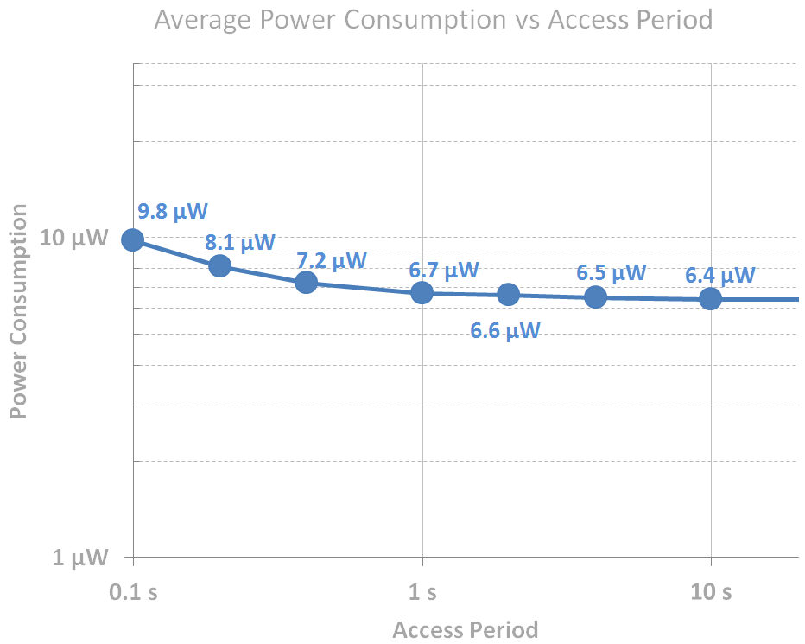
Investigation on Periodic Wake-Up Access
Ultra-low power mode of sampling WUR [7]
  suitable for continuous
  preamble WUR listening
  access period is dependent of
  user activity or other events
  802.11 wake-up poll every
  2 seconds yields in 5.7 µW
  preamble power mode deter-
  mines minimum average power
  consumption of WUR, here
  i.e. 6.4 µW (preamble: 15.1 ms)
  total WUR packet: 15.52 ms
  NB: LR44 (130 mAh) supplies 7 µW for 3 years

Slide 13
Conclusions
Sampling wake-up receivers offer ultra-low power consumptions below 10 µW
The proposed 2-stage protocol for wake-up packet benefits from scalability of sampling WURs
Combination of very low power capability with very high data rate (e.g. 250 kbps) is feasible
Sampling WUR offer higher robustness in case of interference

Slide 14
References
[1] IEEE 802.11-16/0027r0, “LP-WUR (Low-Power Wake-Up Receiver): Enabling Low-Power and Low-Latency Capability for 802.11”
[2] IEEE 802.11-16/0341r0, “LP-WUR (Low-Power Wake-Up Receiver) Follow-Up”
[3] IEEE 802.11-16/0950r0, “Considerations on WUR Design”
[4] IEEE 802.11-16/1506r1, “Coexistence Mechanism for Wakeup Radio Signal (follow-up)”
[5] IEEE 802.11-1045r09, “A PAR Proposal for Wake-up Radio”
[6] J. Ayers, K. Mayaram and T. S. Fiez, "An Ultralow-Power Receiver for Wireless Sensor Networks," in IEEE Journal of Solid-State Circuits, vol. 45, no. 9, pp. 1759-1769, Sept. 2010.
[7] J. Robert, T. Lindner and H. Milosiu, "Sub 10µW wake-up-receiver based indoor/outdoor asset tracking system," 2015 IEEE 20th Conference on Emerging Technologies & Factory Automation (ETFA), Luxembourg, 2015, pp. 1-3.

Slide 15
References
[8] M. Eppel, H. Milosiu and F. Oehler, "A novel 1 μW super-regenerative receiver with reduced spurious emissions and improved co-channel interferer tolerance," 2016 IEEE Topical Conference on Wireless Sensors and Sensor Networks (WiSNet), Austin, TX, 2016, pp. 85-88.
[9] H. Milosiu et al., "A 3-µW 868-MHz wake-up receiver with −83 dBm sensitivity and scalable data rate," 2013 Proceedings of the ESSCIRC (ESSCIRC), Bucharest, 2013, pp. 387-390.

