Slide 1
Technical Topics for IoT/IoL (Internet of Lights) based LiFi/OCC Technology
Date: Jan 18, 2017
Authors:

Slide 2
SNUST, Technical Topics for IoT/IoL (Internet of Lights) based LiFi/OCC Technology
Vinayagam Mariappan [SNUST]
Jaesang Cha [SNUST]
IoT: Internet of Things
OCC: Optical Camera Communications
Slide 2
Notes:
doc.: IEEE 802.15-09-0117-00-0007
<month year>

Slide 3
Contents
What is IoT/IoL based LiFi/OCC Technology?
Concept of IoT/IoL based LiFi/OCC Technology
Application example of IoT/IoL LiFi/OCC Technology
Conclusions
Jaesang Cha, Seoul National Univ. of Science & Tech.

Slide 4
What is IoT/IoL based LiFi/OCC Technology?
Definition of IoT/IoL LiFi/OCC
  Next Generation Technology newly incorporating LiFi/OCC by using light sources of Light Things of IoL (belonging to IoT) based Light Things.
  IoT/IoL is aimed to deliver a variety of information such as advertisement, promotion, positioning, etc. And it can be used as solutions for various fields/use cases.
Tx/Rx Concept for IoT/IoL based LiFi/OCC Technology
  Tx : A variety of Light Things (Displays, Signage, Smart Device Displays, etc.)
  Rx: Various Rx devices (photo detector, image sensor, etc.)

Slide 5


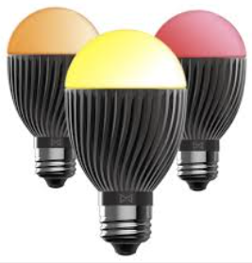

Concept of IoT/IoL based LiFi/OCC Technology
IoT(Internet of Things) Concept
Various Things Connected Based on IP
Supports Any Things based service regardless of Anytime or Anyplace
IoT Things
Light
Things
IoL(Internet of Lights) Concept
IoT/IoL Concept
Things included in IoT as Light Things that generate light themselves
IoL is important to maintain compatibility with existing IoT functions.
Supports Light Things based service regardless of Anytime or Anyplace
Additional grafting technologies include Light-based OWC
Tx : A variety of Light Things (Displays, Signage, Smart Device Displays, etc.)
Rx : A variety of Rx devices (photo detector, image sensor, etc.)

Slide 6


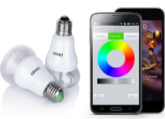

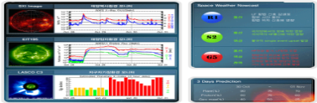




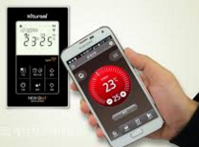
Application example of IoT/IoL based LiFi/OCC Technology
IoL based Comm. (OWC)
IoL Transportation
Smart Lights Control
Signage
LiFi, OCC, LED-ID etc.
Smart signal, traffic management
Remote & RGB control, emotional lighting
Signage lighting control and comm.
Environment
(Management / Monitoring)
Eco-friendly energy management
Farming
Medical (healthcare)
Smart fire alarm, security surveillance
Energy metering, lighting control
and management
IoL agricultural lighting
equipment, monitoring
Healthcare, Endoscopic Illumination
IoT/IoL based LiFi/OCC technology is aimed to deliver a variety of information such as advertisement, promotion, positioning, etc.
And it can be used as solutions for various fields/use cases.

Slide 7
Conclusions
In this presentation, we proposed IoT/IoL based LiFi/OCC concept and some application examples for IoT/IoL technology.
Also, we can offer various application solutions for IoT/IoL based LiFi/OCC technology.

