Slide 1
Link Transmit Power (LTP)
Date: 2017-04-21
Authors:

Slide 2
Abstract
Transceivers can benefit from increased EVM when compared to EVM requirements in the spec
Due to Tx Beamforming, delay spread, Doppler, receiver design, expected variation in operating conditions, e.g. temperature, voltage, ageing, etc.
Existing EVM spec targeted to SISO, CDD
We show both simulation results and measurement data to justify our proposal
Proposal provides a means for TX Power modification per link
Per request of the recipient and approval of the transmitter
Signaling through elements and management frames

Slide 3
CID 8098
Add a mechanism to set the transmit power per direction per link in order to achieve an increase in performance due to improved receiver design since the original EVM specification was written. | Add a mechanism to set the transmit power per direction per link in order to achieve an increase in performance due to improved receiver design since the original EVM specification was written. Expect a submission detailing some changes.

Slide 4
Rationale
Reasons to expect that EVM can be increased over EVM in the spec:
LDPC requires less stringent EVM requirements
TX EVM varies over operating condition, but TX PA set for worst case
Beamforming (NTX > NSS) accommodates relaxed EVM
TX Power is typically conservative due to implementation variance and measurement precision
Channel delay spread is not known at transmitter
Doppler is not known at transmitter
TX EVM defined in standard was low bar for receiver design expectations a few years ago
Modern receivers can typically handle increased EVM due to LDPC, etc.
Additional receiver design improvements are likely in the future
TX EVM defined in standard was based on SISO, CDD

Slide 5
LTP Benefits
Link Transmit Power signaling closes the loop with the receiver
Allowing accuracy in TX Power setting to match (or exceed) TX EVM, receiver capability, channel condition, etc, which transmitter cannot determine
Link Transmit Power signaling mechanism allows:
Increase in TX Power per MCS to allow higher MCS use
Reduction in TX Power to aid in system wide spatial reuse

Slide 6
Transmitter Self Adjustment
Transmitter may be able to make TX power adjustments to account for:
Precoding Scenario (8x2, 4x2, 2x2, using beamforming or spatial expansion)
PA characteristic, e.g. non-linearity, with margin for uncertainty in measurement and for dynamic operating condition changes, e.g. voltage, temperature, ageing
A typical implementation shows an average of 1.5 dB of margin
However, transmitter cannot make adjustments to account for channel condition (Doppler and Delay Spread) and receiver characteristics
Receiver can measure channel effect and request power increase or decrease to optimize link and system gain

Slide 7
Simulation Conditions, Gain Metric
TSIM = Theoretical simulation model, not an architectural model
E.g. ideal channel estimates, floating point math
PA simulated is lab measured Skyworks PA (SKY85302-11)
Using Channel B NLOS 80MHz, and D NLOS 80MHz
For NSS=2: tested scenarios are Precoding NTX=4 x NRX=2 and NTX=8 x NRX=2.
For NSS=1: tested scenarios are Precoding NTX=4 x NRX=2 and NTX=8 x NRX=2.
Reference scenario is nominal OBO: power that yields standard specified TX EVM with 1.5dB margin.
1.5 dB margin based on practical Tx power accuracy used in APs
For each scenario we mark the OBO which optimizes link budget for 10% PER
The optimal OBO is achievable in a closed loop system that controls Tx power based on measured distortion at the receiver
The difference between the optimal OBO and nominal OBO minus the sensitivity change is the LTP gain we could achieve by letting receiver request transmit power.

Slide 8
Simulation Configuration
N_{TX}=4 and N_{RX}=2
Channel configured for an average attenuation of 0dB
A particular channel draw can have different attenuation
Receiver noise power, P_{RX_NOISE} , is fixed for a desired SNR range around sensitivity
Using the predefined average channel attenuation
Receiver signal power, P_{RX}, is random according the channel draw
Beamforming gain depends on channel draw too
The simulation sweeps on transmitted power P_{TX} , at a given OBO and finds the PER threshold of 10%
Actually, the channel is considered as black box and the simulation controls P_{TX}(OBO) and P_{RX_NOISE}
P_{RX_NOISE}
P_{TX}
Channel
P_{TX}
P_{RX}
+
P_{TX}
P_{RX}
P_{TX}
+
P_{RX_NOISE}

Slide 9
Simulation Results
For each MCS we plot
SNR threshold (i.e. required for 10% PER with 1.7kB packets) as function of OBO
EVM as a function of OBO (green curve)
EVM is computed and plotted for 2x2 MIMO case, Nss=2, using direct mapping (measurement described in IEEE Std 802.11-2016 21.3.17.4.3)
Allowed relative constellation error (EVM Spec) is also marked as a black vertical line
Precoder is normalized to have same power for all antennas, thus precoded signal also obeys same OBO to EVM (green) curve
OBO setting marked by diamond is the OBO value which maximizes system gain min (Psat/N0)=min (OBO+SNR).

Slide 10
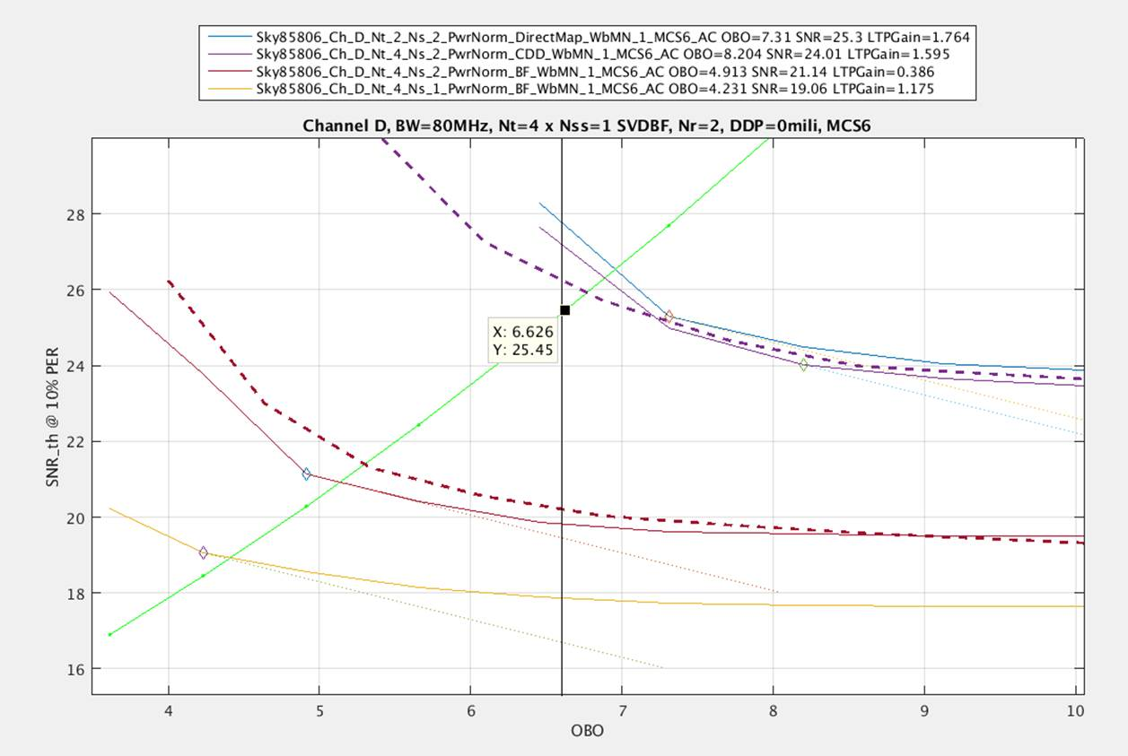
Theoretical sim vs Lab measurements Chan D 80 MHz MCS6
SNR_th is receiver’s SNR measured at Modem input
Noise term is AWGN
Dashed curves are from lab
EVM whitening in TSIM improves match
TSIM discards RF impairments except for PA distortion
TSIM uses ideal CE
Curves were scaled according to TSIM vs. ASIM
4.8dB for BF
3dB for CDD
* ASIM = architectural model
E.g. fixed point math using system component modules
Dashed lines are MEASURED results

Slide 11
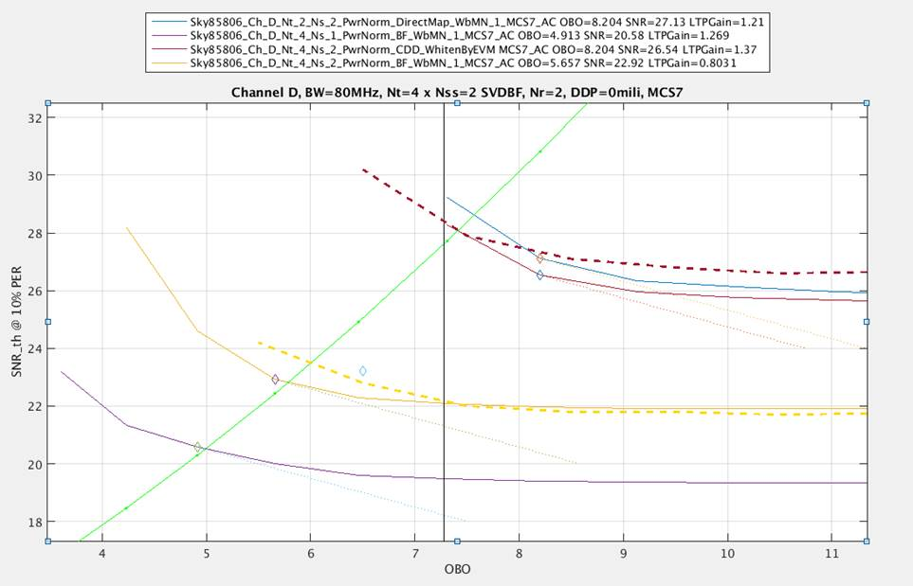
Theoretical sim vs Lab measurements Chan D 80 MHz MCS7
SNR_th is receiver’s SNR measured at Modem input
Noise term is AWGN
Dashed curves are from lab
EVM whitening in TSIM improves match
TSIM delay diversity in CDD is larger than that of chip which improves TSIM
TSIM discards RF impairments except for PA distortion
TSIM used ideal CE
Curves were scaled according to TSIM vs. ASIM
4.8dB for BF
3dB for CDD
Dashed lines are MEASURED results

Slide 12
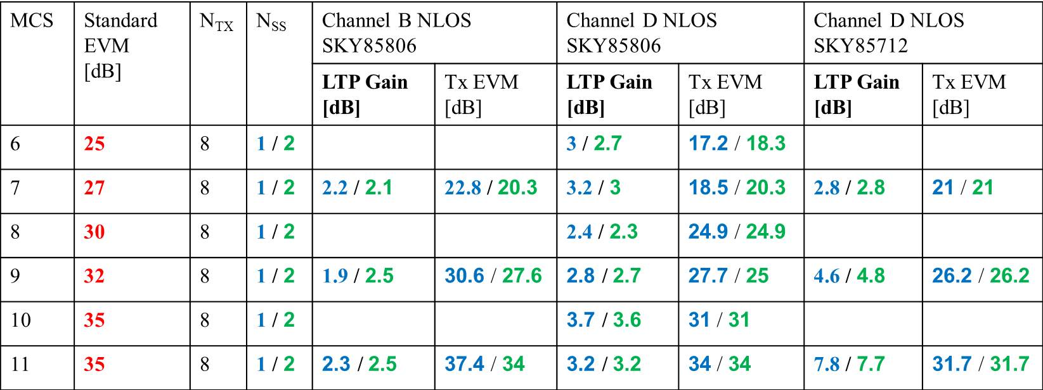
LTP Gain Summary
LTP Gain is based on simulated SVD-BF system at optimal OBO vs. OBO of standard EVM + 1.5dB (practical margin for Tx power control accuracy)
BW=80MHz, N_{RX}=2
Min value
Max value

Slide 13
Conclusion
Link budget increase of 2~7dB for a beamformed system based on LTP
“EVM rejection” of beamforming allows Tx power increase
Tx EVM isn’t beamformed as opposed to the desired signal
Beamformed system tolerates relaxed EVM
1.5dB of the Tx power control margins are regained (which are practically taken to assure standard EVM compliance)
Close loop established by EVM measurements at the receiver eliminate these margins
Optimal Tx power isn’t visible to the transmitter
Depends on PA nonlinear response
Depends on channel
LTP based on EVM estimation and Rx performance controls Tx power and increase link budget

Slide 14
Proposed Draft Changes
Link Transmit Power

Slide 15
LTP Signaling
Add capability of a receiver to request transmitter power per MCS for this link
Within regulatory limits
Not to affect transmitter power on other links with the same STA
Hence, Link Transmit Power
A STA requests a higher power per MCS at its own estimate/risk
LTP requester
Power can be re-adjusted at any time
Per new request from LTP requester
Per LTP responder initiative accompanied by unsolicited LTP response to inform LTP requester of the change
Use a new LTP Request / LTP Response exchange

Slide 16
Add a capability indication
Extended Capability information element (IE)
Existing location for dot11 type-independent features
E.g. this feature can be used by any letter designation
E.g. 11n, 11ac, 11ax, 11afuture
Link Transmit Power capability bit
Not clear that this bit is really needed
No reason why a STA could not send the new element to anyone and if they do not recognize it, they do nothing
If they do recognize it, they could still refuse to cooperate
If they do recognize it, they will respond

Slide 17
Add an information element
Link Transmit Power (LTP) information element
Used to communicate request from receiver to transmitter
Increase/decrease TX Power per MCS
New element can be included in various management frames
Most likely a new Public or Protected Dual of Public Action
No response required (other than ACK)
Transmitter either complies with request or does not comply
If Transmitter makes changes, then it must inform the receiver by sending an LTP element as a response

Slide 18
Add a management action frame
Add to Public and Protected Dual of Public
To avoid type-specific categories

Slide 19
LTP Requester Behavior
STA which transmits an LTP IE request
Does not know exactly how much change in EVM might result at a given MCS for a given amount of TX power change
Estimate is possible if LTP requester sees transmissions from LTP responder at various MCS and power combinations to allow it to make measurements
Otherwise, LTP requester might have to try a few times to find a comfortable value
Desirable to include a test frame
NDP included in specific exchanges (see later slides)
If LTP request is not accepted, then no new request allowed for X ms

Slide 20
LTP Responder Behavior (1)
LTP responder (LTP IE recipient) can choose to use or ignore the LTP IE information
LTP responder might not be able to raise TX power – it might already be at the regulatory or TPC limit
LTP responder might not desire to raise TX power in order to manage spectrum
E.g. cooperative arrangement with neighbors for spatial reuse/interference management
E.g. in a managed environment
If LTP responder chooses to change transmit power, it must inform the LTP requester (LTP IE sender)
Sends an LTP response if raising or lowering TX power

Slide 21
LTP Responder Behavior (2)
TX EVM excursions limited to DATA-bearing frames
TX EVM excursions not allowed for CTRL subtypes
Transmitted in non_HT format
e.g. RTS, CTS, BA, ACK

Slide 22
Proposed Changes Summary (1)
Add a capability bit
Extended Capability IE – preferred location for generic features
Add a new LTP IE
To carry a list of requested or used PABO_{MCSn} values
Allow the LTP IE to be transmitted within various management frames
E.g. Association Request, Association Response, Action, etc
Add a new Management Action frame
To allow post-association requests/changes to be communicated
No requirement for recipient to obey the request
But LTP responder must inform LTP requester if LTP responder makes any TX power changes, requested or self-initiated

Slide 23
Proposed Changes Summary (2)
Change TX EVM rules
Allow transmitter to exceed TX EVM requirements when LTP requester sends LTP request that would cause EVM limits to be violated
LTP requester is specifically indicating that it has no problem with the expected increase in EVM
No change to other TX power related rules
Jurisdictional regulatory limits still apply
TPC limits still apply
AP self-imposed limits apply
Recommend addition of test frame transmissions
E.g. NDP before Beacons

Slide 24
Straw poll #1
Do you support the concept of Link Transmit Power as outlined in the previous slides, without the requirement to send an NDP?
Y
N
A

Slide 25
Straw poll #2
Do you support the requirement that an NDP is transmitted by an LTP as outlined in the previous slides?
Y
N
A

Slide 26
Straw poll #3
Do you support to resolve CID 8098 by adopting the text of 11-17-0123-01-00ax-Link-Transmit-Power-Text?
Y
N
A

Slide 27
Straw Poll PHY #1
Do you support the concept of allowing a transmitter, per request of a receiver, to violate existing TX EVM by increasing the TX Power for transmissions to that requester?
Y
N
A

Slide 28
Annex 1
Link Transmit Power Specific Proposed Changes

Slide 29
Ext Cap IE: add a capability indication
Extended Capability information element (IE)
Link Transmit Power capability bit
Ext Cap IE is the location for dot11 type-independent features
i.e. this feature can be used by any letter designation
E.g. 11n, 11ac, 11ax, 11future
Set by AP and by non-AP STA that support LTP
Acts as implicit NDP request
See next slide

Slide 30
Implicit NDP Request
When Ext Cap LTP bit is set by an AP
AP should transmit NDP, SIFS before each DTIM Beacon
Using TX Power indicated in the Beacon
E.g. TPC Report, Power Capability, LTP IE
NDP transmitted using all TX antennas
When Ext Cap LTP bit is set by non-AP STA and AP also has the bit set
Non-AP STA should transmit an NDP SIFS following the ACK of its Association Request transmission
Using TX Power indicated in the Association Request
E.g. TPC Report, Power Capability, LTP IE
NDP transmitted using all TX antennas

Slide 31
Add an information element
Link Transmit Power (LTP) information element
Used to communicate request from receiver to transmitter
Used to communicate actual values from transmitter to receiver
New element can be included in various management frames
Public Action and Protected Dual of Public Action
New Public Action LTP
(Re)Association request, (Re)Association response, Beacon, Probe Response
LTP Response is only required when changing PA Backoff (PABO) values
In response to LTP Request and when unilaterally changing PABO values

Slide 32
Link Transmit Power Parameters
Link Transmit Power IE contents:
Transmit power suggestion or report per MCS
Value of dB [-23, 40.5]
Transmitting STA can provide as many or as few constellation/coding combinations as it desires per request
Transmitting STA can change values as frequently as it desires
Receiving STA can use the information or ignore it

Slide 33
LTP IE Format
 | Element ID (= 255) | Element Length | Element ID Extension (=<ANA>) | LTP Control | LTP Information
Octets: | 1 | 1 | 1 | 4 | variable
Uses Element ID Extension
Element ID = 255
Element ID Extension assigned by ANA
Link Transmit Power Information field contents:
Series of one-octet transmit power values
One octet per Constellation/encoding (i.e. one per MCI)
MCI = MCS Index
Not necessary to include an octet for every constellation/encoding value

Slide 34
LTP control field
 | B0 | B1 B15 | B16 | B17 | B18 B20 | B21 | B22 B23 | B24 B31
 | LTP Report | LTP MCI Bitmap | TXBF Present | NTXBF Present | Supported Modes | Absolute | Reserved | Transmit Power
Bits: | 1 | 15 | 1 | 1 | 3 | 1 | 2 | 8
LTP Report
LTP Report = 0 indicates a request for the LTP responder to modify TX Power settings according to the accompanying LTP Information
LTP Report = 1 indicates employed values at the LTP responder
LTP MCI Bitmap
Bitmap of MCI (MCS Index) values, e.g.
Value of 1 in bit position B3 means MCI value 2 transmit power information field is present
Value of 0 in bit position B3 means MCI value 2 transmit power information field is absent
TXBF Present, NTXBF Present
Indicates if MCI power values are present for TXBF case, Non TXBF case – entries are in MCI pairs when both are present
Supported Modes
Bitmap of SU, OFDMA (non-MU MIMO), Reserved, when the LTP is a request
Reserved when the LTP is a Report
Reserved -> requested MCS, Ntx for LTP response
Alternative = copy the request LTP PPDU parameters, except for NTX
Absolute
Indicates if MCI TX Power field encoding represents Absolute dBm or Relative dBm (see later slide)
Transmit Power
Same as the field in the TCP Report IE

Slide 35
MCI Encoding
MCI Value | Constellation, Encoding
0 | BPSK, ½, DCM
1 | BPSK, ½
2 | QPSK ½
3 | QPSK ¾
4 | 16QAM ½
5 | 16 QAM ¾
6 | 64QAM 2/3
7 | 64 QAM ¾
8 | 64 QAM 5/6
9 | 256 QAM ¾
10 | 256 QAM 5/6
11 | 1024 QAM ¾
12 | 1024 QAM 5/6
13 – 14 | Reserved
Independent of BW

Slide 36
LTP Information field
 | B0 B6 | B7
 | MCI TX Power | Reserved
Bits: | 7 | 1
LTP Power Entry field
LTP Information field contains 0 or more octets
Each octet is an LTP Power Entry field
One octet per constellation/encoding-transmit power pair
As many octets present as needed, as indicated in the LTP MCI Bitmap
MCI TX Power
See next slide

Slide 37
MCI TX Power Field Encoding
Maximum transmit power per MCI in dBm
Absolute = 1
Unsigned integer (range [0,127])
TXP_{MCI} in dBm = MCI TX Power / 2 – 23
i.e. MCI TX Power = [-23, 40.5] dBm, 0.5 dB steps
Absolute = 0 (i.e. relative)
Unsigned integer (range [0,127])
TXP_{MCI} in dBm = TXP_{MCS0} – (MCI TX Power / 2 – 23)
i.e. MCI TX Power = TXP_{MCS0} - [-23, 40.5] dBm, 0.5 dB steps

Slide 38
Bidirectional LTP Exchange
A single MPDU may contain two LTP IE
Provided that:
One LTP IE has Request = 0
i.e. response to previous LTP IE Request = 1
One LTP IE has Request = 1
i.e. request to STA to which it is sending a response
Allows fewer frames in exchange to establish bidirectional LTP setup
E.g. during Association Request/Response exchange sequence

Slide 39
Add LTP Action to Public Category
 | Category (=4) | Public Action = <ANA>) | LTP Information IE
Octets: | 1 | 1 | Variable
Category is Public (=4) or Protected Dual of Public (=9)
To avoid type-specific categories
Action (=<ANA>)
LTP
Body is LTP Information IE

Slide 40
TX EVM Rules
Change existing standard language TX EVM rule
Current language includes mandatory EVM requirements
LTP IE TX power increase request is an indication that the recipient can handle increased EVM
Third party receivers might have trouble with the increased EVM
But these devices are usually unlikely to successfully decode the PPDU payload anyway because of MCS mismatch to their path
These devices are more and more likely to sleep during the PPDU payload portion when the PPDU is not for them
Allow transmitter to exceed EVM requirement when recipient explicitly allows it through the LTP IE
TX EVM excursions limited to DATA-bearing frames
Not allowed for RTS, CTS, BA, ACK

Slide 41
Reporting Baseline TX Power
LTP Request can be written to express either:
Relative TX Power Requested
Stateful, requires requester to know and remember what transmitter has done with TX Power setting
Absolute TX Power Requested
Stateless = preferred
In order for an LTP Requester to be able to request an absolute TX Power level, the requester needs to know:
What was the TX Power level of the PPDU that the requester examined in order to determine that a new TX Power level is desired?
Requires element for reporting – make the following mandatory:
TX Power Capability Element
TPC Report Element (and the transmission of this element in response to a request)
Additionally, STAs should be able to interpret:
TX Power Constraint Element
Transmit Power Envelope Element
Require that MCS0 power corresponds to the reported TX Power

Slide 42
Annex 2
Link Transmit Power

Slide 43
LTP effect on MCS Selection
Depends on how MCS selection is implemented
E.g. MCS selection is based on SINR estimate vs family of SINR-PER curves
Choose “a good PER” from all curves at a given SINR estimate
Can treat TX power changes as a shift in the SINR-PER curve for each MCS which has an adjusted PABO value
In general
Transmitter must be aware that SINR of link is MCS dependent

Slide 44
Identifying the Source of the PPDU
When TX Power has been adjusted higher
It is necessary to identify the source of a PPDU at the receiver location at the beginning of the reception
To adjust the receiver to accommodate the specific EVM of the transmitter
I.e. to differentiate PPDUs from transmitters employing LTP and those not employing LTP
E.g. an AP that receives PPDUs from many sources, some of which are using LTP and some of which are not
It is important to NOT adjust the receiver for a transmission when the transmission is not utilizing a higher LTP for a given MCS

Slide 45
RTS-CTS Based Source Information
Transmitter uses RTS-CTS exchange before the transmission of the LTP DATA PPDU
Based on the RTS TA value, the intended recipient knows the source of the upcoming DATA PPDU before the reception begins
E.g. recipient assumes that DATA PPDU source is the same as the RTS source
E.g. DATA PPDU source = STA corresponding to RTS TA value
E.g. LTP is NOT applied to the RTS
Or the CTS
This should be the standard method for determining the source of a DATA frame transmitted using LTP
Source “estimate” is possible when RTS-CTS is not present (See Annex)

Slide 46
Association Exchange Example
NDP
DTIM Beacon
AssReq
ACK
NDP
AssRep
ACK
LTP Action
ACK
Optional exchange
AP Transmissions
Non-AP STA Transmissions
Non-AP STA has measured EVM from AP using the NDP preceding the Beacon reception
Allows non-AP STA to request modified AP TX Power within Association Request by including LTP IE
AP measures EVM of non-AP STA using the NDP following the Association Request ACK
Allows the AP to request modified non-AP STA TX Power within the Association Response by including LTP IE
Bidirectional exchange allowed (LTP Request and Response in one frame)
Optional exchange completes bidirectional setup (non-AP STA response)

Slide 47
TX Power Reporting
LTP Element
Power Capability Element
TPC Report Element
Transmit Power Envelope Element

Slide 48
Annex 3
Simulation Summary

Slide 49
Distortion related SNR Loss Estimation
We show that SNR loss due to distortion is reduced in precoding scenarios, this allows working at lower OBO (achieving higher system gain)
$$SNR_{Loss}=10·log10\left(1+SNR0_{rxant}∙EVM∙\frac{G_{D_{TXBF}}}{G_{TXBF}}\right)$$
Where
$SNR0_{rxant}=\frac{P_{txant}∙N_{tx}∙PL∙\frac{N_{tx}}{N_{s}}}{σ_{n}^{2}}$ - Receive SNR thresh (e.g. 10% PER) required by the uncompressed link
$G_{TXBF}=\frac{N_{tx}}{N_{s}}$ is the beamforming gain on the signal
$G_{D_{TXBF}}=\frac{D_{PrecoderSubspace}}{D_{AntennaSpace}}$ is the beamforming effect on distortion.
$EVM=\frac{\min_{G_{c}}{{\left|f_{nl}\left(IDFT\left(Vx\right)\right)−G_{c}∙IDFT\left(Vx\right)\right|}^{2}}}{P_{txant}∙N_{tx}∙G_{C}^{2}}$

Slide 50
References
[1] 11-17-0123-01-00ax-Link-Transmit-Power-Text.docx
[2] 802.11-2016.pdf
[3] Draft P802.11ax_D1.2.pdf

