Slide 1
Link Transmit Power (LTP)
Date: 2017-03-15
Authors:

Slide 2
Abstract
Transceivers can benefit from increased EVM when compared to EVM requirements in the spec
  Due to Tx Beamforming, delay spread, Doppler, receiver design, etc.
  Existing EVM spec targeted to SISO, CDD
We show both simulation results and measurement data to justify our proposal
Propose to provide means for TX Power modification per link
  Per request of the recipient and approval of the transmitter
  Signaling through elements and management frames
Link Transmit Power signaling mechanism creates benefits:
  Increase in TX Power per MCS to allow higher MCS use
  Reduction in TX Power to aid in system wide spatial reuse

Slide 3
CID 8098
Add a mechanism to set the transmit power per direction per link in order to achieve an increase in performance due to improved receiver design since the original EVM specification was written. | Add a mechanism to set the transmit power per direction per link in order to achieve an increase in performance due to improved receiver design since the original EVM specification was written. Expect a submission detailing some changes.

Slide 4
Rationale
Reasons to expect that EVM can be increased over EVM in the spec:
  LDPC requires less stringent EVM requirements
  TX EVM varies over operating condition, but TX PA set for worst case
  Beamforming (NTX > NSS) accommodates relaxed EVM
  TX Power is typically conservative due to implementation variance and measurement precision, ~1.5 dB
  Channel delay spread is not known at transmitter
  Doppler is not known at transmitter
TX EVM defined in standard was low bar for receiver design expectations a few years ago
  Modern receivers can typically handle increased EVM due to LDPC, etc.
  Additional receiver design improvements are likely in the future
TX EVM defined in standard was based on SISO, CDD

Slide 5
LTP Additional Use
Link Transmit Power signaling mechanism allows:
  Increase in TX Power per MCS to allow higher MCS use
  Reduction in TX Power to aid in system wide spatial reuse

Slide 6
Transmitter Self Adjustment
Transmitter may be able to make TX power adjustments to account for:
  Precoding Scenario (8x2, 4x2, 2x2, using beamforming or spatial expansion)
  PA characteristic, e.g. non-linearity
However, transmitter may not be aware of channel (Doppler and Delay Spread) and receiver characteristics
Receiver can measure channel effect and request power increase or decrease to optimize link and system gain
We simulate possible gains as a result of EVM requirement modification

Slide 7
Receiver Based Adjustment
Receiver determines amount of adjustment and signals to transmitter to modify PA backoff through LTP
Receiver method for determination of adjustment:
  Make adjustment table through a-priori simulations such as shown in this presentation
    Transmitter always starts a new link with TX power table set according to specified EVM
  Trial and error – suggest modifications and measure the result
  Use receiver-side estimation of EVM

Slide 8
Simulation Conditions, Gain Metric
    PA simulated is lab measured Skyworks PA (SKY85302-11)
    Using Channel B NLOS 80MHz, and D NLOS 80MHz
    For Nss=2: scenarios are Precoding N_{TX}=4 x N_{RX}=2 and N_{TX}=8 x N_{RX}=2. Reference scenario is N_{TX}=2 x N_{RX}=2 MIMO with direct mapping.
    For Nss=1: scenarios are Precoding N_{TX}=4 x N_{RX}=2 and N_{TX}=8 x N_{RX}=2. Reference scenario is CDD with N_{TX}=4 x N_{RX}=2, Nss=1
    For each scenario N_{TX} x N_{RX} we mark the OBO at which transmit distortion increases required SNR (for 10% PER) by 1dB from ideal
      This OBO is considered a conservative OBO at which the link should operate
    The difference between OBO of precoded (4x2 or 8x2) link and the 2x2 link is considered as the LTP gain we could achieve by letting receiver request transmit power.

Slide 9
Simulation Results
  For each MCS we plot
    SNR thresh (i.e. required for 10% PER with 1.7KB packets) as function of OBO
    EVM as function of OBO (green curve)
  EVM was computed and plotted for 2x2 MIMO case, Nss=2, using direct mapping (measurement described in IEEE Std 802.11-2016 21.3.17.4.3)
  Allowed relative constellation error (EVM Spec) is also marked
  Precoder is normalized to have same power for all antennas, thus precoded signal also obeys same OBO to EVM (green) curve
  OBO setting marked by diamond, is the OBO maximizing system gain (min Psat/N0=min OBO+SNR). This shows similar LTP gain as the 1dB loss point.

Slide 10
Channel D, BW=80MHz, Nss=2 SVDBF, MCS11
Showing RX SNR required (for 10% PER), as function of output backoff (OBO)
  Channel, D 80MHz, NLOS
  Nss=2, MCS11, ML Decoder
Green curve shows SISO per TX ant EVM as function of OBO
Comparing OBO at which 1dB SNR margin is lost for each case
2x2, Used as reference case
4x2 50DDP Gain=2.6 dB
4x2 0DDP Gain=3.3 dB
8x2 50DDP Gain=4.2 dB
8x2 0DDP Gain=4.5 dB

Slide 11
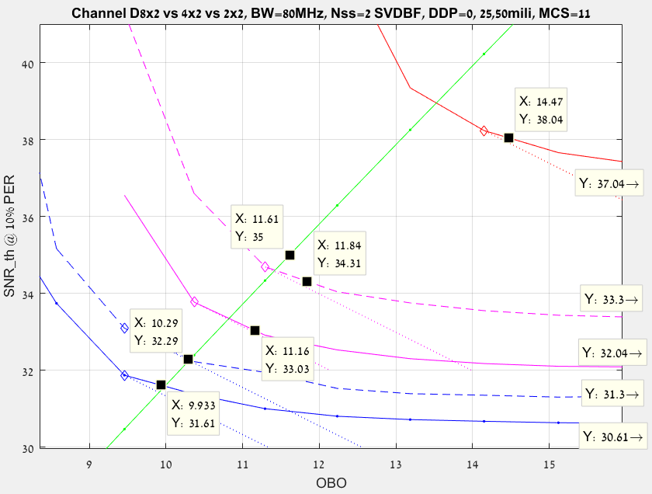
Channel D, BW=80MHz, Nss=2 SVDBF, MCS11
D2x2
EVM measured per TX antenna
1dB loss
EVM Spec
D4x2 50DDP
1dB loss
D4x2 0DDP
D8x2 25DDP
D8x2 0DDP

Slide 12
Channel D, BW=80MHz, Nss=2 SVDBF, MCS7
Showing RX SNR required (for 10% PER), as function of output backoff (OBO)
Channel, D 80MHz, NLOS
Nss=2, MCS7, ML Decoder
Comparing OBO at which 1dB SNR margin is lost for each case
2x2, Used as reference case
4x2 50DDP Gain= 2.3 dB
4x2 0DDP Gain= 3.7 dB
8x2 50DDP Gain= 4.1 dB
8x2 0DDP Gain= 4.8 dB

Slide 13
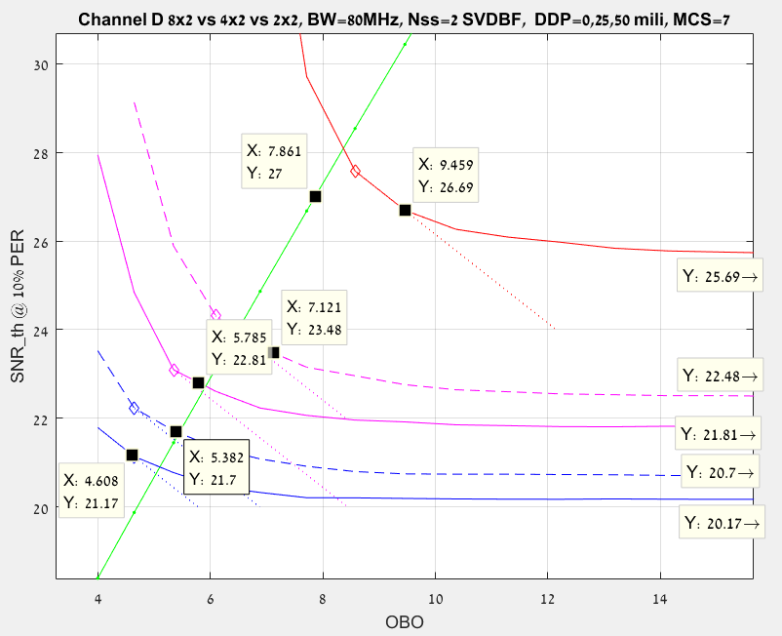
Channel D, BW=80MHz, Nss=2 SVDBF, MCS7
EVM Spec
EVM measured
D2x2
1dB loss
1dB loss
D4x2 50DDP
1dB loss
D4x2 0DDP
D8x2 50DDP
D8x2 0DDP

Slide 14
Channel B, BW=80MHz, Nss=2 SVDBF, MCS7
Showing RX SNR required (for 10% PER), as function of output backoff (OBO)
Channel, B 80MHz, NLOS
Nss=2, MCS7, ML Decoder
Comparing OBO at which 1dB SNR margin is lost for each case
2x2, Used as reference case
4x2 50DDP Gain= 2.4 dB
4x2 0DDP Gain= 3.4 dB
8x2 50DDP Gain= 3.6 dB
8x2 0DDP Gain= 4.3 dB

Slide 15
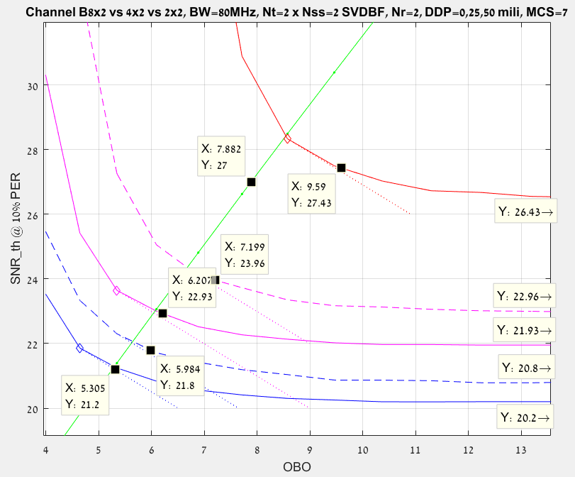
Channel B, BW=80MHz, Nss=2 SVDBF, MCS7
EVM measured
D2x2
EVM Spec
1dB loss
1dB loss
D4x2 50DDP
1dB loss
D4x2 0DDP
D8x2 25DDP
D8x2 0DDP

Slide 16
Measured Lab Results

Slide 17
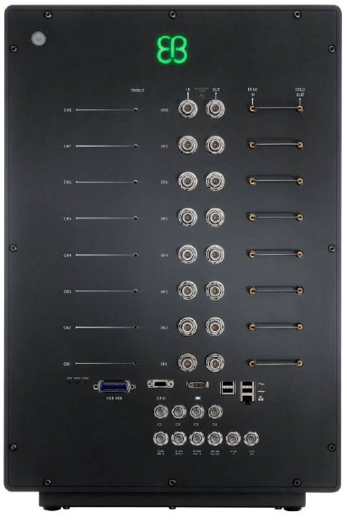
System setup for PA OBO (Output Back Off) gain measurements with real devices and channel emulator
EB channel emulator with channel model BNLOS/DNLOS
AP:BRCM
+
iperf
Client:BRCM
+
iperf

Slide 18
PA OBO gain results with real devices and channel emulator: BF(Beam forming) vs. CDD
With 4x2 Tx BF, the maximum link budget is achieved at Tx EVM of -20.2dB, which is 4.8dB worse than the standard requirement (mcs=6).
Compared to CDD mode, BF has 2dB higher transmit power at the maximum link budget (e.g. OBO gain).
MCS | N_{TX} | N_{RX} | N_{SS} | Channel D NLOS
 |  |  |  | OBO Gain | Tx EVM
6 | 4 | 2 | 1 | 2.0 dB | 20.18 dB
9 | 4 | 2 | 1 | 2.0 dB | 27.7 dB
7 | 4 | 2 | 2 | 2.0 dB | 24.7 dB
Note: OBO gain is calculated as the difference of Tx powers at the maximum link budget between BF and CDD modes. Tx EVM is the Tx EVM at the Tx power where the maximum link budget is achieved with BF.

Slide 19
Link budget comparison between LAB measurements and C simulations
LAB measurements and simulation results correlate well.
With 4x2 Tx BF, the maximum link budget is achieved at Tx EVM of -20.2dB, which is 4.8dB worse than the standard requirement of -25.0dB (mcs=6).
Compared to CDD mode, BF has ~2dB higher Tx power at the maximum link budget (OBO gain).
Optimal Tx power in BF mode is ~2dB higher than the Tx EVM limited Tx power.

Slide 20
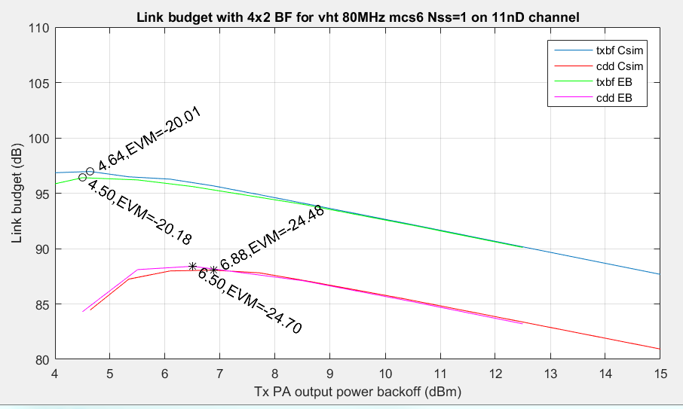
Link budget comparison between LAB measurements and C simulations

Slide 21
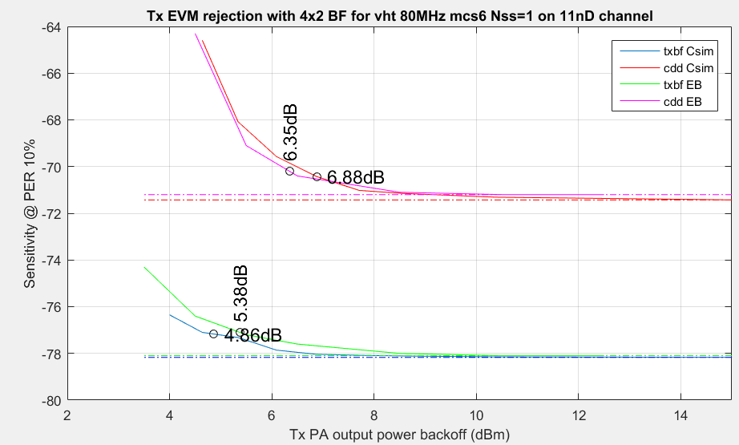
1dB loss point

Slide 22
Proposed Draft Changes
Link Transmit Power

Slide 23
LTP Signaling
Add capability of a receiver to request transmitter power per MCS for this link
  Within regulatory limits
  Not to affect transmitter power on other links with the same STA
  Hence, Link Transmit Power
  A STA requests a higher power per MCS at its own estimate/risk
    LTP requester
  Power can be re-adjusted at any time
    Per new request from LTP requester
    Per LTP responder initiative accompanied by unsolicited LTP response to inform LTP requester of the change
  Use a new LTP Request / LTP Response exchange

Slide 24
Add a capability indication
Extended Capability information element (IE)
  Existing location for dot11 type-independent features
  E.g. this feature can be used by any letter designation
    E.g. 11n, 11ac, 11ax, 11afuture
  Link Transmit Power capability bit
  Not clear that this bit is really needed
    No reason why a STA could not send the new element to anyone and if they do not recognize it, they do nothing
    If they do recognize it, they could still refuse to cooperate
    If they do recognize it, they will respond

Slide 25
Add an information element
Link Transmit Power (LTP) information element
Used to communicate request from receiver to transmitter
  Increase/decrease TX Power per MCS
New element can be included in various management frames
  Most likely a new Public or Protected Dual of Public Action
No response required (other than ACK)
  Transmitter either complies with request or does not comply
  If Transmitter makes changes, then it must inform the receiver by sending an LTP element as a response

Slide 26
Add a management action frame
Add to Public and Protected Dual of Public
  To avoid type-specific categories

Slide 27
LTP Requester Behavior
STA which transmits an LTP IE request
  Does not know exactly how much change in EVM might result at a given MCS for a given amount of TX power change
    Estimate is possible if LTP requester sees transmissions from LTP responder at various MCS and power combinations to allow it to make measurements
    Otherwise, LTP requester might have to try a few times to find a comfortable value
Desirable to include a test frame
  NDP included in specific exchanges (see later slides)
If LTP request is not accepted, then no new request allowed for X ms

Slide 28
LTP Responder Behavior (1)
LTP responder (LTP IE recipient) can choose to use or ignore the LTP IE information
  LTP responder might not be able to raise TX power – it might already be at the regulatory or TPC limit
  LTP responder might not desire to raise TX power in order to manage spectrum
    E.g. cooperative arrangement with neighbors for spatial reuse/interference management
    E.g. in a managed environment
If LTP responder chooses to change transmit power, it must inform the LTP requester (LTP IE sender)
  Sends an LTP response if raising or lowering TX power

Slide 29
LTP Responder Behavior (2)
TX EVM excursions limited to DATA-bearing frames
TX EVM excursions not allowed for CTRL subtypes
  Transmitted in non_HT format
  e.g. RTS, CTS, BA, ACK

Slide 30
Proposed Changes Summary (1)
Add a capability bit
  Extended Capability IE – preferred location for generic features
Add a new LTP IE
  To carry a list of requested or used PABO_{MCSn} values
  Allow the LTP IE to be transmitted within various management frames
    E.g. Association Request, Association Response, Action, etc
Add a new Management Action frame
  To allow post-association requests/changes to be communicated
No requirement for recipient to obey the request
  But LTP responder must inform LTP requester if LTP responder makes any TX power changes, requested or self-initiated

Slide 31
Proposed Changes Summary (2)
Change TX EVM rules
  Allow transmitter to exceed TX EVM requirements when LTP requester sends LTP request that would cause EVM limits to be violated
    LTP requester is specifically indicating that it has no problem with the expected increase in EVM
No change to other TX power related rules
  Jurisdictional regulatory limits still apply
  TPC limits still apply
  AP self-imposed limits apply
Recommend addition of test frame transmissions
  E.g. NDP before Beacons

Slide 32
Straw poll #1
Do you support the concept of Link Transmit Power as outlined in the previous slides, without the requirement to send an NDP?
  Y
  N
  A

Slide 33
Straw poll #2
Do you support the requirement that an NDP is transmitted by an LTP as outlined in the previous slides?
  Y
  N
  A

Slide 34
Straw poll #3
Do you support to resolve CID 8098 by adopting the text of 11-17-0123-00-00ax-Link-Transmit-Power-Text?
  Y
  N
  A

Slide 35
Straw Poll PHY #1
Do you support the concept of allowing a transmitter, per request of a receiver, to violate existing TX EVM by increasing the TX Power for transmissions to that requester?
  Y
  N
  A

Slide 36
Annex 1
Link Transmit Power Specific Proposed Changes

Slide 37
Ext Cap IE: add a capability indication
Extended Capability information element (IE)
  Link Transmit Power capability bit
  Ext Cap IE is the location for dot11 type-independent features
  i.e. this feature can be used by any letter designation
    E.g. 11n, 11ac, 11ax, 11future
  Set by AP and by non-AP STA that support LTP
  Acts as implicit NDP request
    See next slide

Slide 38
Implicit NDP Request
When Ext Cap LTP bit is set by an AP
  AP should transmit NDP, SIFS before each DTIM Beacon
    Using TX Power indicated in the Beacon
      E.g. TPC Report, Power Capability, LTP IE
    NDP transmitted using all TX antennas
When Ext Cap LTP bit is set by non-AP STA and AP also has the bit set
  Non-AP STA should transmit an NDP SIFS following the ACK of its Association Request transmission
    Using TX Power indicated in the Association Request
      E.g. TPC Report, Power Capability, LTP IE
    NDP transmitted using all TX antennas

Slide 39
Add an information element
Link Transmit Power (LTP) information element
  Used to communicate request from receiver to transmitter
  Used to communicate actual values from transmitter to receiver
New element can be included in various management frames
  Public Action and Protected Dual of Public Action
    New Public Action LTP
  (Re)Association request, (Re)Association response, Beacon, Probe Response
LTP Response is only required when changing PA Backoff (PABO) values
  In response to LTP Request and when unilaterally changing PABO values

Slide 40
Link Transmit Power Parameters
Link Transmit Power IE contents:
  Transmit power suggestion or report per MCS
    Value of dB [-23, 40.5]
Transmitting STA can provide as many or as few constellation/coding combinations as it desires per request
Transmitting STA can change values as frequently as it desires
Receiving STA can use the information or ignore it

Slide 41
LTP IE Format
 | Element ID (= 255) | Element Length | Element ID Extension (=<ANA>) | LTP Control | LTP Information
Octets: | 1 | 1 | 1 | 4 | variable
Uses Element ID Extension
  Element ID = 255
  Element ID Extension assigned by ANA
Link Transmit Power Information field contents:
  Series of one-octet transmit power values
    One octet per Constellation/encoding (i.e. one per MCI)
      MCI = MCS Index
    Not necessary to include an octet for every constellation/encoding value

Slide 42
LTP control field
 | B0 | B1 B15 | B16 | B17 | B18 B20 | B21 | B22 B23 | B24 B31
 | LTP Report | LTP MCI Bitmap | TXBF Present | NTXBF Present | Supported Modes | Absolute | Reserved | Transmit Power
Bits: | 1 | 15 | 1 | 1 | 3 | 1 | 2 | 8
LTP Report
  LTP Report = 0 indicates a request for the LTP responder to modify TX Power settings according to the accompanying LTP Information
  LTP Report = 1 indicates employed values at the LTP responder
LTP MCI Bitmap
  Bitmap of MCI (MCS Index) values, e.g.
    Value of 1 in bit position B3 means MCI value 2 transmit power information field is present
    Value of 0 in bit position B3 means MCI value 2 transmit power information field is absent
TXBF Present, NTXBF Present
  Indicates if MCI power values are present for TXBF case, Non TXBF case – entries are in MCI pairs when both are present
Supported Modes
  Bitmap of SU, OFDMA (non-MU MIMO), Reserved, when the LTP is a request
  Reserved when the LTP is a Report
Reserved -> requested MCS, Ntx for LTP response
  Alternative = copy the request LTP PPDU parameters, except for NTX
Absolute
  Indicates if MCI TX Power field encoding represents Absolute dBm or Relative dBm (see later slide)
Transmit Power
  Same as the field in the TCP Report IE

Slide 43
MCI Encoding
MCI Value | Constellation, Encoding
0 | BPSK, ½, DCM
1 | BPSK, ½
2 | QPSK ½
3 | QPSK ¾
4 | 16QAM ½
5 | 16 QAM ¾
6 | 64QAM 2/3
7 | 64 QAM ¾
8 | 64 QAM 5/6
9 | 256 QAM ¾
10 | 256 QAM 5/6
11 | 1024 QAM ¾
12 | 1024 QAM 5/6
13 – 14 | Reserved
Independent of BW

Slide 44
LTP Information field
 | B0 B6 | B7
 | MCI TX Power | Reserved
Bits: | 7 | 1
LTP Power Entry field
  LTP Information field contains 0 or more octets
  Each octet is an LTP Power Entry field
One octet per constellation/encoding-transmit power pair
  As many octets present as needed, as indicated in the LTP MCI Bitmap
MCI TX Power
  See next slide

Slide 45
MCI TX Power Field Encoding
Maximum transmit power per MCI in dBm
Absolute = 1
  Unsigned integer (range [0,127])
    TXP_{MCI} in dBm = MCI TX Power / 2 – 23
      i.e. MCI TX Power = [-23, 40.5] dBm, 0.5 dB steps
Absolute = 0 (i.e. relative)
  Unsigned integer (range [0,127])
    TXP_{MCI} in dBm = TXP_{MCS0} – (MCI TX Power / 2 – 23)
      i.e. MCI TX Power = TXP_{MCS0} - [-23, 40.5] dBm, 0.5 dB steps

Slide 46
Bidirectional LTP Exchange
A single MPDU may contain two LTP IE
  Provided that:
  One LTP IE has Request = 0
    i.e. response to previous LTP IE Request = 1
  One LTP IE has Request = 1
    i.e. request to STA to which it is sending a response
  Allows fewer frames in exchange to establish bidirectional LTP setup
    E.g. during Association Request/Response exchange sequence

Slide 47
Add LTP Action to Public Category
 | Category (=4) | Public Action = <ANA>) | LTP Information IE
Octets: | 1 | 1 | Variable
Category is Public (=4) or Protected Dual of Public (=9)
  To avoid type-specific categories
Action (=<ANA>)
  LTP
Body is LTP Information IE

Slide 48
TX EVM Rules
Change existing standard language TX EVM rule
  Current language includes mandatory EVM requirements
  LTP IE TX power increase request is an indication that the recipient can handle increased EVM
    Third party receivers might have trouble with the increased EVM
      But these devices are usually unlikely to successfully decode the PPDU payload anyway because of MCS mismatch to their path
      These devices are more and more likely to sleep during the PPDU payload portion when the PPDU is not for them
  Allow transmitter to exceed EVM requirement when recipient explicitly allows it through the LTP IE
  TX EVM excursions limited to DATA-bearing frames
    Not allowed for RTS, CTS, BA, ACK

Slide 49
Reporting Baseline TX Power
LTP Request can be written to express either:
  Relative TX Power Requested
    Stateful, requires requester to know and remember what transmitter has done with TX Power setting
  Absolute TX Power Requested
    Stateless = preferred
In order for an LTP Requester to be able to request an absolute TX Power level, the requester needs to know:
  What was the TX Power level of the PPDU that the requester examined in order to determine that a new TX Power level is desired?
Requires element for reporting – make the following mandatory:
  TX Power Capability Element
  TPC Report Element (and the transmission of this element in response to a request)
Additionally, STAs should be able to interpret:
  TX Power Constraint Element
  Transmit Power Envelope Element
Require that MCS0 power corresponds to the reported TX Power

Slide 50
Annex 2
Link Transmit Power

Slide 51
LTP effect on MCS Selection
Depends on how MCS selection is implemented
  E.g. MCS selection is based on SINR estimate vs family of SINR-PER curves
    Choose “a good PER” from all curves at a given SINR estimate
    Can treat TX power changes as a shift in the SINR-PER curve for each MCS which has an adjusted PABO value
In general
  Transmitter must be aware that SINR of link is MCS dependent

Slide 52
Identifying the Source of the PPDU
When TX Power has been adjusted higher
It is necessary to identify the source of a PPDU at the receiver location at the beginning of the reception
  To adjust the receiver to accommodate the specific EVM of the transmitter
    I.e. to differentiate PPDUs from transmitters employing LTP and those not employing LTP
    E.g. an AP that receives PPDUs from many sources, some of which are using LTP and some of which are not
  It is important to NOT adjust the receiver for a transmission when the transmission is not utilizing a higher LTP for a given MCS

Slide 53
RTS-CTS Based Source Information
Transmitter uses RTS-CTS exchange before the transmission of the LTP DATA PPDU
  Based on the RTS TA value, the intended recipient knows the source of the upcoming DATA PPDU before the reception begins
    E.g. recipient assumes that DATA PPDU source is the same as the RTS source
    E.g. DATA PPDU source = STA corresponding to RTS TA value
    E.g. LTP is NOT applied to the RTS
      Or the CTS
This should be the standard method for determining the source of a DATA frame transmitted using LTP
  Source “estimate” is possible when RTS-CTS is not present (See Annex)

Slide 54
Association Exchange Example
NDP
DTIM Beacon
AssReq
ACK
NDP
AssRep
ACK
LTP Action
ACK
Optional exchange
AP Transmissions
Non-AP STA Transmissions
      Non-AP STA has measured EVM from AP using the NDP preceding the Beacon reception
        Allows non-AP STA to request modified AP TX Power within Association Request by including LTP IE
      AP measures EVM of non-AP STA using the NDP following the Association Request ACK
        Allows the AP to request modified non-AP STA TX Power within the Association Response by including LTP IE
      Bidirectional exchange allowed (LTP Request and Response in one frame)
      Optional exchange completes bidirectional setup (non-AP STA response)

Slide 55
TX Power Reporting
LTP Element
Power Capability Element
TPC Report Element
Transmit Power Envelope Element

Slide 56
Annex 3
Simulation Summary

Slide 57
LTP Gain
BW 80 MHz, N_{RX}=2
MCS | Standard EVM [dB] | N_{TX} | N_{SS} | Channel B NLOS |  | Channel D NLOS
 |  |  |  | OBO Gain [dB] | Tx EVM [dB] | OBO Gain [dB] | Tx EVM [dB]
6 | 25 | 4 | 1 | 1.4 | 21.5 | 2.2 | 19.3
11 | 35 | 4 | 1 | 1.5 | 34 | 2.4 | 32.5
7 | 27 | 4 / 8 | 2 | 3.4 / 4.3 | 23.2 / 21.3 | 3.7 / 4.8 | 22.5 / 19.7
9 | 32 | 4 / 8 | 2 | 3.4 / 4.2 | 29 / 27 | 3.9 / 4.9 | 27.8 / 25.8
11 | 35 | 4 / 8 | 2 | 3.2 / 4.2 | 34.5 / 32.5 | 3.3 / 4.5 | 34 / 31.5

Slide 58
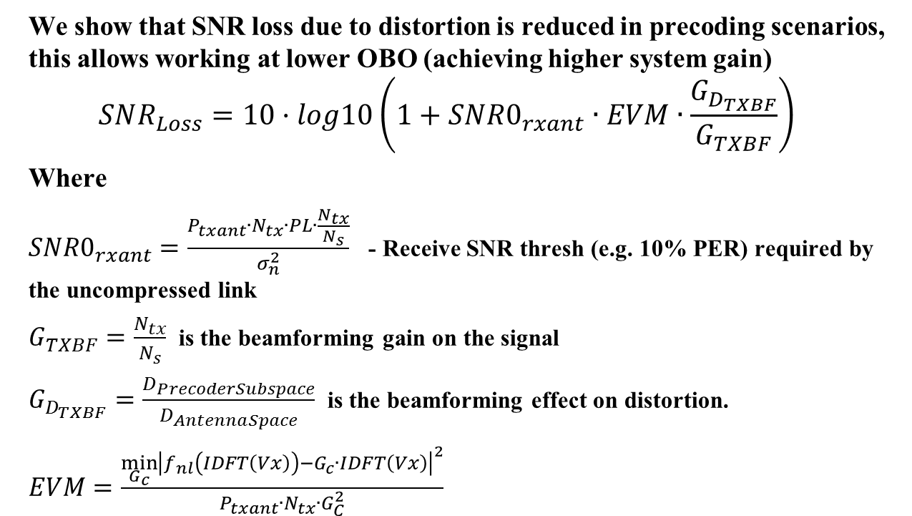
Distortion related SNR Loss Estimation
We show that SNR loss due to distortion is reduced in precoding scenarios, this allows working at lower OBO (achieving higher system gain)
$$SNR_{Loss}=10·log10\left(1+SNR0_{rxant}∙EVM∙\frac{G_{D_{TXBF}}}{G_{TXBF}}\right)$$
Where
$SNR0_{rxant}=\frac{P_{txant}∙N_{tx}∙PL∙\frac{N_{tx}}{N_{s}}}{σ_{n}^{2}}$ - Receive SNR thresh (e.g. 10% PER) required by the uncompressed link
$G_{TXBF}=\frac{N_{tx}}{N_{s}}$ is the beamforming gain on the signal
$G_{D_{TXBF}}=\frac{D_{PrecoderSubspace}}{D_{AntennaSpace}}$ is the beamforming effect on distortion.
$EVM=\frac{\min_{G_{c}}{{\left|f_{nl}\left(IDFT\left(Vx\right)\right)−G_{c}∙IDFT\left(Vx\right)\right|}^{2}}}{P_{txant}∙N_{tx}∙G_{C}^{2}}$

Slide 59
References
[1] 11-17-0123-00-00ax-Link-Transmit-Power-Text.docx
[2] 802.11-2016.pdf
[3] Draft P802.11ax_D1.0.pdf

