Slide 1
Short SSW Frame for A-BFT
Date: 2017-01-18
Authors:
Name | Company | Address | Phone | Email
Kyungtae Jo | LG Electronics |  |  | kyungtae.jo@lge.com
SungJin Park |  |  |  | allean.park@lge.com
HanGyu Cho |  |  |  | hg.cho@lge.com
JinMin Kim |  |  |  | jinmin1230.kim@lge.com
Saehee Bang |  |  |  | saehee.bang@lge.com
Sang G. Kim |  |  |  | sanggook.kim@lge.com

Slide 2
Introduction
Short SSW frame is introduced for fast sector sweep for 11ay.
This contribution intends to investigate which parameter of A-BFT is needed to modify to support transmission of short SSW frame in A-BFT.

Slide 3
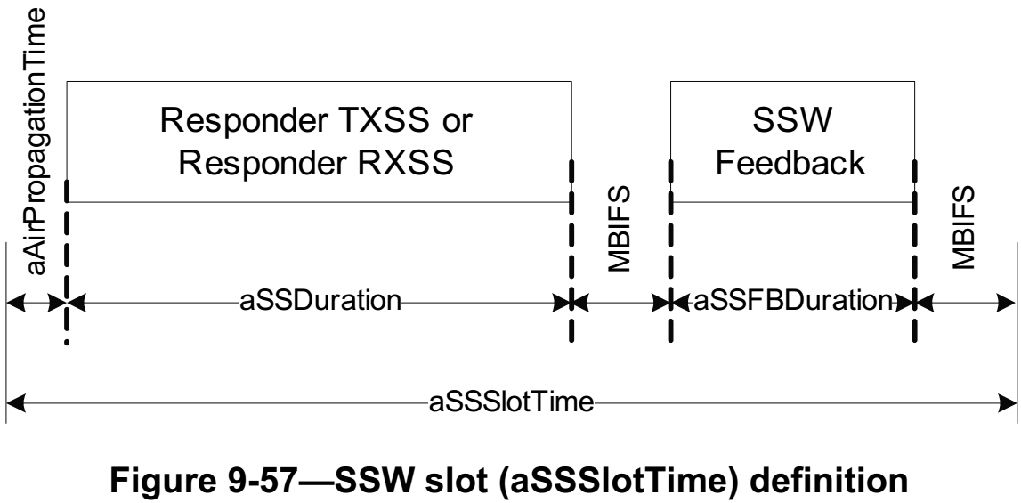
Short SSW frame transmission for A-BFT
The related parameters should be modified to support short SSW frame in A-BFT.
A-BFT LENGTH: the length of A-BFT in unit of Sector Sweep Slot (SSSlot) Times
FSS (aSSDuration): the number of SSW Frames in a SSSlot
IFS in a slot
aSSSlotTime = aAirPropagationTime + aSSDuration + MBIFS + aSSFBDuration + MBIFS

Slide 4
Proposed short SSW frame transmission
SSW slot time for short SSW frame has same time with 11ad, regardless of SSW frame type (Short SSW / SSW frame)
➔ No fairness issue between 11ad&11ay
Short SSW frame can be transmitted for both original slots and additional slots.
➔ More SSW frames can be transmitted within a SSW slot.
Same
aSSSlot Time
for short SSW frame transmission
aSSSlot Time
for SSW frame transmission
…
…
FSS = (N+α)
FSS = N
SBIFS
Short
SSW
SBIFS
…
Short
SSW
Short
SSW
…
Short
SSW
…
SSW
SSW
SSW
8.8us
# Additional SSSW frame transmissions = α
14.91us
9.8 us
11ay Short SSW
15.91us
11ad SSW

Slide 5
Summary
Short SSW frame can be used in A-BFT for fast sector sweep for EDMG STA
To support above, we propose that SSW slot time for short SSW frame has same time with 11ad
No fairness issue between 11ad&11ay
More SSW frames can be transmitted

Slide 6
Straw poll/motion #1
Do you agree to add the following text into SFD?
Short SSW frame can be transmitted by associated STAs in A-BFT for 11ay
Y/N/A

Slide 7
Straw poll/motion #2
Do you agree to add the following text into SFD?
If short SSW frame is transmitted in A-BFT, SSW slot time for short SSW frame has same with 11ad

